Slide 2
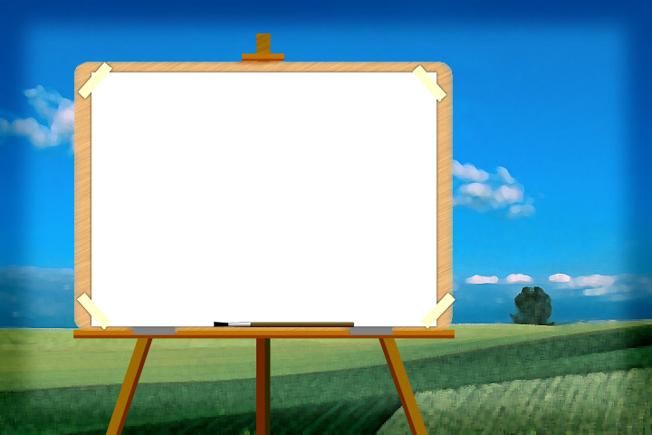


WELCOME TO OUR CLASS
GIA PHUONG SECONDARY SCHOOL
Teacher: Nguyen Bich Thao

Slide 3




REVIEW
2
LESSON 2: SKILLS
1

Slide 4
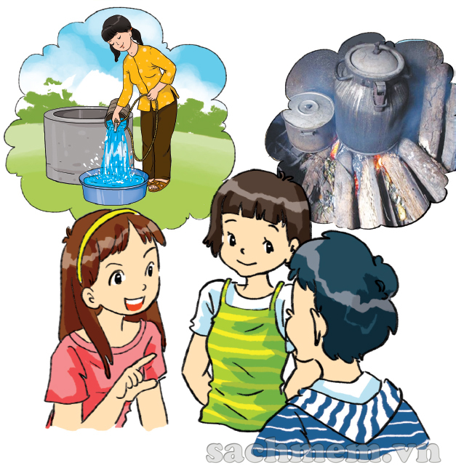
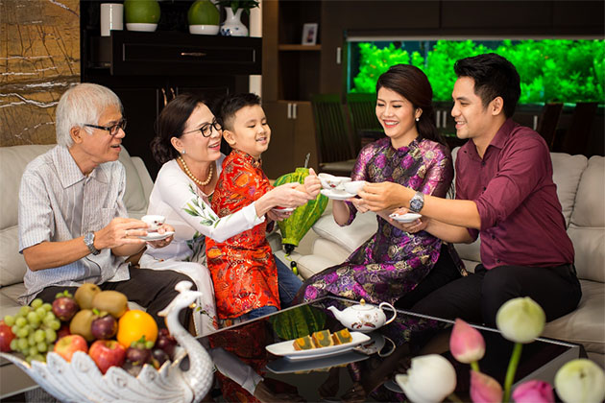

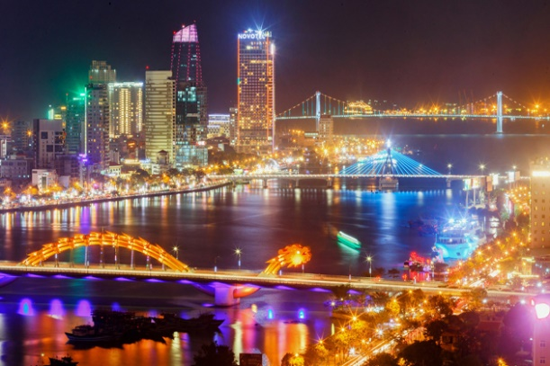
WARM-UP
The differences between life
in the past and
at present?

Slide 5

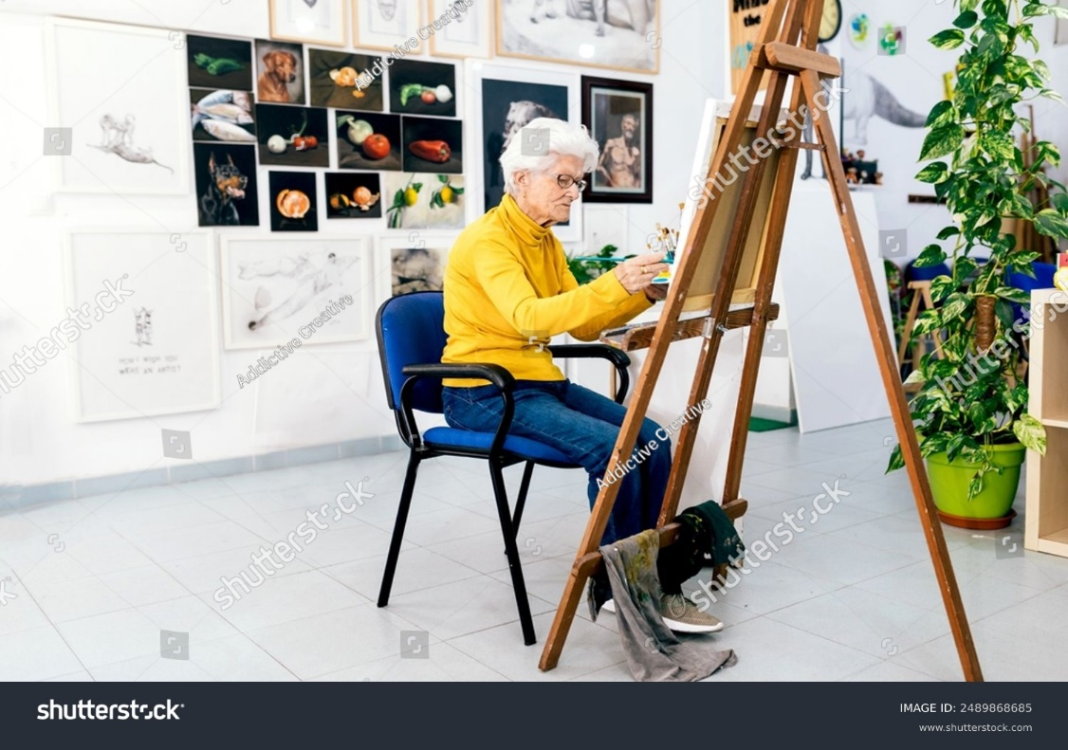
PRESENTATION- VOCABULARY
preference ( n)
/ˈpref.ər.əns/
sở thích, sự thích
Her hobby is painting

Slide 6
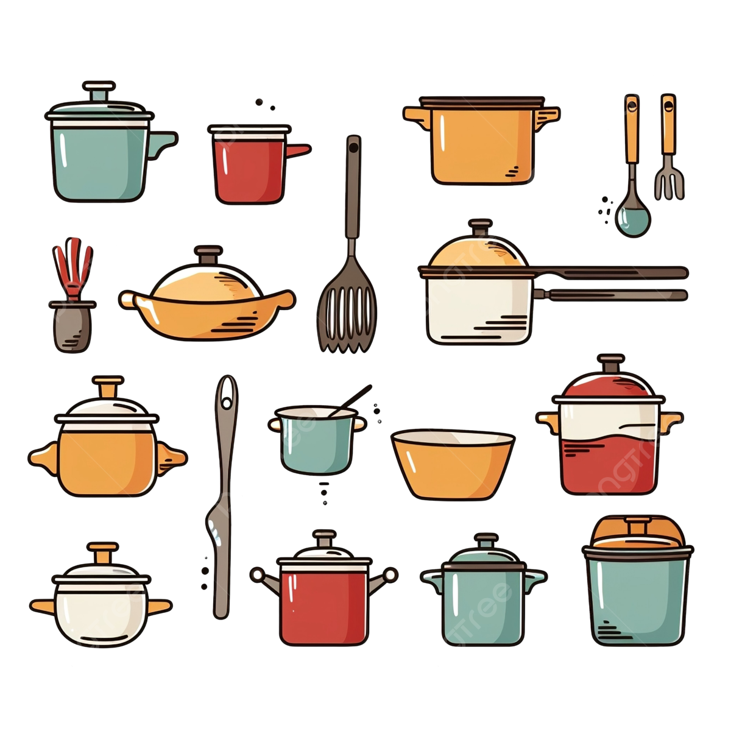
PRESENTATION - VOCABULARY
kitchenware
/ˈkɪtʃ.ən.weər/
đồ dùng nhà bếp

Slide 7
PRESENTATION - VOCABULARY
cosmetics
/kɒzˈmet.ɪk/
để làm cho đẹp hơn

Slide 8
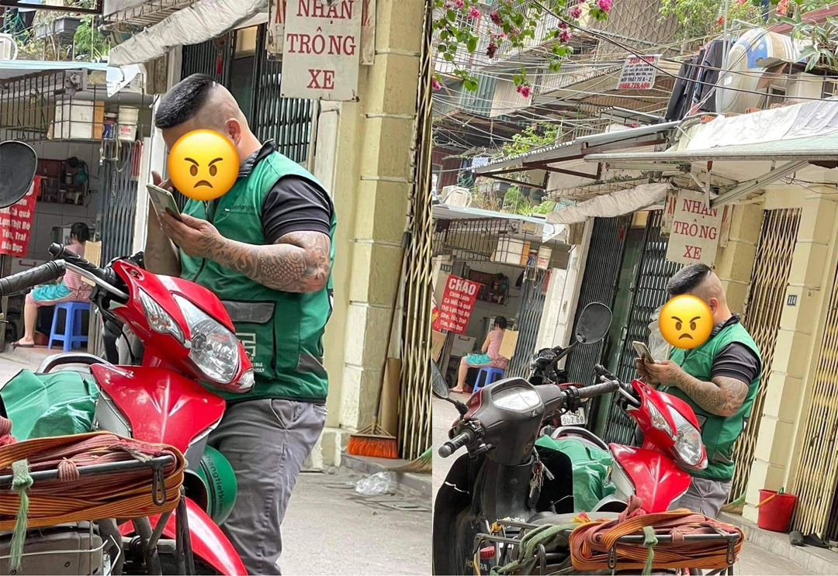
PRESENTATION - VOCABULARY
delivery service ( n)
dɪlɪv.ər.i sɜː.vɪs/
dịch vụ giao hàng

Slide 9
PRESENTATION - VOCABULARY
New words | Pronunciation | Meaning
1. preference ( n) | /ˈpref.ər.əns/ | sở thích, sự thích
2. Kitchenware ( n) | /ˈkɪtʃ.ən.weər/ | đồ dùng nhà bếp
3. Cosmetics | /kɒzˈmet.ɪk/ | để làm cho đẹp hơn
4. delivery service ( n) | / dɪlɪv.ər.i sɜː.vɪs/ | dịch vụ giao hàng

Slide 10
PRESENTATION
Form |  | Vietnamese equivalent
1. preference ( n) |  | a. đồ dùng nhà bếp
2. Kitchenware ( n) |  | b. dịch vụ giao hàng
3. Cosmetics |  | c. để làm cho đẹp hơn
4. delivery service ( n) |  | d. sở thích, sự thích

Slide 11

READING
1
Read the passage and choose the correct answer A, B, C, or D.
Not long ago, open-air markets played an important part in the lives of the Vietnamese. Wherever there was open space, the local people could start their own market. There, you could find almost everything from local home-made and home-grown products to those that the sellers bought wholesale from somewhere and resold them for a profit. Since the locals went there nearly every day, they knew one another, and the sellers even remembered the customers’ preferences. Then supermarkets came and soon became popular. There are many reasons to explain their popularity. First, they offer a cool and large shopping site. Shoppers can spend hours in them without worrying about heat or rain. Second, they provide shoppers with a wide range of goods, from foods and kitchenware to cosmetics and pet care products. People do not have to move from shop to shop to collect all the things they need. Nowadays, many supermarkets even offer home-delivery service and online shopping, which makes shopping even easier.

Slide 12
READING
1
Read the passage and choose the correct answer A, B, C, or D.
Not long ago, open-air markets played an important part in the lives of the Vietnamese. Wherever there was open space, the local people could start their own market. There, you could find almost everything from local home-made and home-grown products to those that the sellers bought wholesale from somewhere and resold them for a profit. Since the locals went there nearly every day, they knew one another, and the sellers even remembered the customers’ preferences. Then supermarkets came and soon became popular. There are many reasons to explain their popularity. First, they offer a cool and large shopping site. Shoppers can spend hours in them without worrying about heat or rain. Second, they provide shoppers with a wide range of goods, from foods and kitchenware to cosmetics and pet care products. People do not have to move from shop to shop to collect all the things they need. Nowadays, many supermarkets even offer home-delivery service and online shopping, which makes shopping even easier.
1. In the past, the local people could start an open-air market when ______.
A. they paid the rent
B. they found a spacious spot
C. they had products to sell
D. they didn’t want to shop elsewhere

Slide 13
READING
1
Read the passage and choose the correct answer A, B, C, or D.
Not long ago, open-air markets played an important part in the lives of the Vietnamese. Wherever there was open space, the local people could start their own market. There, you could find almost everything from local home-made and home-grown products to those that the sellers bought wholesale from somewhere and resold them for a profit. Since the locals went there nearly every day, they knew one another, and the sellers even remembered the customers’ preferences. Then supermarkets came and soon became popular. There are many reasons to explain their popularity. First, they offer a cool and large shopping site. Shoppers can spend hours in them without worrying about heat or rain. Second, they provide shoppers with a wide range of goods, from foods and kitchenware to cosmetics and pet care products. People do not have to move from shop to shop to collect all the things they need. Nowadays, many supermarkets even offer home-delivery service and online shopping, which makes shopping even easier.
2. The relationship between the sellers and the market-goers at an open-air market was ______.
A. healthy
B. distant
C. formal
D. close

Slide 14
READING
1
Read the passage and choose the correct answer A, B, C, or D.
Not long ago, open-air markets played an important part in the lives of the Vietnamese. Wherever there was open space, the local people could start their own market. There, you could find almost everything from local home-made and home-grown products to those that the sellers bought wholesale from somewhere and resold them for a profit. Since the locals went there nearly every day, they knew one another, and the sellers even remembered the customers’ preferences. Then supermarkets came and soon became popular. There are many reasons to explain their popularity. First, they offer a cool and large shopping site. Shoppers can spend hours in them without worrying about heat or rain. Second, they provide shoppers with a wide range of goods, from foods and kitchenware to cosmetics and pet care products. People do not have to move from shop to shop to collect all the things they need. Nowadays, many supermarkets even offer home-delivery service and online shopping, which makes shopping even easier.
3. The writer mentions two ______ the supermarket.
A. of his experiences with
B. types of goods in
C. benefits of
D. types of shoppers in

Slide 15
READING
1
Read the passage and choose the correct answer A, B, C, or D.
Not long ago, open-air markets played an important part in the lives of the Vietnamese. Wherever there was open space, the local people could start their own market. There, you could find almost everything from local home-made and home-grown products to those that the sellers bought wholesale from somewhere and resold them for a profit. Since the locals went there nearly every day, they knew one another, and the sellers even remembered the customers’ preferences. Then supermarkets came and soon became popular. There are many reasons to explain their popularity. First, they offer a cool and large shopping site. Shoppers can spend hours in them without worrying about heat or rain. Second, they provide shoppers with a wide range of goods, from foods and kitchenware to cosmetics and pet care products. People do not have to move from shop to shop to collect all the things they need. Nowadays, many supermarkets even offer home-delivery service and online shopping, which makes shopping even easier.
4. The supermarket also offers ______.
A. pet food
B. pets
C. pet shops
D. pet vets

Slide 16
READING
1
Read the passage and choose the correct answer A, B, C, or D.
Not long ago, open-air markets played an important part in the lives of the Vietnamese. Wherever there was open space, the local people could start their own market. There, you could find almost everything from local home-made and home-grown products to those that the sellers bought wholesale from somewhere and resold them for a profit. Since the locals went there nearly every day, they knew one another, and the sellers even remembered the customers’ preferences. Then supermarkets came and soon became popular. There are many reasons to explain their popularity. First, they offer a cool and large shopping site. Shoppers can spend hours in them without worrying about heat or rain. Second, they provide shoppers with a wide range of goods, from foods and kitchenware to cosmetics and pet care products. People do not have to move from shop to shop to collect all the things they need. Nowadays, many supermarkets even offer home-delivery service and online shopping, which makes shopping even easier.
5. Which statement is true according to the information in this passage?
A. Now you can find open-air markets in the countryside only.
B. Every supermarket offers home-delivery service.
C. It’s more convenient to shop in a supermarket than in an open-air market.
D. Supermarkets offer everything we need.

Slide 17
READING
1
Read the passage and choose the correct answer A, B, C, or D.
Not long ago, open-air markets played an important part in the lives of the Vietnamese. Wherever there was open space, the local people could start their own market. There, you could find almost everything from local home-made and home-grown products to those that the sellers bought wholesale from somewhere and resold them for a profit. Since the locals went there nearly every day, they knew one another, and the sellers even remembered the customers’ preferences. Then supermarkets came and soon became popular. There are many reasons to explain their popularity. First, they offer a cool and large shopping site. Shoppers can spend hours in them without worrying about heat or rain. Second, they provide shoppers with a wide range of goods, from foods and kitchenware to cosmetics and pet care products. People do not have to move from shop to shop to collect all the things they need. Nowadays, many supermarkets even offer home-delivery service and online shopping, which makes shopping even easier.
6. The word: “ them” in the passage refers to
Shoppers
B. shopping site
C. Sellers
D. products

Slide 18
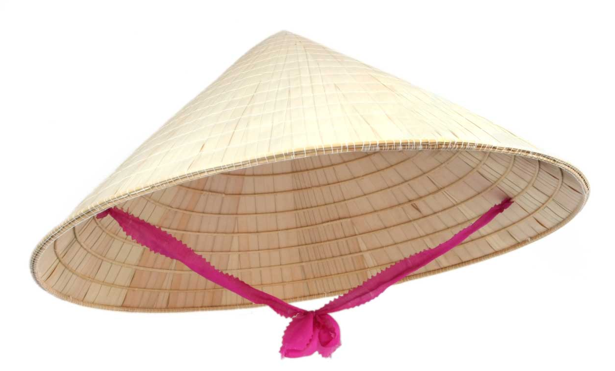
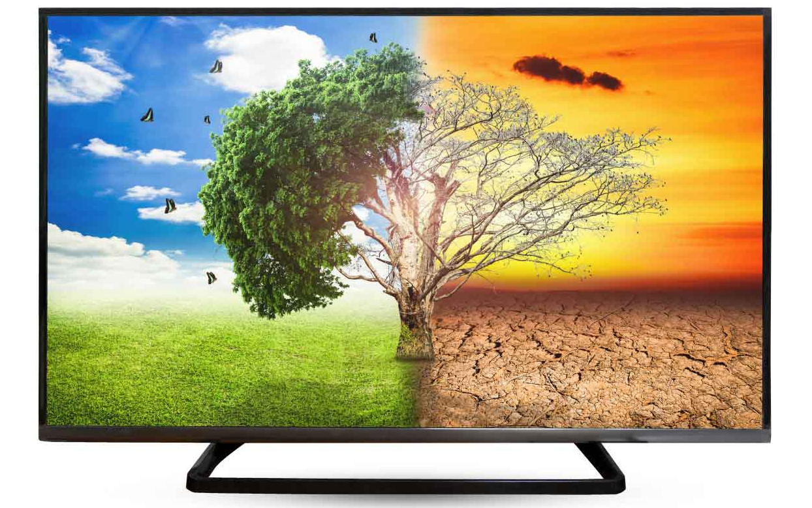
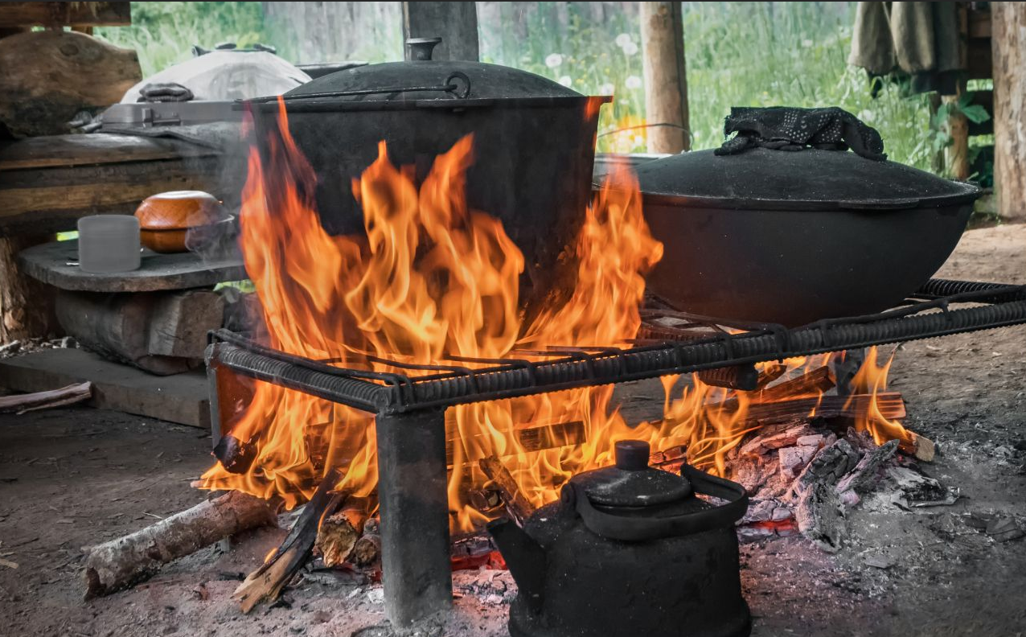
SPEAKING
2
Work in groups. Choose ONE of the things below and discuss it, using the cues. Then present it to your class.
1. conical hat
2. smart TV
3. open wood fire

Slide 19
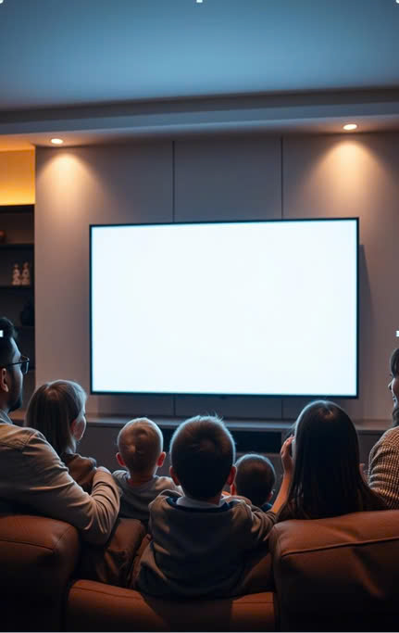
TV Evolution in Vietnam: A Decade of Change
Explore the evolution of television in Vietnam from 2013 to 2023: technology, accessibility, and societal impact

Slide 20
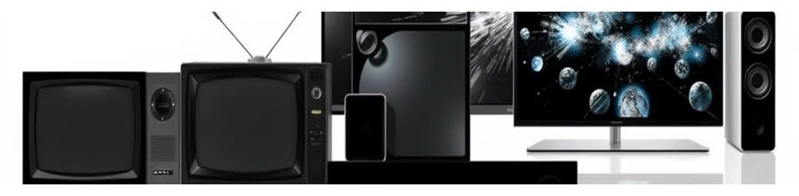
Technological Advancements
2013
2018
CRT, LCD, Plasma dominated the market, limited streaming options
Smart TV's with built-in streaming, voice control, and apps
1
2
3
4
2015
2023
LED & OLED models gained popularity, 4K resolution became mainstream
QLED, Mini-LED, 8K, and advanced HDR technology

Slide 21
Growing Accessibility
2013
Limited access to internet, restricted streaming options
2023
Broadband internet access increased, streaming services expanded

Slide 22
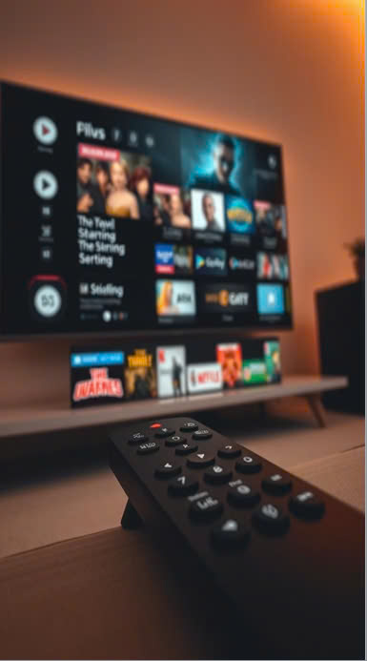



Enhanced Features and Convenience
Smart Remote
Voice control, content search, intuitive navigation
On-Demand Content
Unlimited streaming, diverse content options
Gaming
TVs now function as gaming consoles

Slide 23



Influence on Lifestyle
Entertainment
1
Immersive viewing experience
Information
2
Access to news, education, and knowledge
Social Connection
3
Shared viewing experiences, social media integration

Slide 24
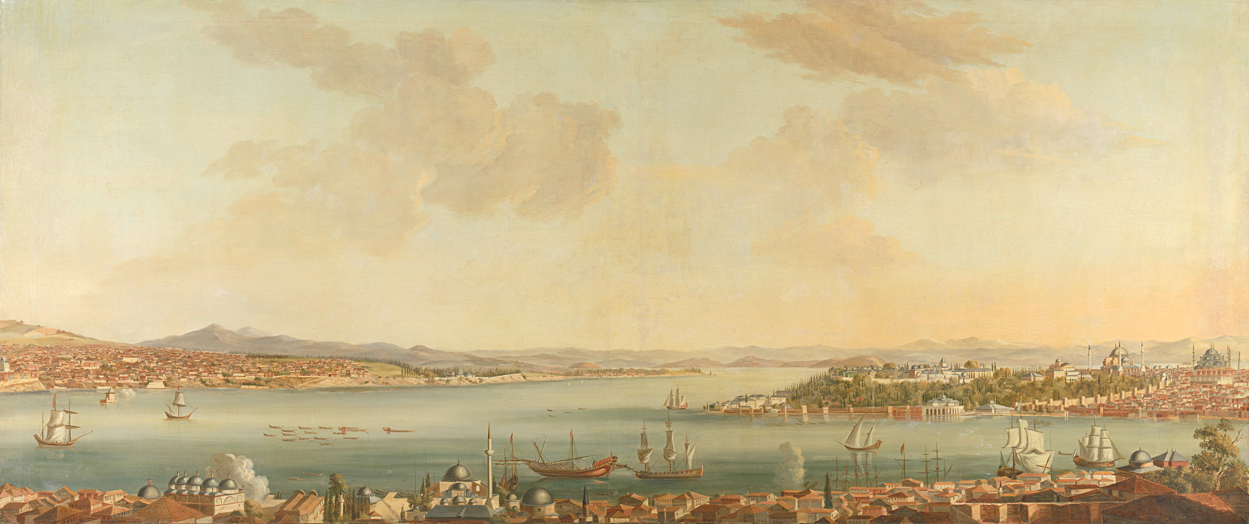

THE KITCHEN
in the past and at present
Francois Mercer - Vintage Style Photography

Slide 25
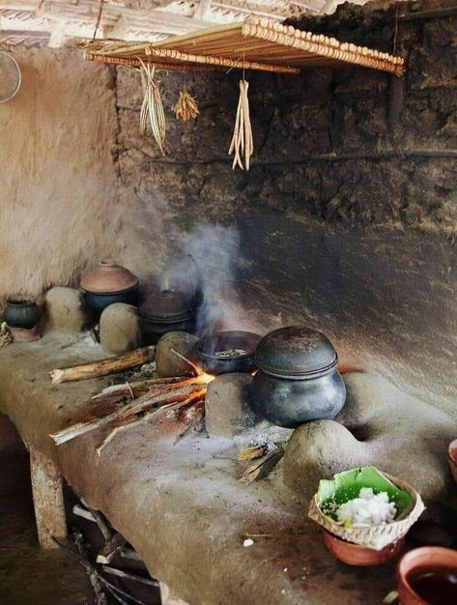


in the past
the kitchen
mainly used firewood,
straw and coal as fuel

Slide 26
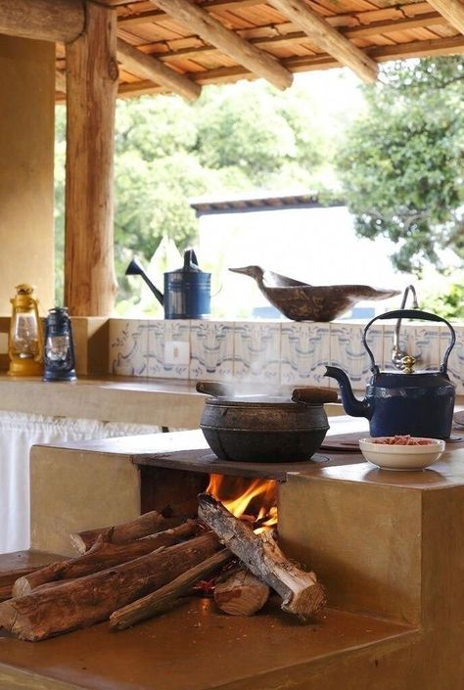
many disadvantages
  caused air pollution by smoke and dust
  took a lot of time to start a fire
  the design was simple and couldn’t adjust the temperature accurately

Slide 27
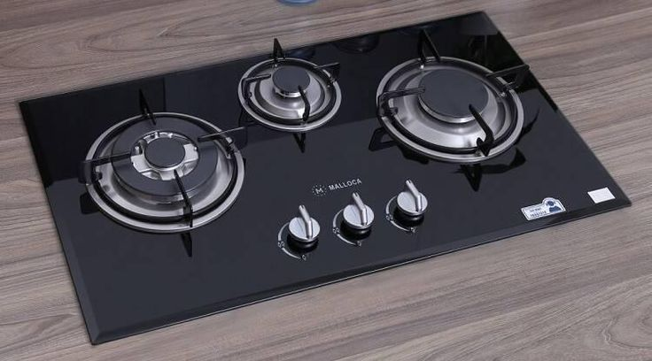
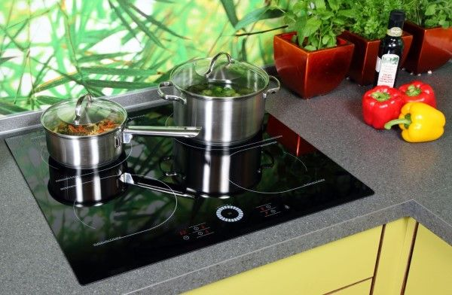
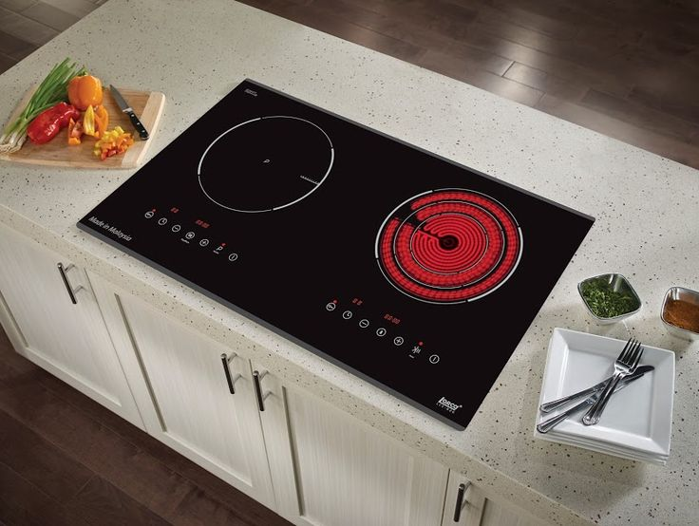
at the present
Add a little bit of body text
There are diverse type of the kitchen now such as gas stoves, electric stoves or induction cooktops.

Slide 28




the convenience of stove nowaday
save a lot time and
more eco-friendly than
in the past
now the kitchens are easier to use than open wood fire
become safer and has more modern functions

Slide 29
THANKS FOR LISTENING

Slide 30
Our group will talk about the conical hat. It’s a symbol of Vietnamese women. They wear it to protect them from sunlight and rain whenever they go out, whether on foot or by bike. It was used in the past, is still in use at present, and will continue to exist in the future. The change is not in the hat itself. It’s still the same in sharp, colour and materials. The change is in the use. Since conical hats are not easy to carry around, especially when more and more women travel by bikes and motorbikes, they are now not as popular as they used to. More girls and women change to cloth hats as they are more convenient to carry. However, you can still find conical hats in every corner of Viet Nam.

Slide 31
Our group will talk about smart TV. As you know in our great - grandparent’s generation, only wealthy families had a black and white TV. They only had two colour – black and white and it was small and heavy. But now all the families have smart TV, they are larger than they used to and they are much lighter. If we have smart TV connecting with the Internet we can watch the live – football match from far distance and find many channel we like.

Slide 32
LISTENING
3
Listen to a talk about entertainment for Vietnamese children in the past and complete each sentence with ONE word.
1. Games in the past required little ___________.
2. We floated paper boats on imagined ‘rivers’ formed from __________.
3. Thanks to making our own toys, we became ________.
4. We played most games in _______ outdoors.
5. Team games helped develop _______ bonds among us.
equipment
rainwater
creative
groups
strong

Slide 33
WRITING
4
Make complete sentences from the clues. Make any changes and add more words if necessary.
1. I / wish / I can / attend / traditional festivals / minority people / Viet Nam.
→ I wish I could attend some traditional festivals of minority people in Viet Nam.
2. When we / arrive / fair, / rice-cooking competition / taking place.
→ When we arrived at the fair, the rice-cooking competition was taking place.
3. He promise / help me / PowerPoint presentation / but he / not.
→ He promised to help me with my PowerPoint presentation but he didn’t.

Slide 34
WRITING
4
Make complete sentences from the clues. Make any changes and add more words if necessary.
4. We / never see / sight / as beautiful as / mountain at sunset.
→ We have never seen a sight as beautiful as the mountain at sunset.
5. he / fancy / become / fashion designer / when / he / child?
→ Did he fancy becoming a fashion designer when he was a child?

Slide 35

CONSOLIDATION
1
Wrap-up
What have we learnt in this lesson?
Reading?
Speaking?
Listening?
Writing?

Slide 36

CONSOLIDATION
2
Homework
- Review all the knowledge you have learnt from the first semester.
- Prepare for the final first semester test.

Slide 37
Website: hoclieu.vn
Fanpage: facebook.com/tienganhglobalsuccess.vn/

