Slide 1
Welcome to
OUR CLASS

Slide 2
Unit
3
MY FRIENDS
LESSON 3: A CLOSER LOOK 2
The present continuous
1

Slide 3
WARM-UP
Look at the video and answer the question.
What are they doing?
They are playing football.

Slide 4
WARM-UP
What are they doing?
They are riding a bike.

Slide 5
WARM-UP
What are they doing?
They are dancing.

Slide 6
WARM-UP
Arrange the words to make sentences meaningful.
1. now / learning / she / English / is.
She is learning English now.

Slide 7
2. walk / park / he / dog / for / talking the / his / in / a / is.
He is taking his dog for a walk in the park.

Slide 8
3. Trang / friends / about / talking / new / Phong / their / and / are.
Phong and Trang are talking about their new friends.

Slide 9
4. isn’t / piano / Susan / playing / the.
Susan isn’t playing the piano.
Susan

Slide 10
5. me / parents / my / visiting / my.
My parents are visiting me.

Slide 11
PRESENTATION

Slide 12
PRESENTATION
Grammar
The present continuous
We use the present continuous for actions happening now.
Example: - She’s talking.
- They’re not talking.
We can use the present continuous with now, at present, or at the moment.
Example: - I’m doing my homework at present.
- A: Are you reading now?
B: Yes, I am.

Slide 13
PRESENTATION
Grammar
The present continuous
Form | Example

Slide 14
PRESENTATION
Grammar
The present continuous
Form | Example
S + am/ is/ are + V-ing

Slide 15
PRESENTATION
Grammar
The present continuous
Form | Example
S + am/ is/ are + V-ing
S + am not/ isn’t/ aren’t + V-ing

Slide 16
PRESENTATION
Grammar
The present continuous
Form | Example
S + am/ is/ are + V-ing
S + am not/ isn’t/ aren’t + V-ing
Am/ Is/ Are + S + V-ing?

Slide 17
PRESENTATION
Grammar
The present continuous
Form | Example
S + am/ is/ are + V-ing
S + am not/ isn’t/ aren’t + V-ing
Am/ Is/ Are + S + V-ing?
Wh + am/ is/ are + S + V-ing?

Slide 18
PRESENTATION
Grammar
The present continuous
Form | Example
S + am/ is/ are + V-ing | She is playing basketball in the garden.
S + am not/ isn’t/ aren’t + V-ing
Am/ Is/ Are + S + V-ing?
Wh + am/ is/ are + S + V-ing?

Slide 19
PRESENTATION
Grammar
The present continuous
Form | Example
S + am/ is/ are + V-ing | She is playing basketball in the garden.
S + am not/ isn’t/ aren’t + V-ing | They are not going to school at the moment.
Am/ Is/ Are + S + V-ing?
Wh + am/ is/ are + S + V-ing?

Slide 20
PRESENTATION
Grammar
The present continuous
Form | Example
S + am/ is/ are + V-ing | She is playing basketball in the garden.
S + am not/ isn’t/ aren’t + V-ing | They are not going to school at the moment.
Am/ Is/ Are + S + V-ing? | Are you having lunch?
Wh + am/ is/ are + S + V-ing?

Slide 21
PRESENTATION
Grammar
The present continuous
Form | Example
S + am/ is/ are + V-ing | She is playing basketball in the garden.
S + am not/ isn’t/ aren’t + V-ing | They are not going to school at the moment.
Am/ Is/ Are + S + V-ing? | Are you having lunch?
Wh + am/ is/ are + S + V-ing? | Why is he standing over there?

Slide 22
PRACTICE
1
Put the verbs in brackets in the present continuous.
1. Nam (read) __________ a book now.
2. They (play) ___________ football at the moment.
3. My sister (not make) ___________ a sandwich at present.
4. I (go) __________ to the supermarket at the moment.
5. _____ they (talk) __________ about their new friends?
is reading
are playing
isn’t making
am going
Are
talking

Slide 23
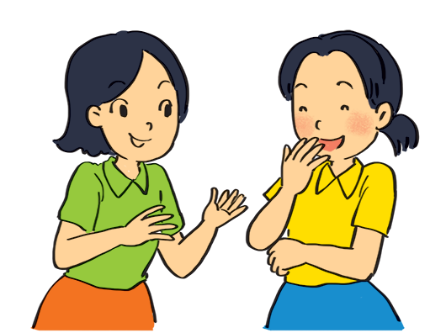
PRACTICE
2
Look at the pictures. Write sentences like the example. Use positive or negative present continuous verbs.
Example:
She’s talking to Mai. (talk)
__________

Slide 24
PRACTICE
2
Look at the pictures. Write sentences like the example. Use positive or negative present continuous verbs.
Example:
She’s talking to Mai. (talk)

Slide 25
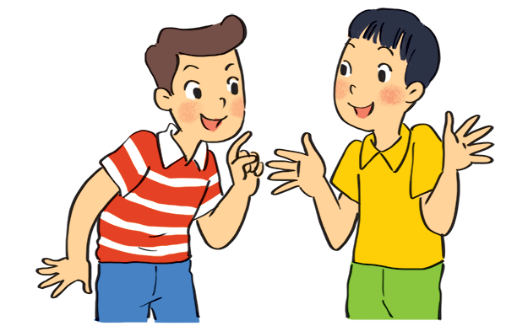
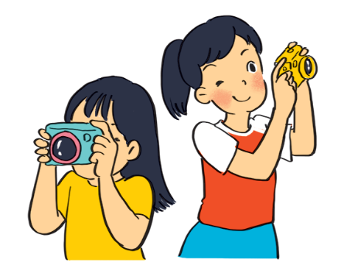
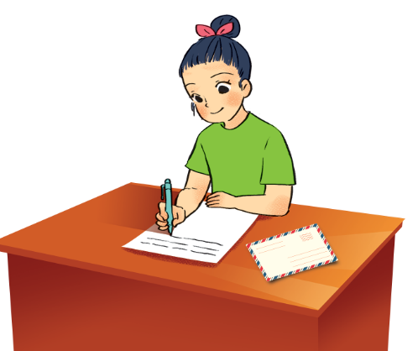
PRACTICE
2
Look at the pictures. Write sentences like the example. Use positive or negative present continuous verbs.
are not / aren’t eating ice cream
1. Nam and Ba ___________________________.
(eat ice cream)
2. Lan and Trang _______________.
(take photos)
3. Ha ___________________.
(write a letter)
are taking photos
is / ’s writing a letter

Slide 26
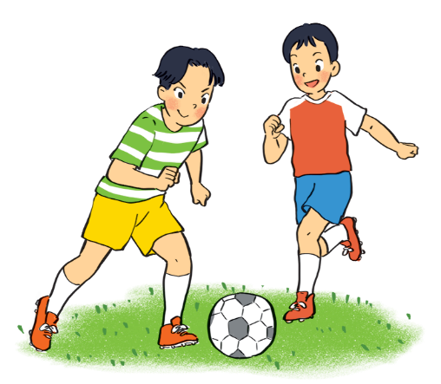
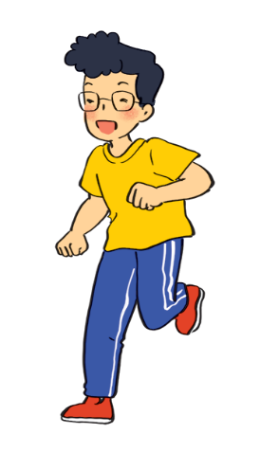
PRACTICE
2
Look at the pictures. Write sentences like the example. Use positive or negative present continuous verbs.
4. Duong and Hung ______________________________.
(play badminton)
5. Phong _________________________.
(draw a picture)
are not / aren’t playing badminton
is not / isn’t drawing a picture

Slide 27
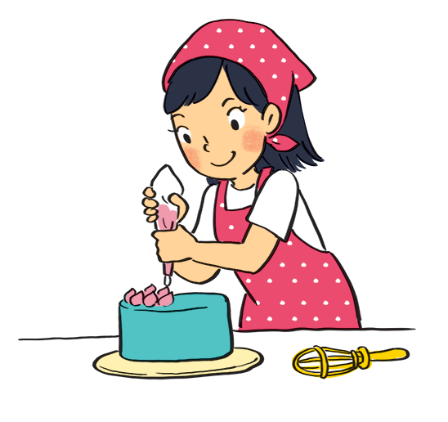
PRACTICE
3
Work in pairs. Look at the pictures. Ask and answer.
Example:
A: your sister / make a cake?
Is your sister making a cake?
B: Yes, she is.

Slide 28
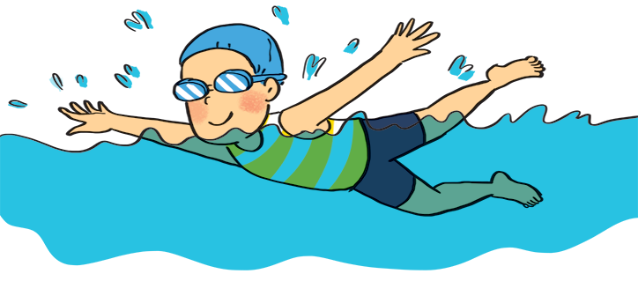
PRACTICE
3
Work in pairs. Look at the pictures. Ask and answer.
1. A: your friend / swim?
______________________
B: __________
Is your friend swimming?
Yes, he is.

Slide 29
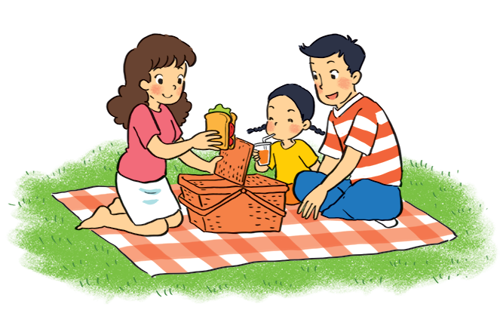
PRACTICE
3
Work in pairs. Look at the pictures. Ask and answer.
2. A: they / listen to music?
_______________________
B: _____________
Are they listening to music?
No, they aren’t.
(They are having a picnic.)

Slide 30
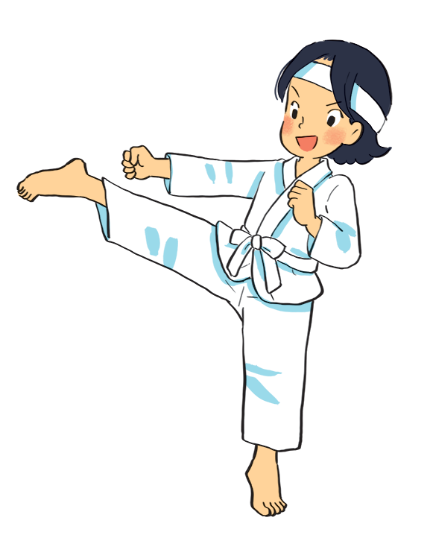
PRACTICE
3
Work in pairs. Look at the pictures. Ask and answer.
3. A: Mi / play the piano?
______________________
B: _____________
Is Mi playing the piano?
No, she isn’t.
(She is doing karate.)

Slide 31
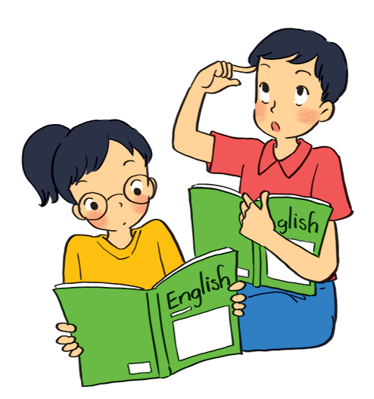
PRACTICE
3
Work in pairs. Look at the pictures. Ask and answer.
4. A: they / learn English?
______________________
B: _____________
Are they learning English?
Yes, they are.

Slide 32
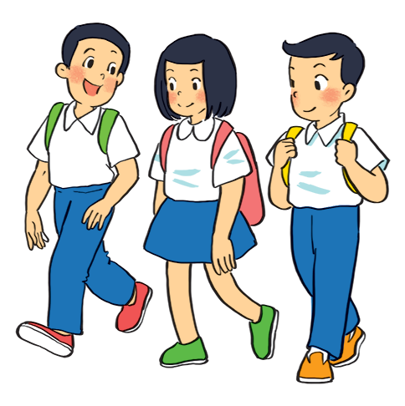
PRACTICE
3
Work in pairs. Look at the pictures. Ask and answer.
5. A: your friends / cycle to school?
____________________________
B: _____________
Are your friends cycling to school?
No, they aren’t.
(They are walking to school.)

Slide 33
PRACTICE
Grammar
The present continuous
When something often happens or is fixed, we use the present simple.
When something is happening now, we use the present continuous.

Slide 34
PRACTICE
4
Put the verbs in brackets in the present simple or present continuous.
1. My best friend (not walk) _______________________ to school every day. Sometimes she (cycle) _______.
2. Look! What _______ he (play) _______?
3. _______ your friends (study) _______ in the library every
afternoon?
4. I (write) ________________ an email to my friend now.
5. He (not do) ________________ his homework now. He (read) ____________.
does not / doesn’t walk
cycles
is
playing
Do
study
am / ‘m writing
is not / isn‘t doing
is / ‘s reading

Slide 35
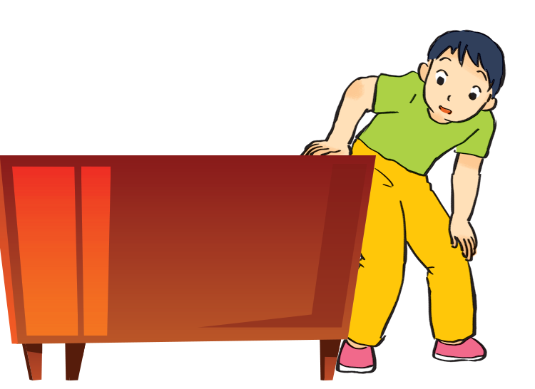
PRODUCTION
5
Charades. Take turns to mime different actions.
Others guess what you are doing.
Example:
A: Are you dancing?
B: No, I’m not.
C: Are you looking for something?
B: Yes, I am.

Slide 36
CONSOLIDATION
1
Wrap-up
What have we learnt in this lesson?
Use the present continuous to talk about things happening now;
Ask about appearance and personality

Slide 37
CONSOLIDATION
2
Homework
Do exercises in the Workbook.

Slide 38
GOODBYE

