Slide 3
1
2
3
Warm-up and review
4
5
Fun corner and wrap-up
Look, listen and repeat.
Listen, point and say.
Let’s talk.

Slide 5
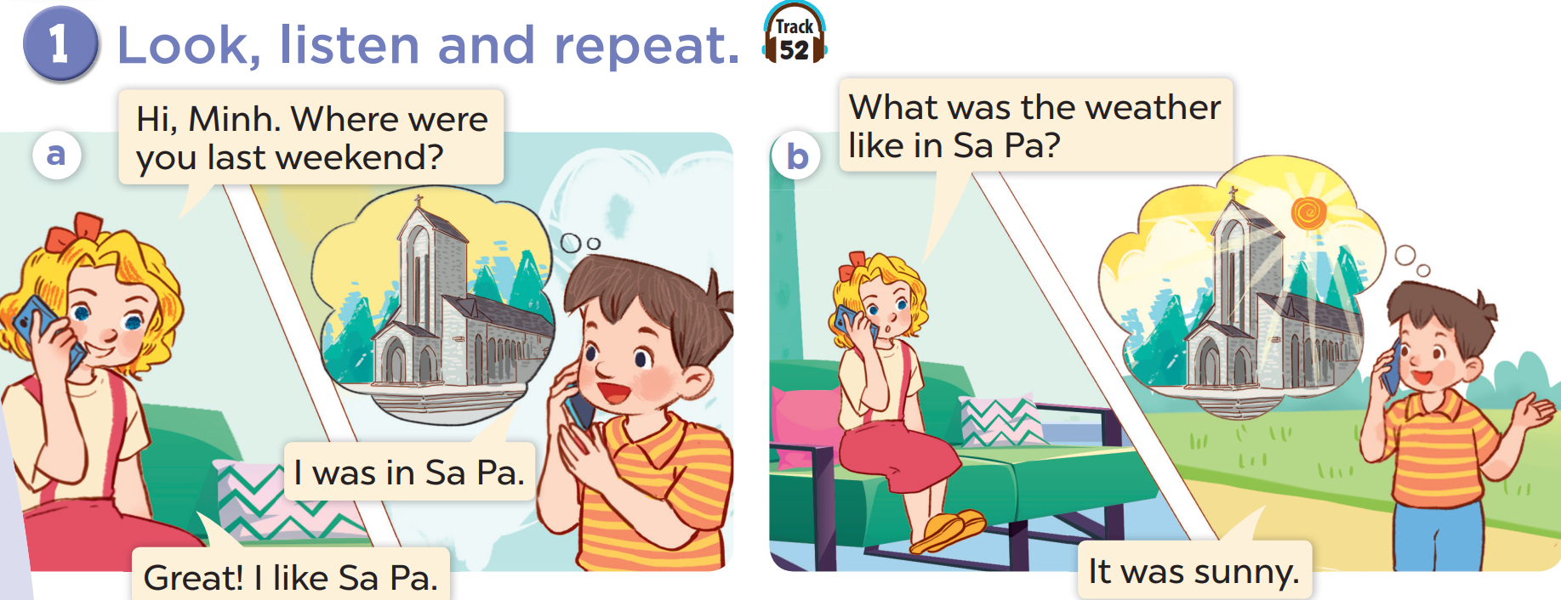

Slide 7
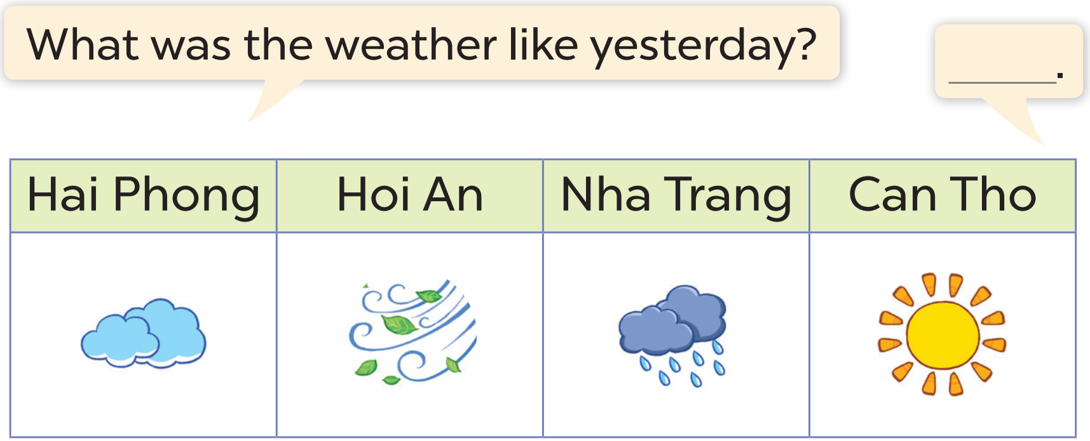

Slide 8
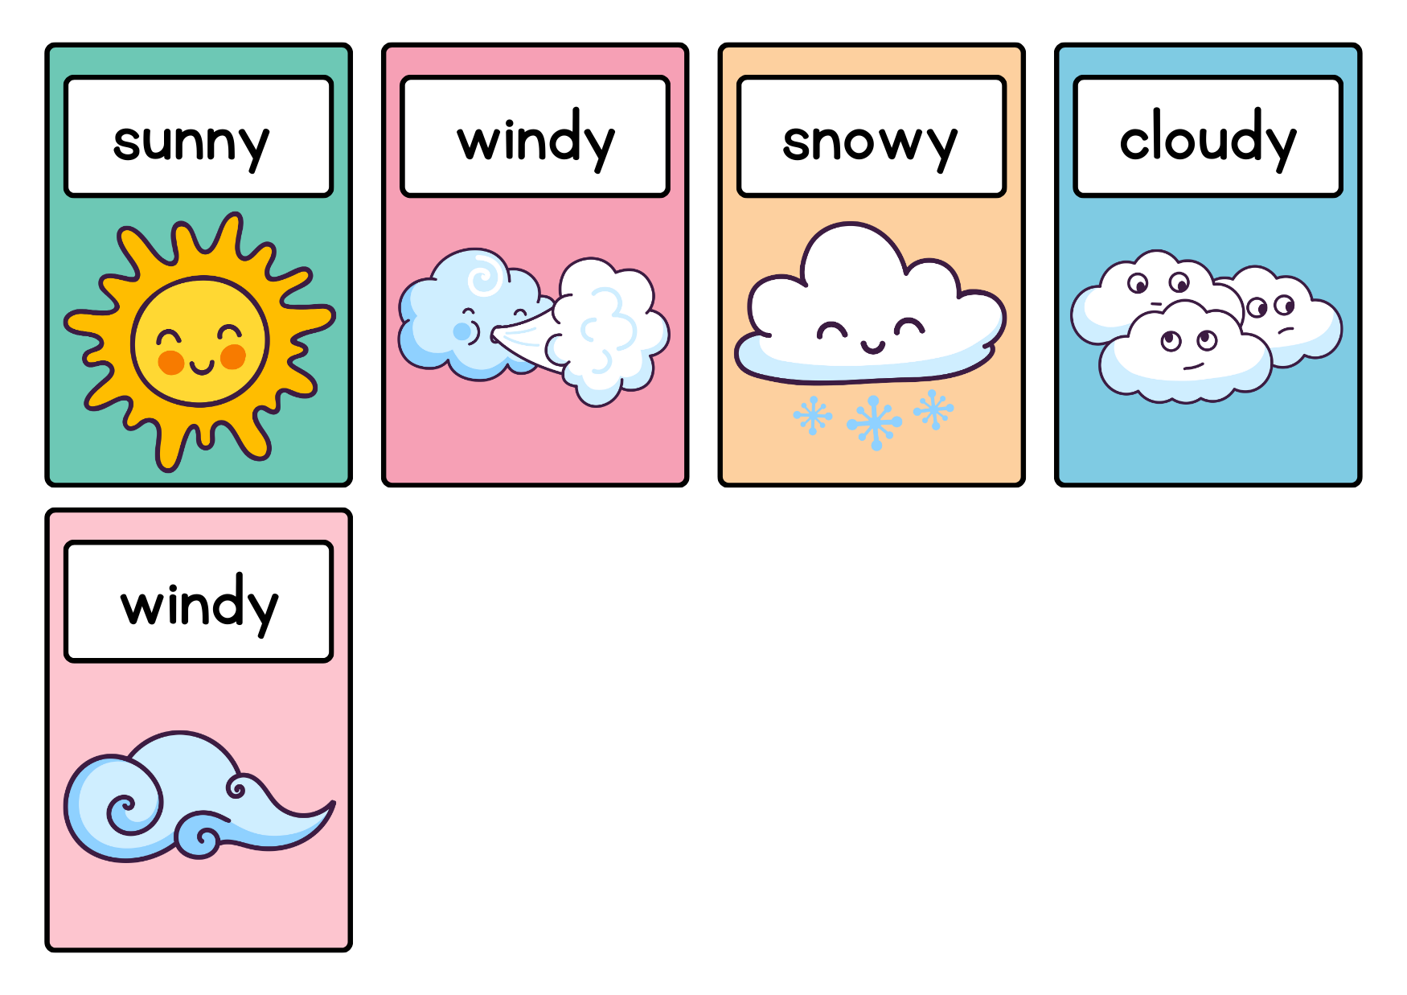
HANOI

Slide 9
WHAT’S THE MISSING LETTER?

Slide 10
S
U
?
N
N
Y

Slide 11
W
I
D
?
N
Y

Slide 12
C
L
O
U
D
?
Y

Slide 13
Website: hoclieu.vn
Fanpage: facebook.com/www.tienganhglobalsuccess.vn

