Slide 2
Unit
5
GLOBAL WARMING
Unit
FAMILY LIFE
WELCOME ALL THE TEACHERS
TO CLASS 11B4
Teacher: Phạm Thị Ánh Hồng

Slide 3
Unit
5
GLOBAL WARMING
Unit
FAMILY LIFE
WARM -UP
Work in Group
Look at the pictures and do
the Climate change quiz

Slide 4
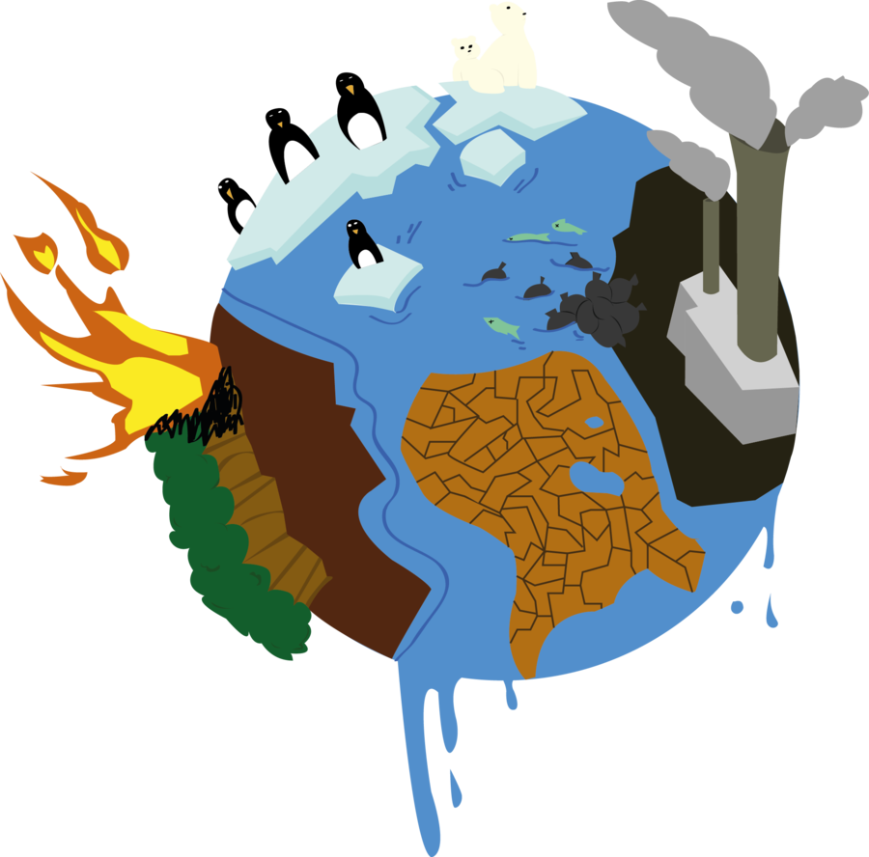
WARM-UP
Climate Change Quiz

Slide 5
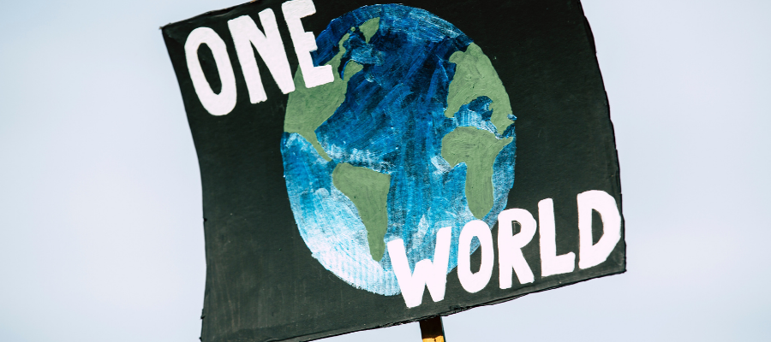
1. True or False The majority of scientists agree that climate change is real and caused by humans.
True
False

Slide 6
4
2. What will happen if there is a balance between the greenhouse gases released and those removed from the atmosphere? A. Global warming will be limited to 1.5∘C. B. Global CO2 emissions will increase. C. Countries will switch to clean energy.

Slide 7
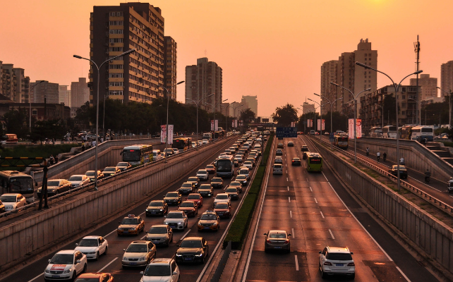
3. Methane is resonsible for nearly______ than of current warming from human activities?
two-thirds
one-third
three-fifths

Slide 8
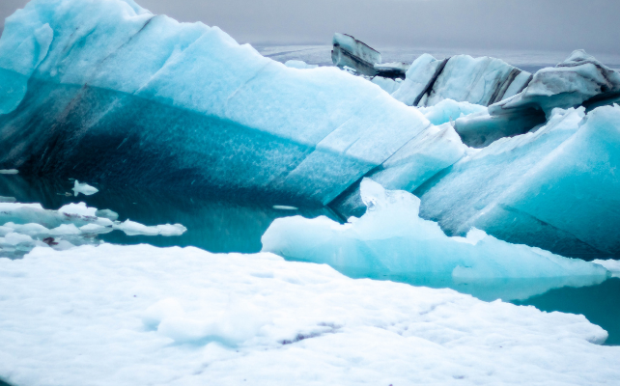
4. Which has been the hottest year on record?
2016
2020
2023

Slide 9
5. Which typhoon caused the most severe damage when it made landfall in Vietnam in 2024?
Milton
Yagi
Krathon

Slide 10
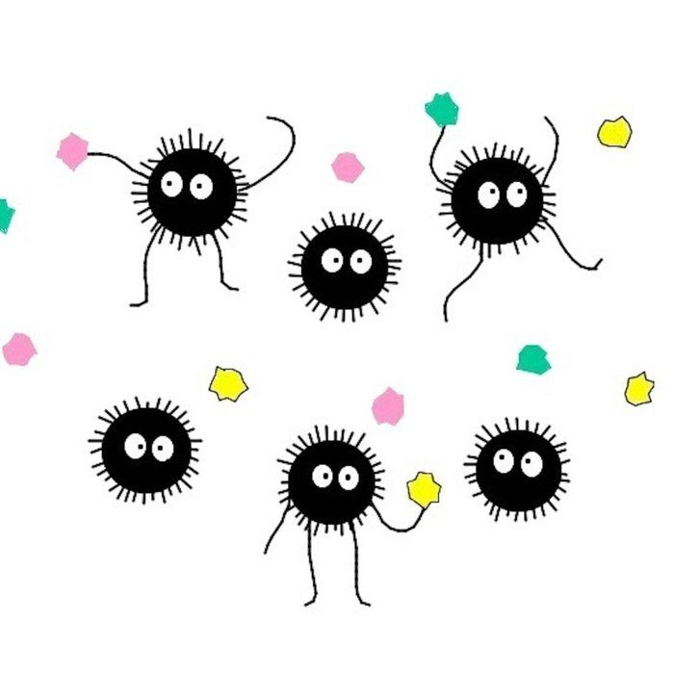
6. Black carbon is called…………………
soot
liquid
methane

Slide 11
Unit
5
GLOBAL WARMING
Unit
FAMILY LIFE
LESSON 7
COMMUNICATION AND CULTURE / CLIL
Student Book – page 59

Slide 12
LESSON 7
COMMUNICATION AND CULTURE / CLIL
WARM-UP
Do the quiz
EVERYDAY ENGLISH
Task 1: Complete the conversation.
Task 2: Make similar conversations.
Vocabulary
Task 1: Read and answer the questions.
Task 2: Read and tick the pictures.
Task 3: Discussion.
CLIL
CONSOLIDATION
Wrap-up
Homework

Slide 13
EVERYDAY ENGLISH
1
Listen and complete the conversation with the expressions in the box. Then practise it in pairs.
Jane: Hi, Nga. Is that a coal-burning stove? Nga: Hi. Yes, my dad bought it last week. It heats up our home very quickly. Let me put in some more coal. Jane: (1) __________! You’re too close and will burn yourself! Nga: (2) __________. I’m very careful. Jane: Yes, it feels very warm, but (3) _______________ burning coal produces soot. Nga: Oh no, I didn’t know that. (4) ______________. I’ll tell my dad.
Watch out
Don’t worry
I must warn you
Thanks so much

Slide 14
EVERYDAY ENGLISH
GIVING WARNINGS AND RESPONDING

Slide 15
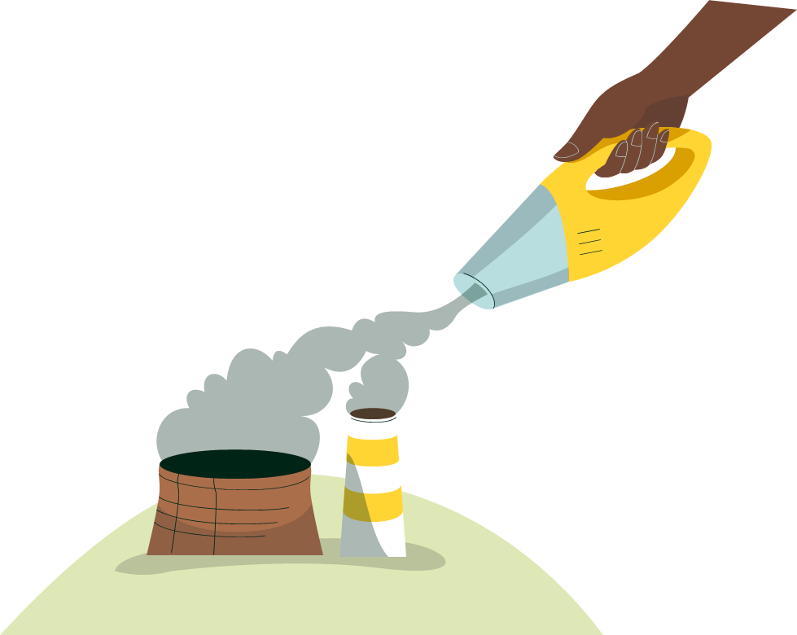
EVERYDAY ENGLISH
2
Work in pairs. Use the model in 1 to make similar conversations for these situations. One of you is Student A, the other is Student B. Use the expressions below to help you.
1. Student A is burning rubbish. Student B is warning him/her about the dangers of open waste burning to people's health and the environment. 2. Student B is building a campfire. Student A is warning him/her about the risk of starting a forest fire and the health risks.

Slide 16
Work in pairs (3 minutes)
Make similar conversations

Slide 17
Work in pairs
PRACTICE

Slide 18
II. CULTURE (CLIL)
1. Vocabulary

Slide 19
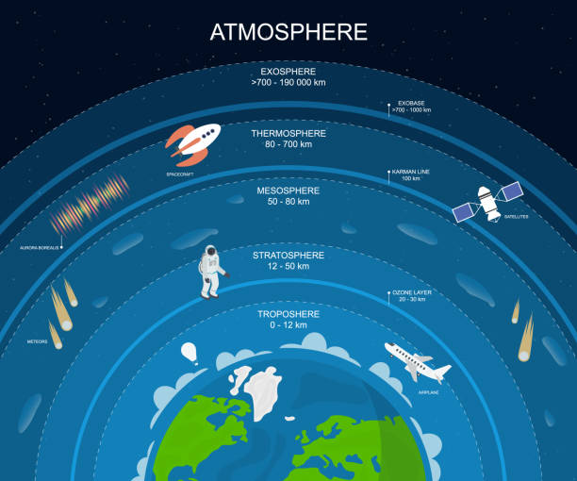
CLIL
atmosphere (n)
/ˈætməsfɪə(r)/
Khí quyển
the mixture of gases that surrounds the earth

Slide 20
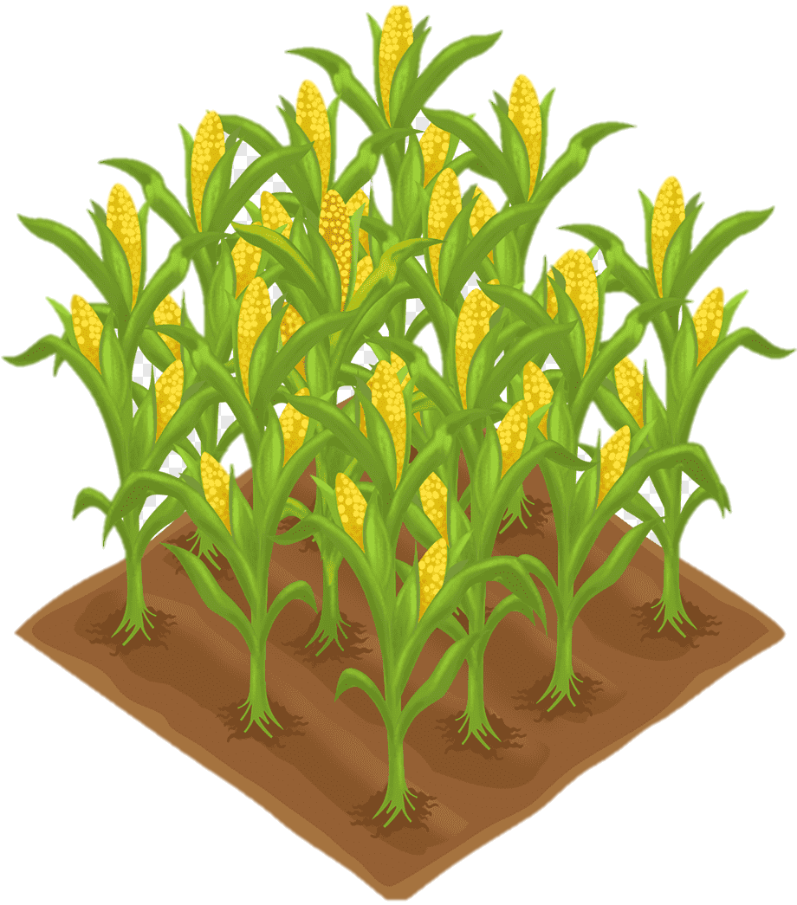
CLIL
crop (n)
/krɒp/
Cây trồng, vụ, mùa
the amount of grain, fruit, etc. that is grown in one season

Slide 21
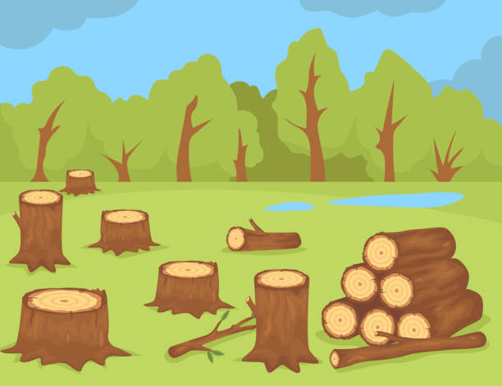
CLIL
deforestation (n)
/ˌdiːˌfɒrɪˈsteɪʃn/
Sự phá rừng
the act of cutting down or burning the trees in an area

Slide 22
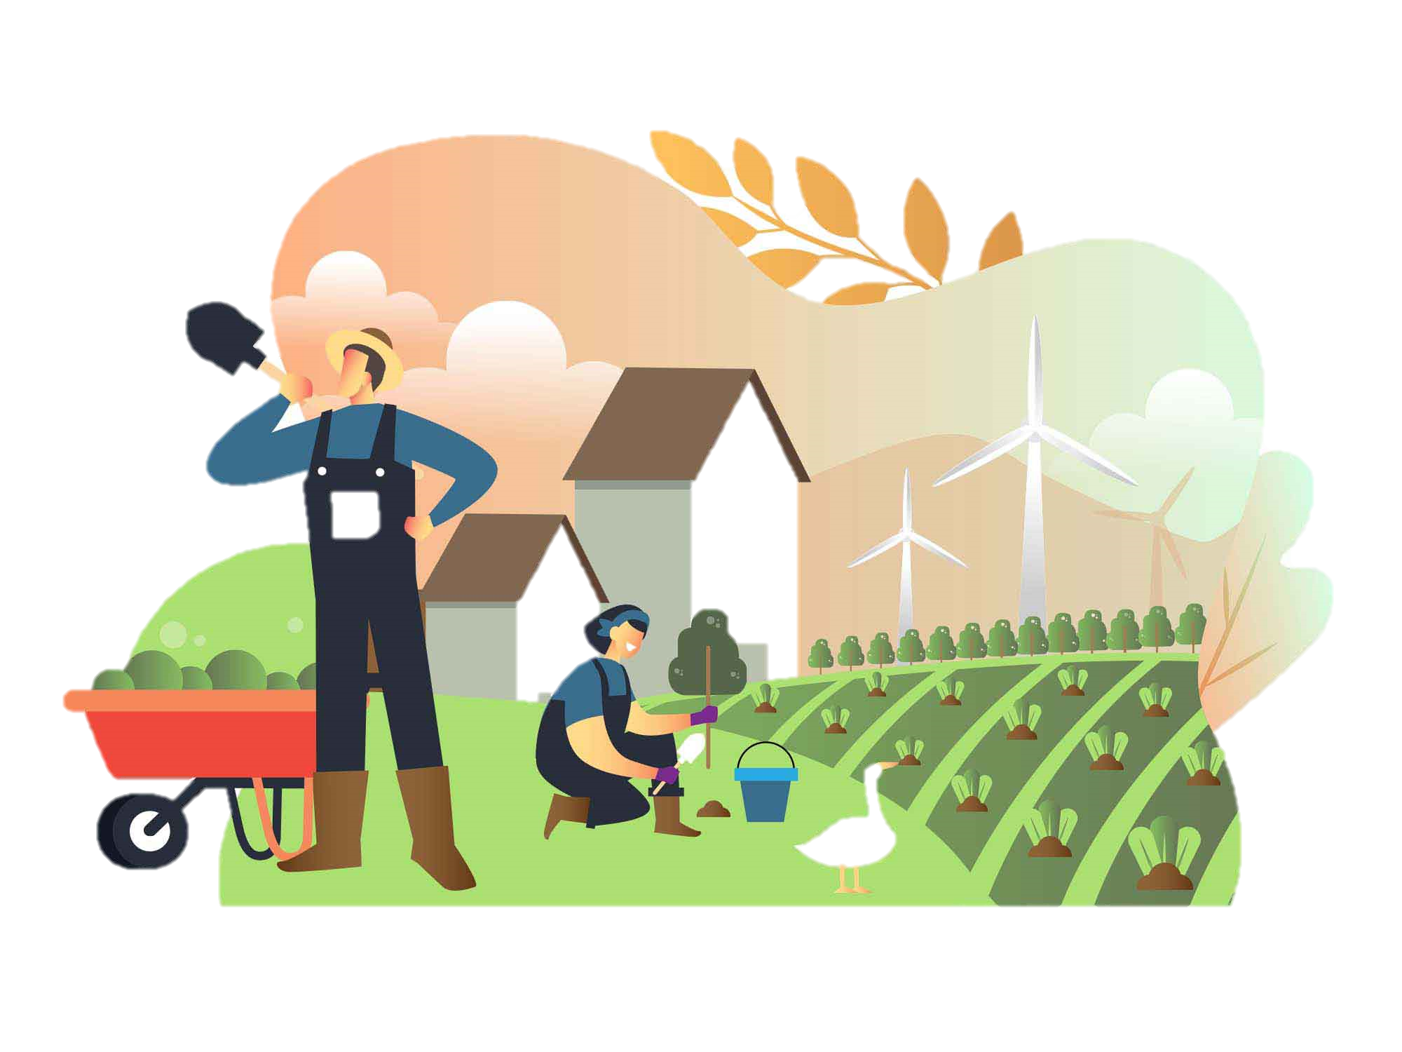
CLIL
farming (n)
/ˈfɑːmɪŋ/
(Việc) canh tác
the activity of working on a farm or organizing the work there

Slide 23
CLIL
Form | Pronunciation | Meaning
1. atmosphere (n) | /ˈætməsfɪə(r)/ | Khí quyển
2. crop (n) | /krɒp/ | Cây trồng, Mùa, vụ
3. deforestation (n) | /ˌdiːˌfɒrɪˈsteɪʃn/ | Sự phá rừng
4. farming (n) -> Farming method | /ˈfɑːmɪŋ/ | (việc) Canh tác Phương pháp canh tác

Slide 24
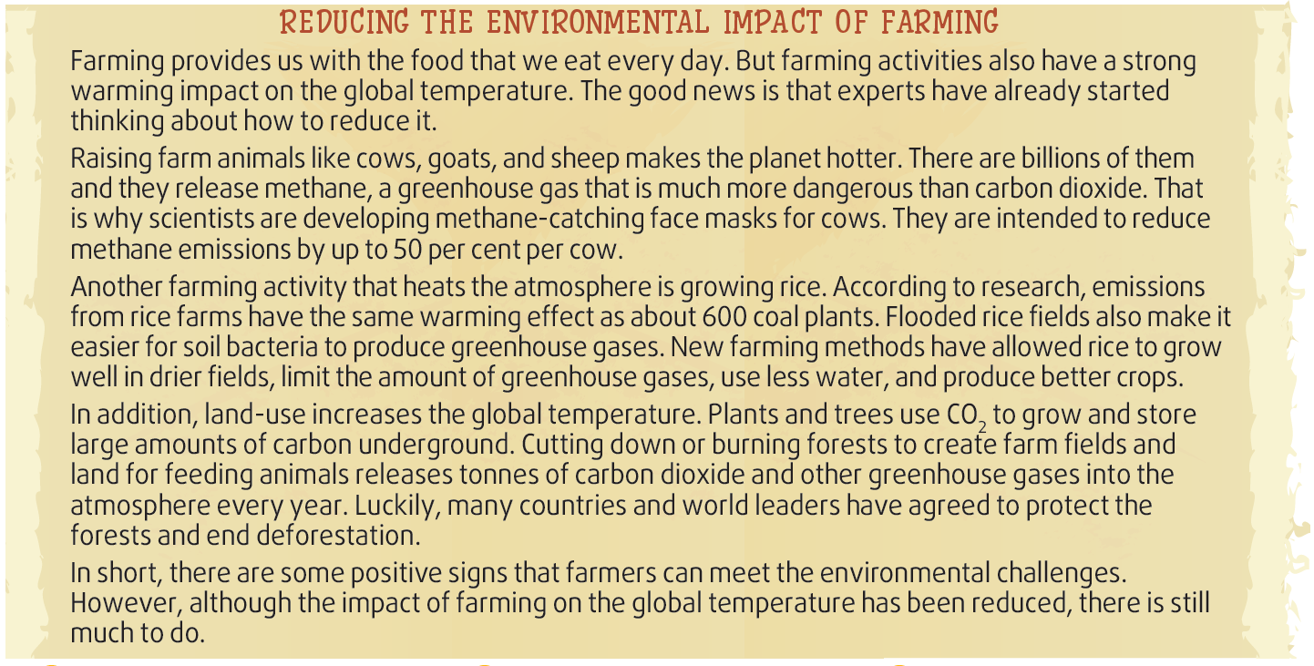
CLIL
1
Read the text and choose the best option to answer each of the questions

Slide 25
1. What does the word “they” in paragraph 2 refer to?
A. farming activities
B. farming methods
C. farming animals
D. experts

Slide 26
2. Why do the scientists develop methane-catching face masks for cows?
A. They want to reduce methane emission
B. They want to help them grow quickly
C. They hope to produce more methane gas
D. They want to release methane into the atmosphere

Slide 27
3. According to the text, what farming activities that have negative impact on the global temperature NOT MENTIONED?
A. Raising farm animals
B. Growing rice
C. Land-use
D. Using pesticides

Slide 28
CLIL
2
Read the text and tick (✓) the pictures that show ways to reduce global warming.

Slide 29
CLIL
3
Read the text and tick (✓) the pictures that show ways to reduce global warming.
✓
D. Using pesticides
D. Using pesticides
✓

Slide 30
WRAP-UP
WATCH THE VIDEO AND ANSWER THE QUESTIONS
According to the video,
Farm animals contribute less to the emission of CO2 than vehicles. True or False?
How many kilograms of plant protein are used in order to produce 1kg of animal protein?
What can we do to reduce greenhouse gas?

Slide 31
WRAP-UP
WATCH A VIDEO
Notes:
https://www.youtube.com/watch?v=7I0v3LhKhQg

Slide 32
WRAP-UP
According to the video,
Farm animals contribute less to the emission of CO2 than vehicles. True or False?
False

Slide 33
WRAP-UP
According to the video,
2. How many kilograms of plant protein are used in order to produce 1 kilogram of animal protein?
6 kilograms

Slide 34
WARM-UPWRAP
According to the video,
3. What can we do to reduce greenhouse gas?
We can consume fewer animal products or even go meat free.

Slide 35
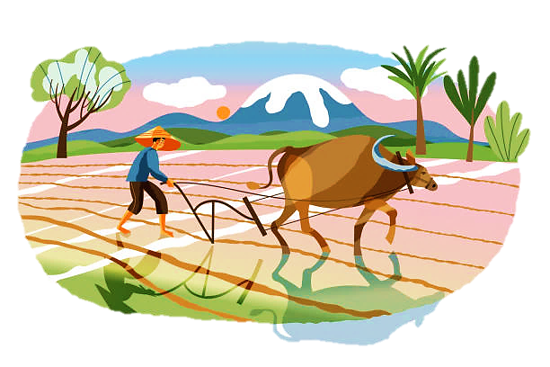
CLIL
2
Work in groups. Discuss the following questions.
What farming activities in Viet Nam do you think have negative impact on the global temperature?
What do you think are the alternatives to those activities?

Slide 36
What have you learnt today?
CONSOLIDATION
1
Wrap-up
Give warnings and respond
The environmental impact of farming and how to reduce it

Slide 37
Homework
CONSOLIDATION
2
1. Do exercises in the workbook.
2. Prepare for Lesson 8 - Unit 5

Slide 38
Website: hoclieu.vn
Fanpage: facebook.com/www.tienganhglobalsuccess.vn/

