Slide 2
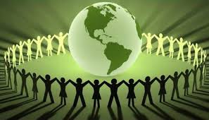
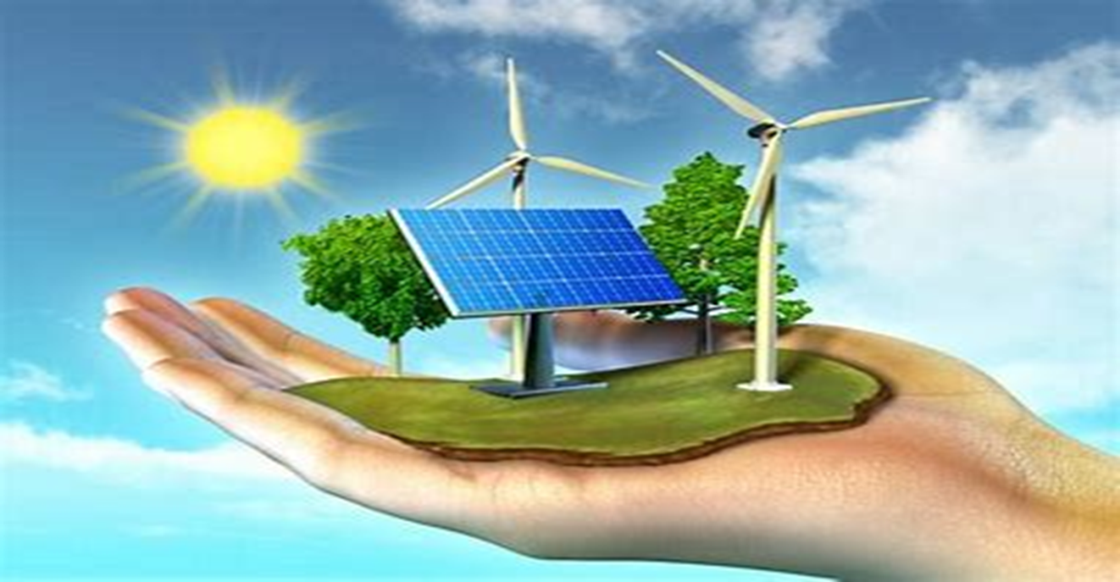
Welcome to our class

Slide 3
Unit
3
CITIES OF THE FUTURE
Unit
FAMILY LIFE
LESSON 8:
LOOKING BACK AND PROJECT

Slide 4
VOCABULARY
GAME: BINGO
Rules:
- Work in 4 groups
- Write down 9 words relating to the topic “Cities of the future” in 9 squares within 3 minutes.
- T will read 10 words, if you have three words in a row, shout “BINGO”
- The group having BINGO first is the winner.

Slide 5
VOCABULARY
2
Complete the sentences. Use words and phrases you have learnt in this unit.
1. Improved road conditions may help reduce t________ j________ in the city. 2. My city was ranked as the most l________ city in the country thanks to its excellent facilities and clean air. 3. Cities in the future will have a lower carbon footprint and will be more s__________. 4. Smart technologies have made lives of c________ d________ more convenient.
raffic
ams
iveable
ustainable
ity
wellers

Slide 6
GRAMMAR
STORY TELLING
Listen and correct grammatical mistakes in the following story

Slide 7
GRAMMAR
STORY TELLING
I have a friend, whose name is James.
James seems intelligently, but he sometimes asks some silly questions.
He lives in a crowded city, so he feels unhappily.
He and I are in the kitchen now.
He is tasting the soup. It is tasting delicious.
I ask him not to talk because I think about what we will have for lunch tomorrow.

Slide 8
GRAMMAR
STORY TELLING
I have a friend, whose name is James.
James seems intelligent, but he sometimes asks some silly questions.
He lives in a crowded city, so he feels unhappily.
He and I are in the kitchen now.
He is tasting the soup. It is tasting delicious.
I ask him not to talk because I think about what we will have for lunch tomorrow.
intelligently
intelligent
unhappily
unhappy
is tasting
tastes
think
am thinking

Slide 9
PRONUNCIATION:
Listen and mark the consonants and vowel sounds
I have a friend, whose name is James.
James seems intelligent, but he sometimes asks some silly questions.
He lives in a crowded city, so he feels unhappy.
He and I are in the kitchen now.
He is tasting the soup. It tastes delicious.
I ask him not to talk because I am thinking about what we will have for lunch tomorrow.

Slide 10
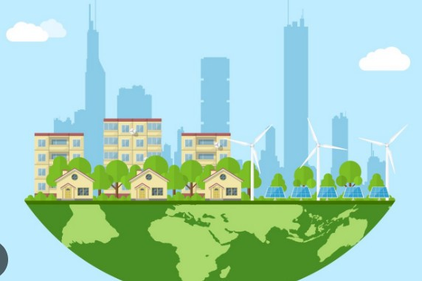
PROJECT
THE IDEAL CITY OF THE FUTURE

Slide 11
PROJECT
THE IDEAL CITY OF THE FUTURE
CUES:
- Where will it be located?
- How big will it be?
- How many people will live in it?
- How will people travel?
- What kind of buildings will people live in?
- Will people use AI technologies?
- If yes, how will they use them?

Slide 12
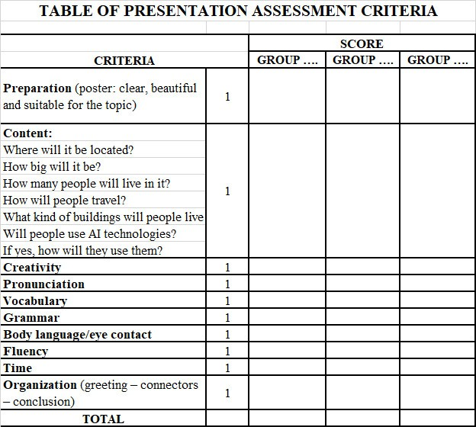
PROJECT
THE IDEAL CITY OF THE FUTURE

Slide 13
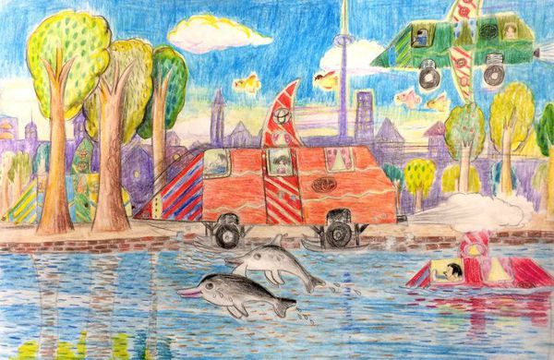
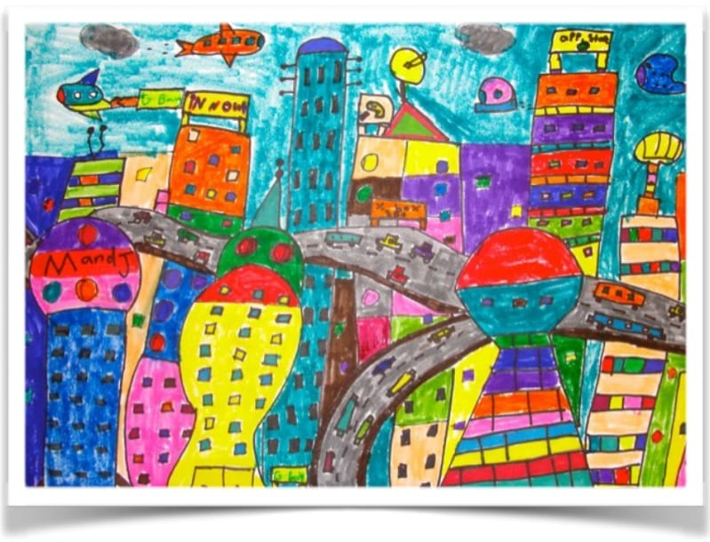
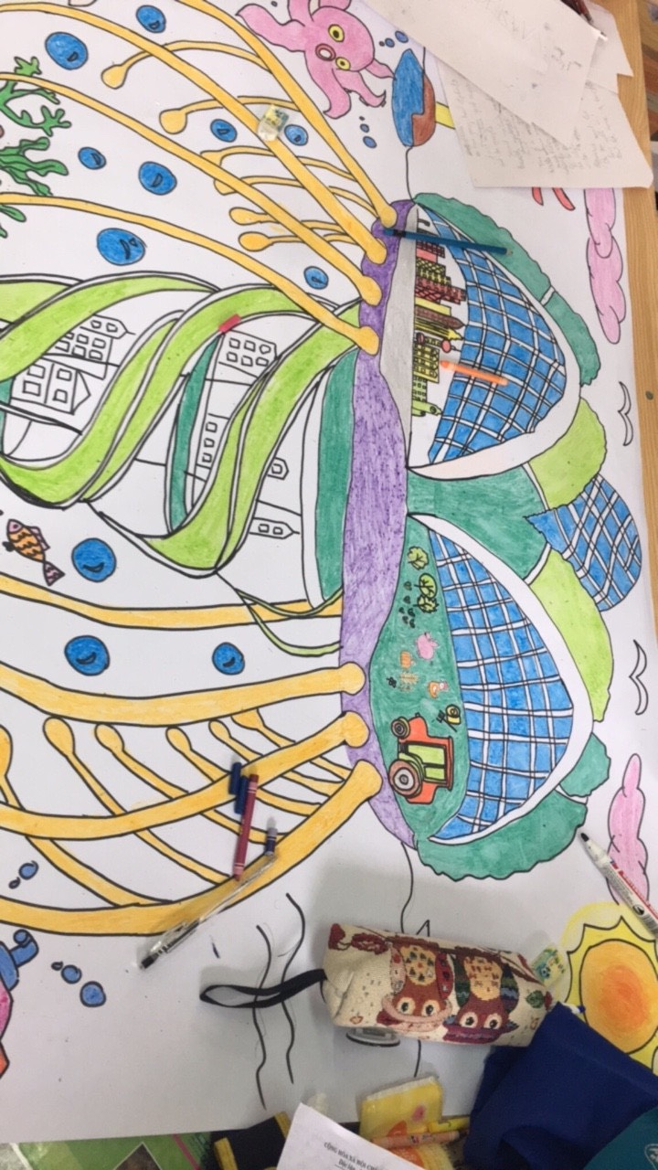
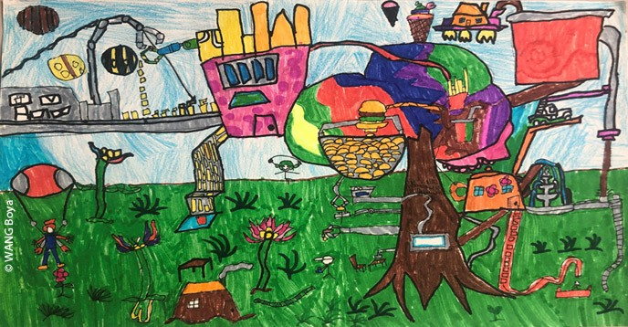
PROJECT
THE IDEAL CITY OF THE FUTURE

Slide 14
CONSOLIDATION
1
Wrap-up
What have you learnt today?
- Review the vocabulary and grammar of Unit 3.
- Review linking final consonant to initial vowel.
2. What can we do after the lesson?
- Apply vocabulary and grammar points into practice through the project “The ideal city of the future”.

Slide 15
CONSOLIDATION
Homework
Do exercises in the workbook.
Prepare for Unit 4 - Getting.

