Slide 2
WARM-UP: Gap-filling
A: What’s it like living (1) ________ skyscraper? B: (2) ________ great. I (3)____ enjoy the best
views (4) ____ the city from my sofa. A: (5) ________ have a balcony? B: No, (6) ________. (7) _________ huge windows.
in a
It’s
can
of
Do you
I don’t
But I have

Slide 3
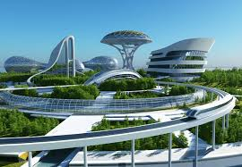
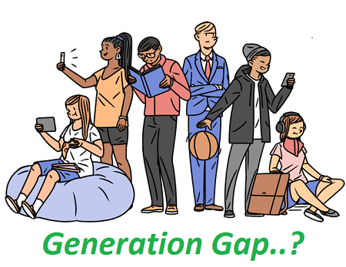
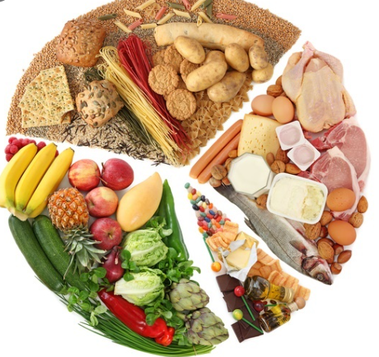
REVIEW 1
LESSON 1: LANGUAGE

Slide 4
Thêm tiêu đề: PRONUNCIATION

Slide 5
PRONUNCIATION
Listen and complete the conversation. Then underline the weak forms of the auxiliary verbs, circle the contracted forms, and mark the consonant-to-vowel linking with (ᴗ). Practise saying the conversation in pairs.
A: What's it like living in a skyscraper?
B: It’s great. I can enjoy the best views of the city from my sofa.
A: Do you have a balcony?
B: No, I don’t. But I have huge windows.

Slide 6
Thêm tiêu đề: VOCABULARY

Slide 7
VOCABULARY
1
Choose the correct answers A, B, C or D to complete the following sentences.
1. If you want to stay healthy, you should have a balanced diet and ________ regularly. A. work out B. take out C. speak out D. stand out 2. For a healthy diet, you should ________ sugar and eat more vegetables. A. take on B. cut down on C. go on D. cut with 3. Many experts believe that good ________ transport will solve traffic problems in big cities. A. individual B. private C. public D. national

Slide 8
VOCABULARY
Choose the correct answers A, B, C or D to complete the following sentences.
1
4. People feel safe in this neighbourhood because ________ are installed everywhere. A. smart cities B. smartphones C. smart cars D. smart sensors 5. People of different generations often come into ________ with one another. A. belief B. conflict C. agreement D. support 6. My brother is a true ________. he grew up with technology, and started using a computer at an early age. A. curious boy B. critical thinker C. digital native D. book lover

Slide 9
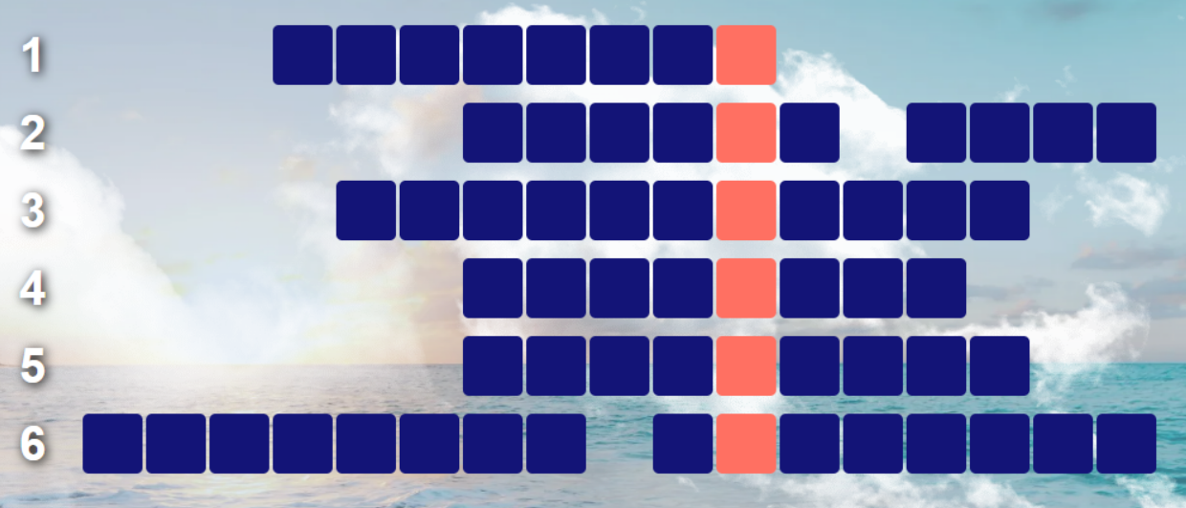
VOCABULARY
2
CROSSWORD

Slide 10
VOCABULARY
2
CROSSWORD

Slide 11
Thêm tiêu đề: GRAMMAR

Slide 12
GRAMMAR
1
Complete the sentences with the correct form of the words in brackets.
1. My mother (take up) ________ aerobics ten years ago. 2. The government (just, decide) ______________ to increase taxes on fast food. 3. I (win) ________ several races since I started a new workout routine. 4. The idea of smart cities (start) ________ in the 21st century. 5. So far, more than 70 million people (receive) _____________ vaccines to build protection against the virus. 6. I (already, show) _________________ my grandmother how to use her new smartphone.
took up
has just decided
have won
started
have received
have already shown

Slide 13
GRAMMAR
2
Choose the correct words or phrases.
1. You look so angry / angrily. What’s wrong? 2. I think / I'm thinking of taking up yoga. I feel a bit stressed / stress these days. 3. Do you remember/Are you remembering Ms Wilson? She’s a great yoga instructor. 4. The traffic gets / is getting worse. What do you think / are you thinking we should do?

Slide 14
GRAMMAR
3
Choose the correct answers A, B, C or D to complete the following sentences.
1. If you want to maintain a healthy weight, you ________ have snacks between meals. A. shouldn’t B. should C. must D. don’t have to 2. I ________ strictly follow the doctor’s instructions if I want to get better quickly. A. shouldn’t B. must C. can D. don’t have to 3. The government ________ improve the infrastructure of big cities to boost the economy. A. mustn’t B. doesn’t have to
C. should D. didn’t have to

Slide 15
GRAMMAR
3
Choose the correct answers A, B, C or D to complete the following sentences.
4. People living in high-rise buildings ________ obey the safety rules and regulations strictly. A. shouldn’t B. mustn’t C. may D. have to 5. Lots of women in the past ________ stay at home, look after their children, and do all the housework. A. must B. should C. had to D. have to 6. My parents respect my career choice, so I ________ follow in their footsteps. A. mustn’t B. don’t have to
C. should D. shouldn’t

Slide 16
CONSOLIDATION
1
Wrap-up
Strong and weak forms, contractions and consonant-to-vowel linking;
Vocabulary related to the topics of unit 1, 2 and 3;
Past simple and Present perfect tense; linking verbs and stative verbs; modal verbs.

Slide 17
CONSOLIDATION
2
Homework
Do exercises in the workbook.
Prepare for Review 1 – Lesson 2.

Slide 18
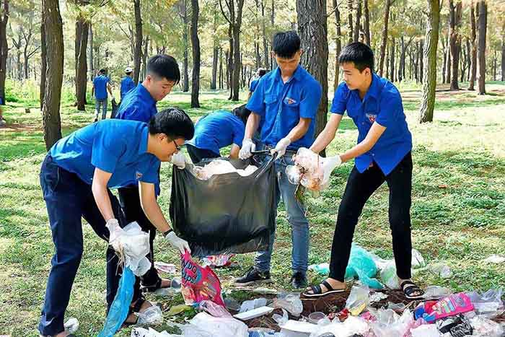
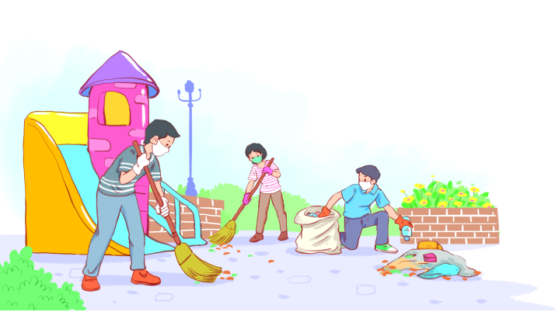
Thanks for your attending!
Please keep this slide for attribution

