Slide 2
Watch the video and remember the activities

Slide 3
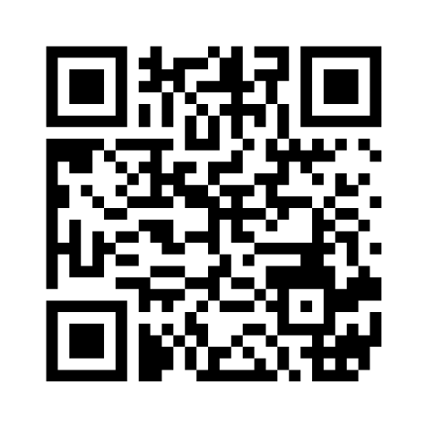
What activities can you remember?
https://www.mentimeter.com/app/presentation/n/741c63e1b3a846197d255fff9972b781/present?question=mvyeobjdm2gk

Slide 4
DISCUSSION
donating money, clothes, blood, food
Teaching children
planting trees, flowers
Meaningful Activities
reading books to
the elderly
joining clean-up activities
Helping the old/ sick
Helping orphan, street children

Slide 5
FOR A BETTER COMMUNITY
Unit 4
For A Better Community
Lesson 1: Getting started
Volunteering in the community

Slide 6
1. Vocabulary

Slide 7
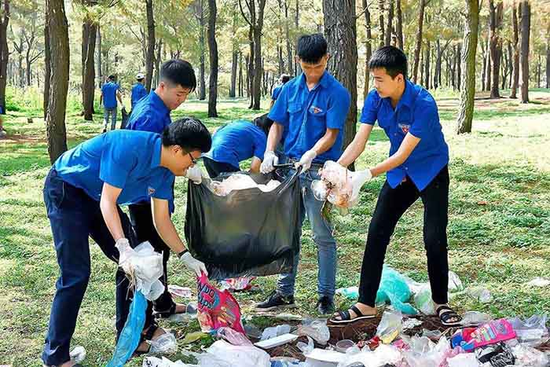
VOCABULARY
volunteer (n/ v)
/ˌvɒlənˈtɪə(r)/
They are volunteers.
They are volunteering to collect the trash in the park.

Slide 8
Advertisement (n)
/ədˈvɜːtɪsmənt/

Slide 9
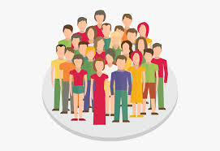
VOCABULARY
community (n)
/kəˈmjuːnəti/
all the people who live in a particular area, country, etc.

Slide 10
boost (v)
/buːst/
= increase/ develop/ enhance

Slide 11
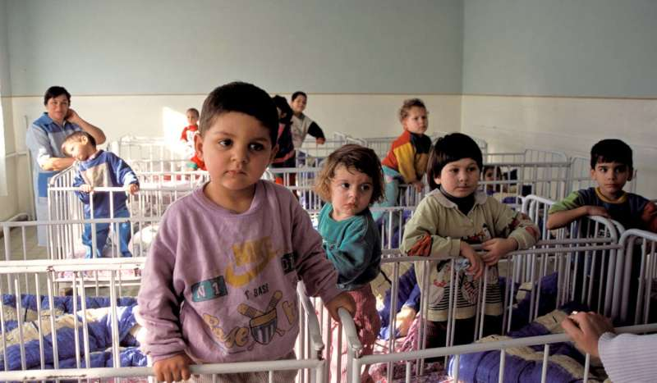
orphanage (n)
/ˈɔːfənɪdʒ/
After his parents’ death, he was brought up in an orphanage.

Slide 12
VOCABULARY
New words | Pronunciation | Definition
volunteer (n) | /ˌvɒlənˈtɪə(r)/ | a person who does a job without being paid for it
advertisement (n) | /ədˈvɜːtɪsmənt/ | a notice, picture or film telling people about a product, job or service
community (n) | /kəˈmjuːnəti/ | all the people who live in a particular area, country, etc.
boost (v) | /buːst/ | to make something increase, or become better or more successful
orphanage (n) | /ˈɔːfənɪdʒ/ | a home for children whose parents are dead
Mercury
Venus
Mars

Slide 13
VOCABULARY QUICK-CHECK
New words | Definition
1.volunteer (n) | a. all the people who live in a particular area, country, etc. when talked about as a group
2.advertisement (n) | b. to make something increase, or become better or more successful
3.community (n) | c. a person who does a job without being paid for it
4.boost (v) | d. a home for children whose parents are dead
5.orphanage (n) | e. a notice, picture or film telling people about a product, job or service

Slide 14
2. PRACTICE

Slide 15
1
Listen and read.
Volunteering in the community
Kim: Hi, Tam. I went to your house at 9 a.m., but you weren’t there.
Tam: Oh, when you came, I was working as a volunteer at our local centre for community development.
Kim: Ah, I see. How did you become a volunteer there?
Tam: Just by chance. Last summer, while I was visiting the centre, I saw an advertisement for volunteers. I applied and my application was successful.
Kim: I also want to be a volunteer. I find community work very interesting.
Tam: I agree. Community service not only benefits the local area, but can also boost our confidence and help us learn many useful skills.

Slide 16
1
Listen and read.
Volunteering in the community
Kim: What are the regular activities organised by the centre?
Tam: Oh, there are endless opportunities for getting involved. For example, you can join a local environmental group to clean up the park once a week or volunteer at an orphanage.
Kim: Sounds good. How can I apply?
Tam: I’ll email you the form. You just fill it in and send it in.
Kim: Thanks so much. I’m so excited about volunteering at the centre.
Tam: No problem. Good luck. Hope your application is successful and you enjoy the work.

Slide 17
PRACTICE
Time up
Time
Start
:
1
0
0
00
59
58
57
56
55
54
53
52
51
50
49
48
47
46
45
44
43
42
41
40
39
38
37
36
35
34
33
32
31
30
29
28
27
26
25
24
23
22
21
20
19
18
17
16
15
14
13
12
11
10
09
08
07
06
05
04
03
02
01
00
2
Read the conversation again and answer the questions.
1. What was Tam doing when Kim went to her house?
2. What are some regular activities at the centre for community development?
3. How can Kim apply for volunteer work at the centre?
4. What are the benefits of community service?

Slide 18
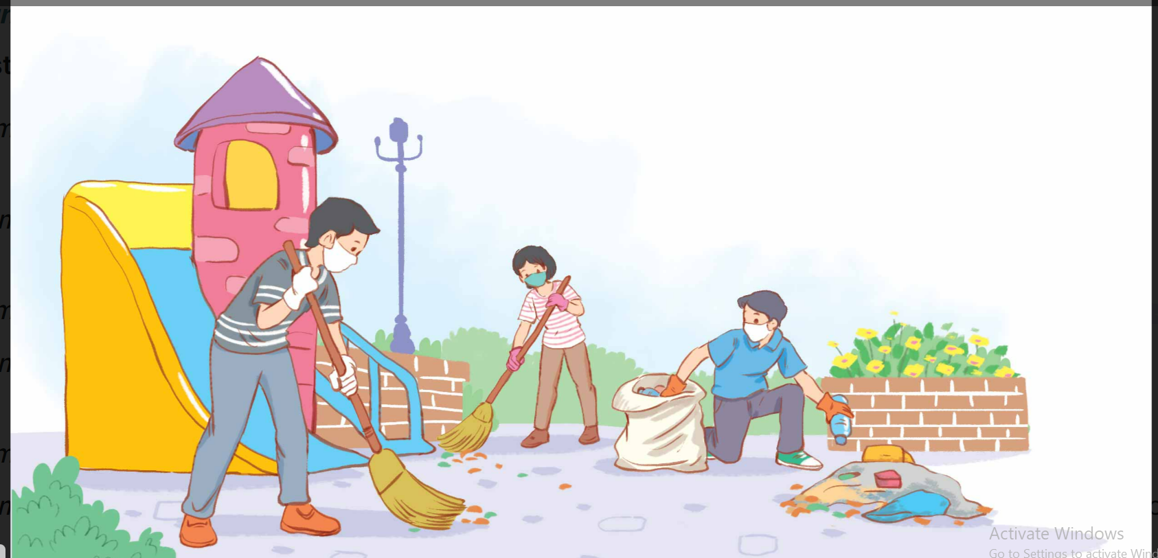
LET’S CLEAN THE SCHOOL
Work in 2 groups
Choose the number for the question.
You get 10 points for each correct answer, 20 points for the lucky number
The team with more points is the winner.

Slide 19
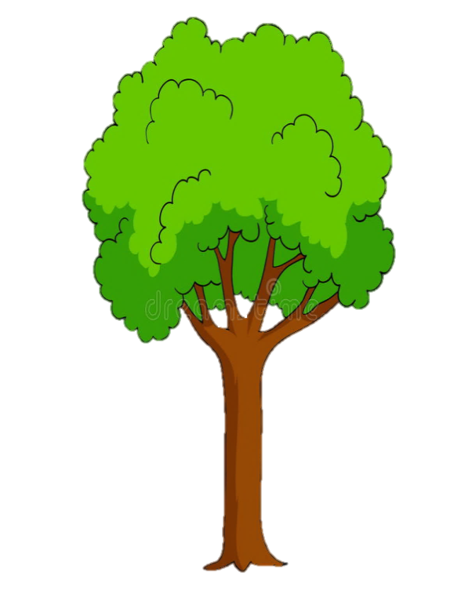
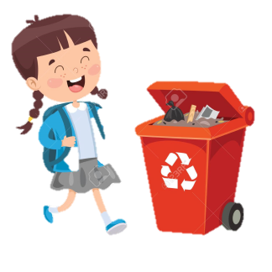
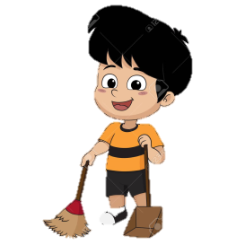
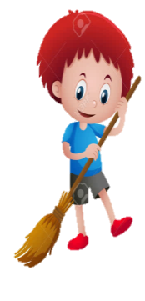
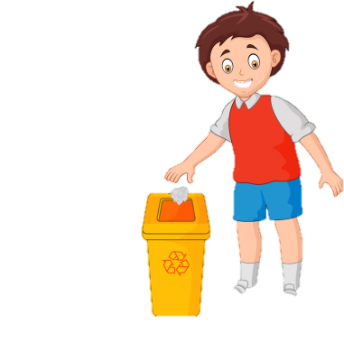
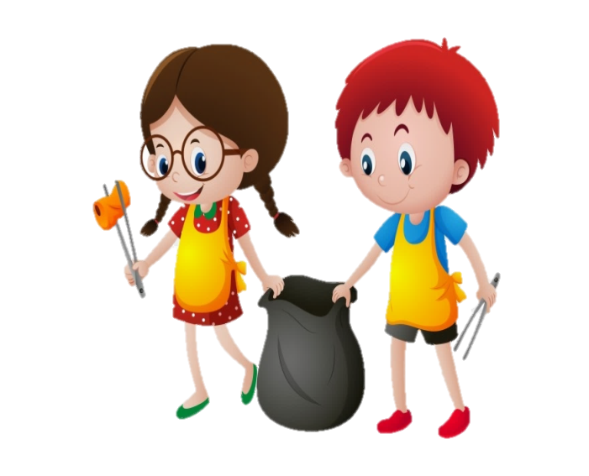
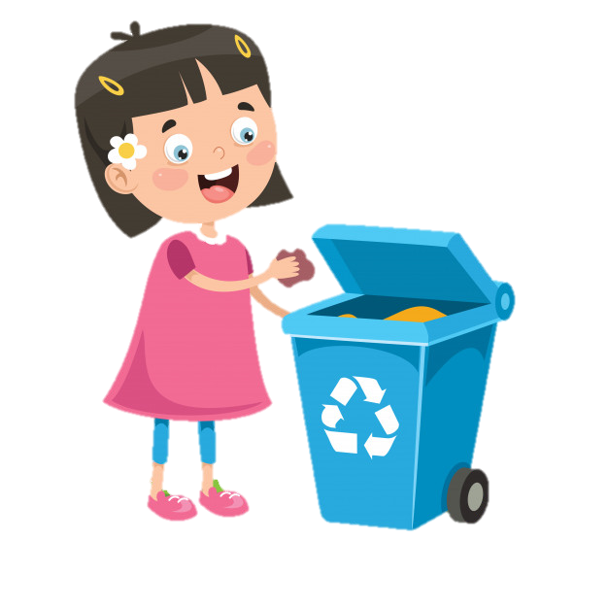
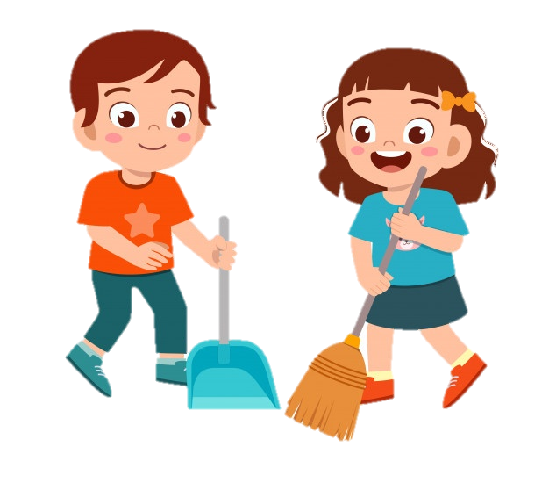
1
3
4
2
5

Slide 20
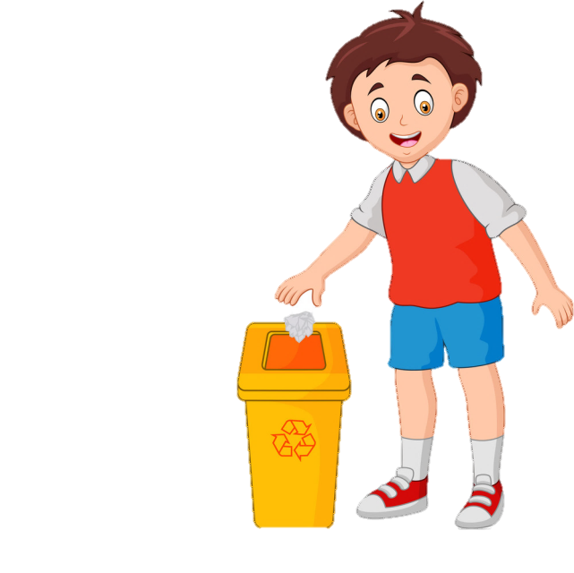
1. What was Tam doing when Kim went to her house?
She was working as a volunteer at the local centre for community development.

Slide 21
2. What are the benefits of community service?
Community service/ It not only benefits the local area, but can also boost our confidence and help us learn many useful skills.

Slide 22
3. What are some regular activities at the center for community development?
Cleaning up the park or volunteering at the orphanage.

Slide 23
4. How can Kim apply for volunteer work at the centre?
She needs to fill in the form, then send it in.

Slide 24
LUCKY

Slide 25
PRACTICE
1
Listen and read.
Volunteering in the community
Kim: Hi, Tam. I went to your house at 9 a.m., but you weren’t there.
Kim: Ah, I see. How did you become a volunteer there?
Tam: Just by chance. Last summer, while I was visiting the centre, I saw an advertisement for volunteers. I applied and my application was successful.
Kim: I also want to be a volunteer. I find community work very interesting.
Tam: Oh, when you came, I was working as a volunteer at our local centre for community development.
Tam: I agree. Community service not only benefits the local area, but can also boost our confidence and help us learn many useful skills.

Slide 26
PRACTICE
PRACTICE
Volunteering in the community
Kim: What are the regular activities organised by the centre?
Kim: Sounds good. How can I apply?
Kim: Thanks so much. I’m so excited about volunteering at the centre.
Tam: No problem. Good luck. Hope your application is successful and you enjoy the work.
Tam: Oh, there are endless opportunities for getting involved. For example, you can join a local environmental group to clean up the park once a week or volunteer at an orphanage.
Tam: I’ll email you the form. You just fill it in and send it in.

Slide 27
Activity 2: ANSWER the questions
1. What was Tam doing when Kim went to her house? She was working as a volunteer at the local centre for community development 2. What are the benefits of community service? It not only benefits the local area, but can also boost our confidence and help us learn many useful skills. 3. What are some regular activities at the centre for community development? Cleaning up the park or volunteering at the orphanage. 4. How can Kim apply for volunteer work at the centre? She needs to fill in the form, then send it in.

Slide 28
PRACTICE
3
Find the adjectives with the following suffixes
. Work individually in 1 minutes.
. Each student draw a table with 9 small boxes (a 3x3 grid)
. Fill in each box with an adjective with the suffixes (ed, ing, ful, less) in the conversation.
If you can’t find the words, draw an
icon in the blank boxes.
hopeful
bored

Slide 29
PRACTICE
3
BINGO GAME
.The teacher reads the answers. If you hear the word you wrote, draw an “X” ​​on it. If the “X” form a horizontal, vertical or diagonal line you say “Bingo”
. Who has Bingo first is the winner and receives an interesting gift.
X
X
X

Slide 30
PRACTICE
3
Find the adjectives with the following suffixes in the conversation and write them below.
suffixes | adjectives
-ed
-ing
-ful
-less
excited
interesting
useful, successful
endless

Slide 31
PRACTICE
Meaning of adjective suffixes
adj_suffixes | Meaning
adj-ful
adj-less
adj-ed
adj-ing
full of or having the qualities of
without or lacking
describing how people are made to feel
describing things or people causing the feeling

Slide 32
PRACTICE
4
Find a verb phrase in the conversation to complete each sentence.
was working
1. Oh, when you came, I____________ as a volunteer at our local centre for community development.
2. Last summer, while I was visiting the centre, I_____ an advertisement for volunteers.
(Past continuous)
saw
(Past simple)

Slide 33
03
DISCUSSION

Slide 34
TIME LIMIT:
2 minutes
TIME LIMIT:
2 minutes
Talk about activities you did (or) want to do to make your community a better one.
- What activity did you do?
- What did you do?
- When and where did you do?
- Who did you do with?
- How did you feel?
- What are the benefits?
START TIMER
TIME’S UP!

Slide 35
TIME LIMIT:
2 minutes
TIME LIMIT:
2 minutes
Last summer, I and my close friends spent a few weekends volunteering at the local library. I helped classify books and read stories to younger kids. I felt happy when I could help other people. Volunteering at the library also widened my knowledge and boosted my confidence. I encourage everyone to volunteer at a library because it can inspire the love of reading and learning in our community.

Slide 36
04
Consolidation

Slide 37
CONSOLIDATION
1
Wrap-up
Gain an overview about the topic For a better community
Vocabulary/ adj to talk about voluntary work
Using past simple/ continuous with when/ While

Slide 38
2. Homework
Do exercises in the workbook
Write a paragraph (about 100 words) about activities you did (or) want to do to make your community a better one.
Prepare for the next lesson Language

Slide 39
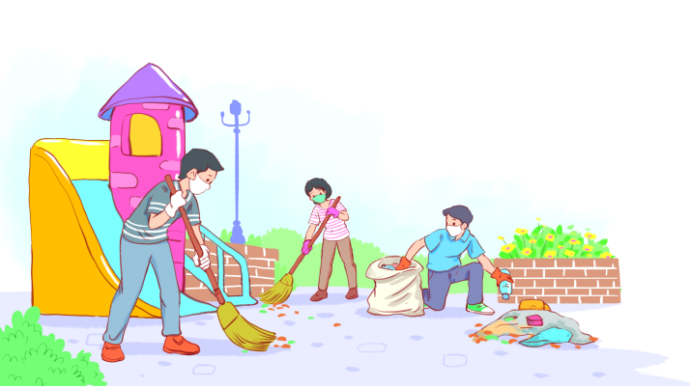
Thanks for your attendance!
Please keep this slide for attribution

