Slide 2
Notes:
welcome slide

Slide 3
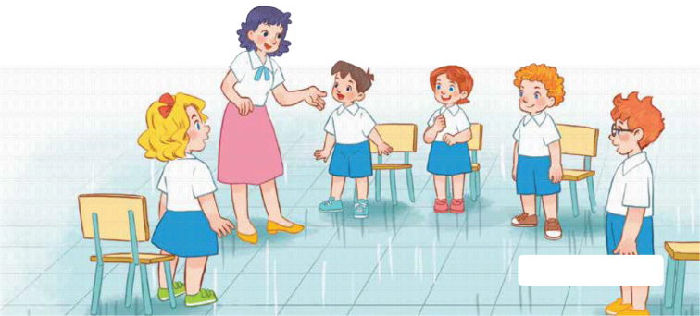
Classroom rules

Slide 4
Hands on the table
Notes:
class rules

Slide 5
Raise your hand

Slide 6
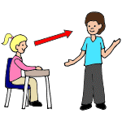
Look at the teacher

Slide 7
Be quiet!

Slide 8
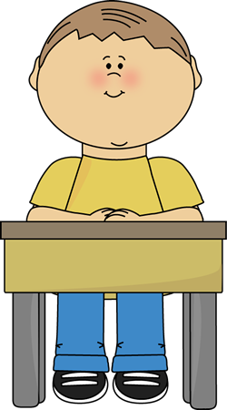
Sit nicely!
Notes:
Set up the class rules.
Hold up or point to the picture and say Sit nicely! and do the TPR action. Have pupils do the TPR action.
Do the same with Listen! and Be happy!

Slide 9
Warm-up
and Review
Notes:
what?

Slide 10
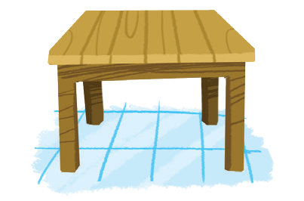
table
grapes
cake
Aa

Slide 11
Game:
Whispering
Aa
Tiếng Anh 2
Trung tâm ngoại ngữ Đăng Khoa

Slide 12
Unit
3. Listen and chant.
4.Listen and circle.
5. Write and say.

Slide 13
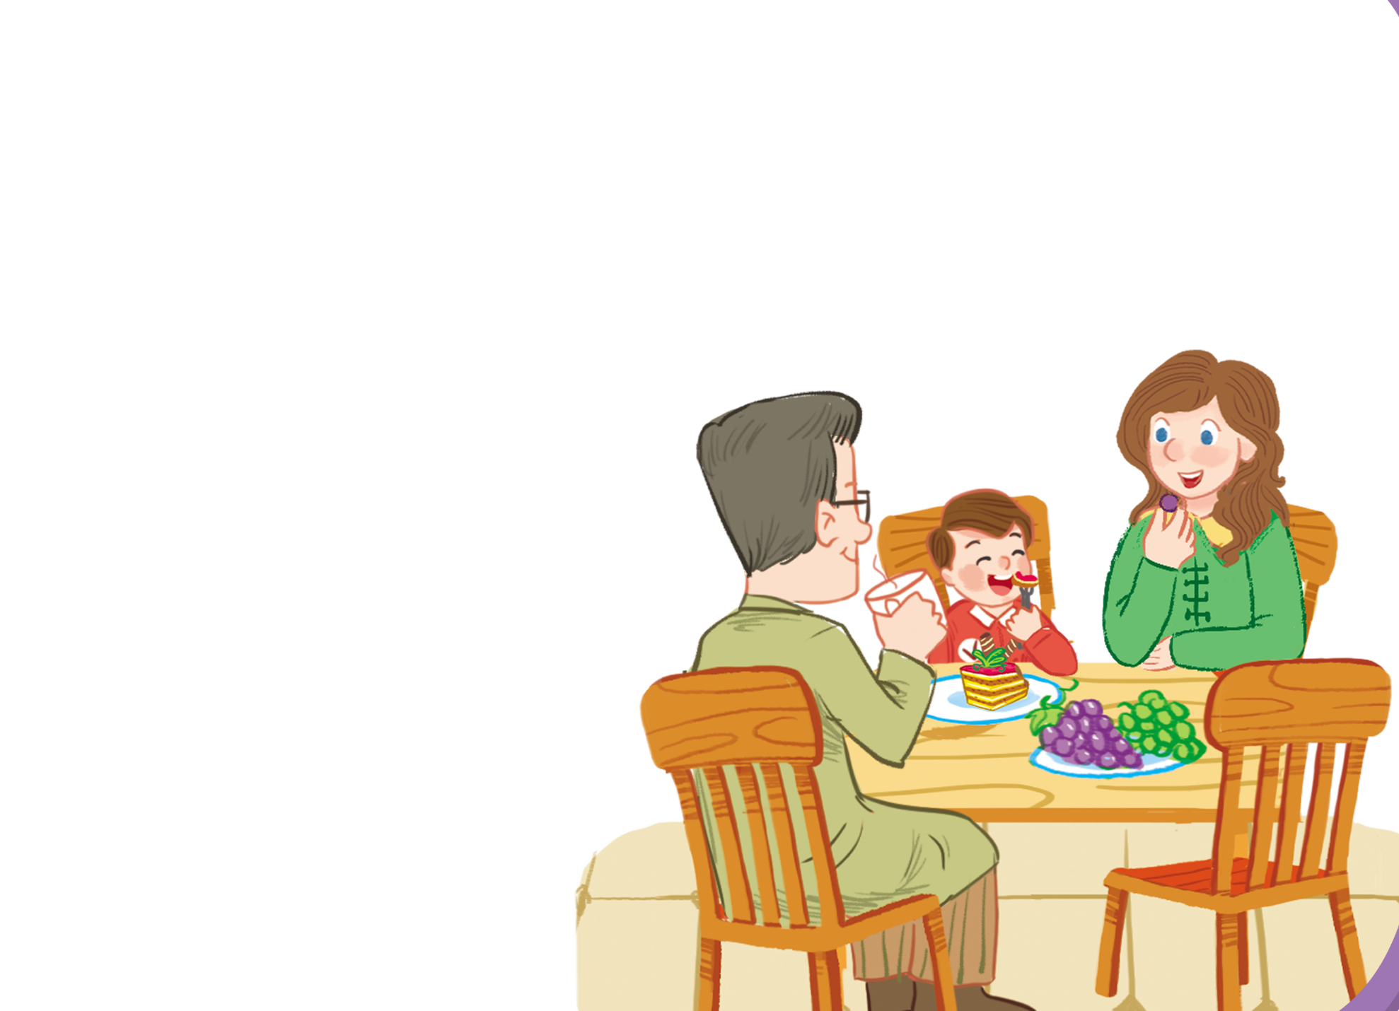
Listen and chant.
A, a, cake.
A, a, cake.
A, a, cake.
A, a, cake.
A, a, cake.
A, a, cake.
A, a, cake.
A, a, cake.
He’s having a cake.
He’s having a cake.
He’s having a cake.
He’s having a cake.
A, a, grapes.
A, a, grapes.
A, a, grapes.
A, a, grapes.
A, a, grapes.
A, a, grapes.
A, a, grapes.
A, a, grapes.
She’s having grapes.
She’s having grapes.
She’s having grapes.
She’s having grapes.

Slide 14
Structure
He’s having a cake
Tiếng Anh 2
Trung tâm ngoại ngữ Đăng Khoa

Slide 15
Structure
She’s having grapes
Tiếng Anh 2
Trung tâm ngoại ngữ Đăng Khoa

Slide 16
Game:
stand up or sit down
Tiếng Anh 2
Trung tâm ngoại ngữ Đăng Khoa

Slide 17
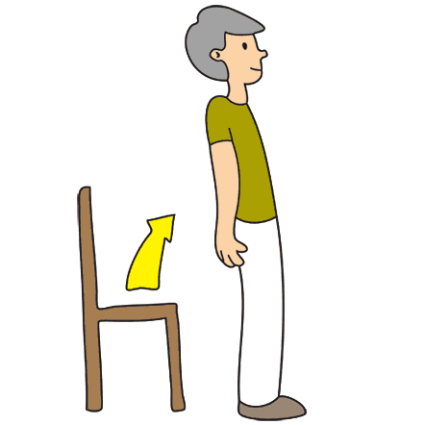
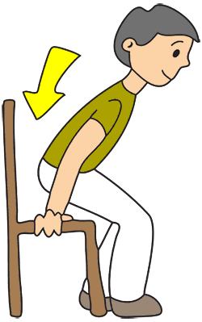
Game:
stand up or sit down
He’s having grapes
He’s having a cake
Tiếng Anh 2
Trung tâm ngoại ngữ Đăng Khoa

Slide 18
Game:
stand up or sit down
He’s having grapes
He’s having a cake
Tiếng Anh 2
Trung tâm ngoại ngữ Đăng Khoa

Slide 19
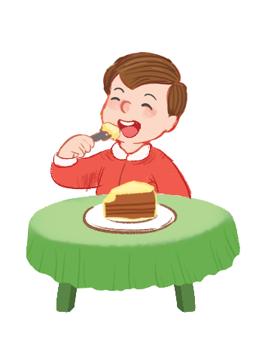
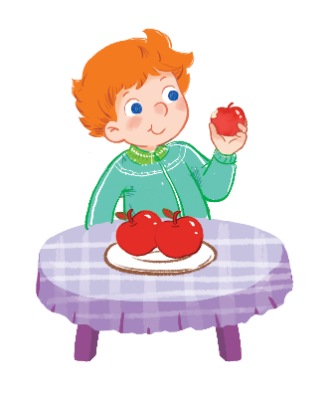
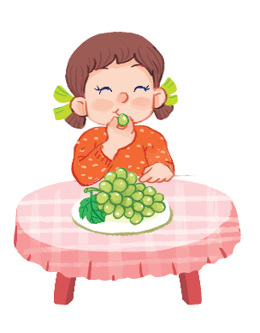
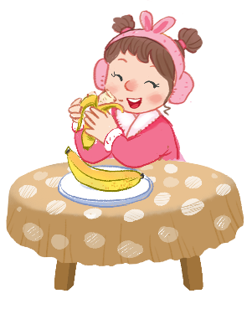
Listen and circle.
1
2

Slide 20
Let’s play
Tiếng Anh 2
Trung tâm ngoại ngữ Đăng Khoa

Slide 21
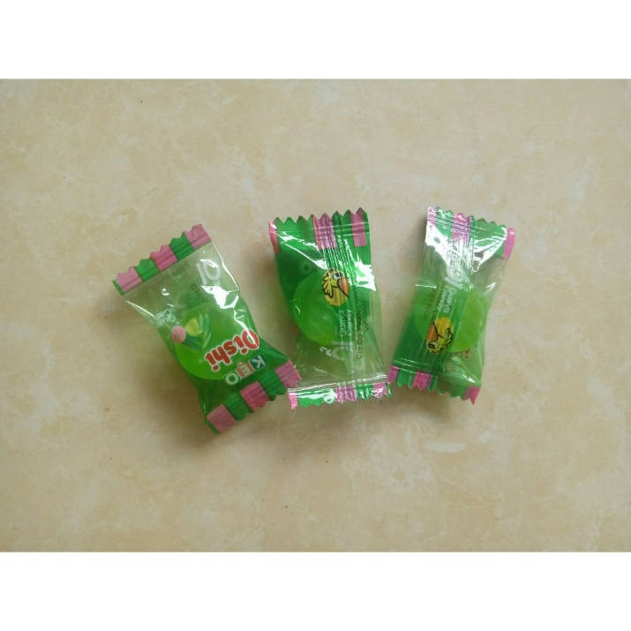
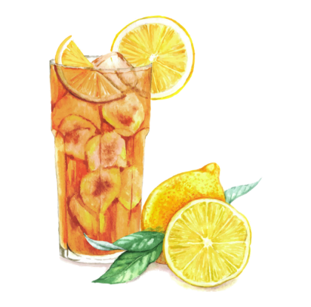
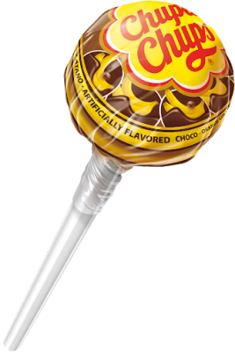
next activity

Slide 22
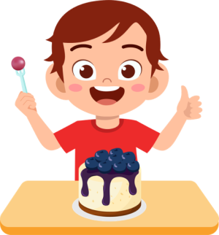
1. Look and choose
A. He’s having a pizza
B. He’s having a cake
C.She’s having a cake
D. She’s having a jam

Slide 23
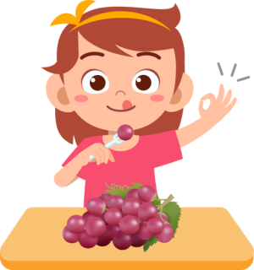
2. Look and choose
A. He’s having grapes
B. She’s having popcorn
C. She’s having grapes
D. He’s having fish

Slide 24
3. Look and choose
yogurt/ having/ He’s/./
A. having He’s yogurt.
B. He’s yogurt having.
C. yogurt having He’s.
D. He’s having yogurt.

Slide 25
4. Look and choose
a pizza/ having/ She’s/./
A. She’s a pizza having
B. She’s having a pizza
C. a pizza She’s having
D. a pizza having She’s

Slide 26
5. Listen and choose
A. He’s having a jelly
B. She’s having a cake
C. She’s having a jam.
D. He’s having a cake

Slide 27
6. Listen and choose
A. She’s having a pizza
B. She’s having grapes
C. He’s having a pizza
D. He’s having grapes

Slide 28
Look and write.
a
a
gr pes
c ke
t ble
a

Slide 29
Game:
Lip reading
Aa
Tiếng Anh 2
Trung tâm ngoại ngữ Đăng Khoa
Notes:
Bỏ hình, bổ sung rules

Slide 30
Unit 12 – Lesson 2
I/ Vocabulary
Aa
grapes
cake
table
II/ Structure
He’s/ She’s having a cake.
III/ Homework
luyện đọc từ mới và mẫu câu trong sách giáo khoa trang …
Làm bài tập trong sách bài tập trang…

Slide 31
Time to say goodbye!
a

