Slide 1
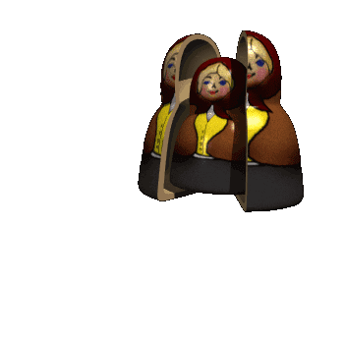
Welcome everybody!
Teacher: CHU THI THUY MINH
Phu Luu Primary School

Slide 2









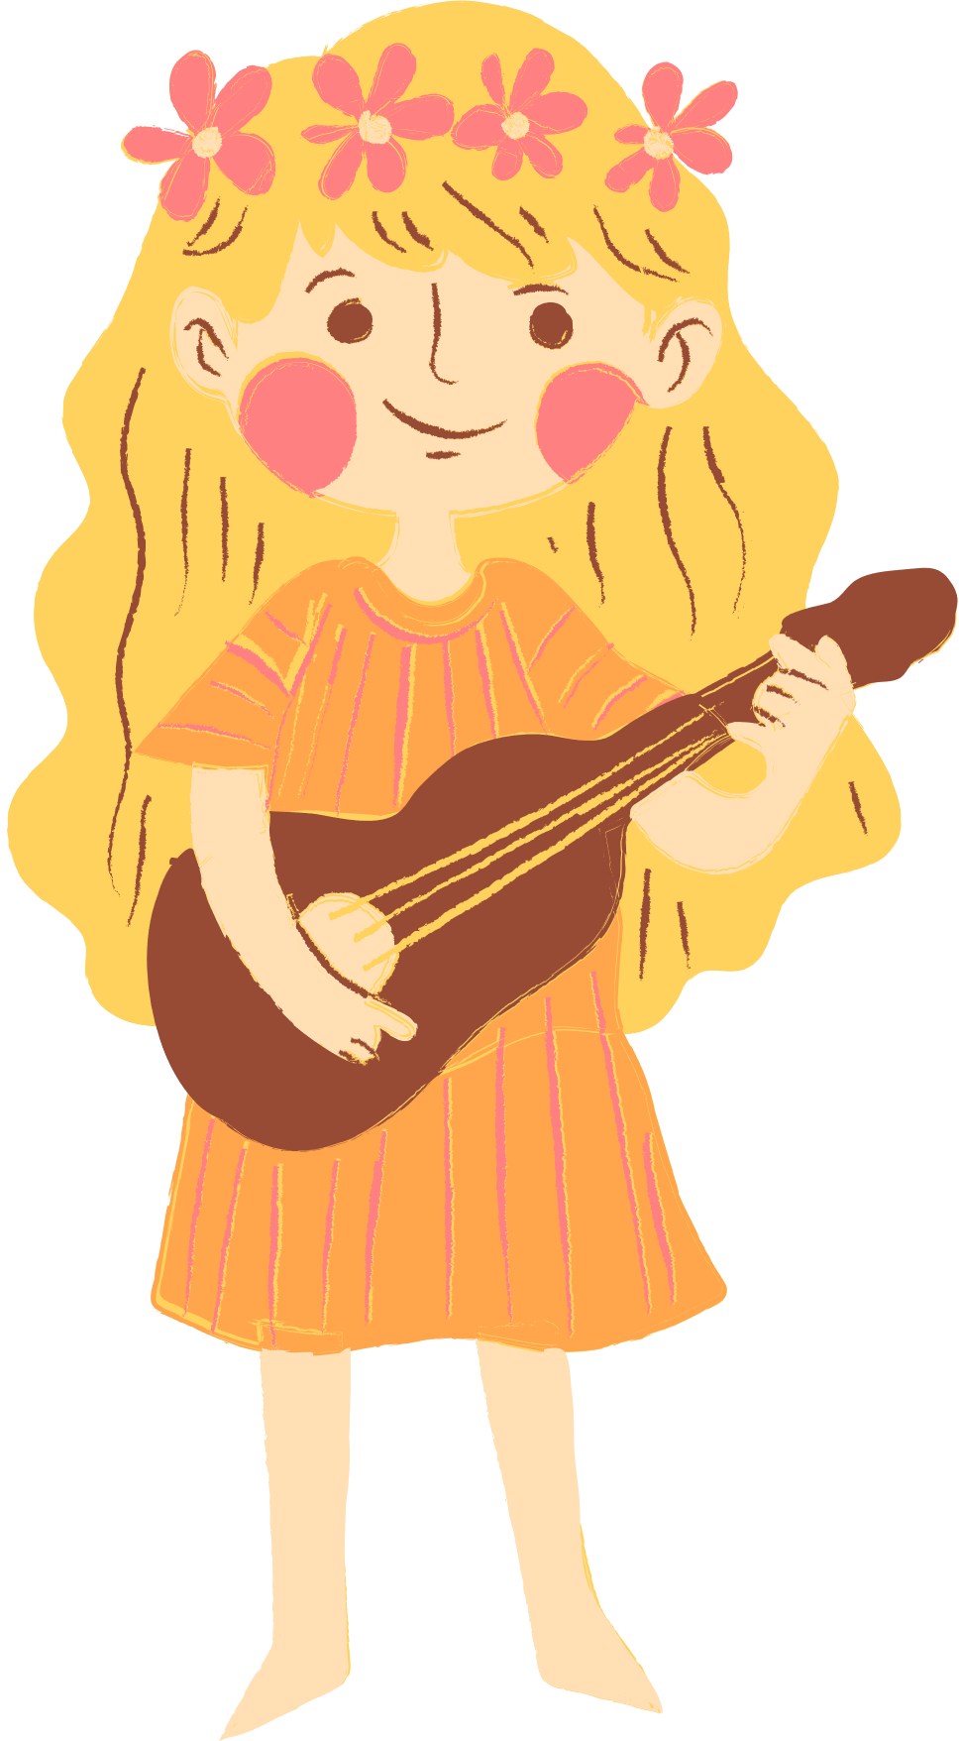
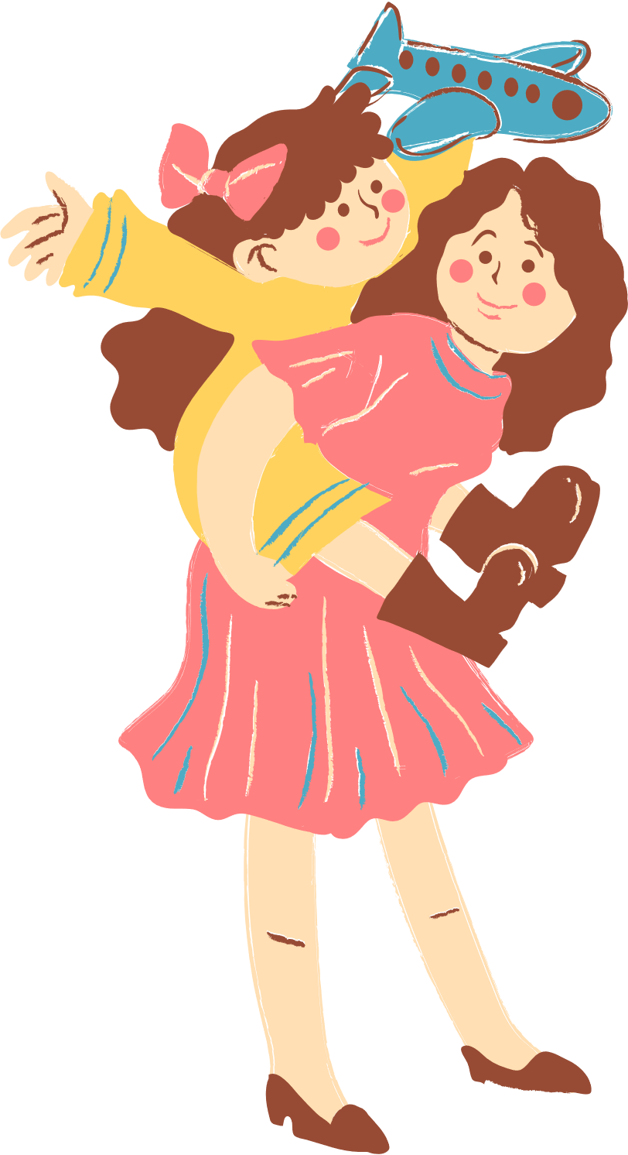
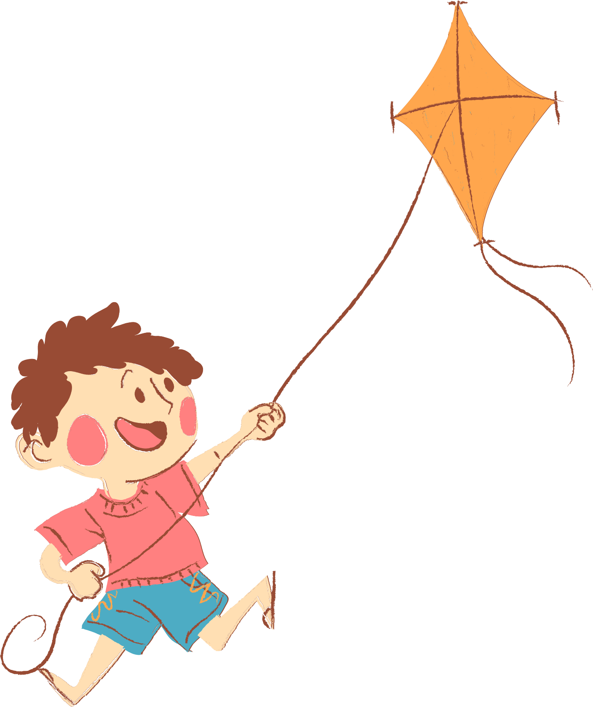
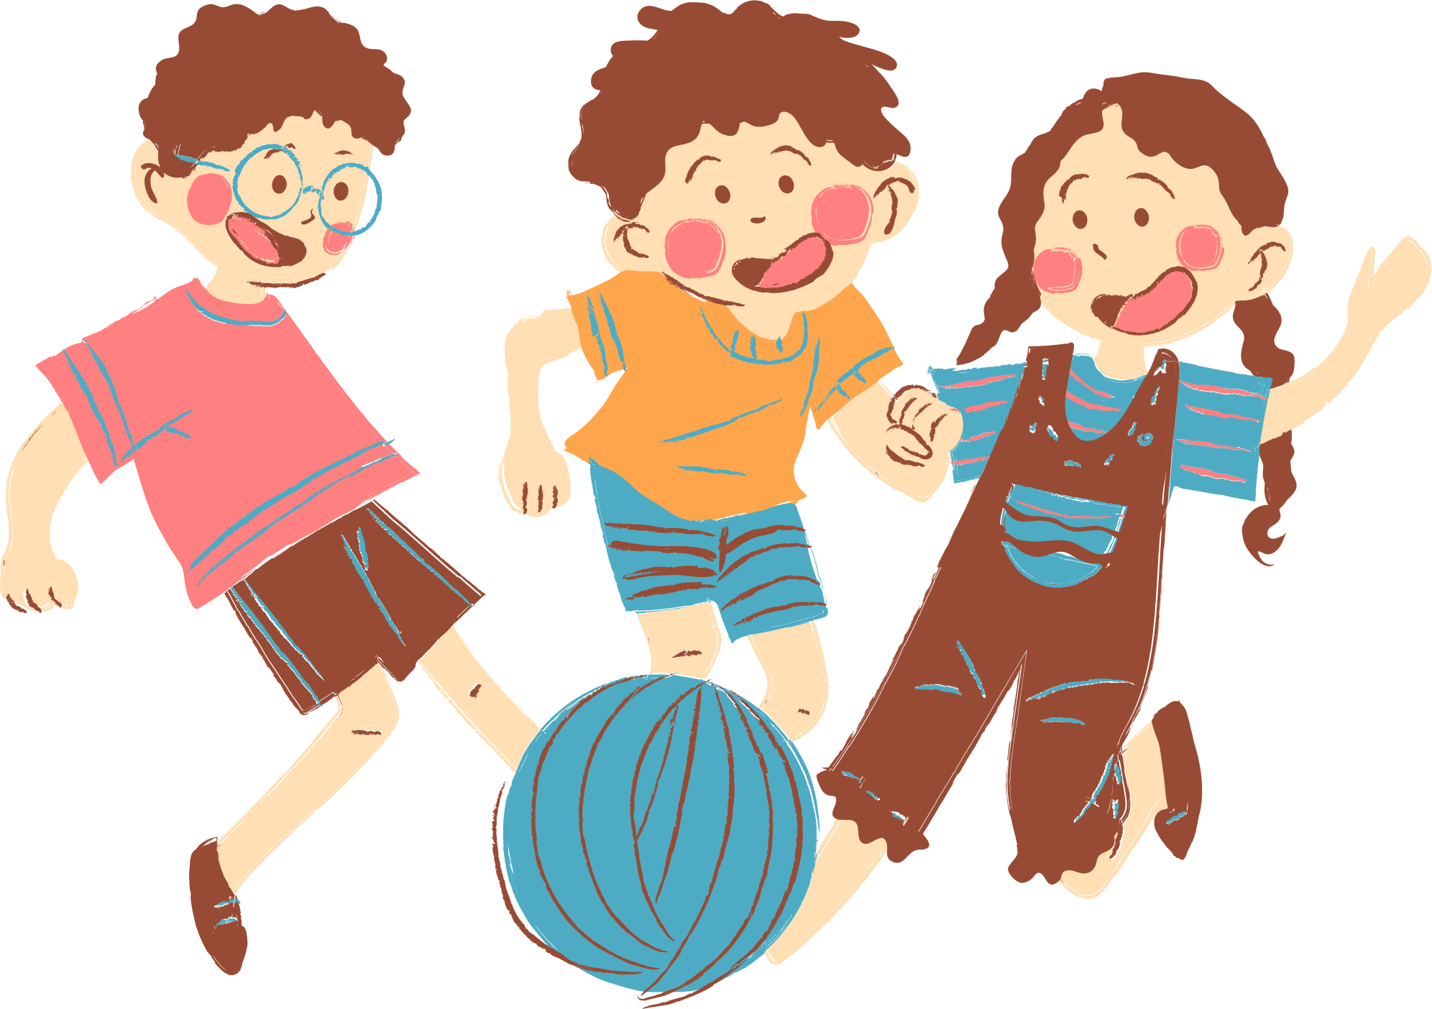
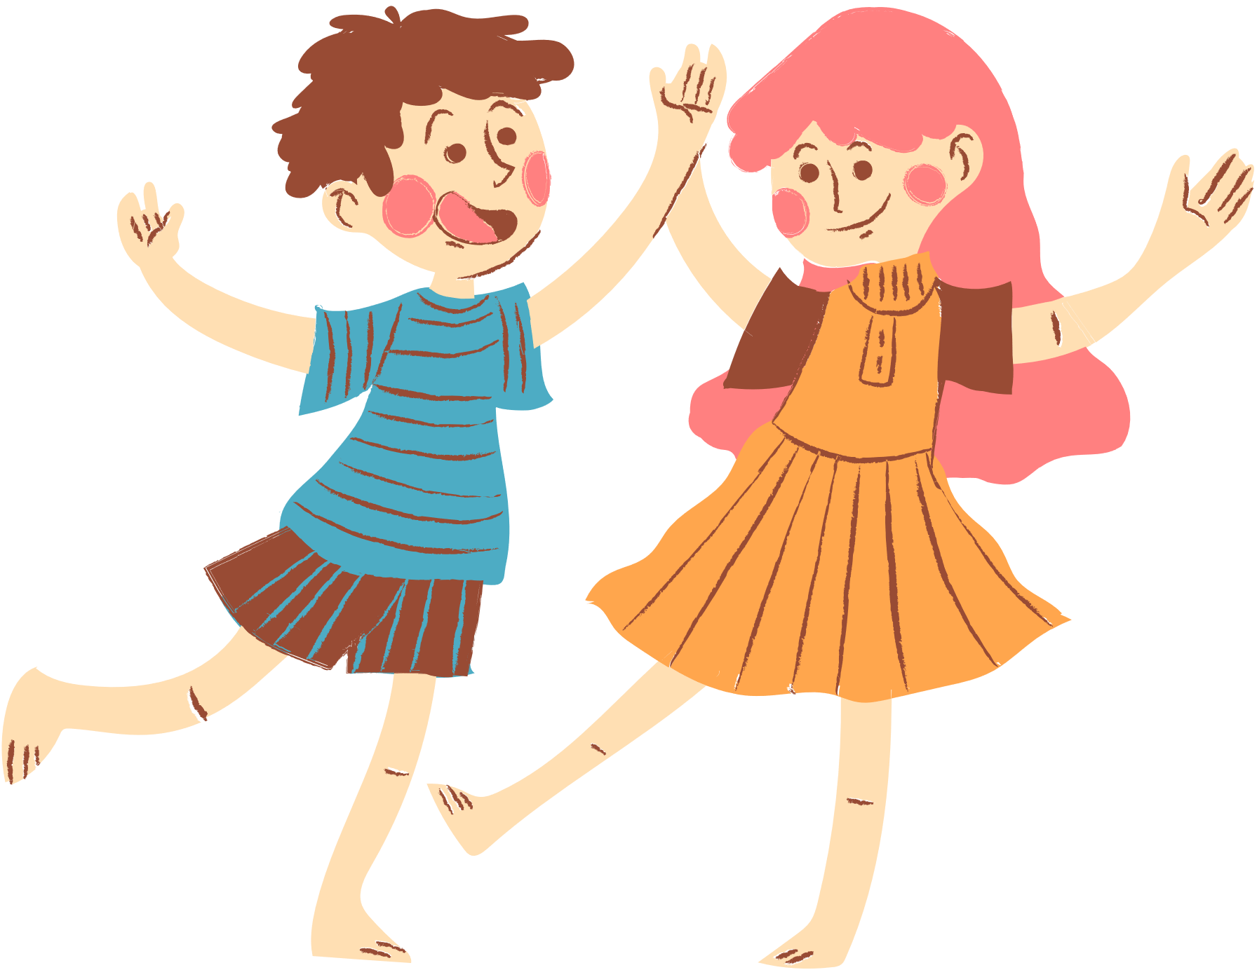
Warm-up & Review
Choose a number and say the activity.

Slide 3

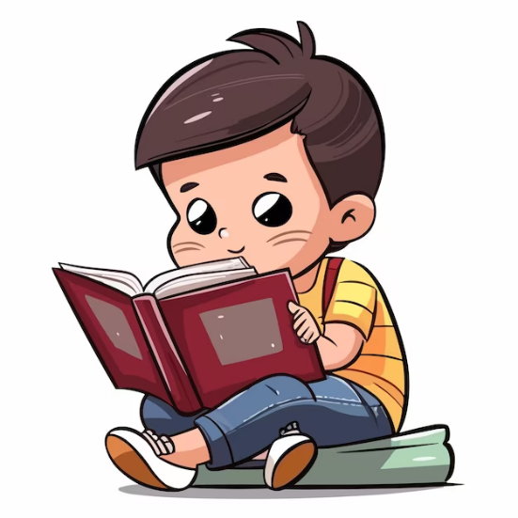
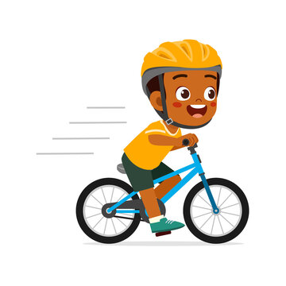
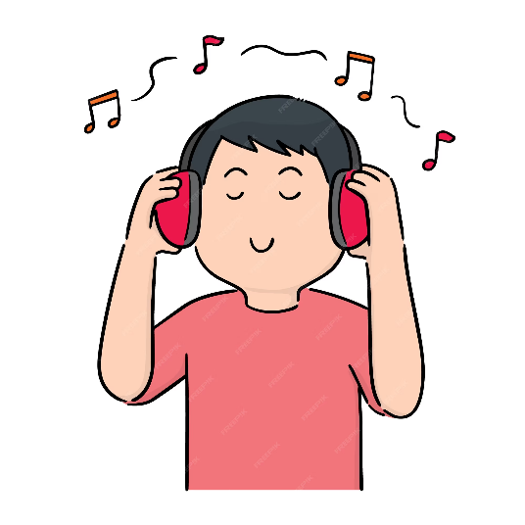
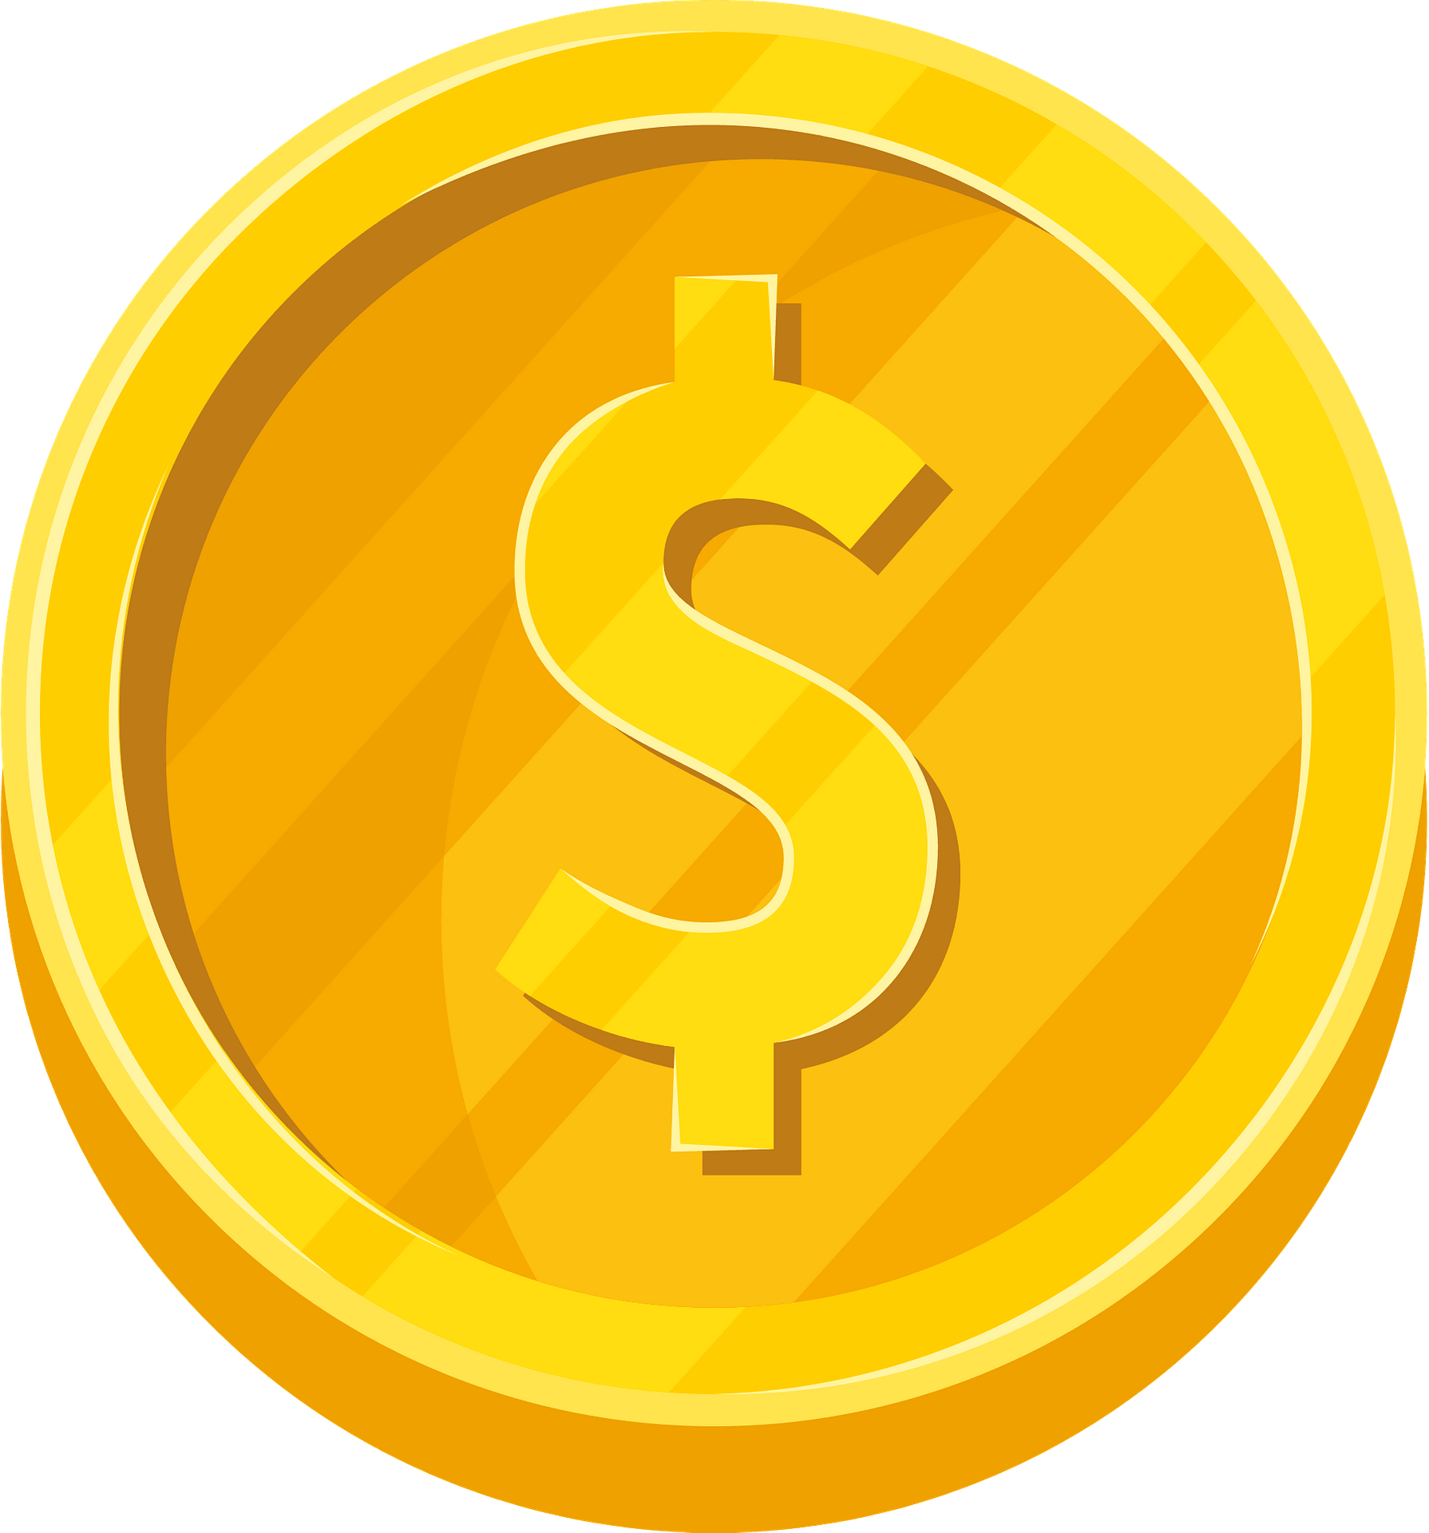

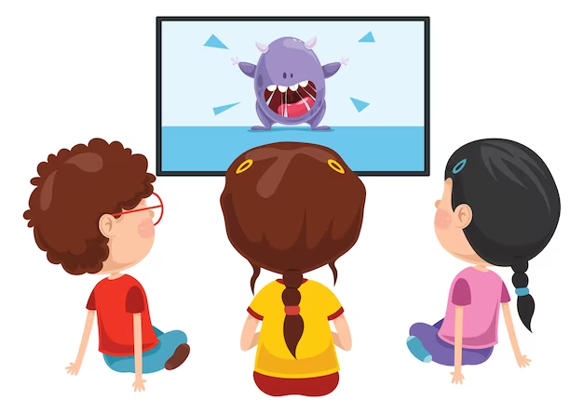

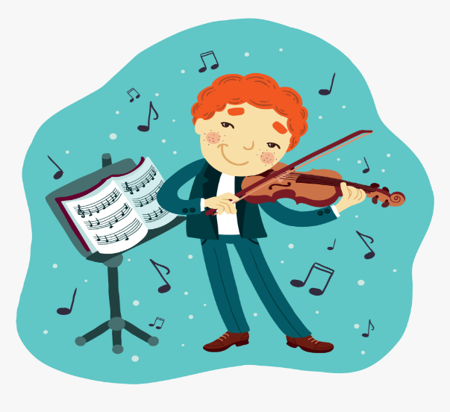
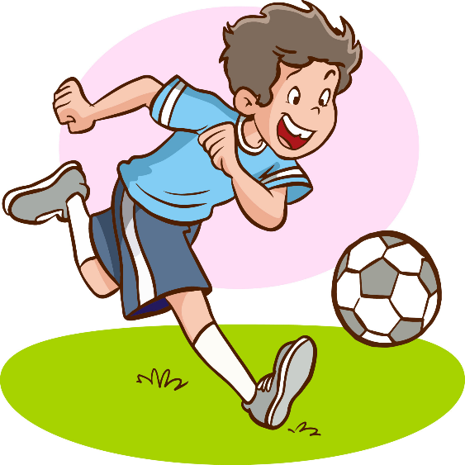
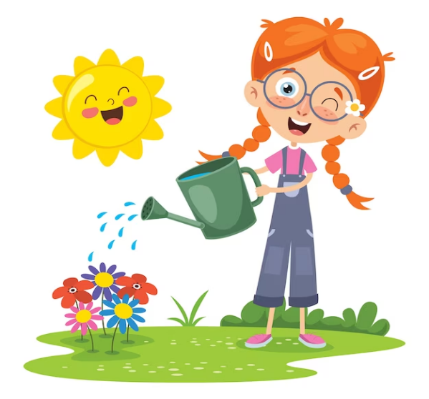
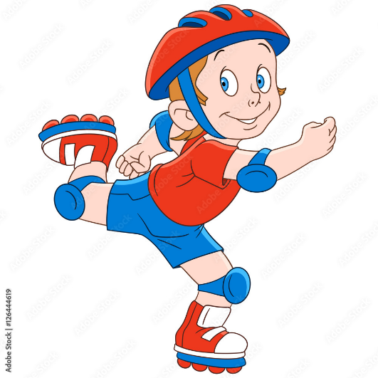
Game: Lucky number
1
2
3
= +1 point
4
5
6
= lose 2 points
= rock, paper, scissors
(winner takes 2)
7
8
9
Notes:
- Divide the class into 3 teams.
- Pupils from each team choose a number (or throw sticky ball on the grid to choose the number), then have 2 pupils from each team ask and answer with the picture in that number.
- Pupils or teacher clicks on the month to reveal the icons indicating the points for that team.
- After 9 numbers, the team with the most points is the winner.

Slide 4

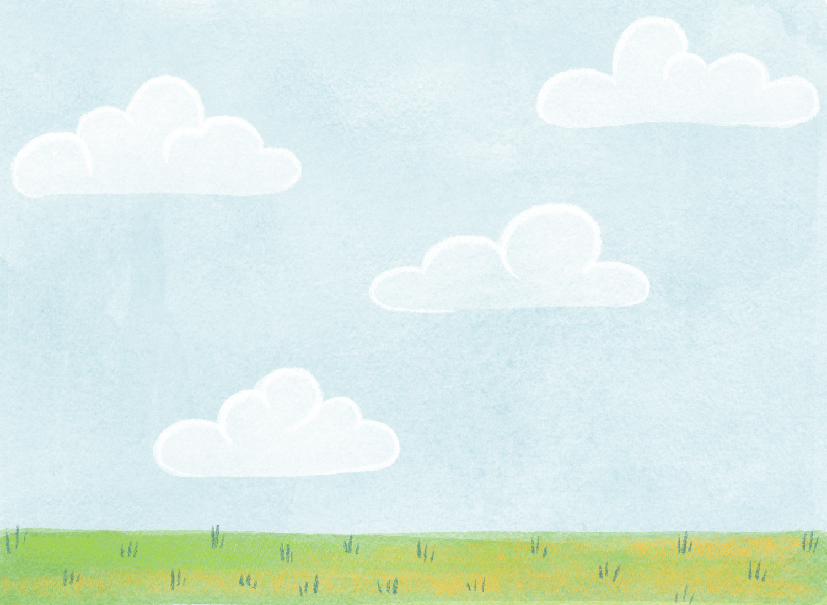


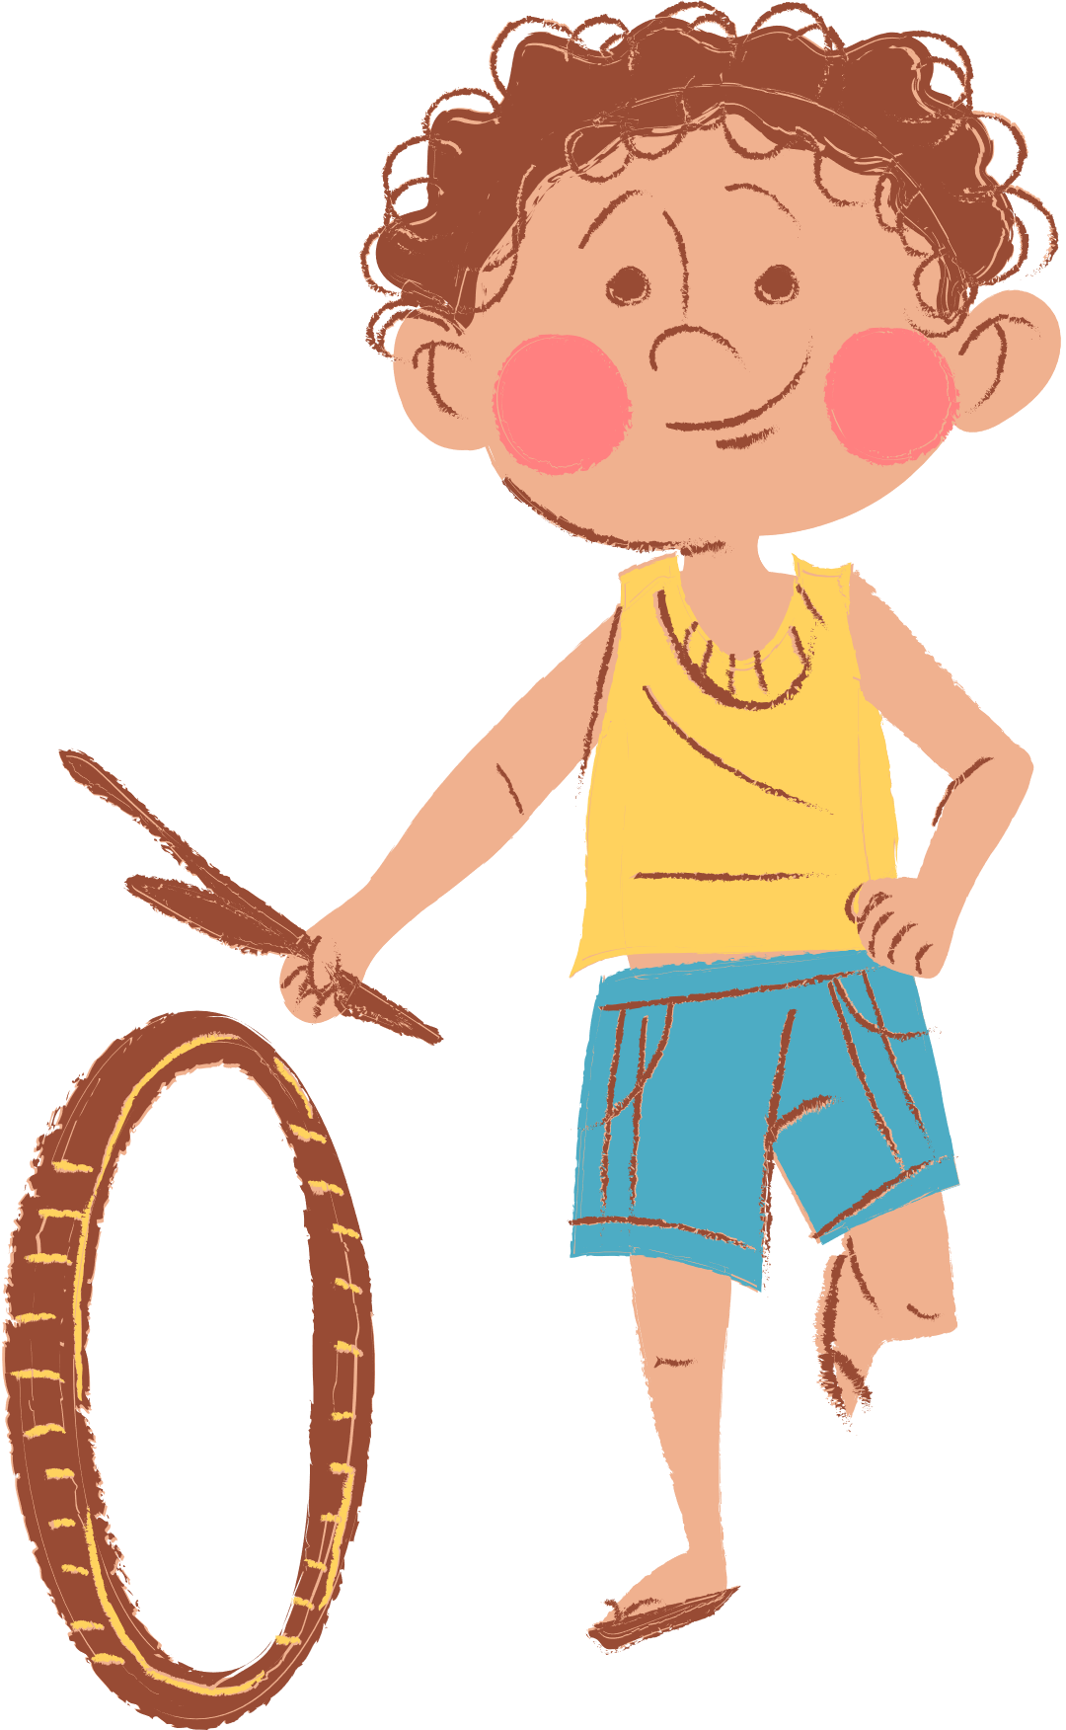
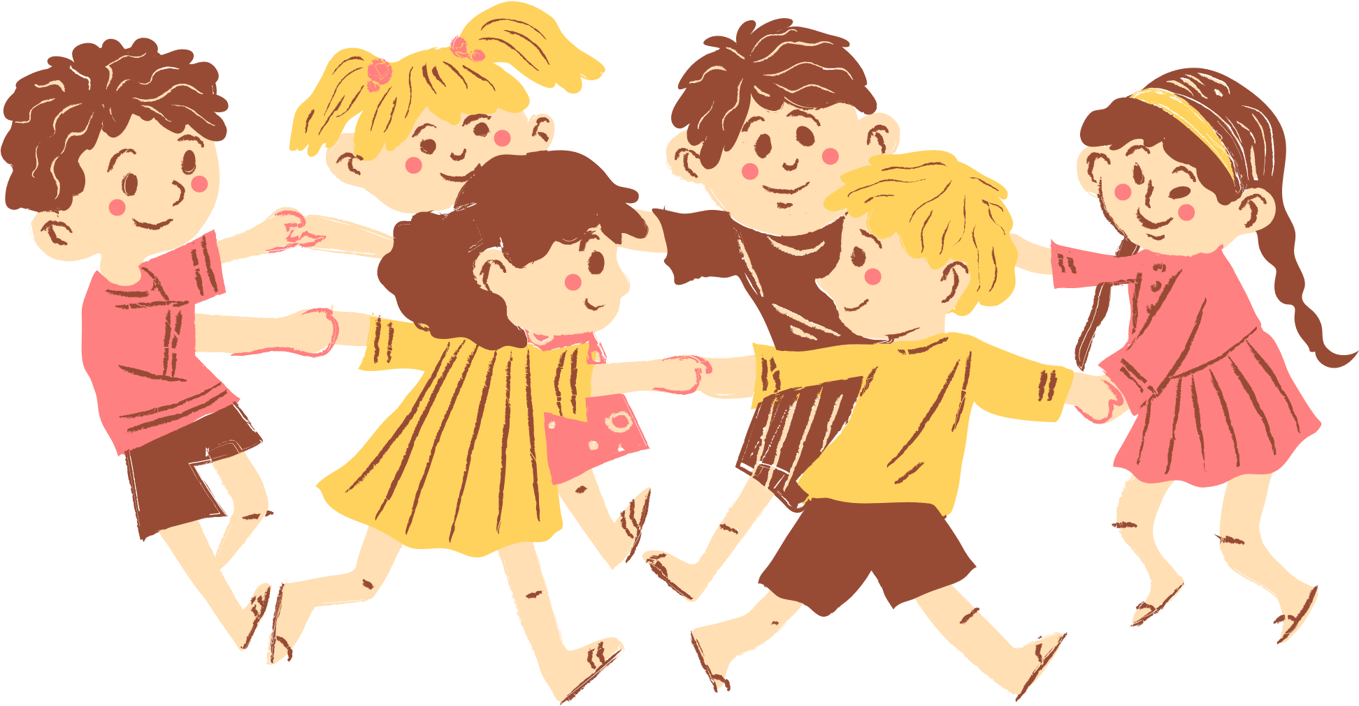
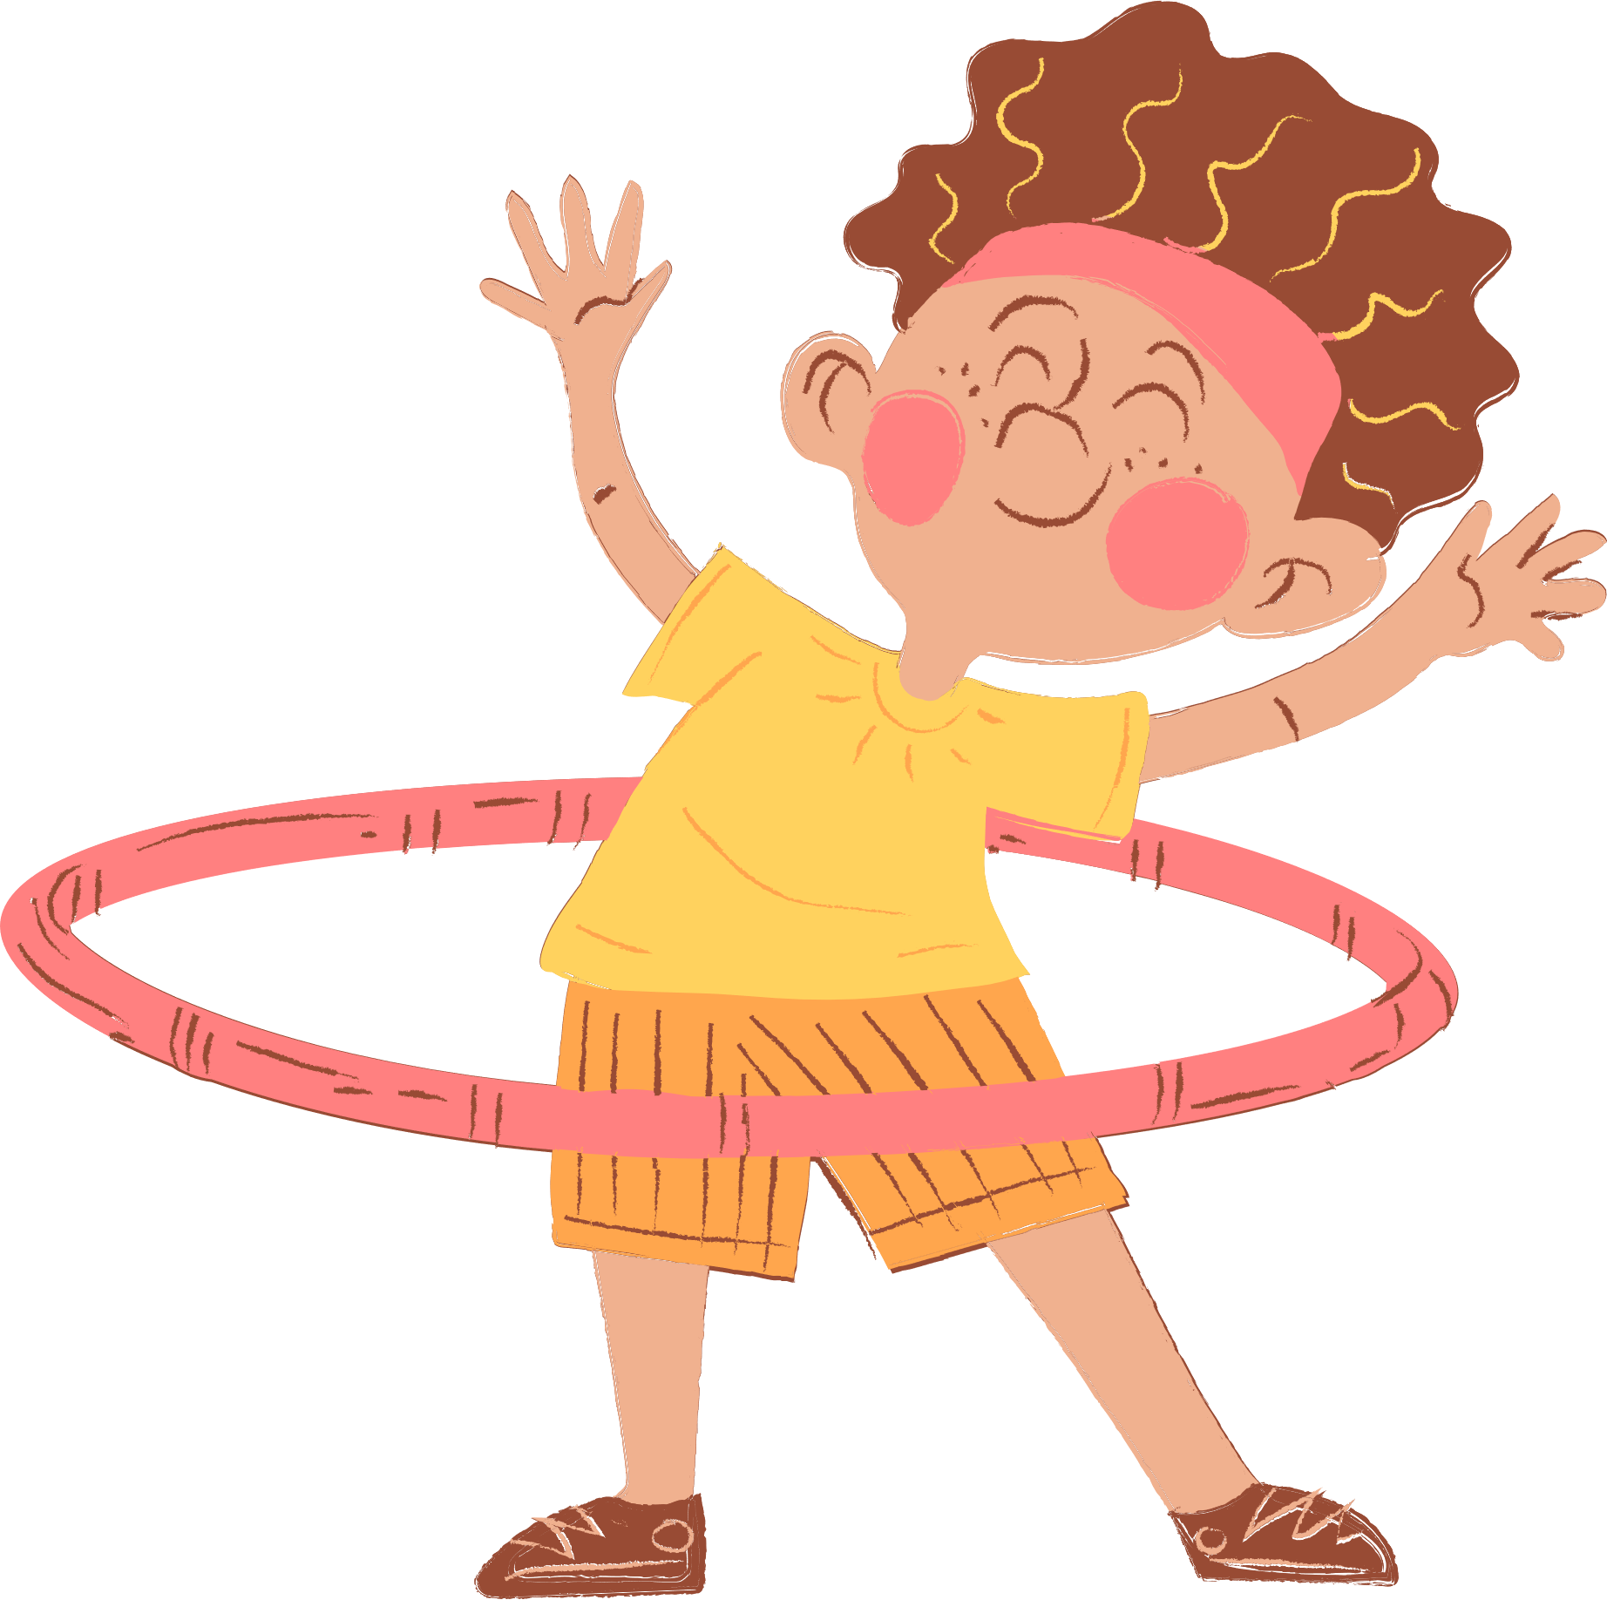
4
Our Free-time Activities -Lesson 2

Slide 5
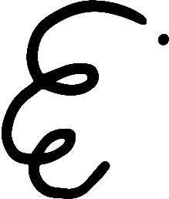


Adverbs of Frequency
always
✓✓✓✓
usually
✓✓✓
often
✓✓
sometimes
✓
never
✗

Slide 6




What do you do at the weekend?
Mon. | Tue. | Wed. | Thu. | Fri. | Sat. | Sun.
always
I always read stories.

Slide 7
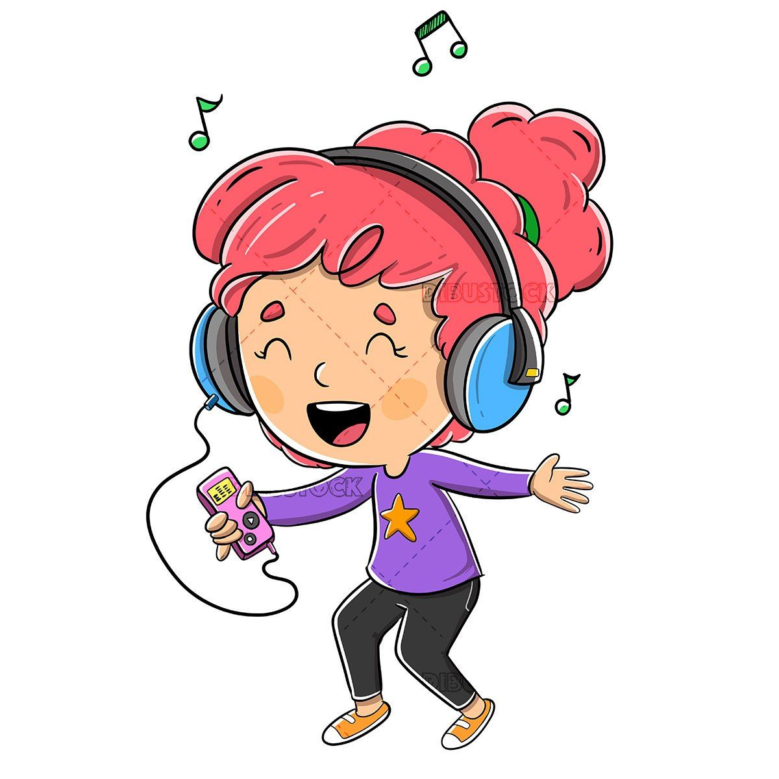
What do you do at the weekend?
Mon. | Tue. | Wed. | Thu. | Fri. | Sat. | Sun.
usually
I usually listen to music.

Slide 8
What do you do at the weekend?
Mon. | Tue. | Wed. | Thu. | Fri. | Sat. | Sun.
never
I never ride my bike.

Slide 9
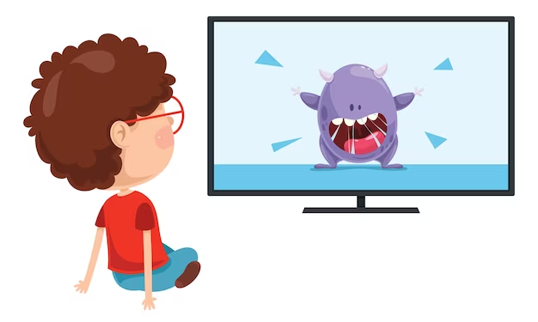
What do you do at the weekend?
Mon. | Tue. | Wed. | Thu. | Fri. | Sat. | Sun.
often
I often watch cartoons.

Slide 10
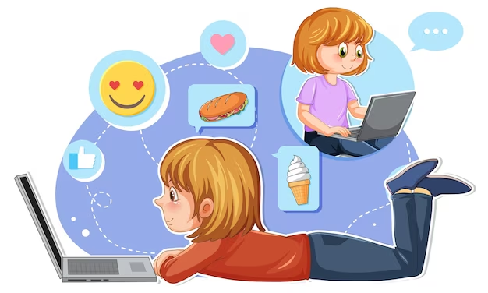
What do you do at the weekend?
Mon. | Tue. | Wed. | Thu. | Fri. | Sat. | Sun.
sometimes
I sometimes surf the Internet.

Slide 11
04.
Listen and tick.

Slide 12
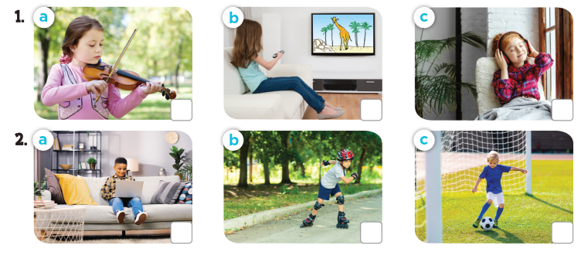
What do they do at the weekend?
Notes:
Press the spacebar or down arrow to reveal the answer.
Press the X to go back to the letter slide (wrong answer), press the question box to go the reward slide (correct answer).

Slide 13
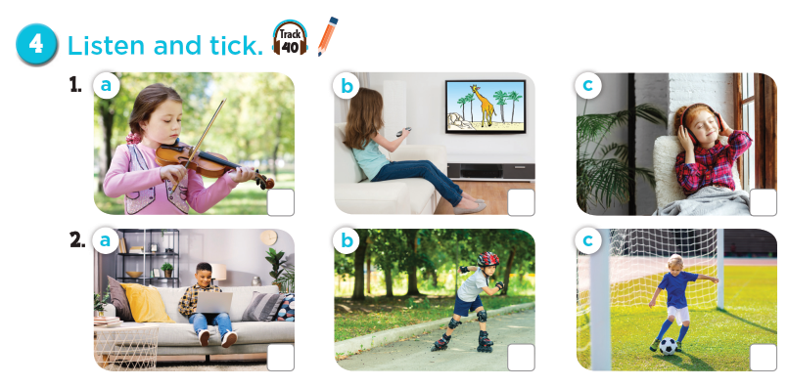

Notes:
Press the spacebar or down arrow to reveal the answer.
Press the X to go back to the letter slide (wrong answer), press the question box to go the reward slide (correct answer).

Slide 14
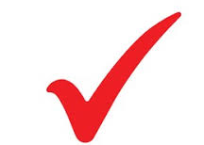
Let's check!
Notes:
Press the spacebar or down arrow to reveal the answer.
Press the X to go back to the letter slide (wrong answer), press the question box to go the reward slide (correct answer).

Slide 15
05.
Read and complete.

Slide 16
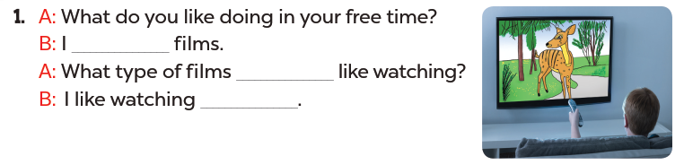
Read. What's the missing word?
like watching
do you
cartoons

Slide 17
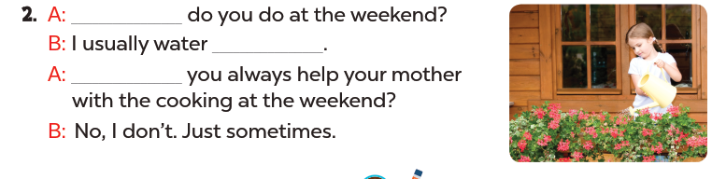
Read. What's the missing word?
What
the flowers
Do

Slide 18
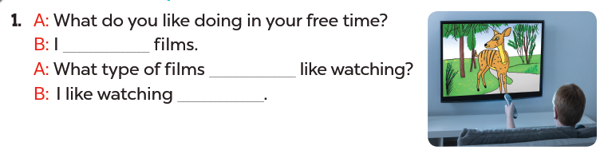
Read aloud.
like watching
do you
cartoons

Slide 19
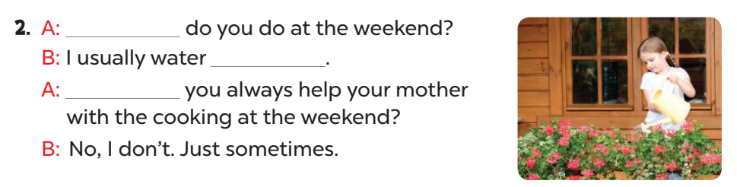
Act it out.
What
the flowers
Do

Slide 20
06.
Let's sing!

Slide 21
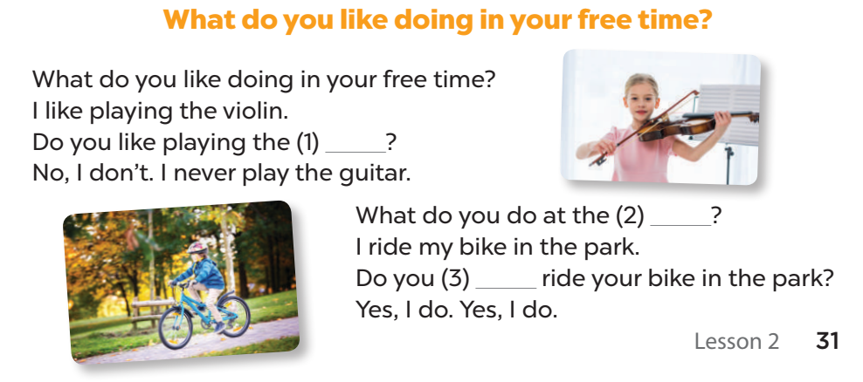
Listen and complete.
guitar
weekend
always

Slide 22
Let's sing.
guitar
weekend
always

Slide 23
.
Fun time!

Slide 24

1
2
3
THE
FOOTBALL GAME
4
5
6
7
8
9

Slide 25
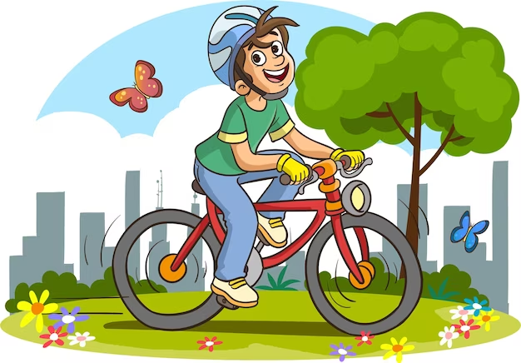
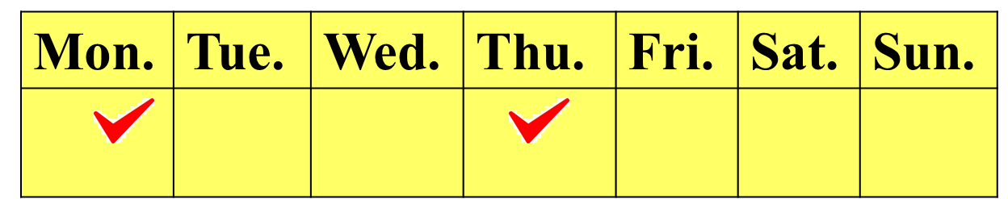
What do you do at the weekend?
I sometimes ride a bike.

Slide 26
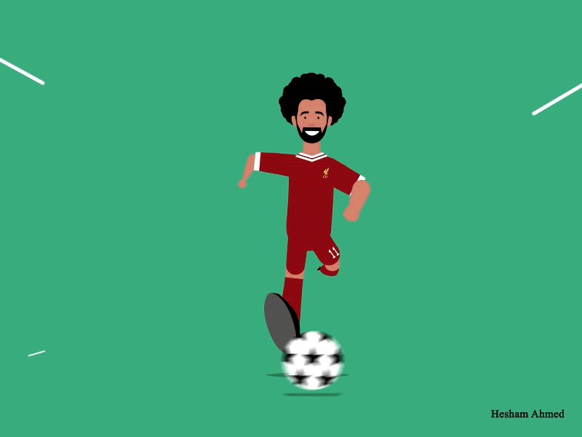
+ 3 points

Slide 27
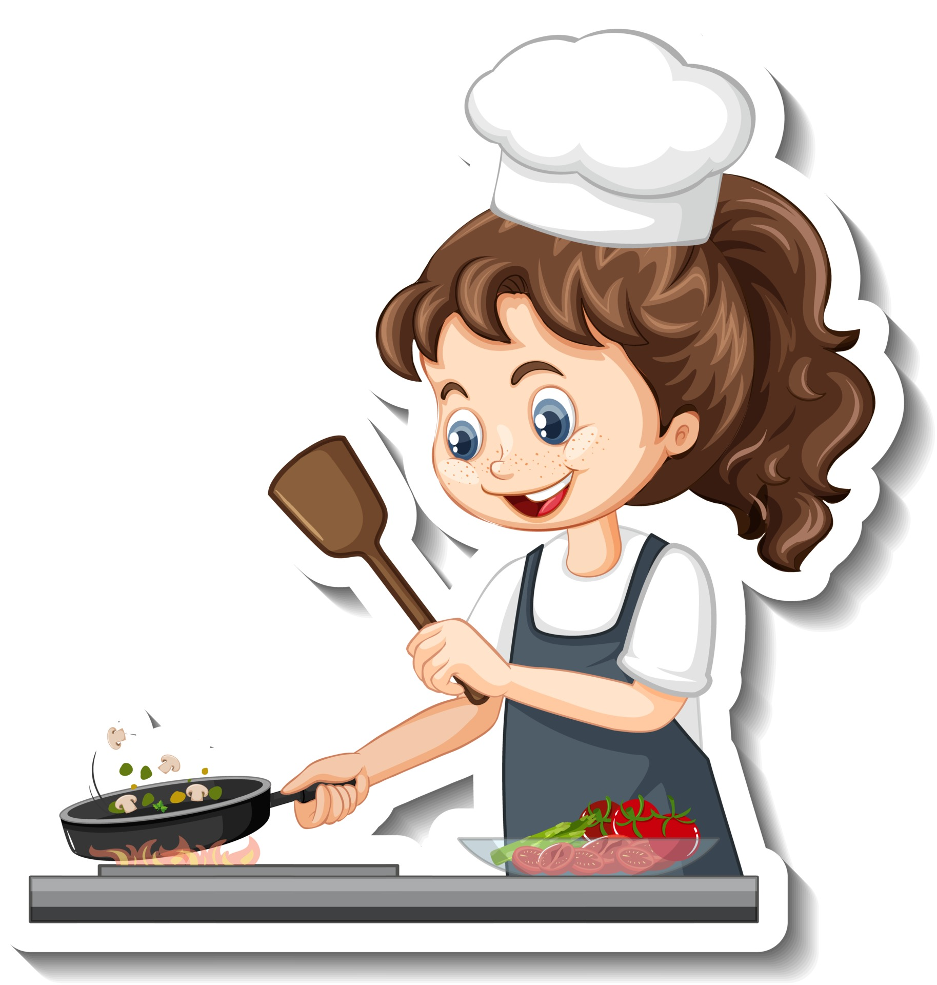
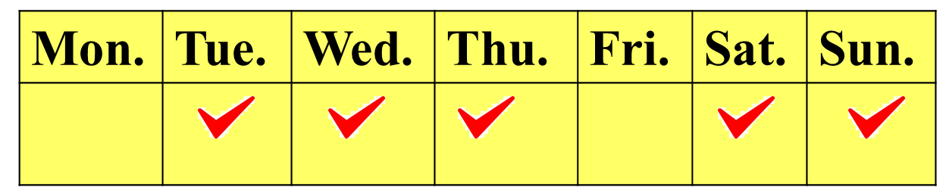
Do you always cook at the weekend?
No, I don't.

Slide 28
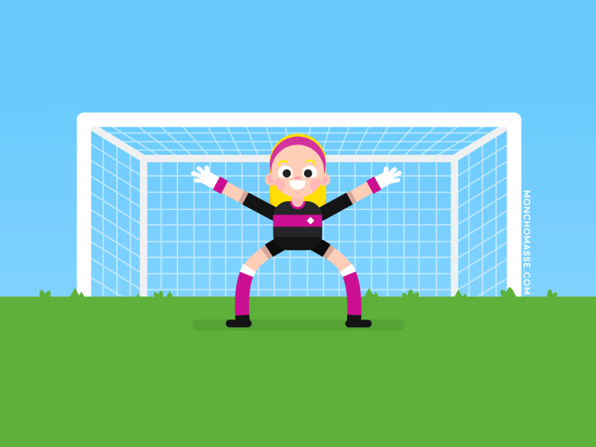
+ 5 points

Slide 29
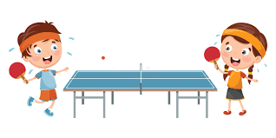
What do you like doing in your free time?
I like playing table tennis.

Slide 30
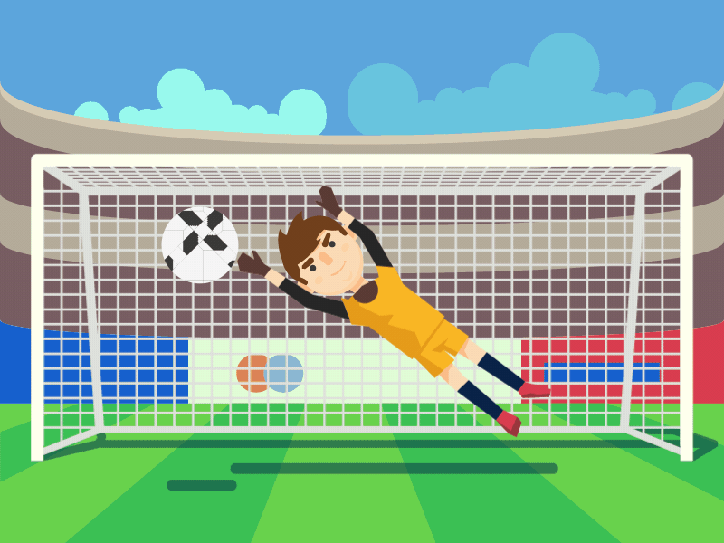
+ 2 points

Slide 31
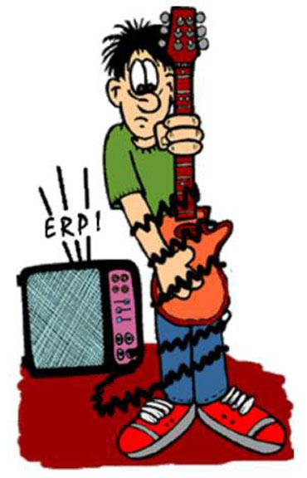
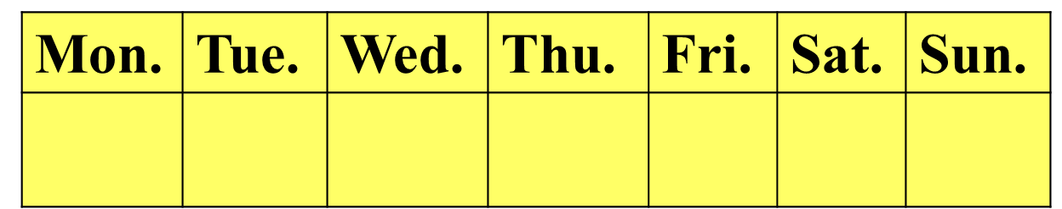
Do you like playing the guitar?
No, I don't.
I never play the guitar.

Slide 32
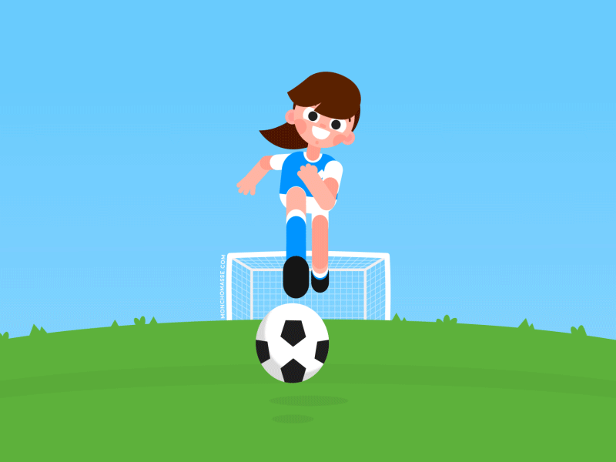
Take 2 points from another team

Slide 33

What
______ do you do at the weekend?
A. Who
B. When
C. What
I water the flower.

Slide 34
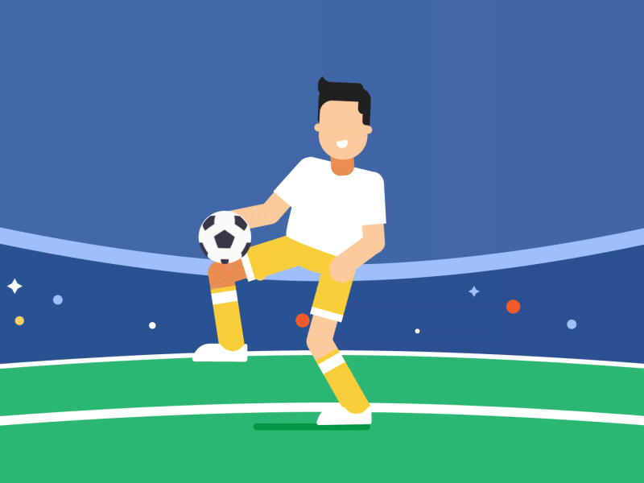
Change points with another team

Slide 35
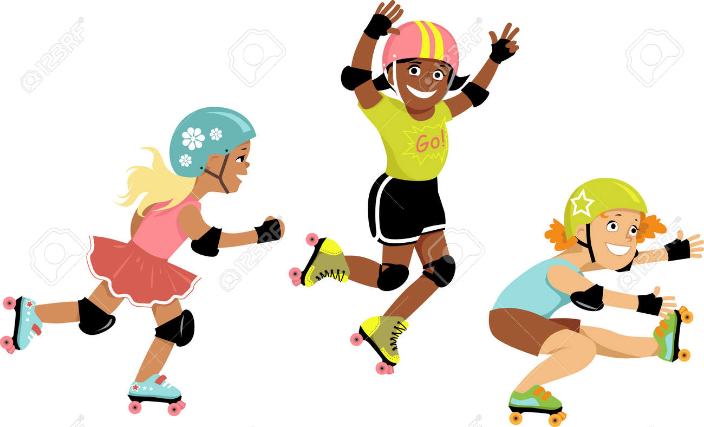
______ always roller skate
at the weekend?
Do you
Yes, I do.
I sometimes roller skate.

Slide 36
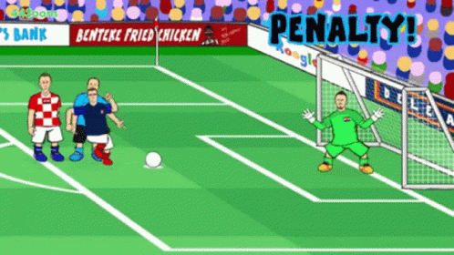
Oh no!
-3 points

Slide 37
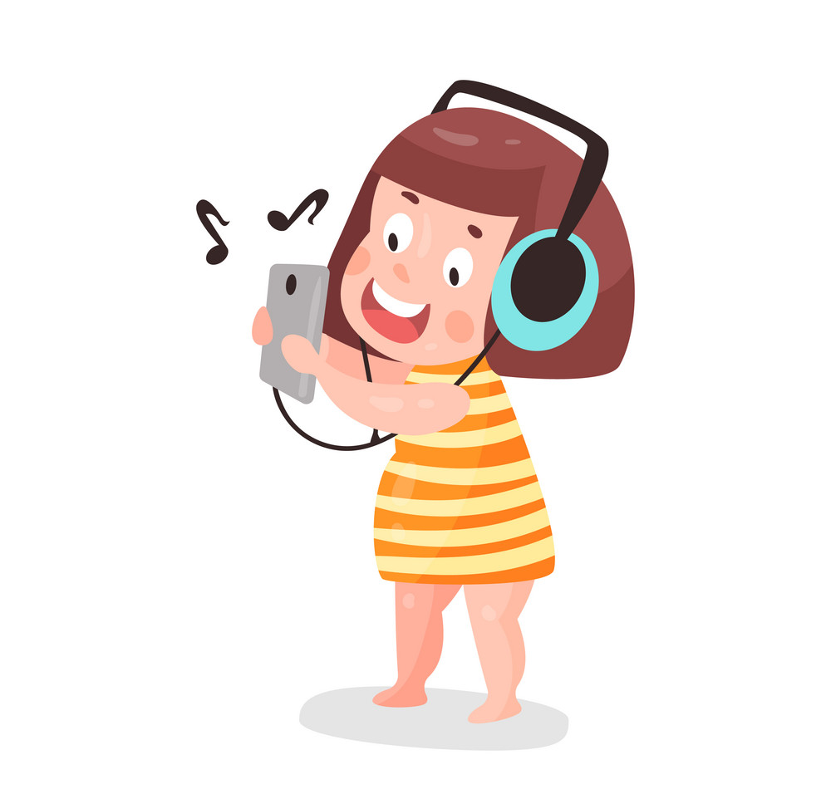
What are you doing?
I'm listening to music.

Slide 38
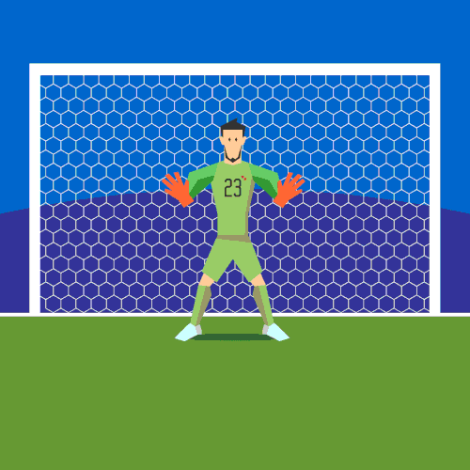
+ 4 points

Slide 39
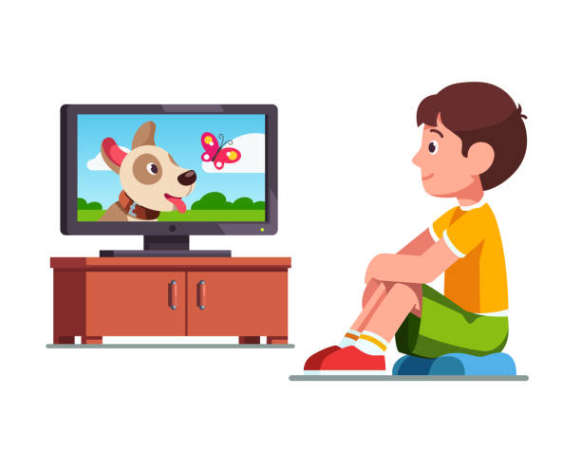
Do you like _____________ at the weekend?
watching cartoons
Yes, I do.

Slide 40
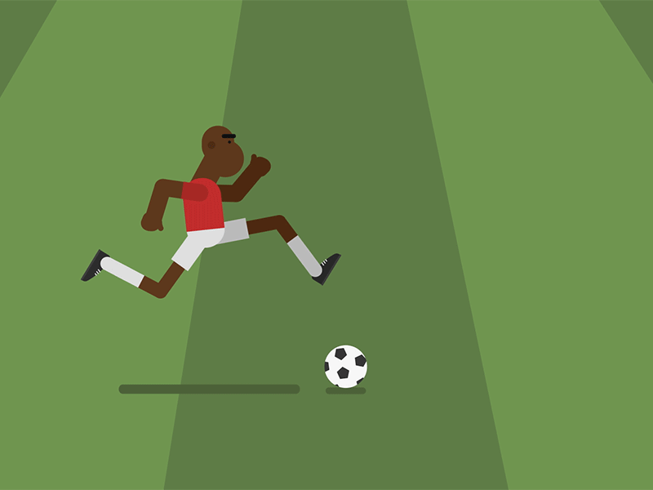
Too slow!
-2 points

Slide 41
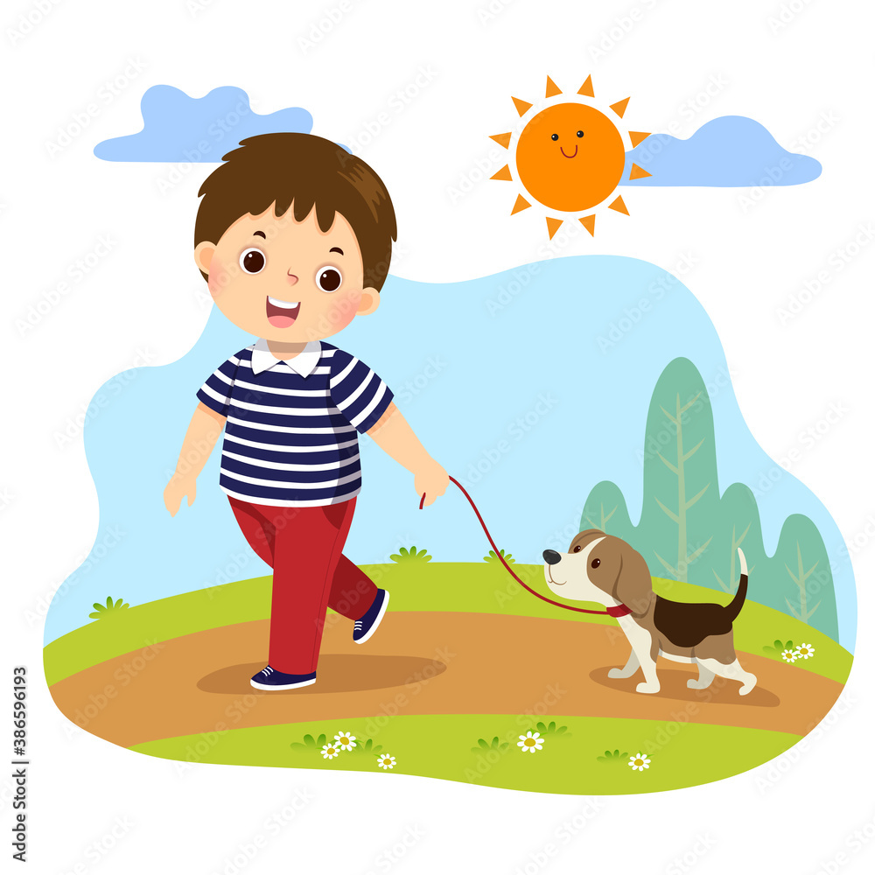
What do you do at the weekend?
I _______ go for a walk.
usually

Slide 42

Oops!
-3 points

Slide 43






Slide 44

Thank you for your attention!

