Slide 1
Vien Noi Secondary School
WELCOME THE teachers TO THE CLASS 8a !
Teacher: Ho Thi Huong

Slide 2
-WARM - UP
Peer pressure
The pressure of teenagers

Slide 3
START TIMER
TIME’S UP!
TIME LIMIT:
2 minutes
-WARM - UP
Peer pressure
120
110
10
The pressure of teenagers
100
20
90
30
80
40
70
50
60

Slide 4
Unit
3
TEENAGERS ( CONT)
PERIOD 20: SKILLS 1

Slide 5
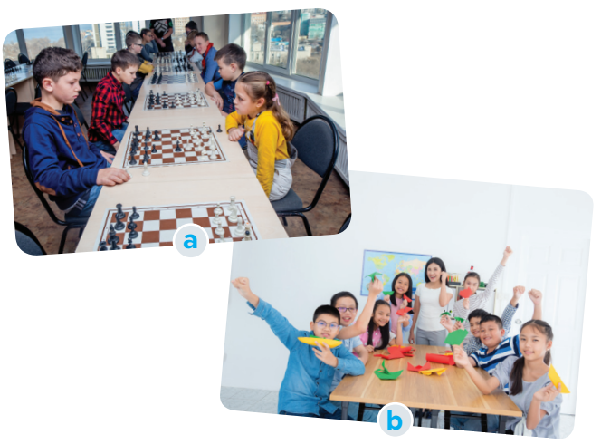
READING
1
Work in pairs:
a. Look at the picture and say what club it is.
Chess club
Arts and crafts club
b. Which of your school clubs do you want to join?

Slide 6
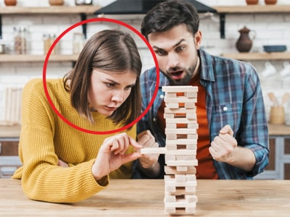
READING
concentrate (v)
/ˈkɒnsntreɪt/
tập trung

Slide 7
READING
focused (adj)
/ˈfəʊkəst/
chuyên tâm, tập trung

Slide 8
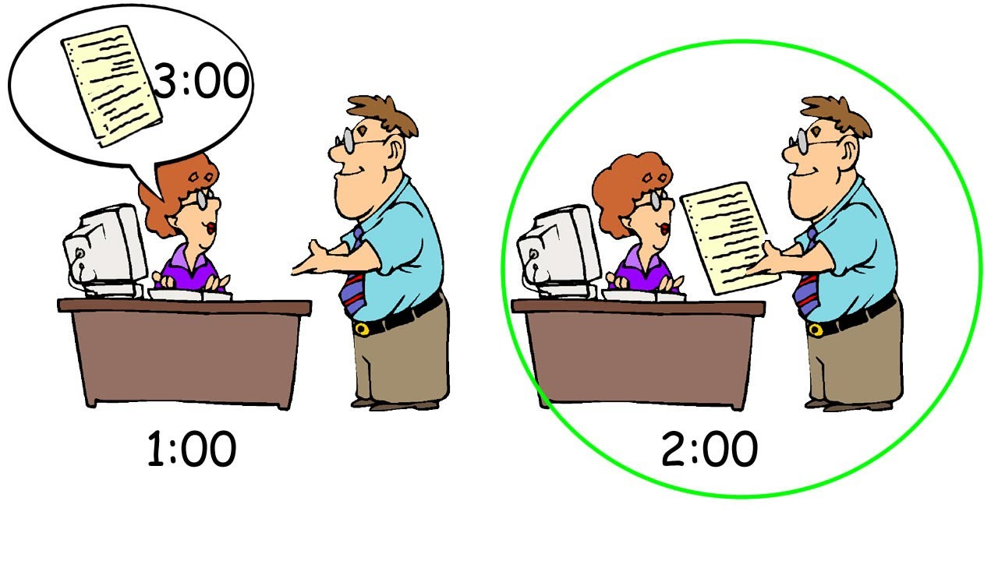
READING
beforehand (adv)
/bɪˈfɔːhænd/
trước

Slide 9
READING
practical (adj)
/ˈpræktɪkl/
thực tế, thực tiễn

Slide 10
PRESENTATION
VOCABULARY
1. concentrate (v) | /ˈkɒnsntreɪt/ | tập trung
2. focused (adj) | /krɑːft/ | chuyên tâm, tập trung
4. beforehand (adv) | /bɪˈfɔːhænd/ | trước
5. practical (adj) | /ˈpræktɪkl/ | thực tế, thực tiễn

Slide 11
READING
2
Read the conversation and tick T (true) or F (false) for each sentence.
Sentences | T | F
1. The school has badminton, chess, and arts and crafts clubs.
2. The badminton club activities are after school.
3. Tom stayed playing chess when he was five.
4. Members of the arts and crafts club do community activities.
five years ago

Slide 12
READING
3
Read the conversation again and choose the correct answer A, B, or C
1. Tom and Mai are discussing _________.
A. their leisure time activities
B. their school club activities
C. their likes and dislikes
2. Tom started playing chess because ________.
A. he loved it
B. he wanted to stay focused
C. his mum wanted him to play

Slide 13
READING
3. Playing chess helps Tom________.
A. connect with other members
B. concentrate better
C. do community service
4. The word “it” refers________.
A. chess club B. arts and crafts club C. community service
5. Mai will participate in the arts and crafts club to ________.
A. help the school B. coach her friends C. do art projects

Slide 14
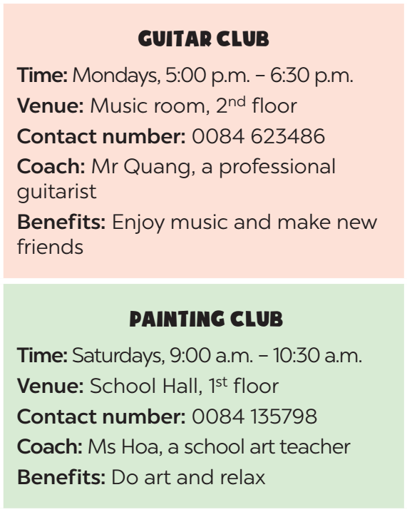
SPEAKING
4
Work in pairs. Make conversations using the given information.
Suggested questions:
- What time does the club meet?
- Where does it meet?
- How can I contact the club? / What is the contact number of the club?
- Who will coach the club?
- What are the benefits you get when you join the club? / Why do you want to join this club?
Example:
A: What time does the guitar club meet?
B: It meets on Mondays, from 5:00 p.m. to 6:30 p.m.
A: Where does it meet?
B: It meets in the music room, on the second floor.

Slide 15
SPEAKING
5
Work in groups. Ask and answer questions about a club at your school. Report the answers to your class.
The music club at my school meets on Tuesdays, from 5:00 p.m. to 6:30p.m. It meets in the music room, on the second floor…

Slide 16
CONSOLIDATION
1
Wrap-up
Retell some school clubs they have learned after the lesson and their benefits.

Slide 17
CONSOLIDATION
2
Homework
- Do exercises in the workbook.
-T: Ask Ss to review the lesson’ contents, and
prepare for the next lesson.
Ss: Listen to T’s instruction and take notes.
- Prepare: Skills 2:
+ Look up new words.
+ Look through all tasks and do them.

Slide 18
SKILLS 1
WARM-UP
Warm up: Network + (Task 1)
Vocabulary
Task 2: Read the conversation and tick T (True) or F (False) for each sentence.
Task 3: Read the conversation again and choose the correct answer A, B, or C.
READING
Task 4: Work in pairs. Make conversations using the given information.
Task 5: Work in groups. Ask and answer questions about a club at your school. Report the answers to your class.
SPEAKING
CONSOLIDATION
Wrap-up
Homework

Slide 19
Thank you for your attention !

Slide 20
Website: hoclieu.vn
Fanpage: facebook.com/www.tienganhglobalsuccess.vn/

