Slide 1
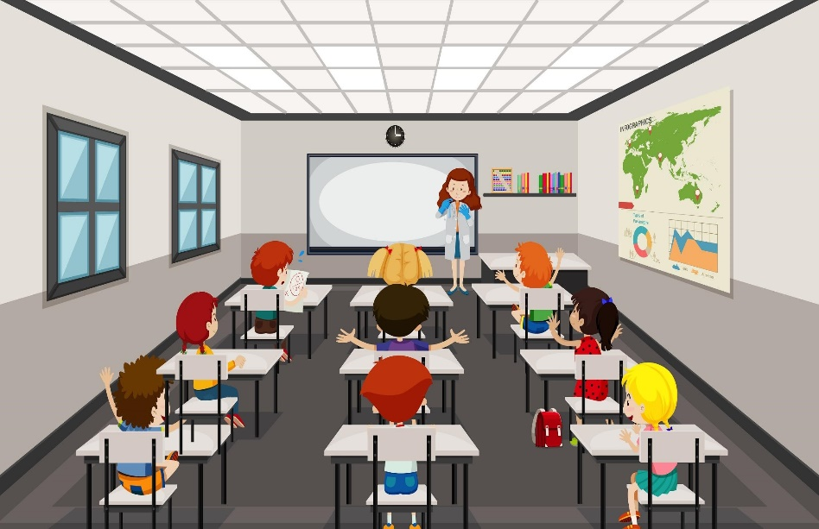
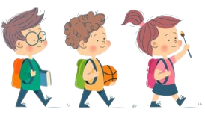
Welcome to our class 6A1

Slide 2
You are in four big groups in which there are small groups of four.
You are going to see eight pictures appearing on the screen in turn in one minutes.
You have to focus to remember the most words from the pictures shown on the screen, any small group Which finishes first will represent the big group to go and write the answers on the board. The one who has the most correct words is the winner.

Slide 3
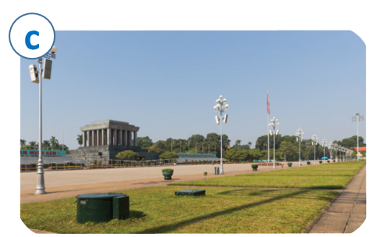
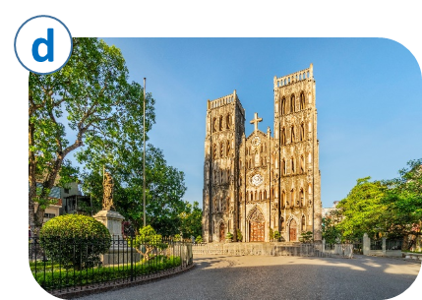
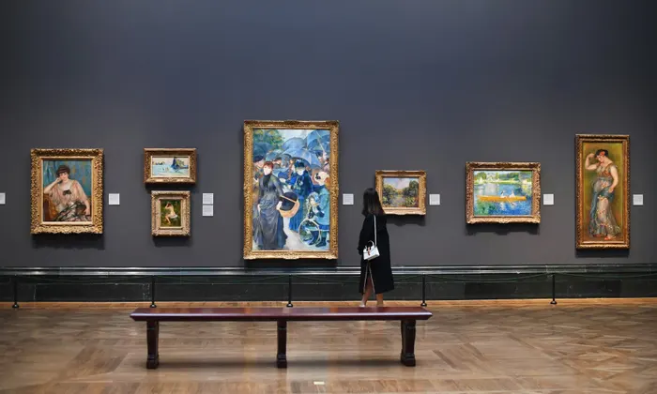
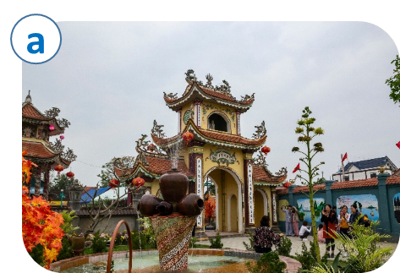
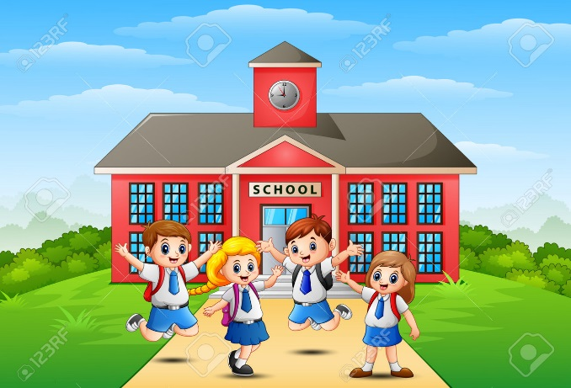
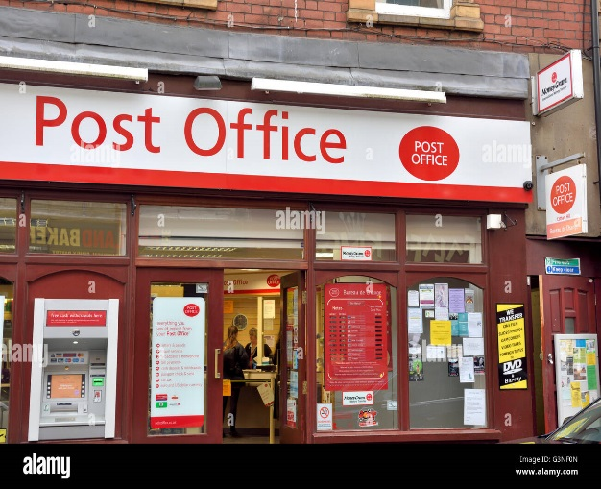

Slide 4
Vocabulary

Slide 5
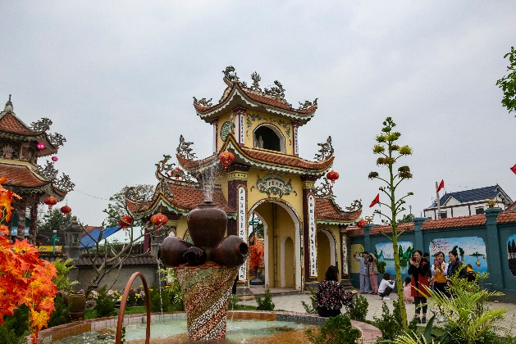
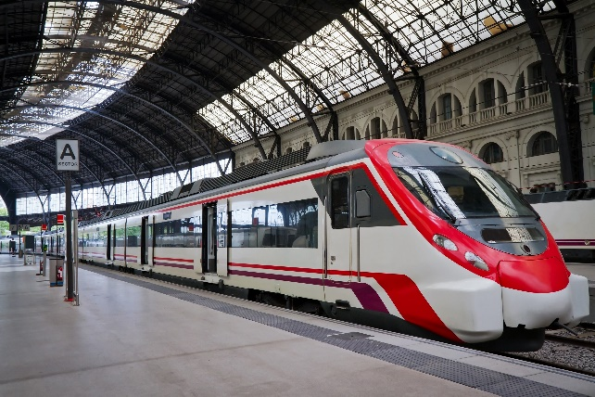
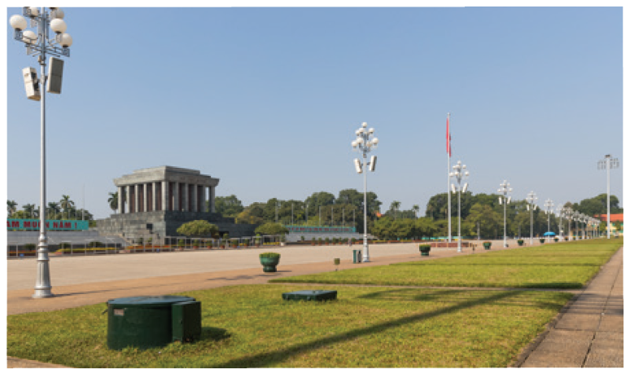
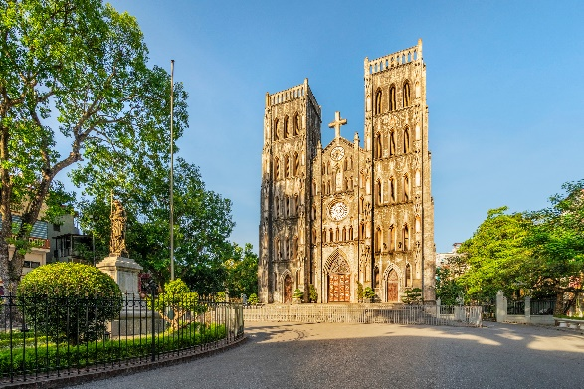
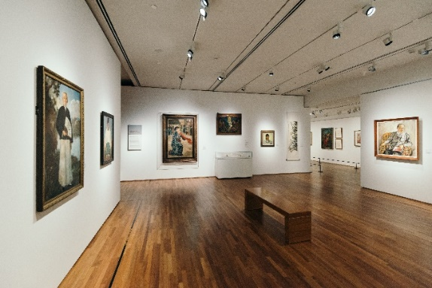
Match the places below with the pictures. Then listen, check and repeat the words.
a
b
b
a
1. square
2. art gallery
3. catherdral
4. temple
4. temple
4. temple
5. railway station
5. railway station
5. railway station
c
d
e
1. square
3. catherdral
2. art gallery
Name some other places in your neighbourhood.

Slide 6
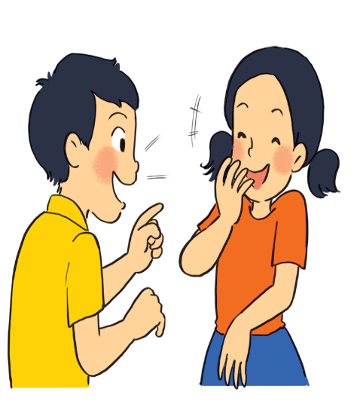
school
market
hotel
hospital
park
Name some other places in your neighbourhood
bookstore
cinema
bank
temple
restaurant
supermarket
Post office
Work in pairs. Ask and answer questions about where you live.
Example:
A: Is there a square in your neighbourhood?
B: Yes, there is. / No, these isn’t.

Slide 7
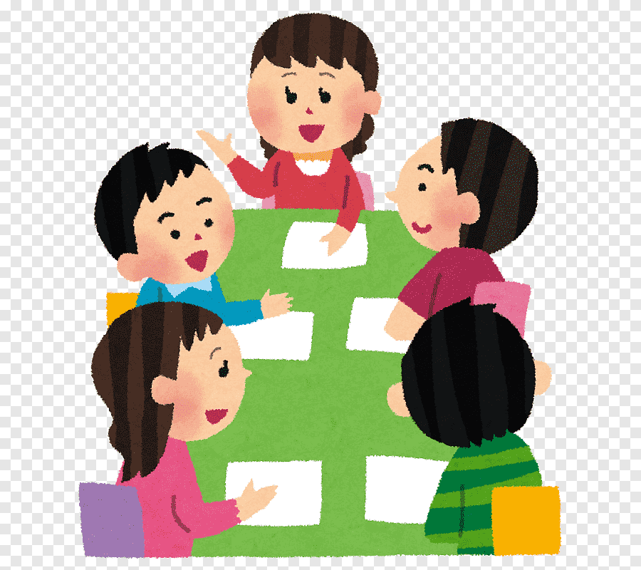
Work in groups. Ask and answer about your neighbourhood. You can use the adjectives below.
noisy
busy
modern
peaceful
quiet
crowded
boring
beautiful
Example:
A: Is your neighbourhood quiet?
B: Yes, it is. / No, it’s noisy.

Slide 8
* Pronunciation:
/ɪ/ and /i:/
Listen and repeat the words. Pay attention to the sounds /ɪ/ and /i:/.
noisy
cheap
peaceful
expensive
noisy
cheap
peaceful
expensive
clean
exciting
friendly
convenient
clean
exciting
friendly
convenient
Now, in pairs put the words in the correct column.
/ɪ/ | /i:/
noisy
convenient
expensive
cheap
exciting
peaceful
friendly
clean

Slide 9
Watch the video. Pay attention to the sounds /ɪ/

Slide 10
Watch the video. Pay attention to the sounds /i:/.

Slide 11
Listen and practise the chant. Notice the sounds /ɪ/ and /i:/.
MY NEIGHBOURHOOD
My city is very noisy.
There are lots of trees growing. The people here are busy.
It’s a lively place to live in.
My village is very pretty.
There are lots of places to see.
The people here are friendly.
It’s a fantastic place to be.

Slide 12
Listen and practise the chant. Notice the sounds /ɪ/ and /i:/.

Slide 13
WRAP UP AND HOMEWORK
Wrap up
What are the main points we have just learnt?
Vocabulary
Pronunciation
Places in a neighbourhood
sounds /i/ and /i:/
HOMEWORK
- Learn by heart Vocab.
Find 5 more words with the sound /i/
and 5 more words with the sound /i:/.
Prepare lesson 3 .

Slide 14
Thank you very much.

