Slide 2
Unit
2
MY HOUSE
LESSON 2: A CLOSER LOOK 1
1

Slide 3
LESSON 2: A CLOSER LOOK 1
LESSON 1: GETTING STARTED
WARM-UP
Jumbled words and matching (Task 1)
Vocabulary: Rooms and furniture
Task 2: Name the things in each room.
Task 3: Ask and answer questions to guess a room.
VOCABULARY
Pronunciation: Final sounds /s/ & /z/
Task 3: Listen and repeat the words
Task 4: Listen to the conversation. Underline the final s in the words and put them into the correct column.
PRONUNCIATION
CONSOLIDATION
Wrap-up
Homework

Slide 4
WARM-UP
Jumbled words and matching
Students work independently.
Rearrange letters to find out the correct word.
Match the words with the pictures.

Slide 5
WARM-UP
Jumbled words
kitchen
1. tchekin | →
2. thraobom | →
3. rodeomb | →
4. lngivi moro | →
5. lahl | →
bathroom
bedroom
living room
hall

Slide 6
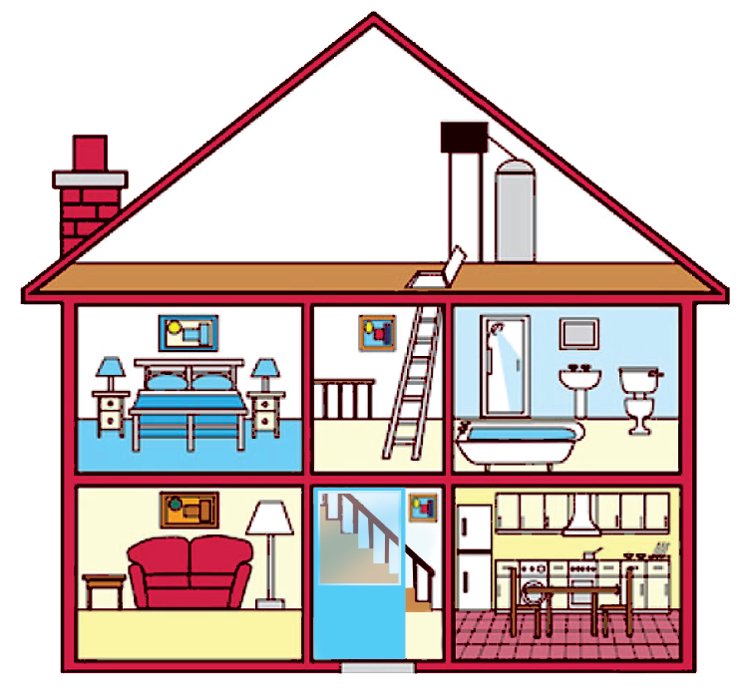
WARM-UP
hall
bathroom
hall
bathroom
Matching
living room
kitchen
living room
kitchen
bedroom
bedroom
c.
bedroom
d.
bathroom
b.
living room
e.
kitchen
a.
hall

Slide 7
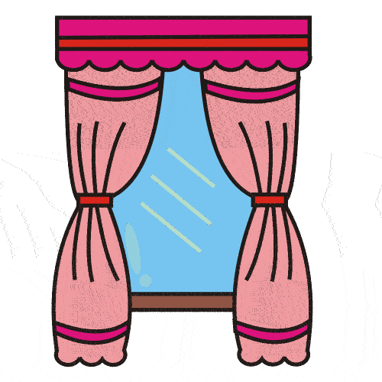
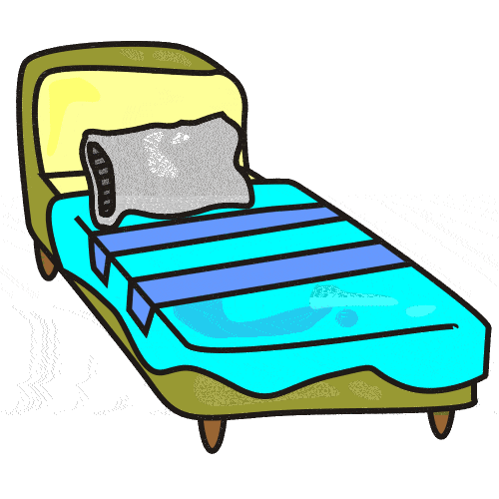
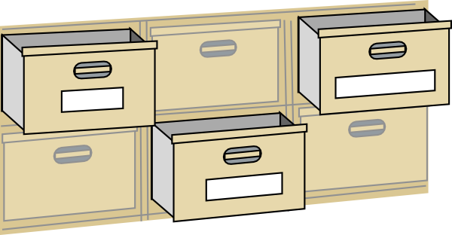
VOCABULARY
Vocabulary
Rooms and furniture

Slide 8
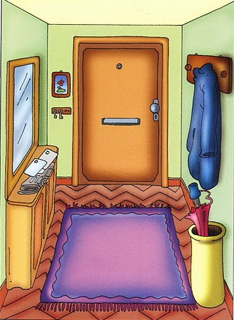
VOCABULARY
hall (n)
/hɔːl/
sảnh

Slide 9
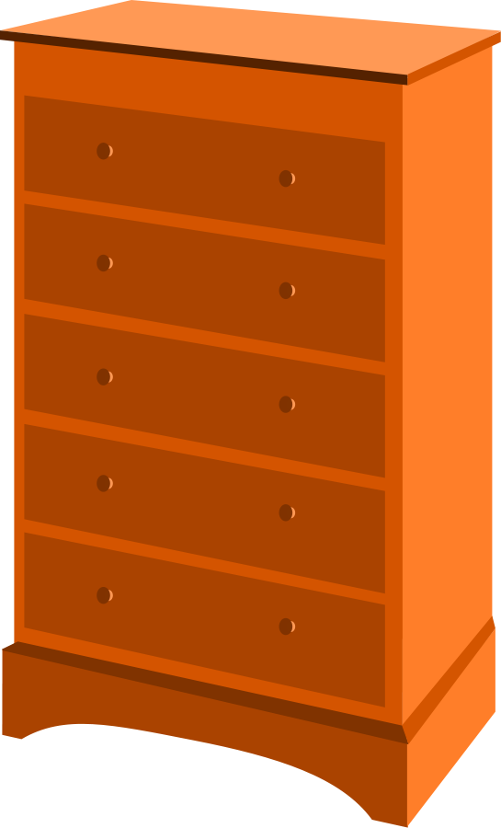
VOCABULARY
chest of drawers (n)
/ˌtʃest əv ˈdrɔːz/
tủ có ngăn kéo

Slide 10
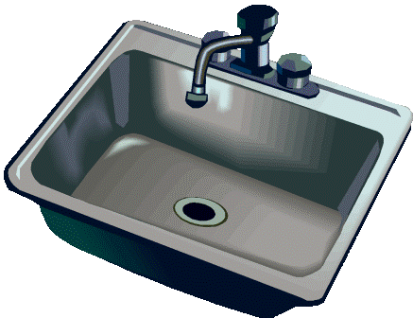
VOCABULARY
sink (n)
/sɪŋk/
bồn rửa bát

Slide 11
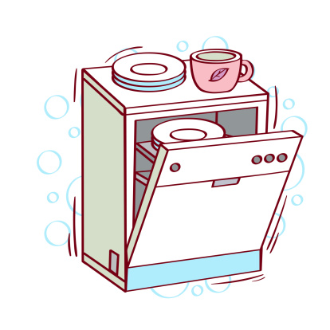
VOCABULARY
dishwasher (n)
/ˈdɪʃˌwɒʃə(r)/
máy rửa bát

Slide 12
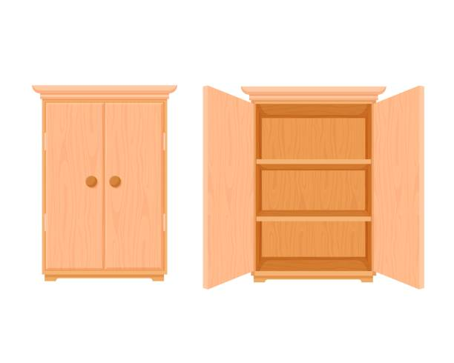
VOCABULARY
cupboard (n)
/ˈkʌbəd/
tủ đựng bát đĩa/ quần áo

Slide 13
VOCABULARY
New words | Pronunciation | Meaning
1. hall (n) | /hɔːl/ | sảnh
2. chest of drawers (n) | /ˌtʃest əv ˈdrɔːz/ | tủ có ngăn kéo
3. sink (n) | /sɪŋk/ | bồn rửa bát
4. dishwasher (n) | /ˈdɪʃˌwɒʃə(r)/ | máy rửa bát
5. cupboard (n) | /ˈkʌbəd/ | tủ đựng bát đĩa/ quần áo

Slide 14
VOCABULARY
2
Name the things in each room in 1. Use the word list below (You may use a word more than once.)
lamp
toilet
picture
cupboard
dishwasher
sink
fridge
shower
sofa
hall | kitchen | bedroom | bathroom | living room
picture
fridge
lamp
shower
lamp
cupboard
picture
sink
sofa
dishwasher
chest of drawers
toilet
picture
sink

Slide 15
VOCABULARY
3
Think of a room in your house. In pairs, ask and answer questions to guess it.
Students work in pairs.
One student thinks of a room in his/her house; the other asks questions to guess the room.

Slide 16
VOCABULARY
3
Think of a room in your house. In pairs, ask and answer questions to guess it.
Example:
S1: What’s in your room?
S2: A lamp and a chest of drawers.
S1: Is it a bedroom?
S2: Yes.

Slide 17
PRESENTATION
Pronunciation
Final sounds: /s/ and /z/

Slide 18
PRESENT
4
Listen and repeat these words.
lamps
cupboards
sinks
sofas
flats
kitchens
toilets
rooms

Slide 19
PRESENT
Final sounds /s/ and /z/
Final –s is pronounced /s/ after voiceless sounds (/t/, /p/, /k/, /f/, /θ/).
Example: cats, lets, stops,…
Final –s is pronounced /z/ after voiced sounds (/b/, /d/, /g/, /n/, /m/, /l/, etc.) and any vowel sounds.
Example: plays, televisions, pens,…

Slide 20
PRACTICE
4
Listen again and write these words into the correct column.
lamps
sinks
flats
toilets
cupboards
sofas
kitchens
rooms
/s/ | /z/

Slide 21
PRACTICE
5
Listen to the conversation. Underline the final –s in the words and put them into the correct column.
Mi: Mum, are you home?
Mum: Yes, honey. I’m in the kitchen. I’ve bought these new bowls and chopsticks.
Mi: They’re beautiful, Mum. Where did you buy them?
Mum: In the department store near our house. They have a lot of things for homes.
Mi: Don’t forget we need two lamps for my bedroom, Mum.
Mum: Let’s go there this weekend.
Now practise the conversation with a partner.
bowls
chopsticks
things
homes
/s/ | /z/
lamps

Slide 22
CONSOLIDATION
1
Wrap-up
What have we learnt in this lesson?
use vocabulary and structures to talk about rooms and furniture pieces in the house
pronounce and recognize the sounds /s/ and /z/

Slide 23
CONSOLIDATION
2
Homework
- Find 5 more words with the sound /s/ and 5 more words with the sound /z/. Write them down and practise pronouncing the words.
- Prepare for the next lesson: A closer look 2

Slide 24
Website: hoclieu.vn
Fanpage: facebook.com/www.tienganhglobalsuccess.vn/

