Slide 2
Unit
7
ENVIRONMENTAL PROTECTION
LESSON 5: SKILLS 1
1

Slide 3
LESSON 5: SKILLS 1
WARM-UP
Task 1: Look at the picture and say what you see. Then list the names of some endangered species you know.
Vocabulary
Task 2: Read the text and choose the words or phrases to make the following statements correct.
Task 3. Read the text again and choose the correct option A, B, or C.
READING
Task 4: Work in pairs. Ask and answer about Vu Quang National Park.
Task 5: Work in groups. Talk about Vu Quang National Park, using the answers in 4.
SPEAKING
CONSOLIDATION
Wrap-up
Homework

Slide 4
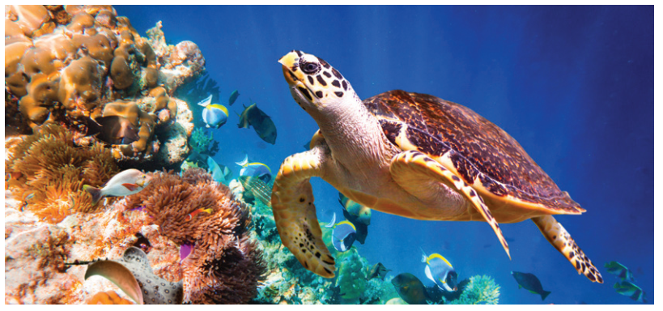
WARM-UP
1
Work in groups. Look at the picture and say what you see.

Slide 5
WARM-UP
1
Then list the names of some endangered species you know.
BLUE WHALE
SEA LION
TIGER
SAOLA
DUGONG
POLAR BEAR
GIANT PANDA
PENGUINES

Slide 6
VOCABULARY
contain (v)
/kənˈteɪn/
chứa đựng

Slide 7
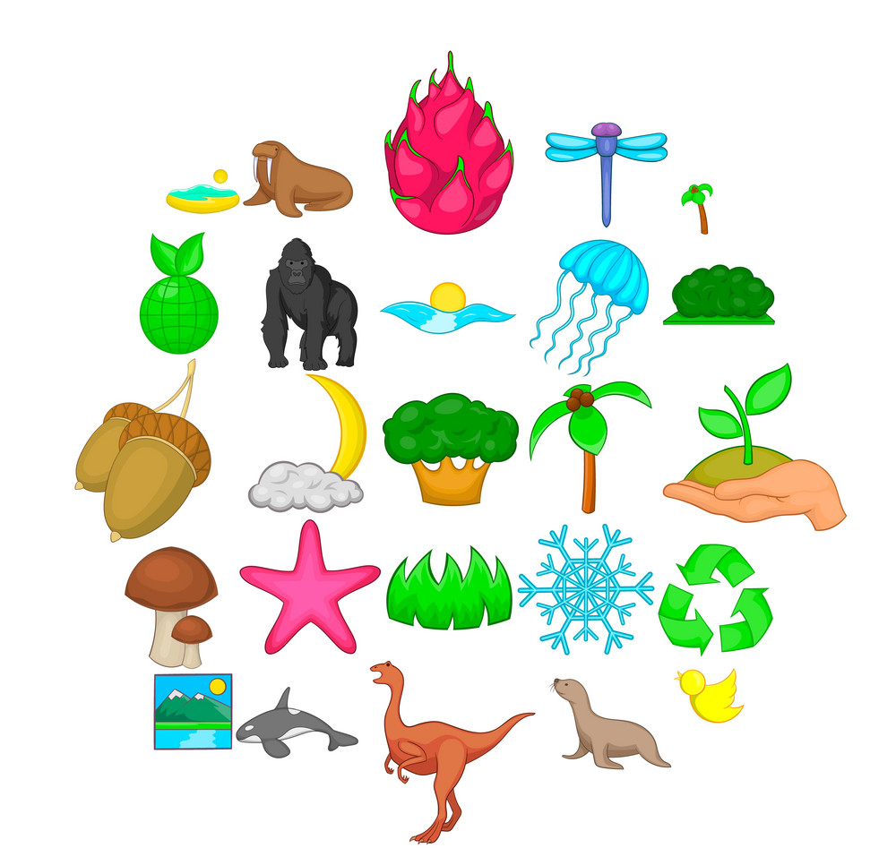
VOCABULARY
diverse (adj)
/daɪˈvɜːs/
phong phú

Slide 8
VOCABULARY
medicinal (adj)
/məˈdɪsɪnl/
dùng làm thuốc

Slide 9
PRESENTATION
New words | Pronunciation | Meaning
1. contain (v) | /kənˈteɪn/ | chứa đựng
2. diverse (adj) | /daɪˈvɜːs/ | phong phú
3. medicinal (adj) | /məˈdɪsɪnl/ | dùng làm thuốc

Slide 10
READING
2
Read the text and choose the words or phrases to make the following statements correct.
1. There are 34 national parks / nations’ parks in Viet Nam now.
2. The conservation / ecosystem in Con Dao is very diverse.
3. The dugong is a(n) dangerous / endangered animal.
4. National parks play a key role in saving the environment / small islands.

Slide 11
READING
3
Read the text again and choose the correct option A, B, or C.
1. What is the best title for the passage?
A. National Parks in Viet Nam
B. Con Dao National Park
C. The Protection of Wildlife
2. National parks are areas for ______.
A. the protection of the environment
B. the management of marine life
C. the sale of animal products

Slide 12
READING
3
Read the text again and choose the correct option A, B, or C.
3. What is the area of Con Dao National Park?
A. 34 hectares
B. 16 hectares
C. 20,000 hectares
4. Con Dao National Park has many kinds of ______.
A. valuable plants
B. ancient trees
C. natural values

Slide 13
READING
3
Read the text again and choose the correct option A, B, or C.
5. Which of the following is NOT true, according to the passage?
A. There are more and more national parks in the world. B. Con Dao National Park is rich in animal species.
C. Con Dao National Park’s mission is to help other national parks.

Slide 14
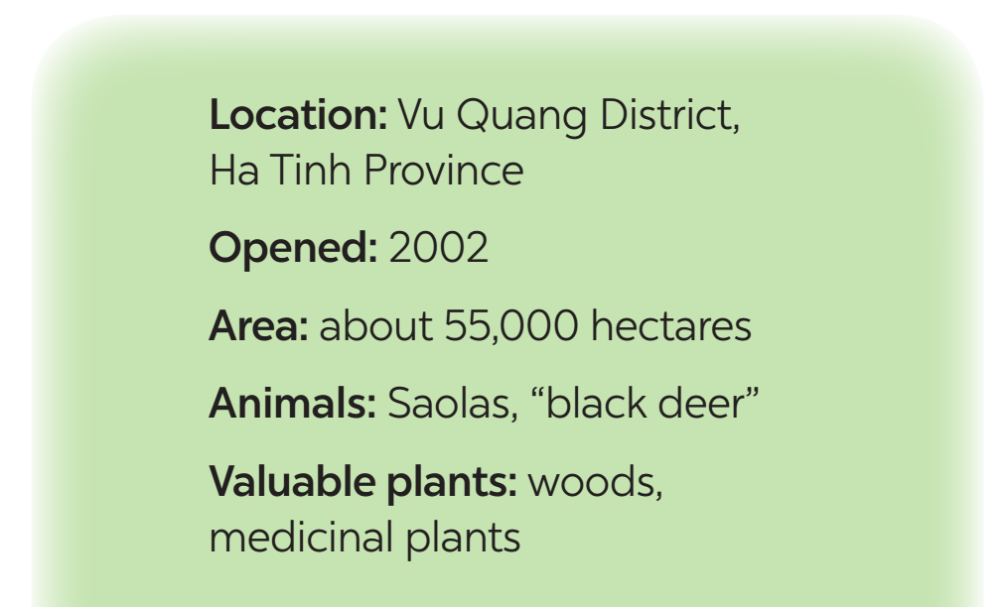
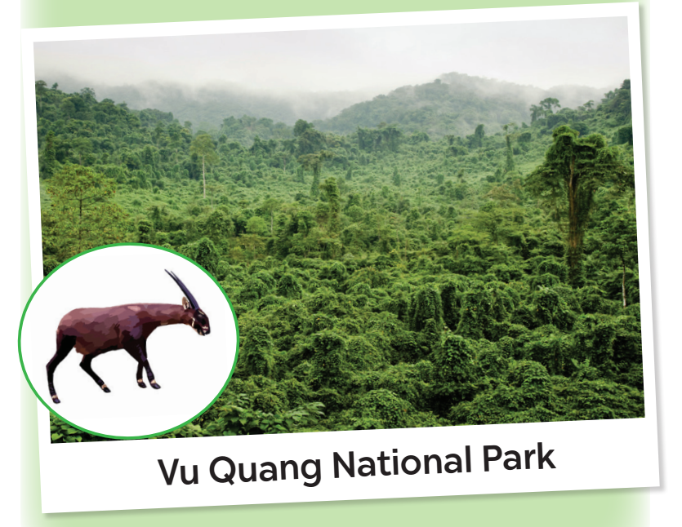
SPEAKING
4
Work in pairs. Ask and answer about Vu Quang National Park.
Look at the facts.
A: Where is Vu Quang National Park?
B: It’s in Vu Quang District, Ha Tinh Province.

Slide 15
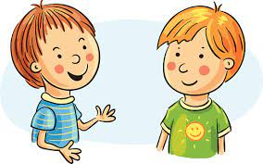
SPEAKING
5
Work in groups. Talk about Vu Quang National Park, using the answers in 4.
Vu Quang National Park is in …
It was opened in ...
It has ...
It’s about …

Slide 16
CONSOLIDATION
1
Wrap-up
What have we learnt in this lesson?
Reading about Con Dao National Park
Talking about Vu Quang National Park

Slide 17
CONSOLIDATION
2
Homework
- Do exercises in the workbook.

Slide 18
Website: hoclieu.vn
Fanpage: facebook.com/www.tienganhglobalsuccess.vn/

