Slide 2



Unit
3
MY FRIENDS
LESSON 7: LOOKING BACK & PROJECT
1

Slide 3
LESSON 7: LOOKING BACK & PROJECT
LESSON 1: GETTING STARTED
Brainstorming
WARM-UP
Task 1: Choose the correct answer A, B, or C.
Task 2: Answer questions about your classmates.
Task 3: Put the verbs in brackets in the present continuous.
Task 4: Put the verbs in brackets in the present simple or present continuous.
LOOKING BACK
PROJECT
My class yearbook
CONSOLIDATION
Wrap-up
Homework

Slide 4
WARM-UP
Adjectives to describe people’s appearance & personalities.
- Work in 2 big groups.
- Each group to go to the board to write adjectives to describe : APPEARANCE & PERSONALITIES
- Students brainstorm all adjectives related to people’s appearance and personalities.
- The group having the most suitable answers is the winner.
Brainstorming

Slide 5
1.Vocabulary

Slide 6
LOOKING BACK
1
Choose the correct answer A, B, or C.
1. Nick is very _____. He makes everyone laugh!
A. confident B. funny C. active
2. My sister always does her homework before class. She’s very _____.
A. hard-working B. creative C. careful
3. Mi is _____. She helps me with my homework.
A. hard-working B. friendly C. kind

Slide 7
LOOKING BACK
1
Choose the correct answer A, B, or C.
4. He is a _____ person. He cares about everybody.
A. caring B. friendy C. kind
5. My best friend is very _____. She likes doing activities.
A. creative B. clever C. active

Slide 8
LOOKING BACK
2
Answer questions about your classmates.
1.
Who has long hair in your class?
2.
Who has a small nose?
3.
Who has a round face?
4.
Does the classmate next to you have long hair?
5.
Does the classmate next to you have big eyes?

Slide 9
2.Gammar

Slide 10

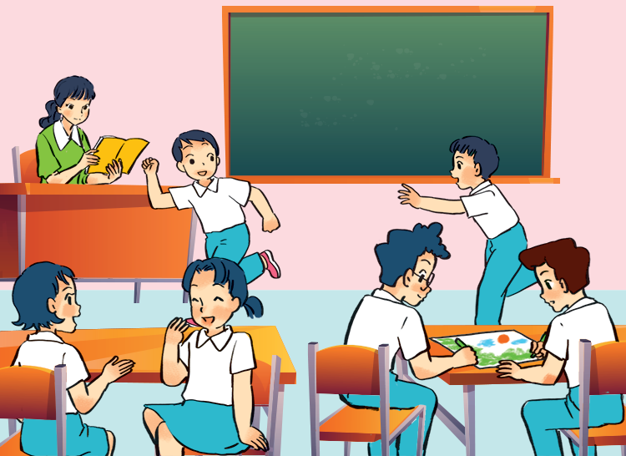
LOOKING BACK
3
Put the verbs in brackets in the present continuous.
This is my class during break time. Some boys
(1. run) __________ around the class. Mi and Mai
(2. talk) _________. Nam and Phong (3. not talk) ___________. They (4. draw) __________ something. My teacher is in the classroom too. She (5. not teach) ___________. She’s reading a book.
are running
are talking
aren’t talking
are drawing
isn’t teaching

Slide 11
READING
4
Put the verbs in brackets in the present simple or present continuous.
1. A: What _______ you (do) _______?
B: I (write) __________ an email to my friend.
2. A: Mai usually (cycle) _______ to school.
B: Really? I (not cycle) __________. I (walk) _____ every day.
3. A: Where is Phong? ____ he (do) ______ his homework?
B: No, he (read) _________ a book in the living room.
are
doing
am writing
cycles
don’t cycle
walk
Is
doing
is reading

Slide 12
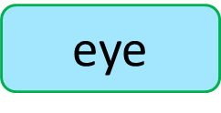

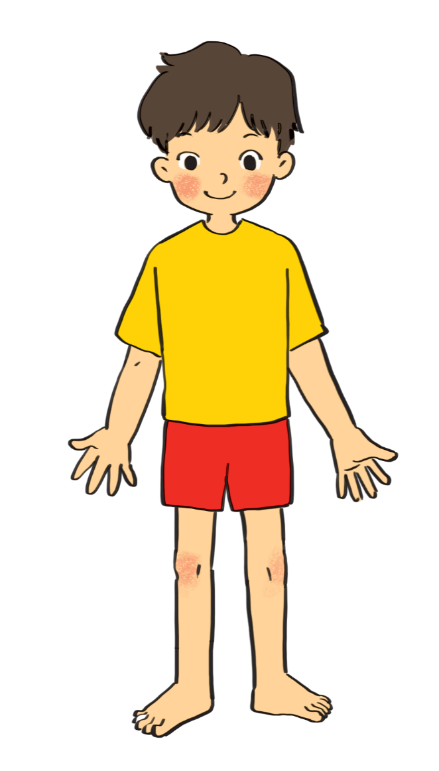
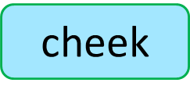
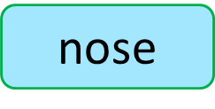

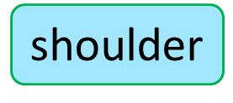
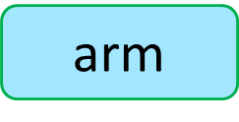
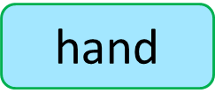
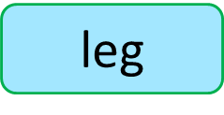

Label the body parts .
1.
10.
9.
2.
8.
3.
7.
4.
5.
6.

Slide 13


My class
yearbook
How to make
a class yearbook
Friends
1.
Stick a photo / drawing of the friend sitting next to you on a large sheet of paper.
Name: ....................
2.
Interview your friend to find out about him / her (e.g. favourite subjects, favourite books, what he / she likes, etc.).

Slide 14
My class
yearbook
How to make
a class yearbook
Friends
3.
Write a short description of your friend. describe his / her appearance and personality. add some information you have from the interview.
Name: ....................
4.
Decorate the page. Show it to your class and talk about it.

Slide 15
My class
yearbook
How to make
a class yearbook
Friends
5.
Together make a class yearbook.
Name: ....................

Slide 16
CONSOLIDATION
Now I can … |  |  | 
use the words for body parts, appearance and personality.
pronounce the sounds /b/ and /p/ correctly.
use the present continuous to talk about things happening now.
ask about appearance and personality.
read about friends and summer camps.
talk about friends and summer camps.
listen about best friends.
write a diary entry about my best friend.
✓
✓
✓
✓
✓
✓
✓
✓
✓
✓
✓
✓
✓
✓
✓
✓
✓
✓
✓
✓
✓
✓
✓
✓

Slide 17

CONSOLIDATION
1
Wrap-up
What have we learnt in this lesson?
Review the vocabulary and grammar of Unit 3
Apply what they have learnt (vocabulary and grammar) into practice through a project

Slide 18

CONSOLIDATION
2
Homework
Prepare for the next lesson: Read Review 1.

Slide 19






Website: hoclieu.vn
Fanpage: facebook.com/www.tienganhglobalsuccess.vn/

