Slide 1


Slide 2
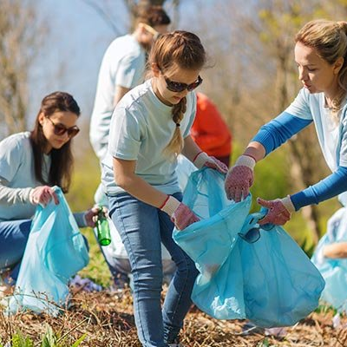

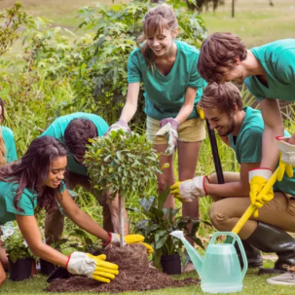
WARM-UP
collecting rubbish
donating clothes
planting trees
1.
2.
3.

Slide 3
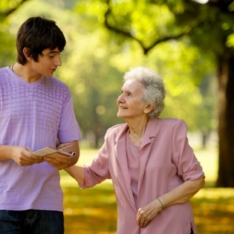
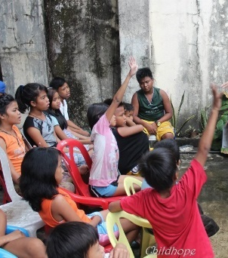
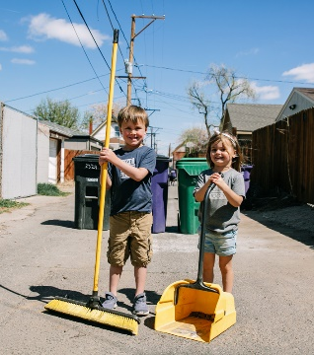
WARM-UP
tutoring homeless children
6.
4.
cleaning the street
5.
helping old people

Slide 4




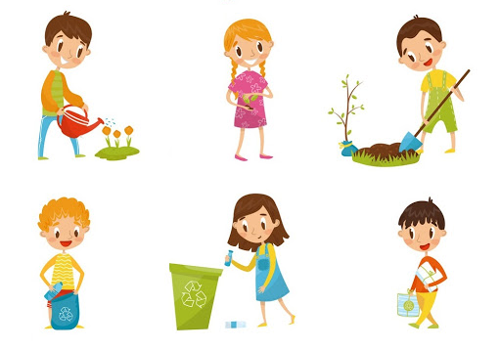
Unit
5
COMMUNITY SERVICE
LESSON 5: SKILLS 1
READING
SPEAKING
Unit
Projects in Bright Future School
What project you can do?

Slide 5


VOCABULARY
monthly (adj/adv)
/ˈmʌnθli/
hằng tháng

Slide 6

VOCABULARY
proud (adj)
/praʊd/
hài lòng, tự hào

Slide 7
VOCABULARY
New words | Pronunciation | Meaning
monthly (adj/adv) | /ˈmʌnθli/ | hằng tháng
proud (adj) | /praʊd/ | hài lòng, tự hào

Slide 8
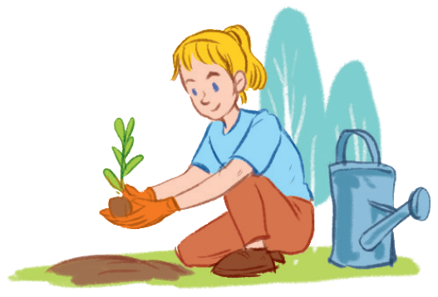
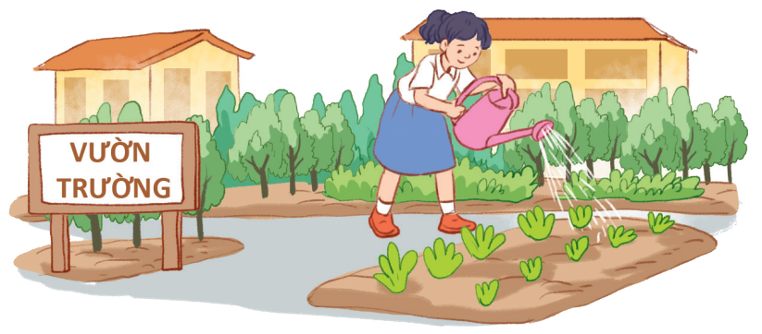
PRE-READING
1
Work in pairs. Circle the activities you would like to do at your school.
A. growing vegetables in the school garden
B. tutoring other students
C. collecting books for the school library

Slide 9
WHILE-READING: Read the passage and match the highlighted words with their meanings
Bright future School has many community activities for students. The school believes that a good way for students to develop themselves is through community service. All students can join any of these different projects:
-Tutoring: Upper grade students tutor lower grade students
-Postcard- to- Help: Students make and sell postcards to raise money for local children.
-Visit-to-Read: Students visit a nursing home monthly and read books to the elderly
-Garden-to-Give: Students grow vegetables and donate them to local school.
-Paper-Plant- Exchange: students collect paper and exchange it for plants. They then look after the plants in their school garden.
-Students learn that they can help people and the world around them when they do community service. They feel useful and proud because they do good things.

Slide 10
WHILE-READING
2
Read the passage and match the highlighted words with their meanings.
1. give
donate
tutor monthly donate exchange proud
2. give and receive
exchange
3. every month
monthly
4. pleased
proud
5. teach
tutor

Slide 11

WHILE-READING
3
Read the passage again, underline the key words and tick True or False.
 | True | False
1. Community service allows students to develop themselves.
2. Each student can join only one project.
3. They tutor younger students.
4. Local children receive postcards from the Postcard-to-Help project.
5. Students receive plants when they give paper.

Slide 12
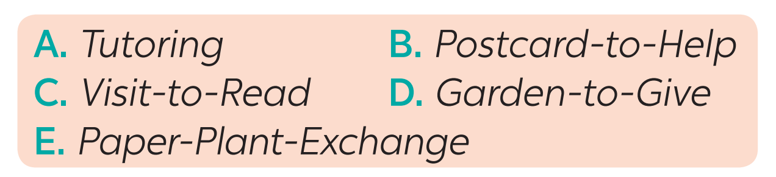
PRE-SPEAKING
4
Read about these students. Write the names of the projects you think they should join in the Projects column.
 | Projects
1. Nick likes reading book. He has a very nice voice, and he is also patient.
2. Ann is very good at maths and literature. She also loves children.
3. Minh loves collecting and making postcards.
4. Mark loves nature.He likes watching programmes about plants. He also likes being out doors.
5.Tom likes collecting newspapers.
C
A
B
D
E

Slide 13
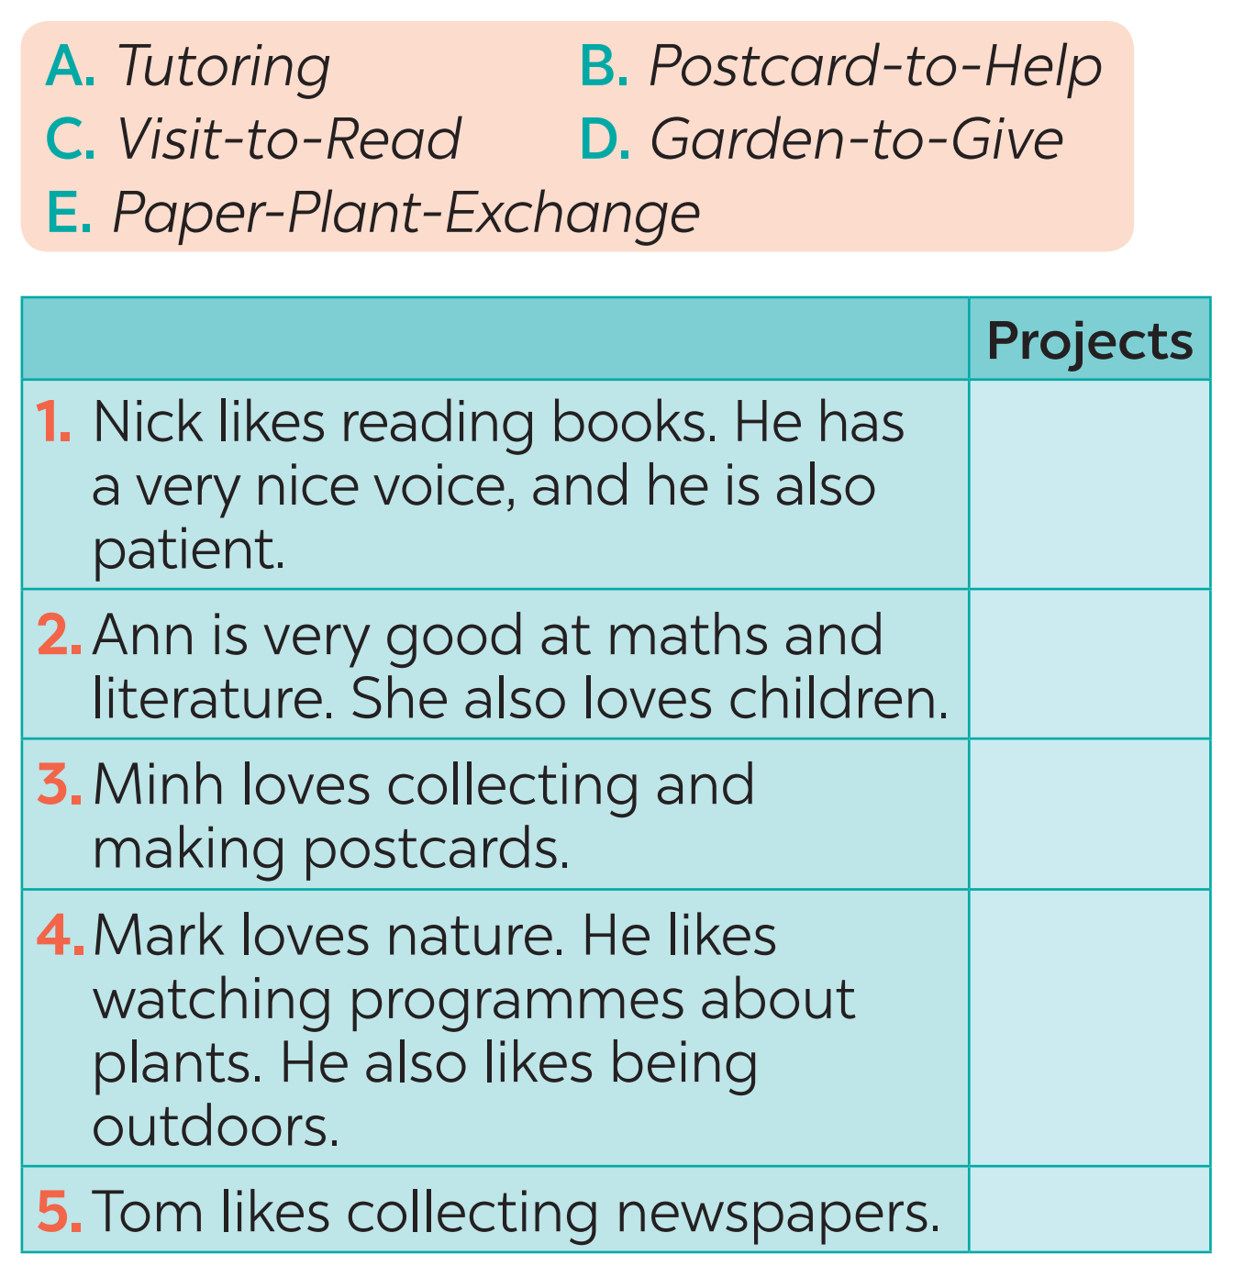
WHILE-SPEAKING
5
Discuss which project in Task 4 you would like to join, and why. Report your group’s answers to the class.
Example:
I will join the Tutoring project because I am good at maths and English. I also love children.

Slide 14
POST-READING & SPEAKING
Work in groups and report your group’s answers to the class
Eg: Minh will join the……because he……
GROUP 1 The Visit-to Read project
GROUP 2 The Paper – Plant- Exchange
GROUP 3 The Postcard-to –Help project
GROUP 4 The Garden- to-Give project

Slide 15
CONSOLIDATION
1
Wrap-up
READING
SPEAKING
Projects in Bright Future School
What project you can do?

Slide 16

CONSOLIDATION
2
Homework
Plan some school activities for next summer holiday.

Slide 17

Website: hoclieu.vn
Fanpage: facebook.com/www.tienganhglobalsuccess.vn/

