Slide 1
Unit 5: Sports and hobbies
Lesson 3.3
Page 76

Slide 2
WARM-UP

Slide 3
BROKEN WORDS
BROKEN WORDS

Slide 4
ska
go
ing
gh
te
rd
boa
set
Click on the piece.

Slide 5
BROKEN WORDS
go skateboarding

Slide 6
ly
swi
ing
mm
go
rd
wa
set
Click on the piece.

Slide 7
BROKEN WORDS
go swimming

Slide 8
go
re
ing
th
wa
si
tch
TV
Click on the piece.

Slide 9
BROKEN WORDS
watch TV

Slide 10
ty
wh
ou
u
go
rd
w
t
Click on the piece.

Slide 11
BROKEN WORDS
Go out

Slide 12
It’s time to learn …

Slide 13
Speaking

Slide 15
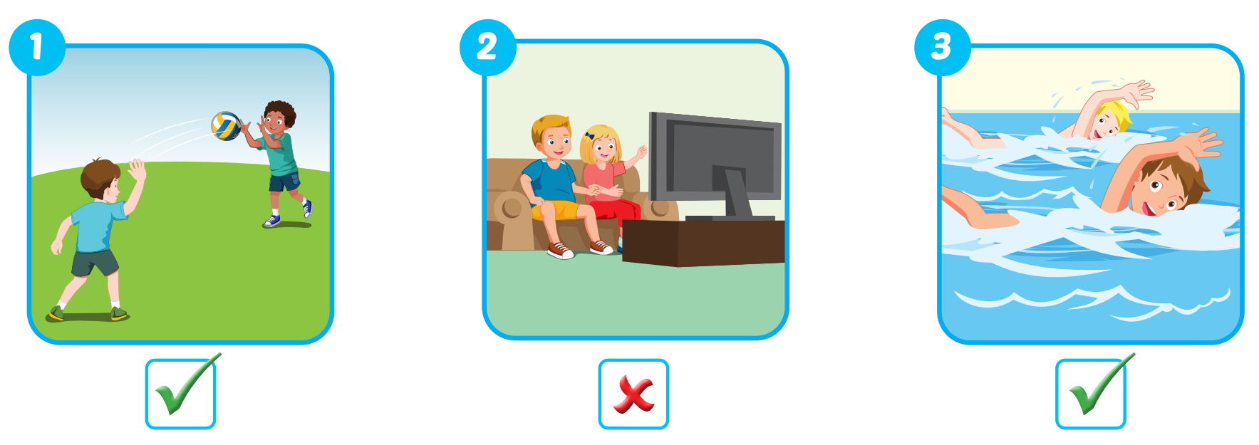

Slide 16
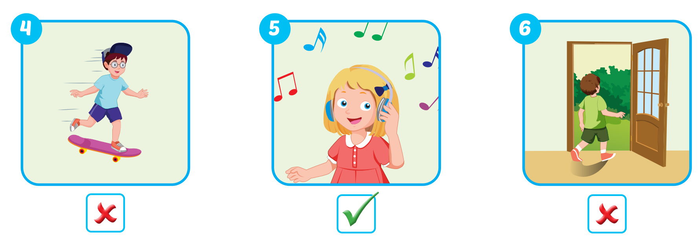

Slide 17
Practice

Slide 18
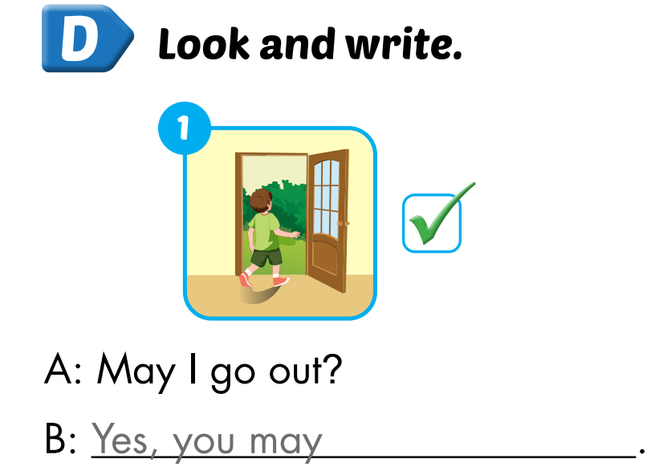
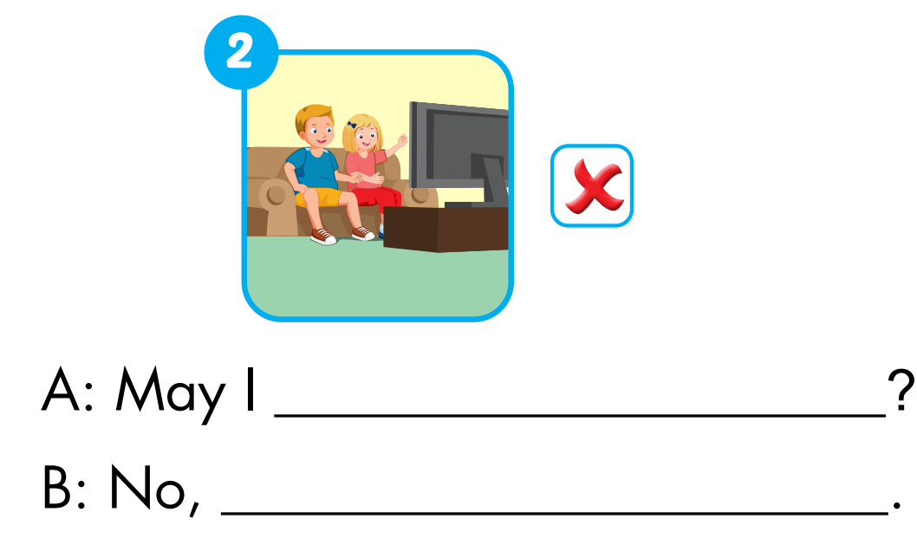
Extra Practice
WB, page 53.
watch TV
you may not

Slide 19
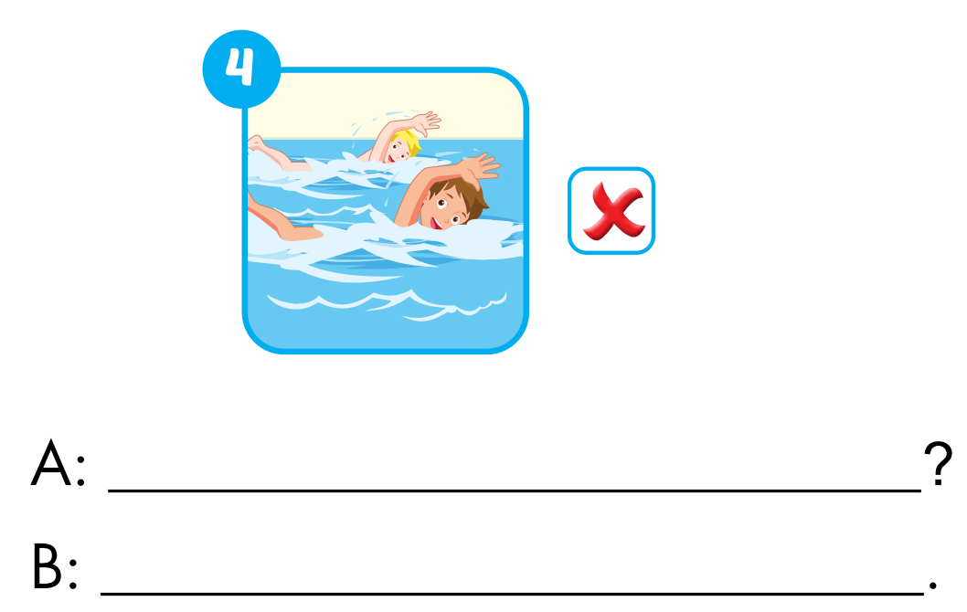
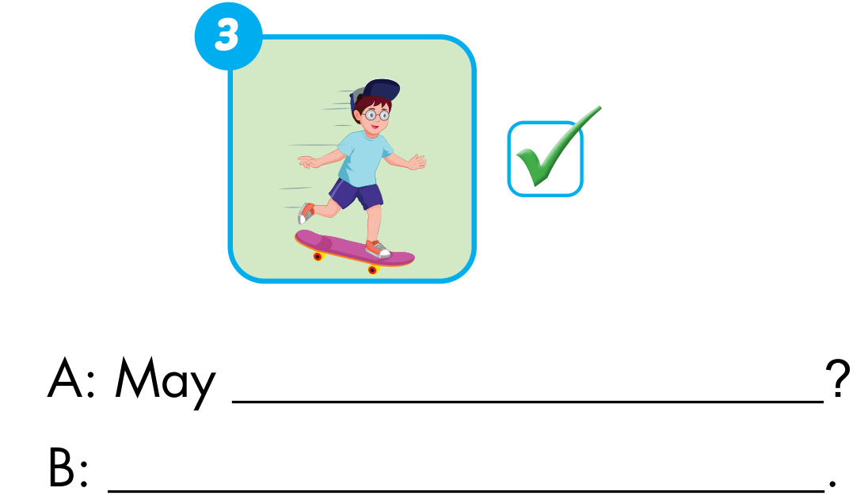
Extra Practice
WB, page 53.
I go skateboarding
May I go swimming?
Yes, you may
No, you may not

Slide 20
WRAP-UP

Slide 21
1. Divide the class into two teams. 2. Show a flashcard to the class and say "yes" or "no". 3. Have Team A ask the question and Team B answer. 4. Swap roles and repeat.

Slide 22
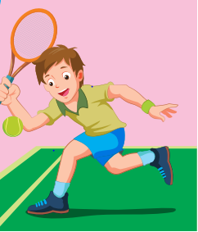
Team A:
May I play tennis?
❌
No, you may not.
Team B:

Slide 23
❌

Slide 24
✓

Slide 25
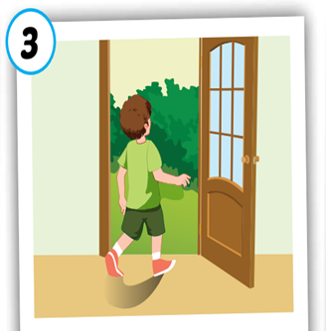
❌

Slide 26
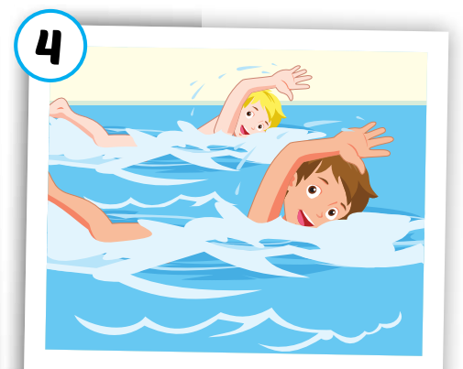
✓

Slide 27
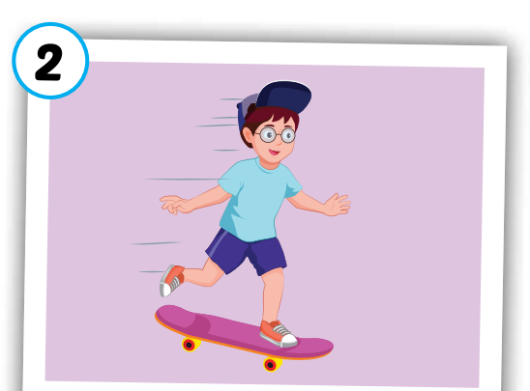
✓

Slide 28
Lesson 3
Stay positive and have a nice day!

