Slide 1
Unit 5: Sports and hobbies
Lesson 3.2
Page 75

Slide 2
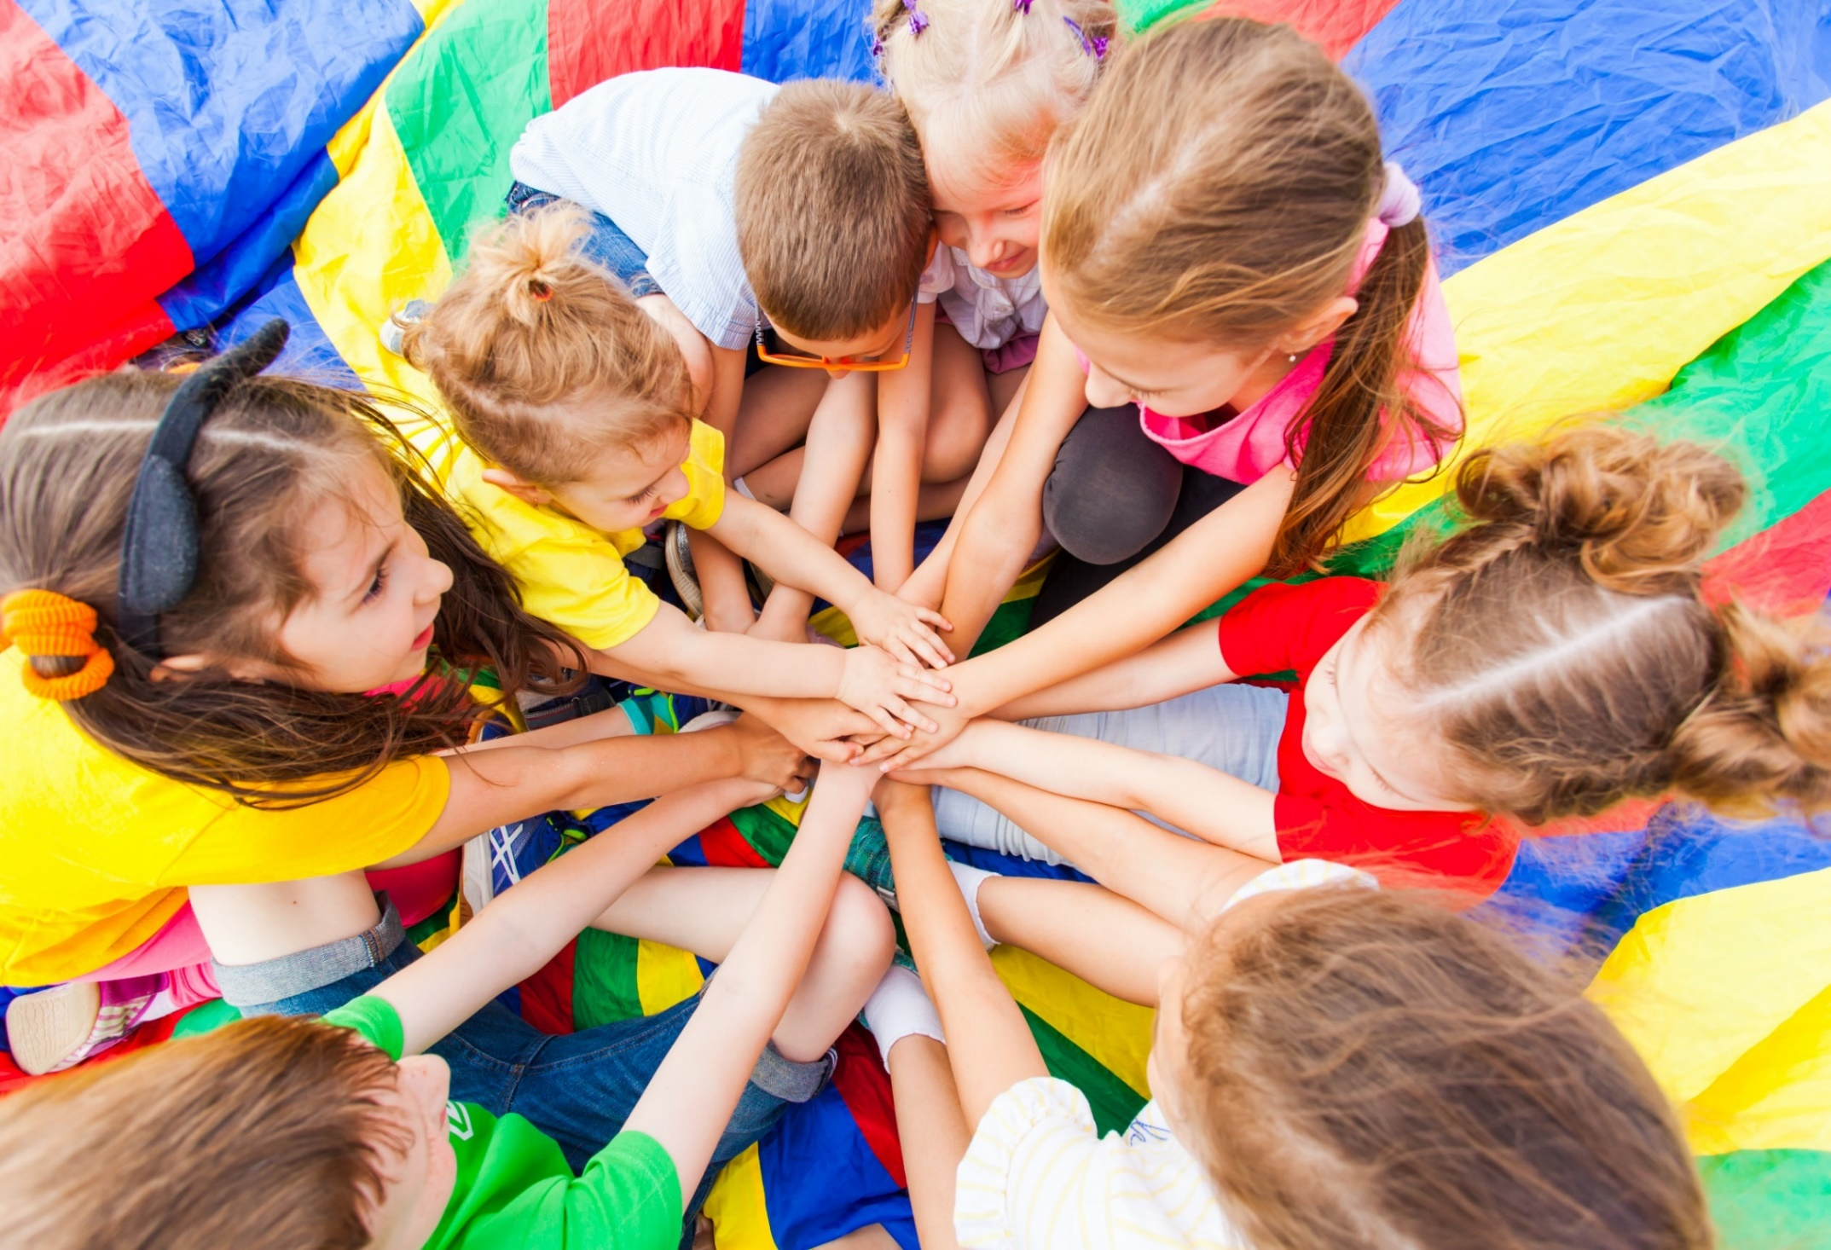
WARM-UP

Slide 3
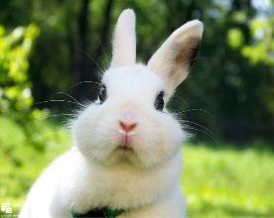
Hidden
Pictures
Guessing
Game

Slide 4
HOW TO PLAY
Hidden Picture Games
- Ask students to choose a color.
Click on the colored shapes. This will reveal the hidden picture.
As the shapes disappear, students should try to guess the word.

Slide 5
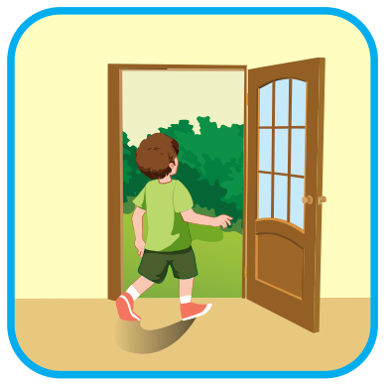
go out
SHOW

Slide 6
watch TV
SHOW

Slide 7
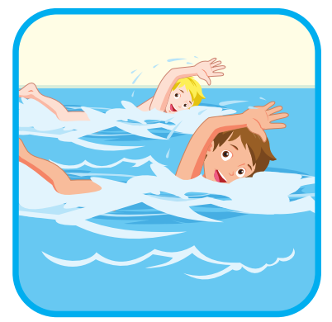
go swimming
SHOW

Slide 8
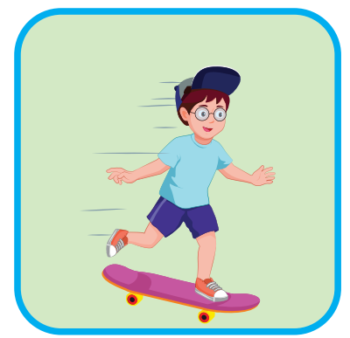
go skateboarding
SHOW

Slide 9
It’s time to learn …

Slide 10
Phonics
/tʃ/

Slide 11
/tʃ/
watch
catch

Slide 12
/tʃ/, /tʃ/, /tʃ/,
/tʃ/, /tʃ/, /tʃ/,
watch, catch,
/tʃ/, /tʃ/, /tʃ/.
/tʃ/, /tʃ/, /tʃ/, /tʃ/, /tʃ/, /tʃ/, watch, catch, /tʃ/, /tʃ/, /tʃ/.
Click to follow the lyrics.
Click one more to follow the second one.

Slide 13
Listening

Slide 14
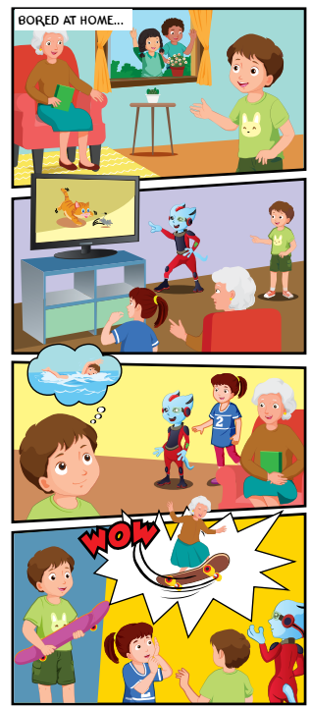
1
Where are the kids?
2
Who is with them?
3
What is Grandma doing?
4

Slide 15
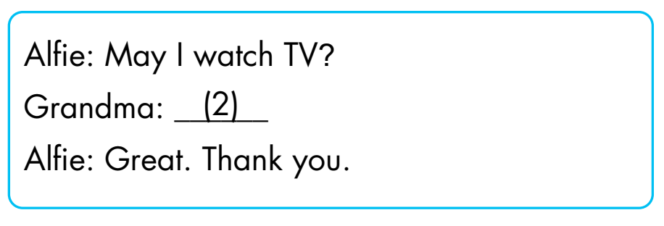
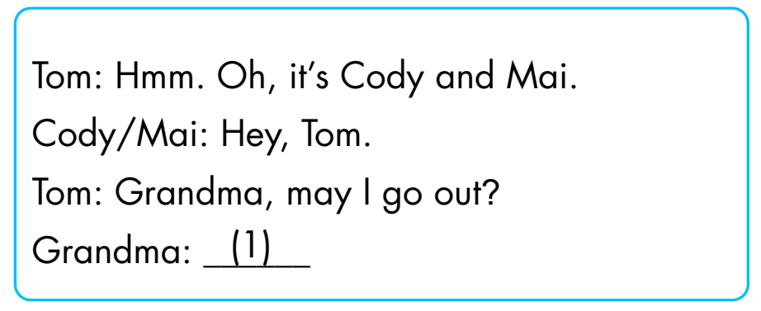
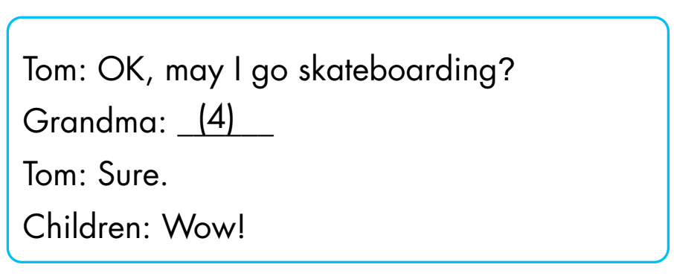
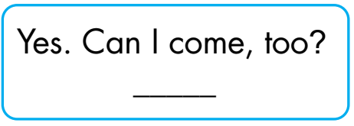
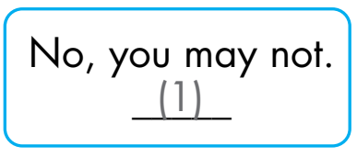
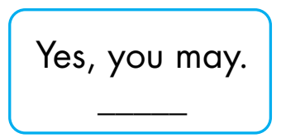
(4)
(3)
(2)

Slide 16
Extra Practice
WB, page 53.
1
2
3
4
May I go
skateboarding?
May I watch TV?
May I go out?
May I go swimming?
❌
✓
❌
✓
Click on the number to hear the sound.

Slide 17
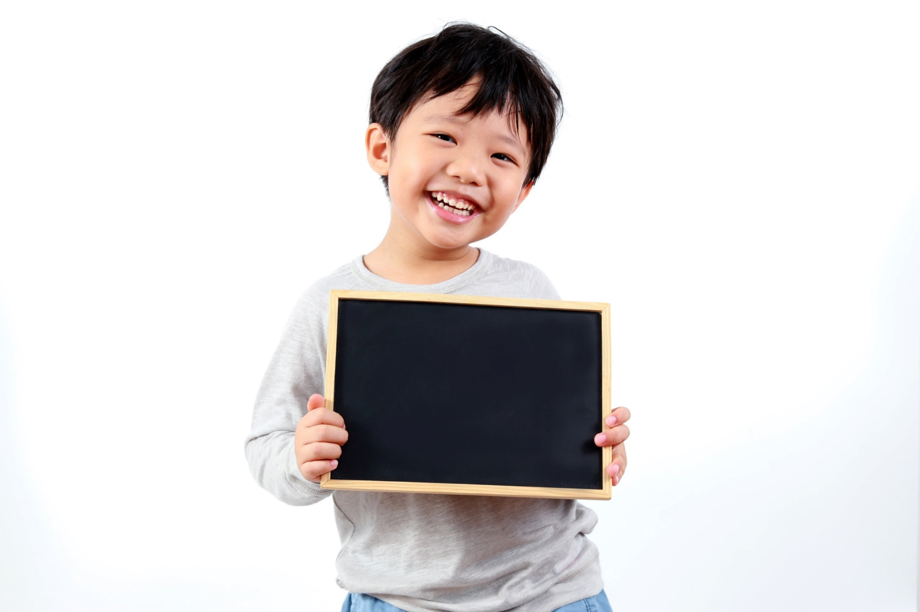
Practice

Slide 18
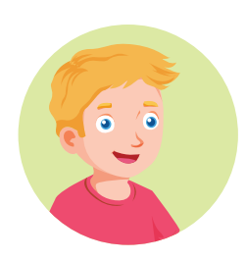
Yes, you may./ No, you may not.
May I watch TV?

Slide 19
THE SLAP GAME 🙌🏽

Slide 20
May I go out?
Yes, you may
Yes, I may

Slide 21
May I go skateboarding?
No, you may not
Yes, I may

Slide 22
May I …TV?
go
watch

Slide 23
May I go …?
swimming
swiming

Slide 24
… go out?
I may
May I

Slide 25
WRAP-UP

Slide 26
Let’s play

Slide 27
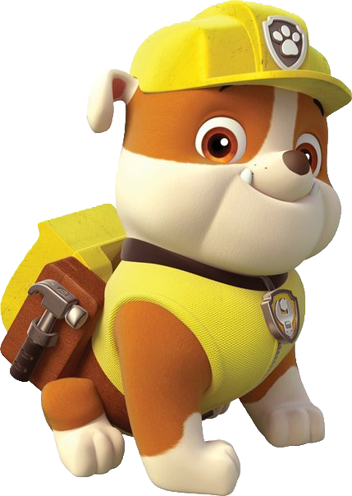
How to play
. Listen to a sound
. Choose the correct answer

Slide 28
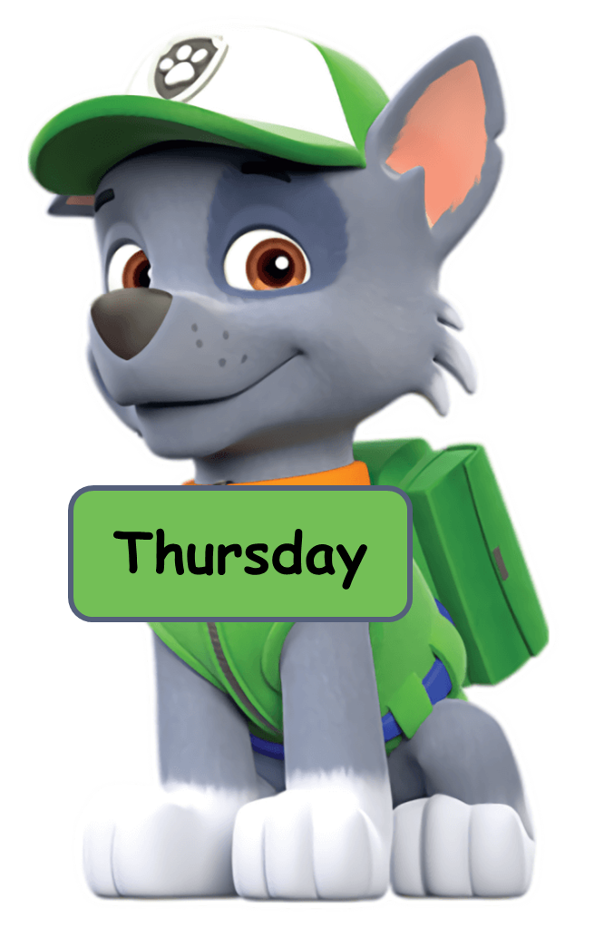
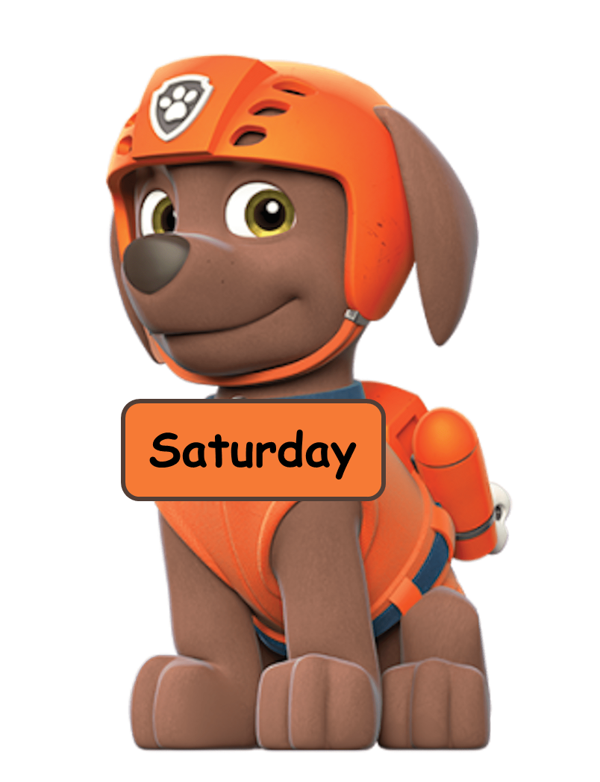
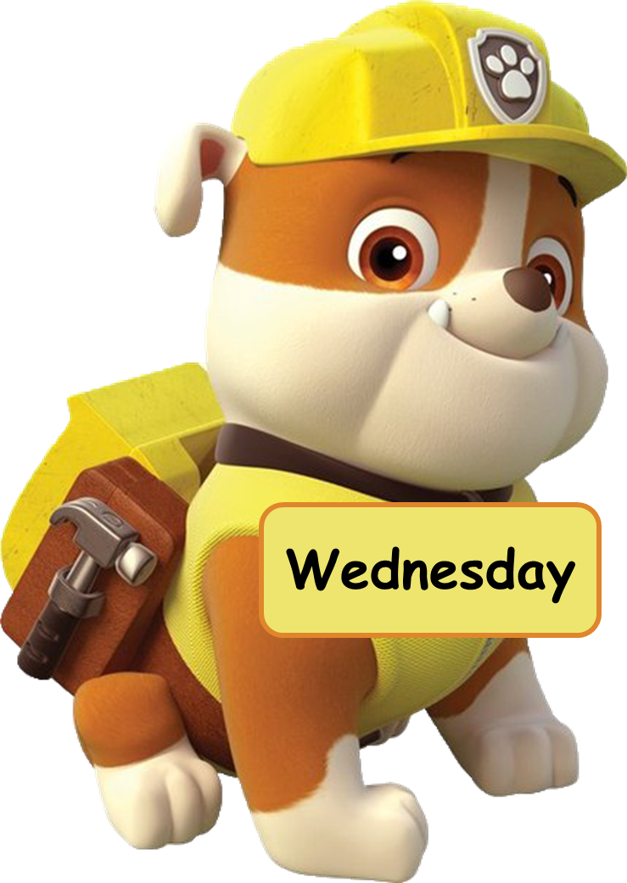
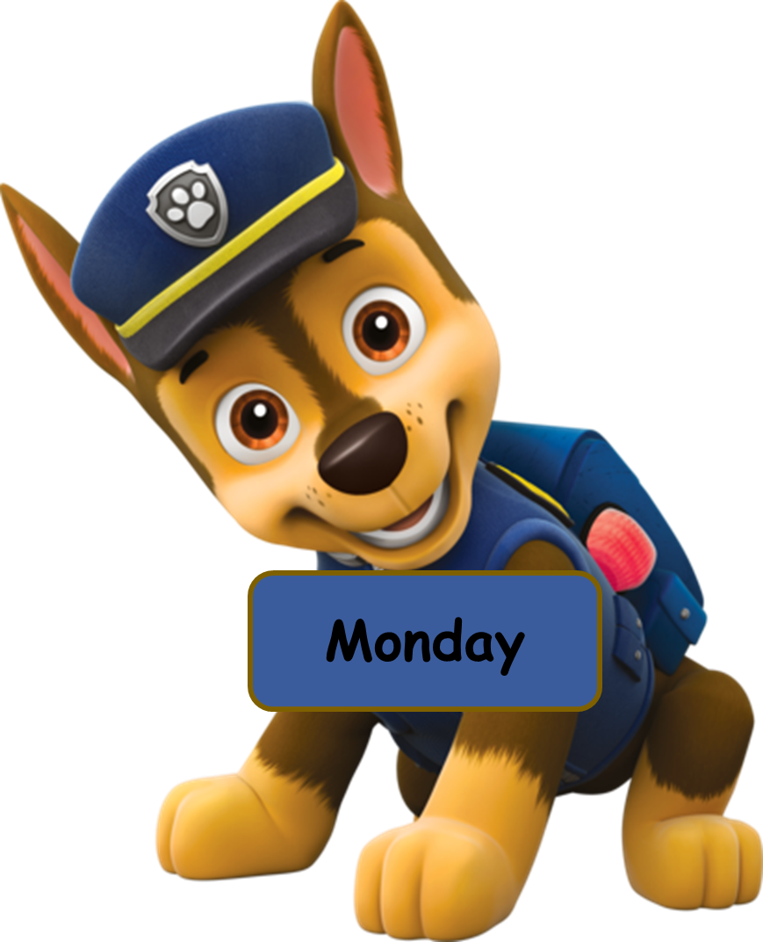
Click the dog having the correct answer.
Click here
Wat TV
Watch VT
Wach TV
Watch TV

Slide 29
Click the dog having the correct answer.
Click here
go swim
go swiming
go swimming
swimming

Slide 30
Click the dog having the correct answer.
Click here
skateboarding
go
skateboarding
go skateboading
go skate

Slide 31
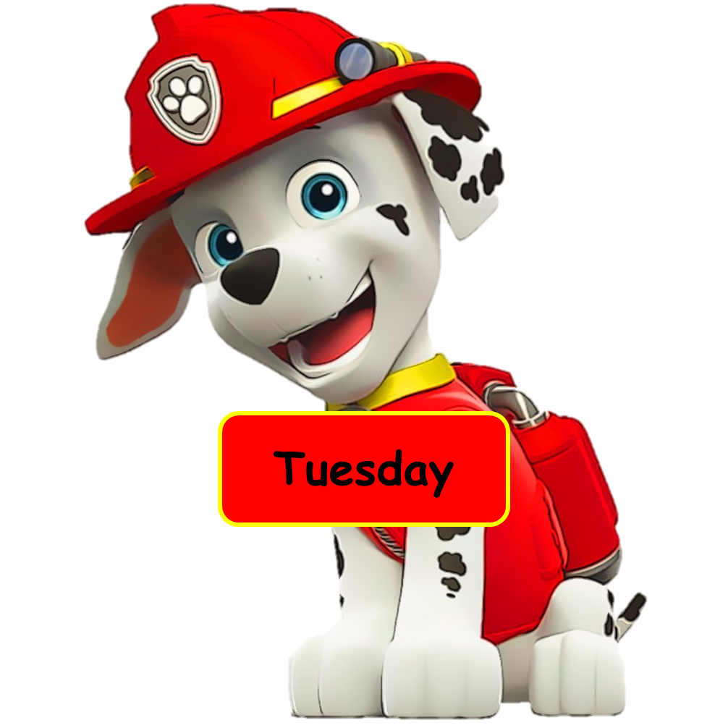
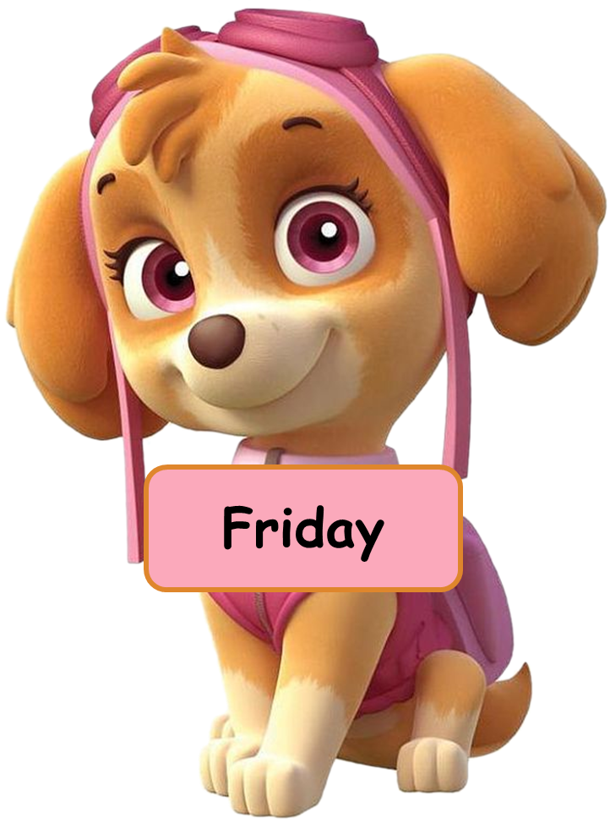
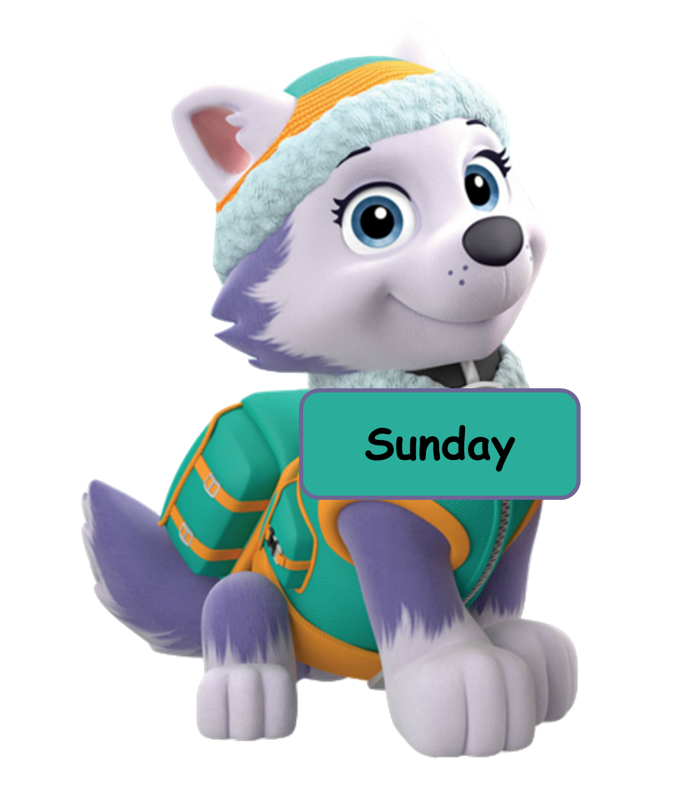
Click the dog having the correct answer.
Click here
going out
go out
out
go ou

Slide 32
Click the dog having the correct answer.
Click here
Answer the question you hear.
No, you may.
Yes, I may.
Yes, you may.
Yes, you may not.

Slide 33
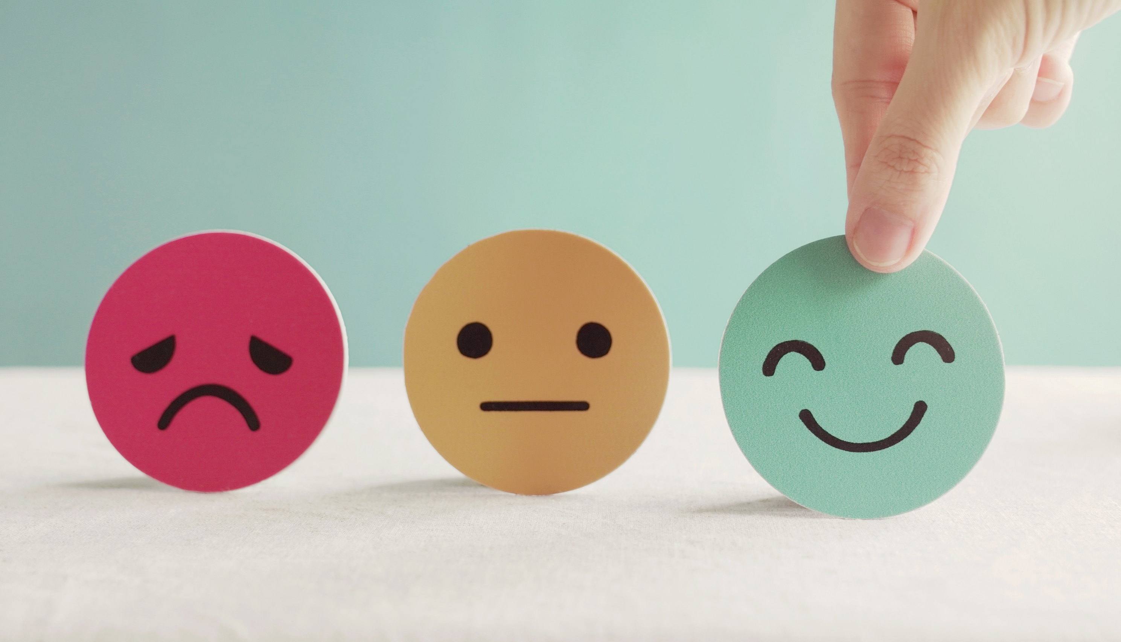
Lesson 3
Stay positive and have a nice day!

