Slide 1
Unit 5: Sports and hobbies
Lesson 3.1
Page 74

Slide 2
WARM-UP

Slide 3
CROSSWORD
1
H | I | T | T | I | N | G
2
V | O | L | L | E | Y | B | A | L | L
3
B | A | D | M | I | N | T | O | N
4
B | A | S | K | E | T | B | A | L | L
5
K | I | C | K | I | N | G
6
T | E | N | N | I | S
7
S | O | C | C | E | R
KEYWORD
Click on the crossword to show the answer.
Click the number to show the hint.
END

Slide 4
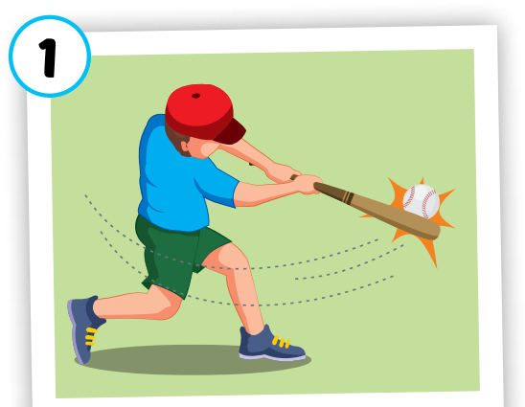
Back

Slide 5
Back

Slide 6
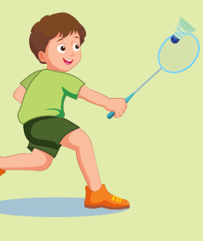
Back

Slide 7
Back

Slide 8
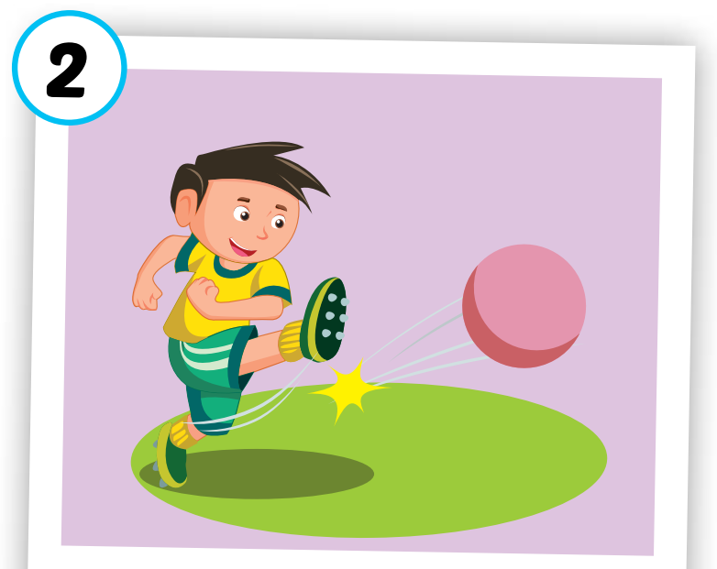
Back

Slide 9
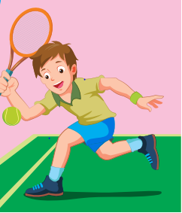
Back

Slide 10
Back

Slide 11
It’s time to learn …

Slide 12
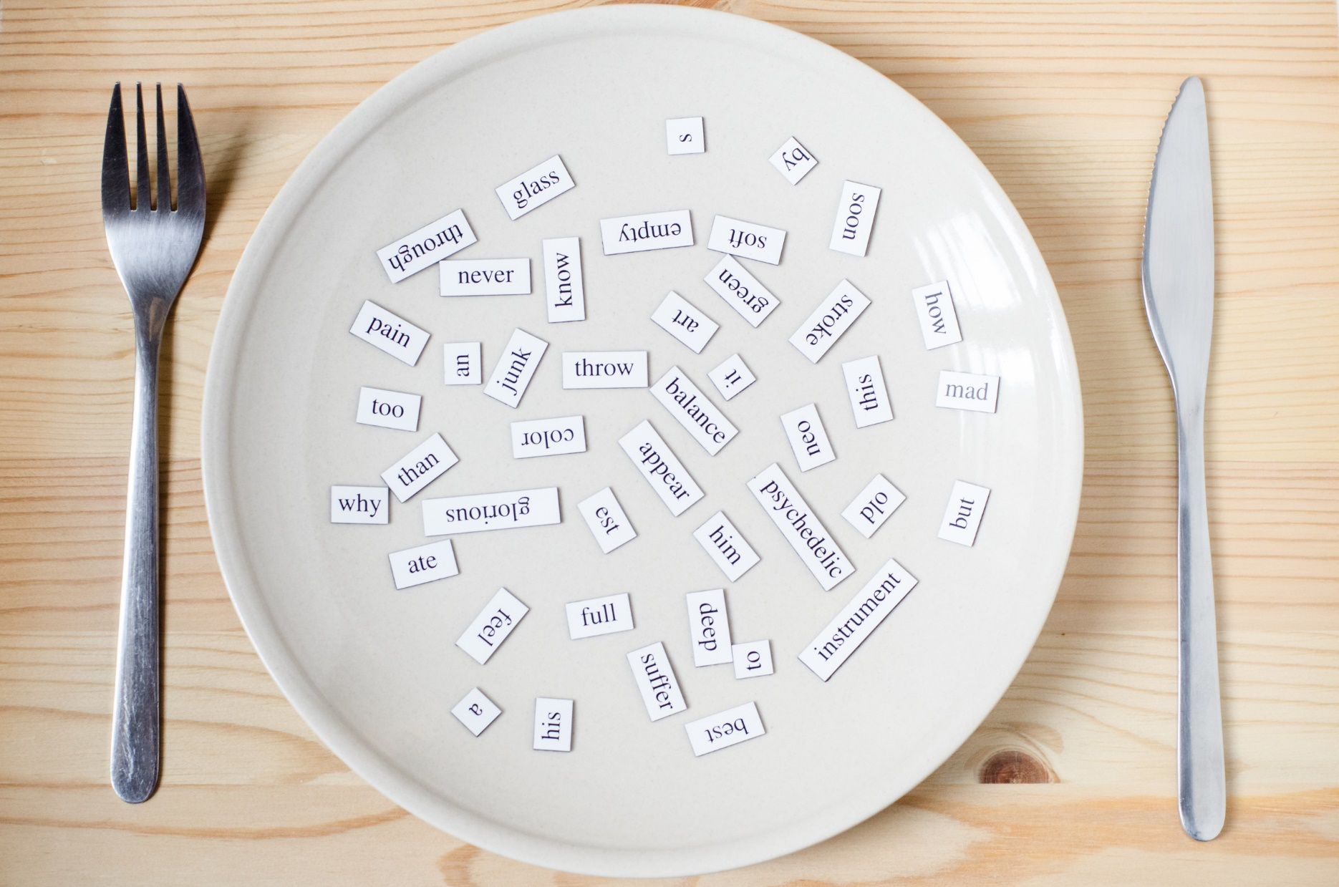
New words
watch TV
go skateboarding
go out
go swimming

Slide 13
watch TV
/wɑːtʃ ˌtiːˈviː/
xem ti-vi
Click on each word to hear the sound.

Slide 14
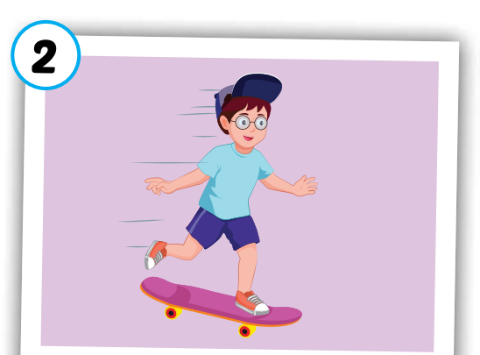
go skateboarding
/ɡoʊ ˈskeɪtˌbɔːrdɪŋ/
đi trượt ván
Click on each word to hear the sound.

Slide 15
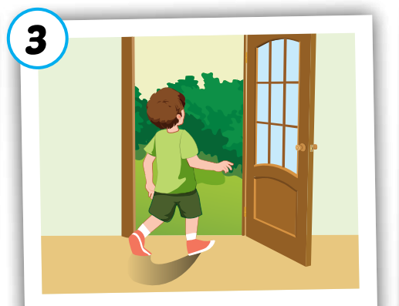
go out
/ɡoʊ aʊt/
đi ra ngoài
Click on each word to hear the sound.

Slide 16
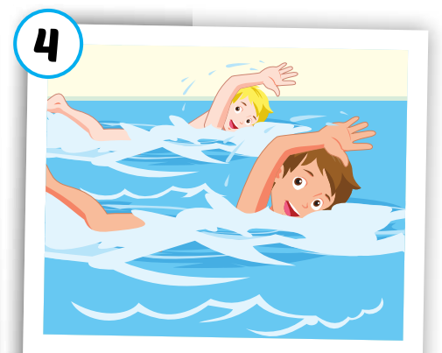
go swimming
/ɡoʊ ˈswɪmɪŋ/
đi bơi
Click on each word to hear the sound.

Slide 17
Click on each word to hear the sound.
watch TV
go skateboarding
go out
go swimming
/wɑːtʃ ˌtiːˈviː/
xem ti-vi
/ɡoʊ ˈskeɪtˌbɔːrdɪŋ/
đi trượt ván
/ɡoʊ aʊt/
đi ra ngoài
/ɡoʊ ˈswɪmɪŋ/
đi bơi

Slide 20
Practice

Slide 21
Answer 1 question correctly, you will open 1 puzzle piece.
1
2
3
4
Click here to open the task.
1
2
3
4
END

Slide 22
go o_t
U
BACK

Slide 23
go s_im_ing
W m
BACK

Slide 24
w_tc_ TV
a h
BACK

Slide 25
__ s_ate_oarding
go k b
BACK

Slide 26
Structures
May I watch TV?
- Yes, you may./No, you may not.

Slide 27
Presentation

Slide 28
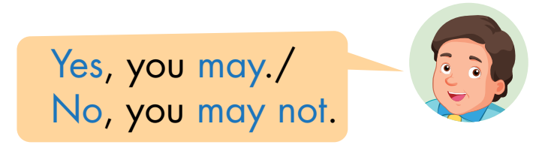

Slide 29
Practice

Slide 30
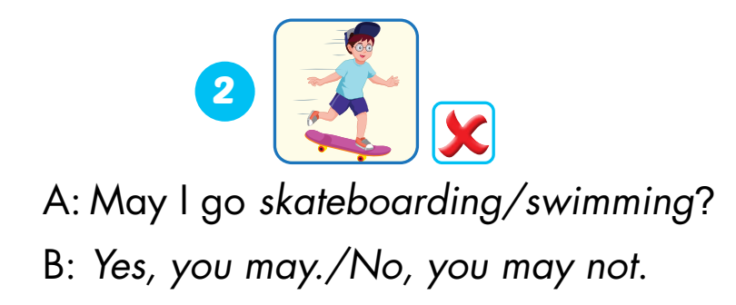
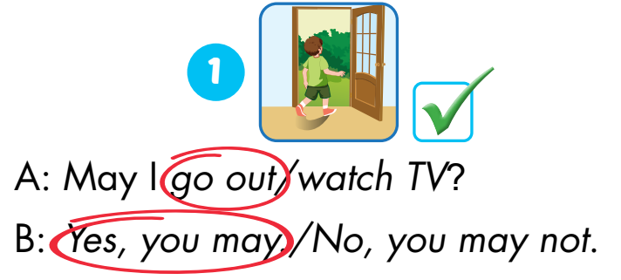
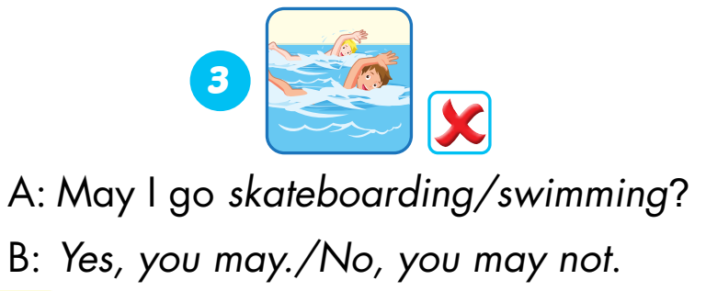
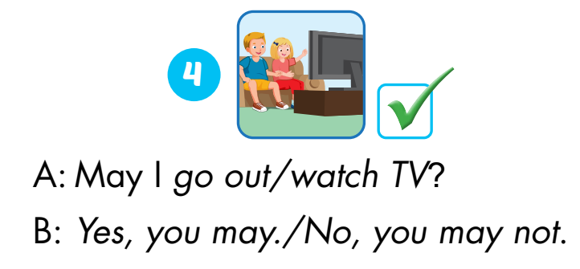

Slide 31
WRAP-UP

Slide 32
May I…?
Lost turn
☹
1
❌
SPIN
❌
4
2
1 more turn
☺
3
✓
✓
Yes, you may./
No, you may not.
Notes:
GV dùng vòng quay để HS chọn số ngẫu nhiên. Khi chọn vào ô số nào thì sẽ làm câu cho số đó

Slide 33
Have a nice day!

