Slide 1
Unit 5: Sports and hobbies
Lesson 2.3
Page 73

Slide 2
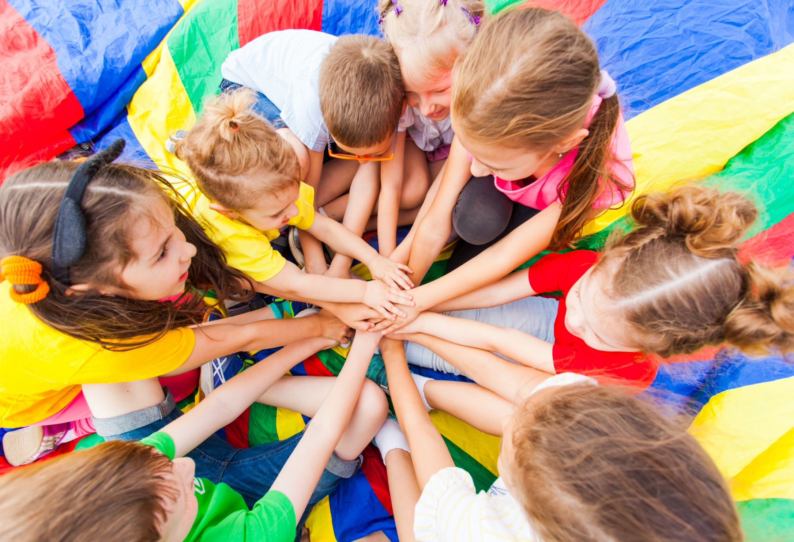
WARM-UP

Slide 3
Vocabulary Review

Slide 4
gickikn
k | i | c | k | i | n | g

Slide 5
actcginh
c | a | t | c | h | i | n | g

Slide 6
nitihtg
h | i | t | t | i | n | g

Slide 7
rhtoginw
t | h | r | o | w | i | n | g

Slide 8
It’s time to learn …

Slide 9
Speaking

Slide 15
Practice

Slide 16
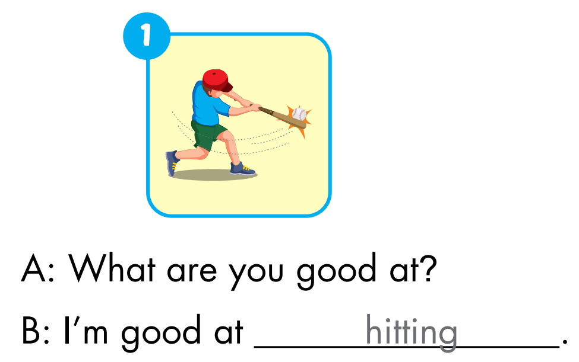
Extra Practice
WB, page 51.

Slide 17
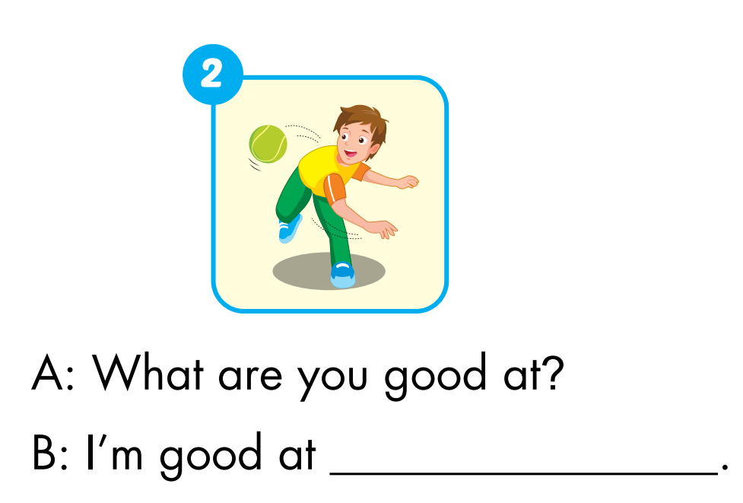
Extra Practice
WB, page 51.
throwing

Slide 18
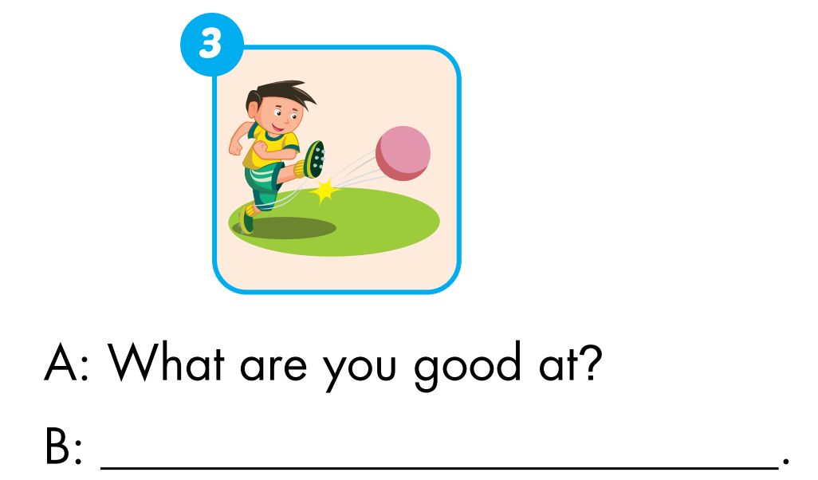
Extra Practice
WB, page 51.
I'm good at kicking

Slide 19
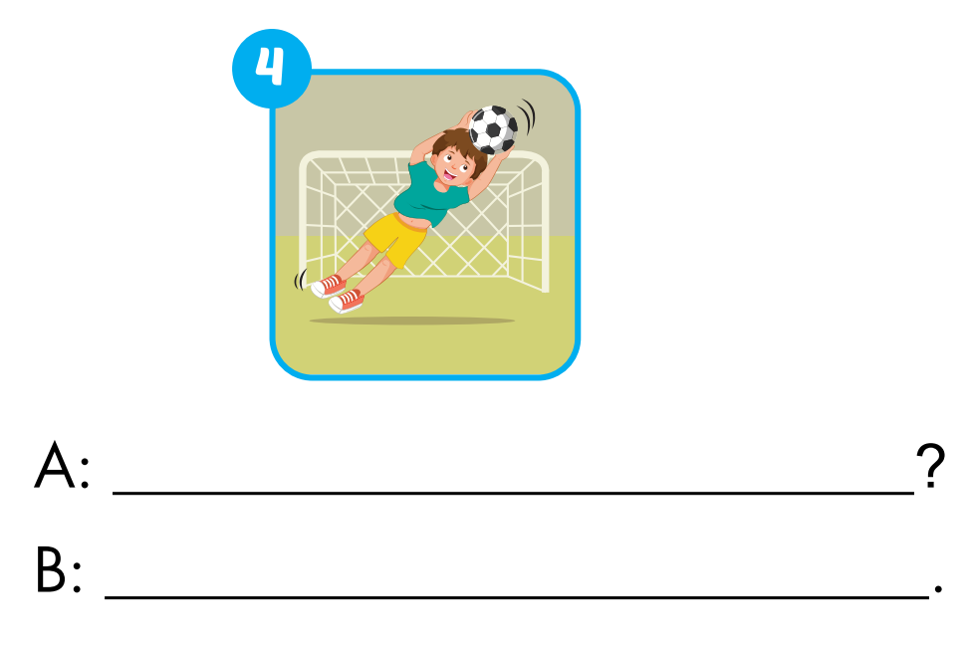
Extra Practice
WB, page 51.
What are you good at
I'm good at catching

Slide 20
CONSOLIDATION

Slide 21
WRAP-UP

Slide 22
Let’s play

Slide 23
How to play
. Listen to a sound
. Choose the correct answer

Slide 24
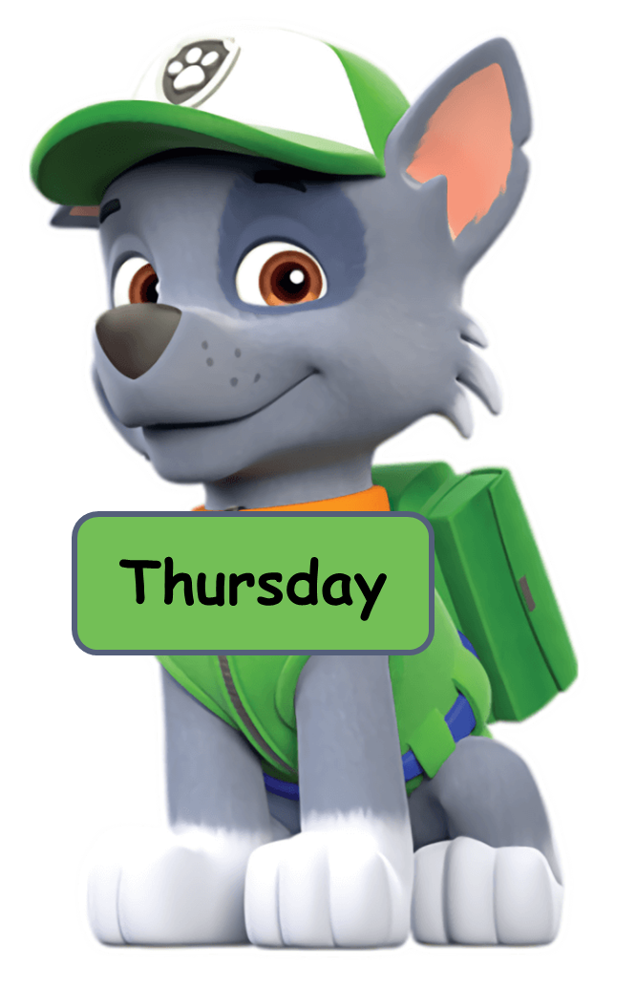
Click the dog having the correct answer.
Click here
kicking
throwing
catching
hitting

Slide 25
Click the dog having the correct answer.
Click here
kicking
throwing
catching
hitting

Slide 26
Click the dog having the correct answer.
Click here
hitting
catching
throwing
kicking

Slide 27
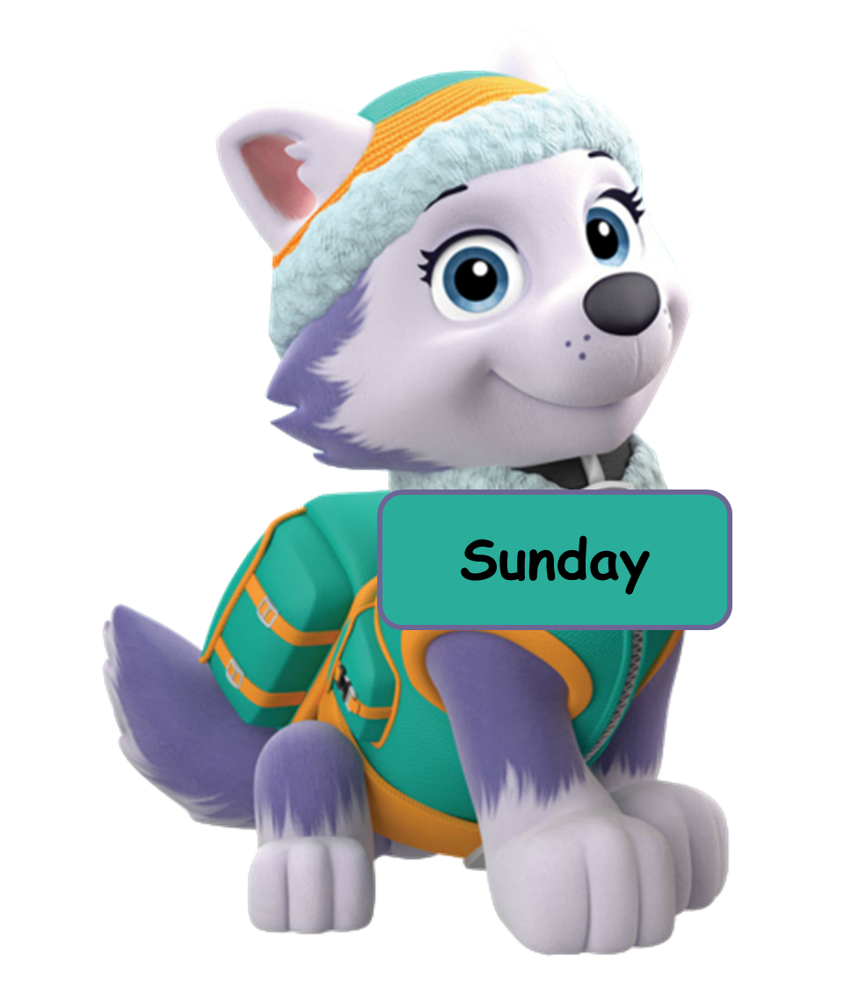
Click the dog having the correct answer.
Click here
throwing
kicking
hitting
catching

Slide 28
Click the dog having the correct answer.
Click here
Answer the question you hear.
I good at hitting.
I’m good hitting.
I am throwing.
I’m good at catching.
I’m good dancing.

Slide 29
Lesson 3
Stay positive and have a nice day!

