Slide 1

Unit 5: Sports and hobbies
Lesson 2.2
Page 72

Slide 2

WARM-UP

Slide 3


Choose a number and fill in the blank.
c_tching
thr_w_ng
1
2
a
o i
k_c_ing
_itting
Click on each word to hear the sound.
3
4
i k
h
Click here to show answers.
1
2
3
4

Slide 4

It’s time to learn …

Slide 5

Phonics
/θ/

Slide 6


/θ/
throwing
three
Click on each word to hear the sound.

Slide 7


/ θ /, / θ /, / θ /,
/ θ /, / θ /, / θ /,
throwing, three,
/ θ /, / θ /, / θ /
/ θ /, / θ /, / θ /,
/ θ /, / θ /, / θ /,
throwing, three,
/ θ /, / θ /, / θ /
Click to follow the lyrics.
Click one more to follow the second one.

Slide 8

Listening

Slide 9

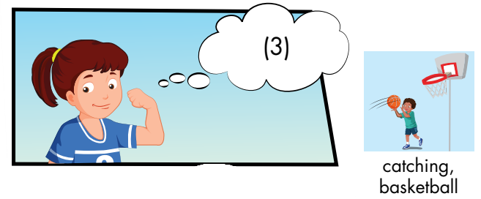
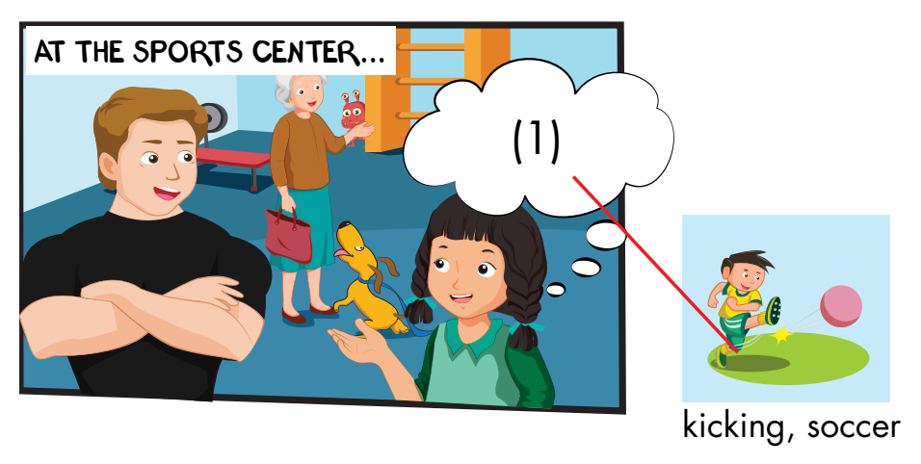
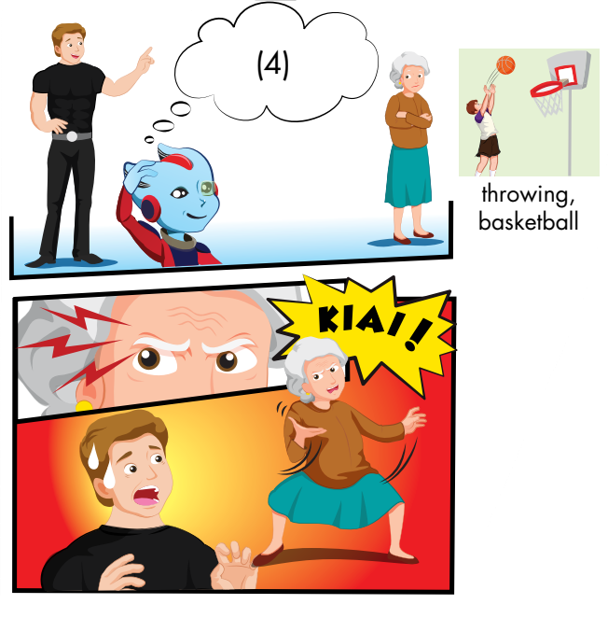
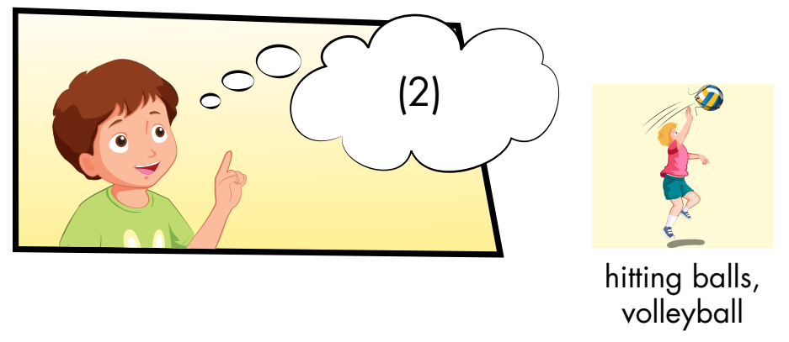
What actions can you see?
Who can you see?
What actions can you see?
How does the man feel?

Slide 10

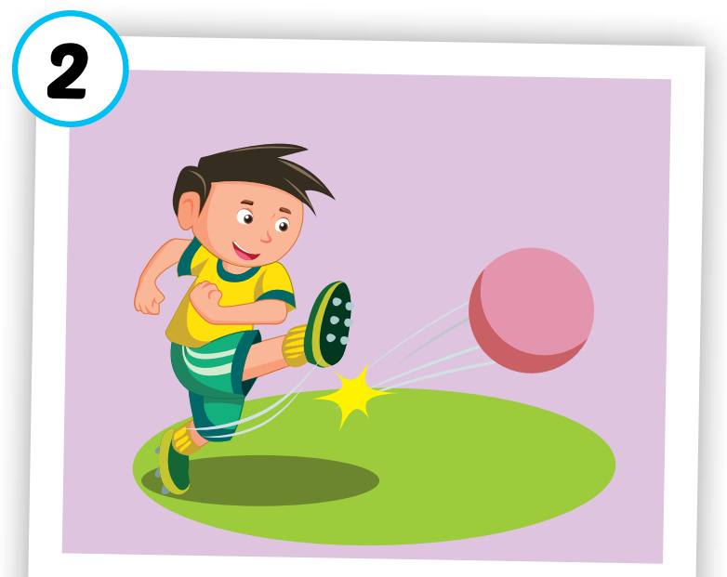
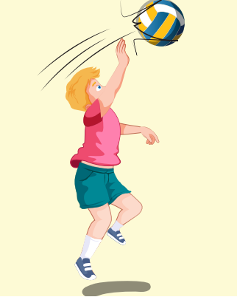
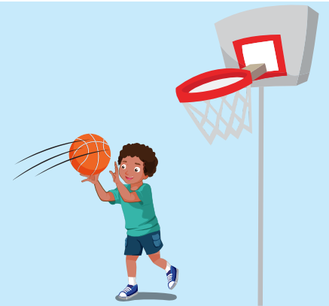
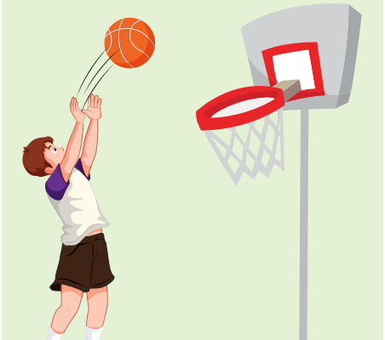
kicking, soccer
hitting balls, volleyball
catching, basketball
throwing, basketball

Slide 11

Click on the number to hear the sound
James: What are you good at, Mai?
Mai: I’m good at ______.
James: Good. You can play with the ______ team.
1
kicking
soccer
James: What are you good at, Tom?
Tom: I’m good at _______.
James: OK. _________ for you.
2
catching
Basketball

Slide 12
James: What about you, Lucy?
Lucy: I’m good at ___________. See?
James: Lucy, the _________ team.
3
hitting balls
volleyball
Click on the number to hear the sound

Slide 13
James: Alfie, what are you good at?
Alfie: I’m good at _________ balls.
James: Good. _________ team.
OK, Grandma? What are you good at?
Grandma: I’m good at doing this! Kiai!
Children: Wow!
throwing
Basketball
4
Click on the number to hear the sound

Slide 14

Practice

Slide 15
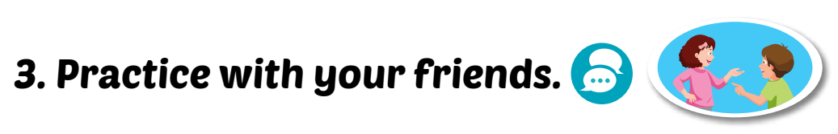
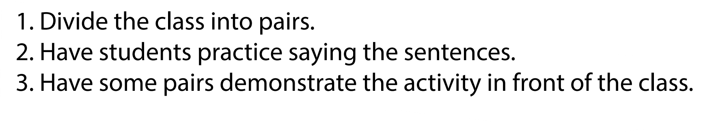


What are you good at?
I’m good at …

Slide 16

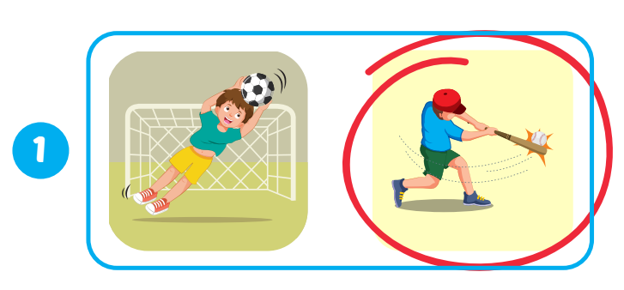
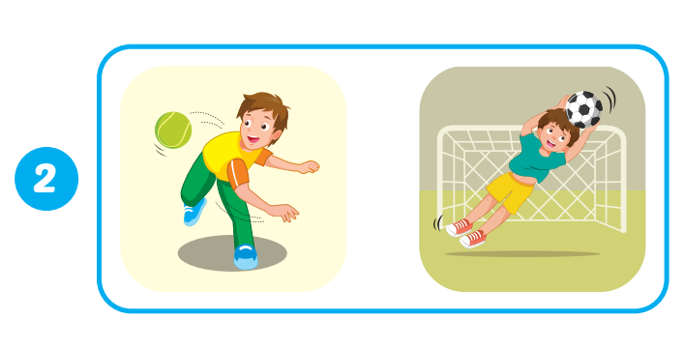
Extra Practice
WB, page 51.
Click on the picture to hear the sound

Slide 17
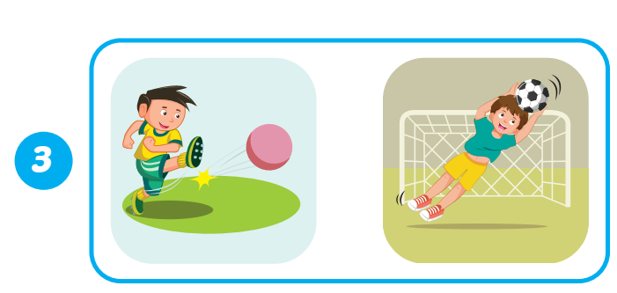
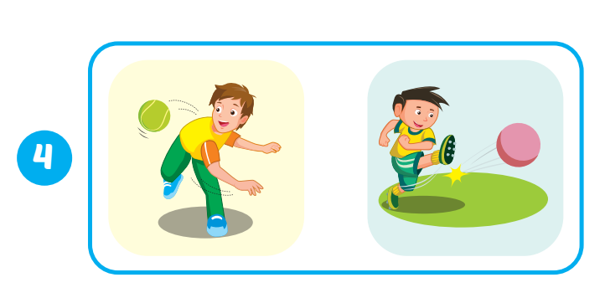
Extra Practice
WB, page 51.
Click on the picture to hear the sound

Slide 18

WRAP-UP

Slide 19



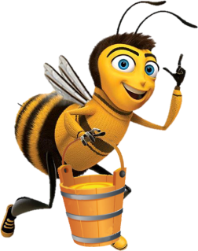
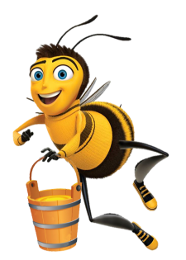

Bees return
to the hive
Play

Slide 20






Click on any bee to open the question.
End

Slide 21

Click the icon to hear the sound
📢
catching
Click to show answer.
Back

Slide 22
Rewrite the word: ihtgint
hitting
Click to show answer.
Back

Slide 23
Rewrite the word: kngckii
kicking
Click to show answer.
Back

Slide 24
Click the icon to hear the sound
📢
throwing
Click to show answer.
Back

Slide 25
Click the icon to hear the sound
📢
hitting
Click to show answer.
Back

Slide 26
Click the icon to hear the sound
📢
What are you good at?
Click to show answer.
Back

Slide 27
Click the icon to hear the sound
📢
kicking
Click to show answer.
Back

Slide 28
Rewrite the word: chatcgni
catching
Click to show answer.
Back

Slide 29
/ˈθroʊɪŋ/
ném
throwing
Click to show answer.
Back

Slide 30

Lesson 3
Stay positive and have a nice day!

