Slide 1
Unit 5: Sports and hobbies
Lesson 2.1
Page 71

Slide 2
WARM-UP

Slide 3
Swap positions

Slide 4
How to play
The students stand in a circle (or sit on a circle of chairs), except for one student (or the teacher), who stands in the middle. Each student must have a fixed position.
The person in the middle says a sentence that starts with Change positions if you… and ends with some condition (e.g. …have curly hair).
If that condition is true for a student, they have to stand up and find a new position as quickly as possible.
Students who can't find swap positions will be penalized.

Slide 5
It’s time to learn …

Slide 6
New words
hitting
kicking
catching
throwing

Slide 7
Presentation

Slide 8
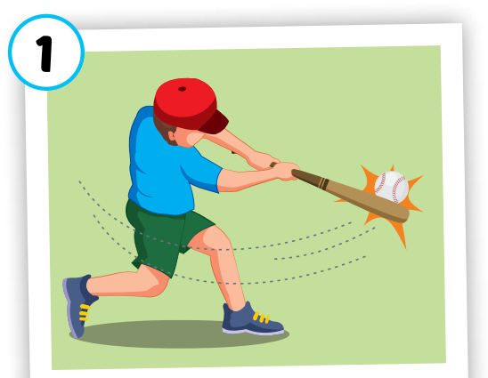
hitting
/ˈhɪtɪŋ/
đánh
Click on each word to hear the sound.

Slide 9
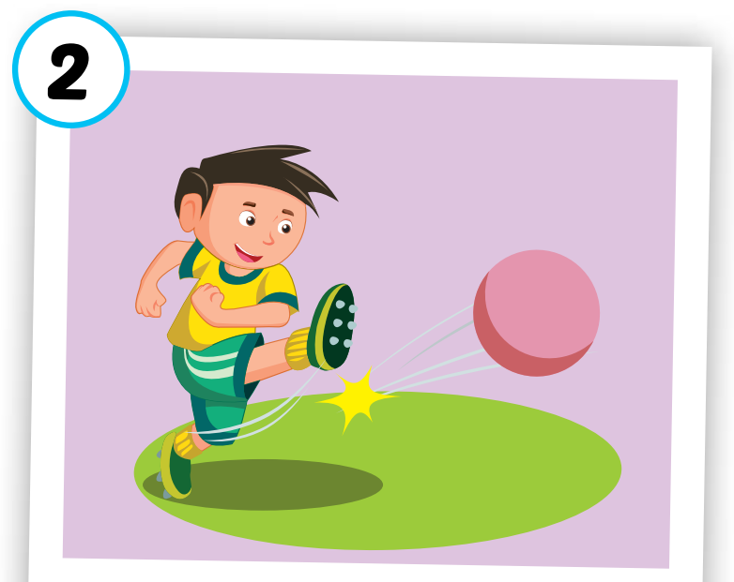
kicking
/ˈkɪkɪŋ/
đá
Click on each word to hear the sound.

Slide 10
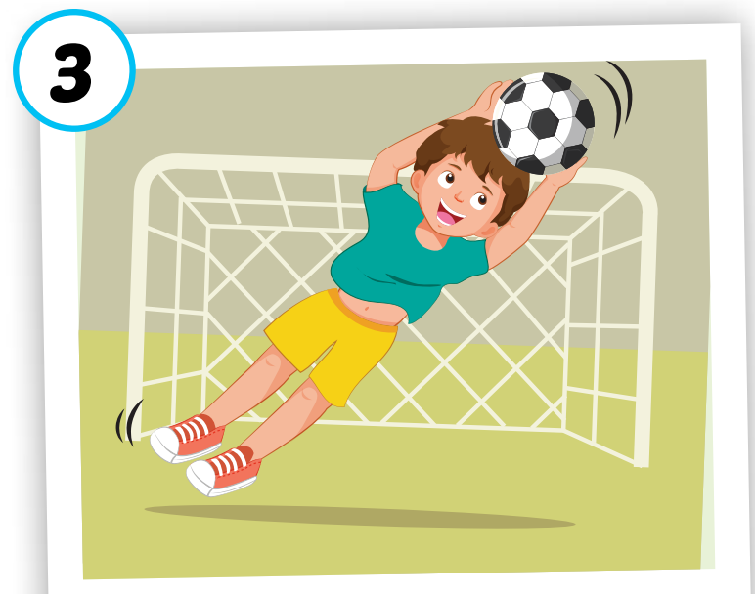
catching
/ˈkætʃɪŋ/
bắt
Click on each word to hear the sound.

Slide 11
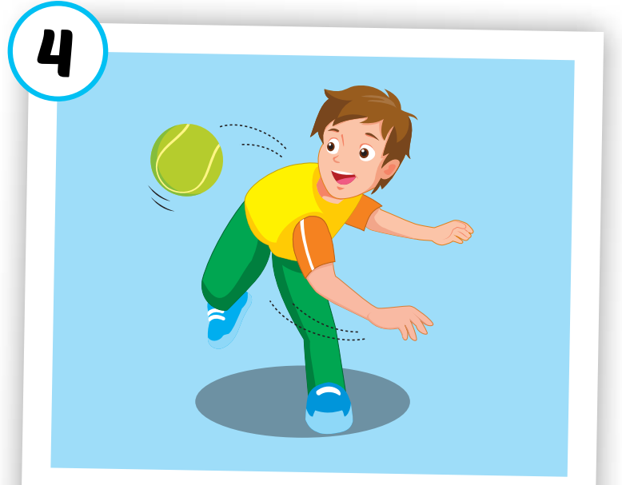
throwing
/ˈθroʊɪŋ/
ném
Click on each word to hear the sound.

Slide 12
hitting
kicking
catching
throwing
/ˈhɪtɪŋ/
đánh
/ˈkɪkɪŋ/
đá
/ˈkætʃɪŋ/
bắt
/ˈθroʊɪŋ/
ném
Click on each word to hear the sound.

Slide 13
Practice

Slide 14
1
2
3
4
5
6
7
8
Choose the same pictures.
Click on the square to see the picture
Click on to close the picture.

Slide 16
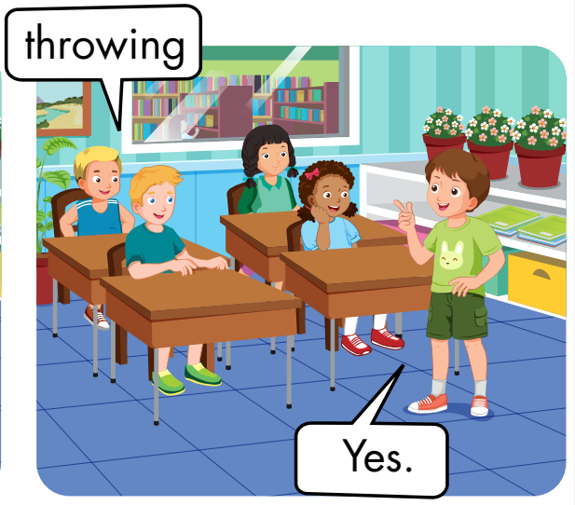
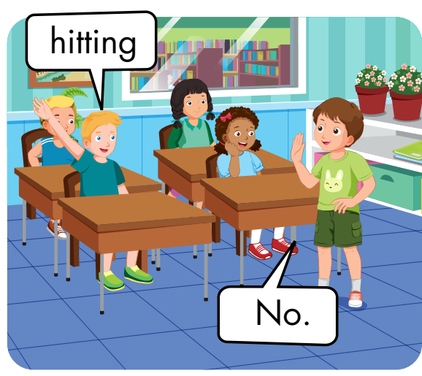

Slide 17
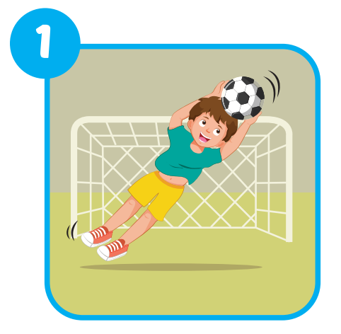
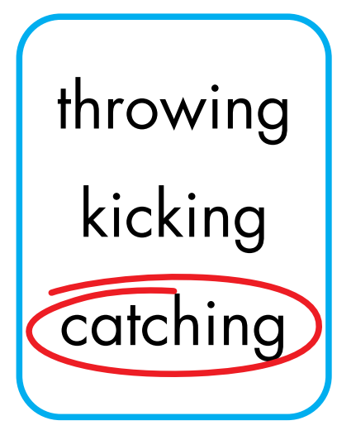
Extra Practice
WB, page 50.

Slide 18
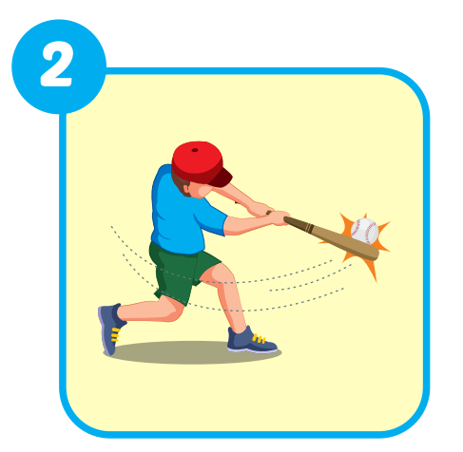
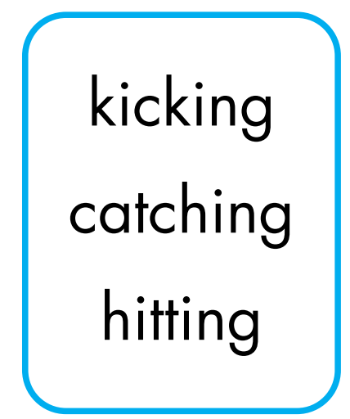
Extra Practice
WB, page 50.

Slide 19
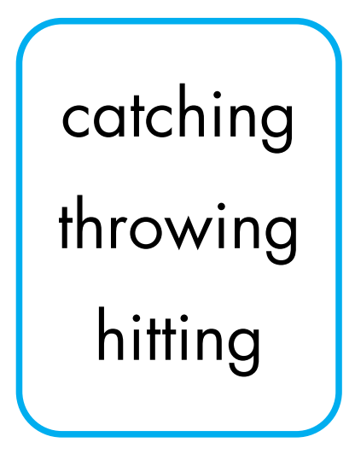
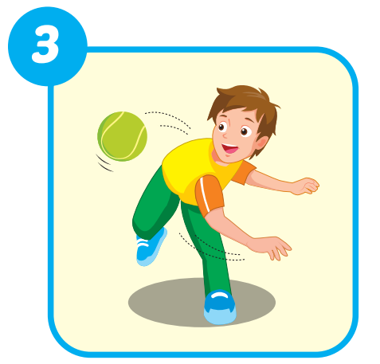
Extra Practice
WB, page 50.

Slide 20
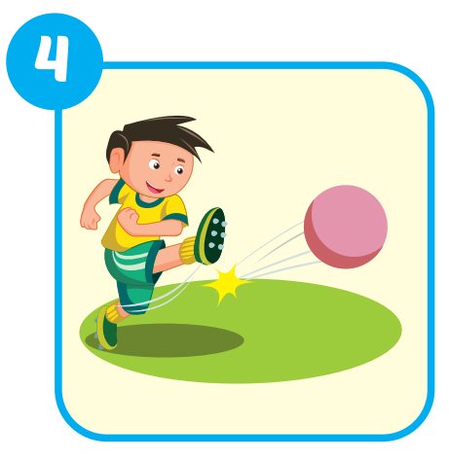
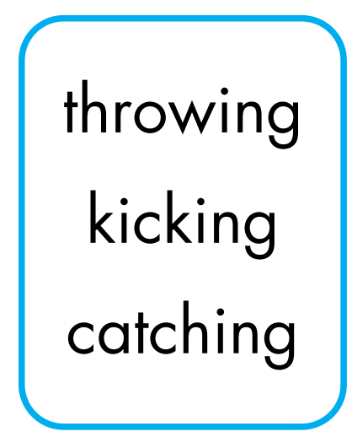
Extra Practice
WB, page 50.

Slide 21
Structures
What are you good at?
- I'm good at kicking.

Slide 22
Presentation

Slide 23
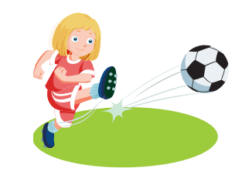

Slide 24
Practice

Slide 25
What
throwing
I’m

Slide 26
CONSOLIDATION

Slide 27
WRAP-UP

Slide 28
Who is faster?

Slide 29
How to play
Divide students into 2 groups.
The group with the correct answer will move on. The group with the wrong answer will be lost turn.
The group across the river first will win.
Group A
Group B

Slide 30
End
Congratulations
Congratulations
Click on the avatar of the group to move the level.
Click the log to show question.

Slide 31
Back
Hitting

Slide 32
Back
Throwing

Slide 33
Back
I'm good at…
What are you good at?

Slide 34
Back
A. Kicking
Choose the correct word.
Kicking B. Caching
C. Thowing D. Hiting

Slide 35
Back
Catching
Rewrite the word:
iccgthna

Slide 36
Back
I'm good at …
What are you good at?

Slide 37
Back
Kicking

Slide 38
Back
Hitting
Rewrite the word:
ihtgint

Slide 39
Back
Catching

Slide 40
Back
C. Throwing
Choose the correct word.
A. Kiking B. Hiting
C. Throwing D. Caching

Slide 41
Have a nice day!

