Slide 1

Unit 5: Sports and hobbies
Lesson 1.2
Page 69

Slide 2

WARM-UP

Slide 3
Vocabulary Review

Slide 4
iodmbntan
b | a | d | m | i | n | t | o | n

Slide 5
cosrec
s | o | c | c | e | r

Slide 6
tsnnie
t | e | n | n | i | s

Slide 7
ovlblylale
v | o | l | l | e | y | b | a | l | l

Slide 8
absletbakl
b | a | s | k | e | t | b | a | l | l

Slide 9

It’s time to learn …

Slide 10

Listening

Slide 11
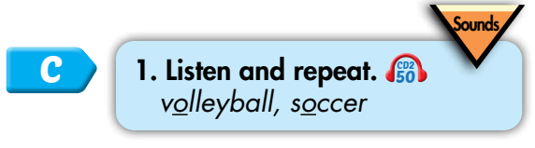

/ɑː/
volleyball
soccer
Click on each word to hear the sound.

Slide 12



/ɑː/, /ɑː/, /ɑː/,
/ɑː/, /ɑː/, /ɑː/,
volleyball, soccer,
/ɑː/, /ɑː/, /ɑː/.
/ɑː/, /ɑː/, /ɑː/,
/ɑː/, /ɑː/, /ɑː/,
volleyball, soccer,
/ɑː/, /ɑː/, /ɑː/.
Click to follow the lyrics.

Slide 13
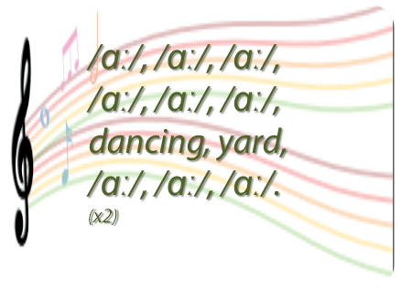
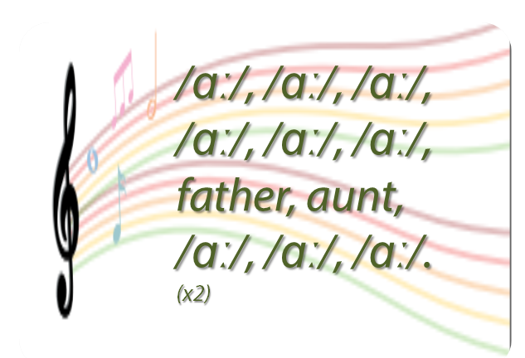
Do a similar chant. 🎤
Click on the circle to open the chant
/ɑː/
🎤
🎤

Slide 14
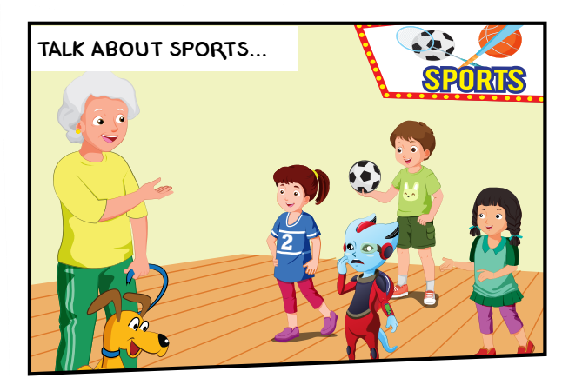
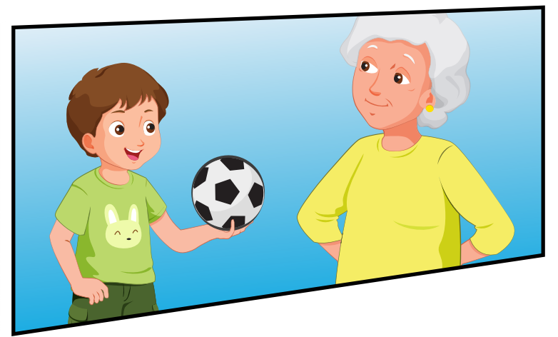
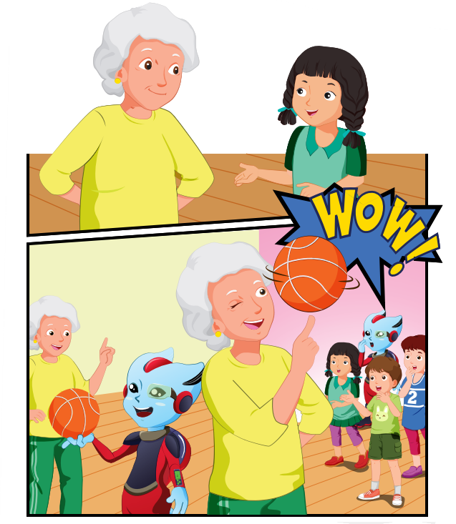
1
Who is she?
2
Are they talking about soccer?
3
What are they talking about?
4
What is Grandma doing ?

Slide 15

2
1
3
1. Grandma: Lucy, can you play badminton?
Lucy: Yes, I can, Grandma.
2. Grandma: Hey, Tom, can you play tennis?
Tom: No, I can't
3. Grandma: Mai, can you play volleyball?
Mai: Yes, I can. I love volleyball.
Grandma: Me too. It's a lot of fun.
4. Grandma: Alfie, can you play basketball?
Alfie: No, I can't.
Lucy: What about you, Grandma?
Grandma: Watch this!
Children: Wow!
4

Slide 16
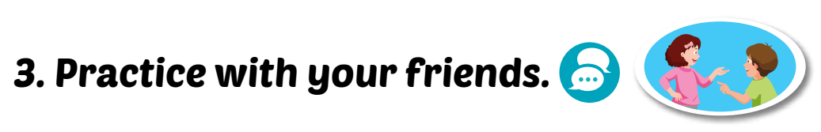
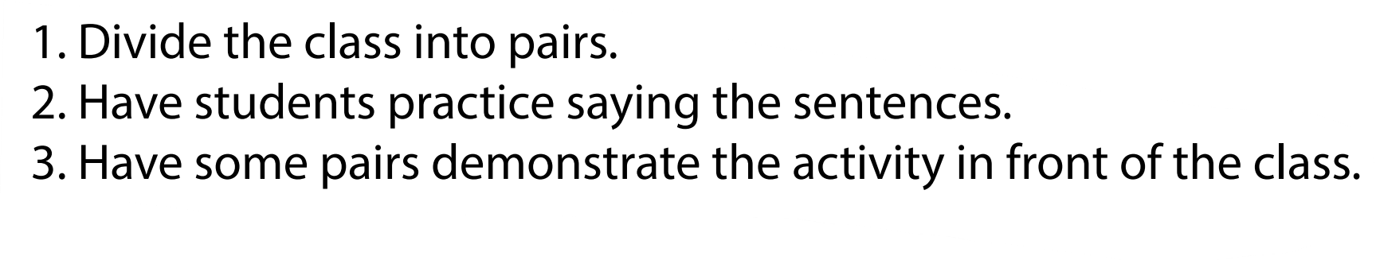
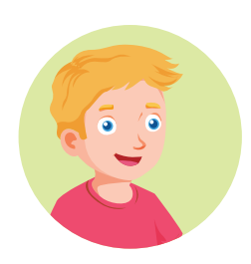

Can you play soccer?
Yes, I can.
/No, I can't.

Slide 17

Practice

Slide 18

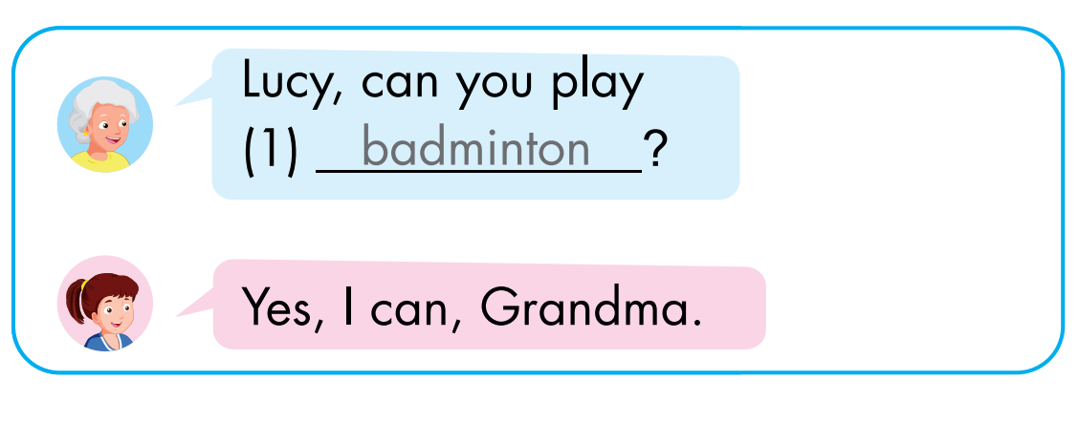
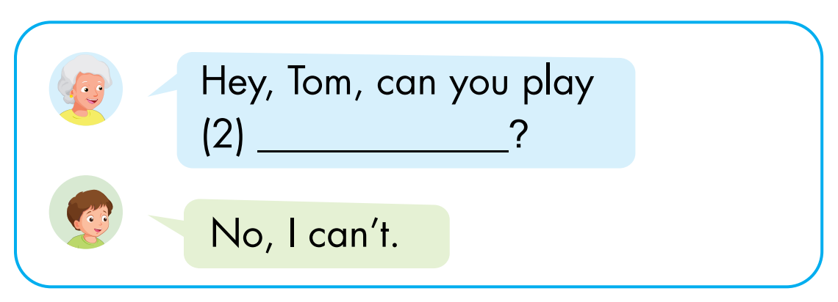
Click on each box to hear the sound.
tennis

Slide 19
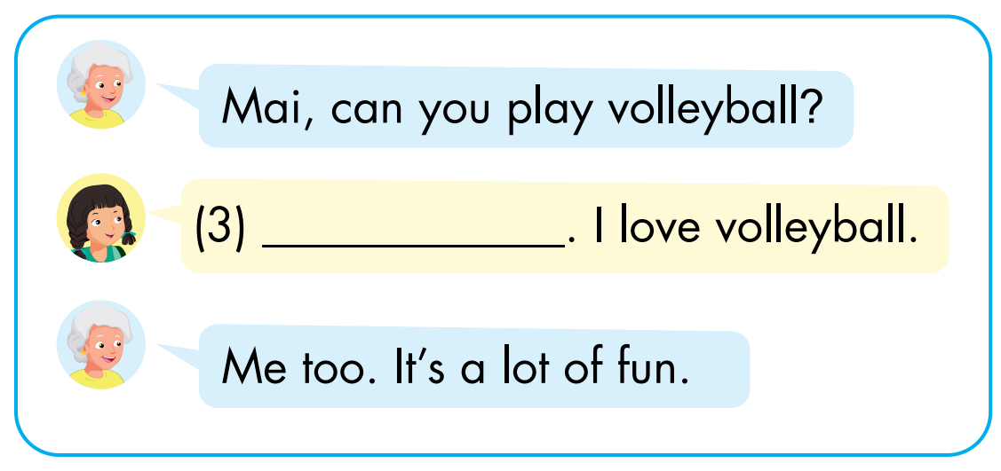
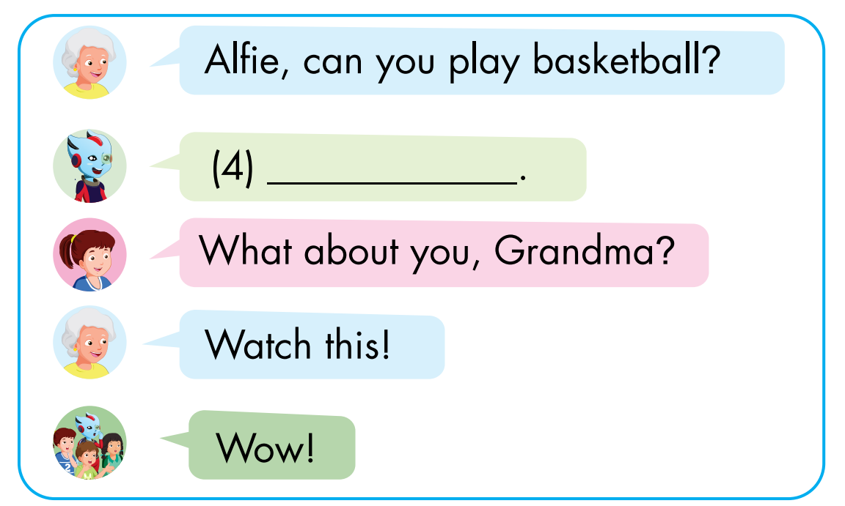
Click on each box to hear the sound.
Yes, I can
No, I can’t

Slide 20

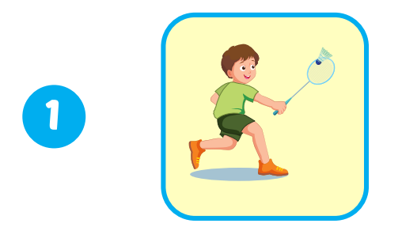
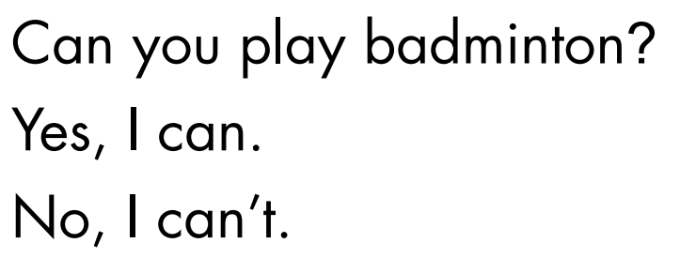
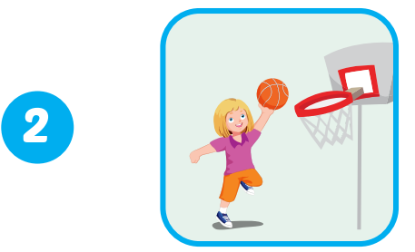
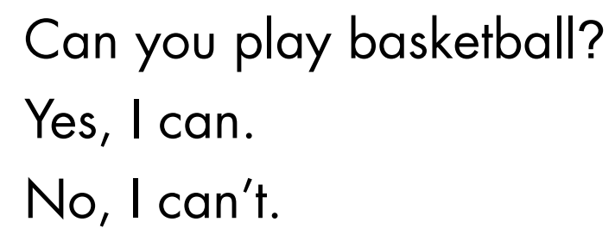
Extra Practice
WB, page 49.
1
✓
✓
2
Click on the number to hear the sound.

Slide 21
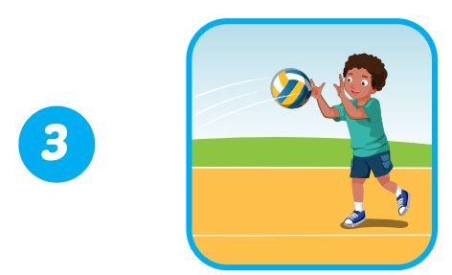
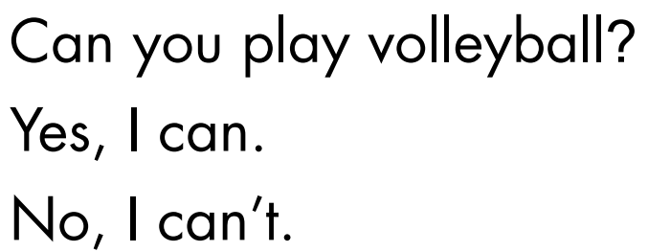
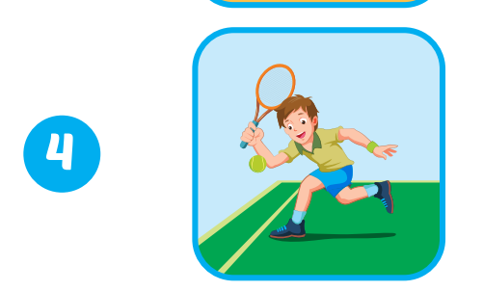
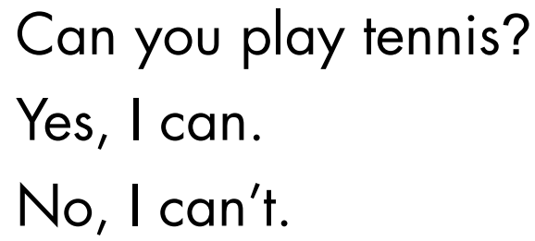
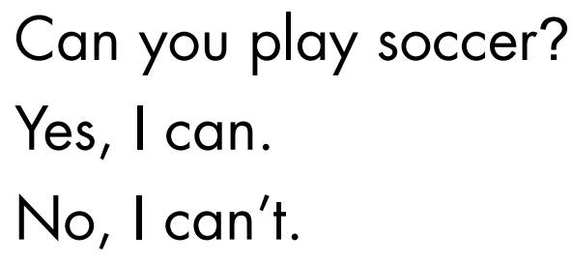
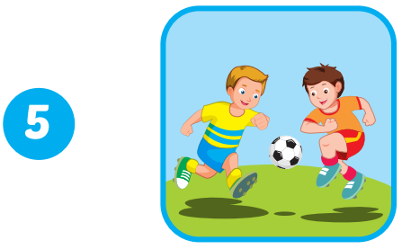
3
✓
✓
4
5
✓
Click on the number to hear the sound.

Slide 22

CONSOLIDATION

Slide 23

Students draw the following chart in notebooks.
SPORTS | NAME
badminton
tennis
volleyball
basketball
soccer
Mai

Slide 24

WRAP-UP

Slide 25









Click on the number

Slide 26


Can you play
badminton?
Click this apple to turn back.

Slide 27
Can you play
tennis?
Click this apple to turn back.

Slide 28
Can you play
volleyball?
Click this apple to continue.

Slide 29
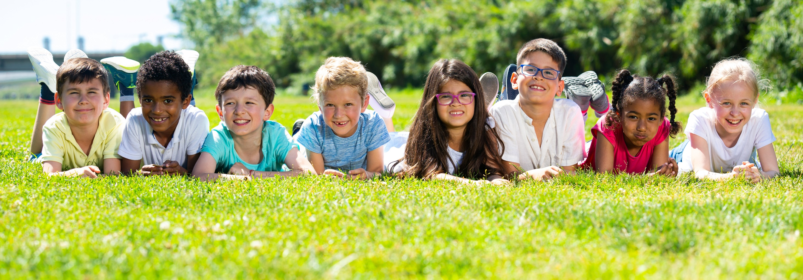
Have a nice day!

