Slide 1
Unit 5: Sports and hobbies
Lesson 1.1
Page 68

Slide 2
WARM-UP

Slide 3
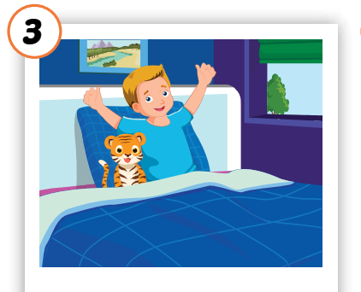
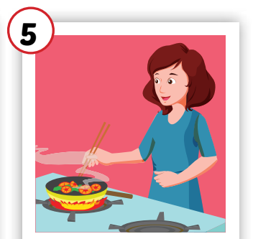
Crossword Puzzle
1
H | O | U | S | E
Click the boxes to show the answer.
2
W | A | K | E | U | P
3
C | O | O | K | I | N | G
4
M | O | T | H | E | R
5
N | O | T | E | B | O | O | K
Double click on the number to open the hint.
Click again on the number to close the hint.
KEYWORD

Slide 4
It’s time to learn …

Slide 5
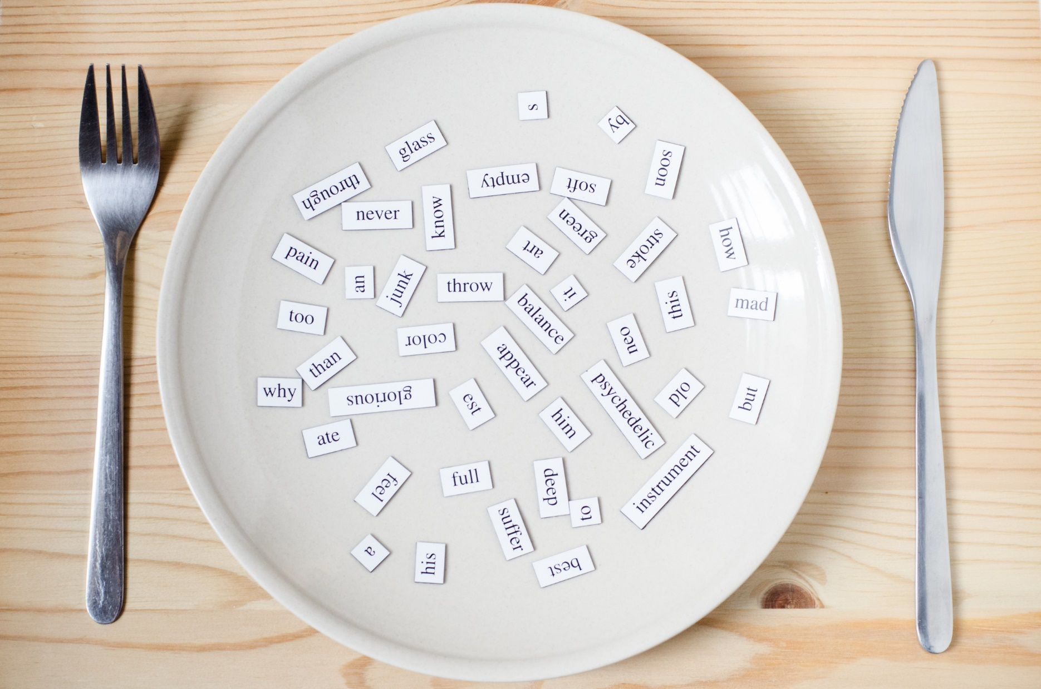
New words
badminton
tennis
volleyball
basketball
soccer

Slide 6
Presentation

Slide 7
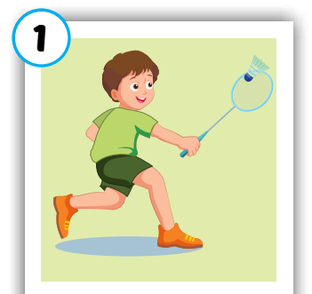
Click on each word to hear the sound.
badminton
/ˈbædmɪntən/
cầu lông

Slide 8
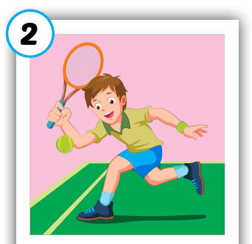
Click on each word to hear the sound.
tennis
/ˈtenɪs/
quần vợt

Slide 9
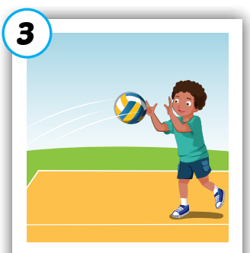
Click on each word to hear the sound.
volleyball
/ˈvɑːlibɑːl/
bóng chuyền

Slide 10
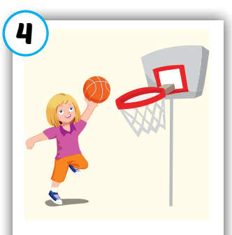
Click on each word to hear the sound.
basketball
/ˈbæskətbɑːl/
bóng rổ

Slide 11
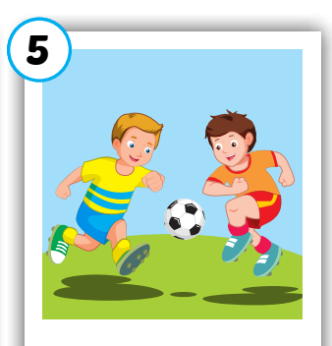
Click on each word to hear the sound.
soccer
/ˈsɑːkər/
bóng đá

Slide 12
Click on each word to hear the sound.
badminton
tennis
volleyball
basketball
soccer
/ˈbædmɪntən/
cầu lông
/ˈtenɪs/
quần vợt
/ˈvɑːlibɑːl/
bóng chuyền
/ˈbæskətbɑːl/
bóng rổ
/ˈsɑːkər/
bóng đá

Slide 13
Practice

Slide 14
1
2
3
4
Click on the square to see the picture
6
7
8
Click on the button to close the picture
5
9
10
11
12
Notes:
Memory game. GV nhấn vào ô để mở, nếu HS chọn 2 hình không giống nhau, GV nhấn vào hình tròn để đóng hình lại, HS phải nhớ những hình đã mở.

Slide 15
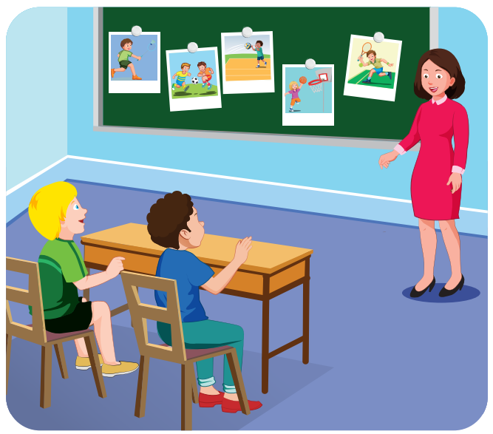
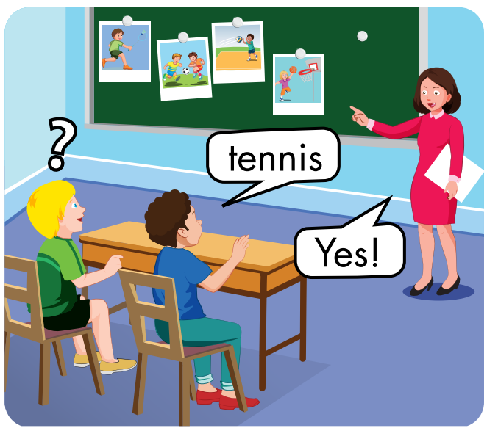

Slide 17
badminton
/ˈbædmɪntən/
cầu lông

Slide 19
volleyball
/ˈvɑːlibɑːl/
bóng chuyền

Slide 21
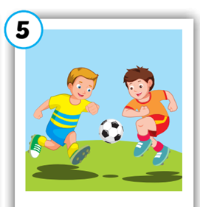

Slide 22
Structures
Can you play soccer?
-Yes, I can./No, I can't.

Slide 23
Presentation

Slide 25
Practice

Slide 26
Can you
Yes
play
I can’t

Slide 27
CONSOLIDATION

Slide 28
Can you play ….?
Lost turn
☹
1
SPIN
5
2
4
3
Yes, I can.
No, I can’t.

Slide 29
WRAP-UP

Slide 30
Have a nice day!

