Slide 1
Primary School
Welcome To Our Class 3
Teacher.

Slide 2
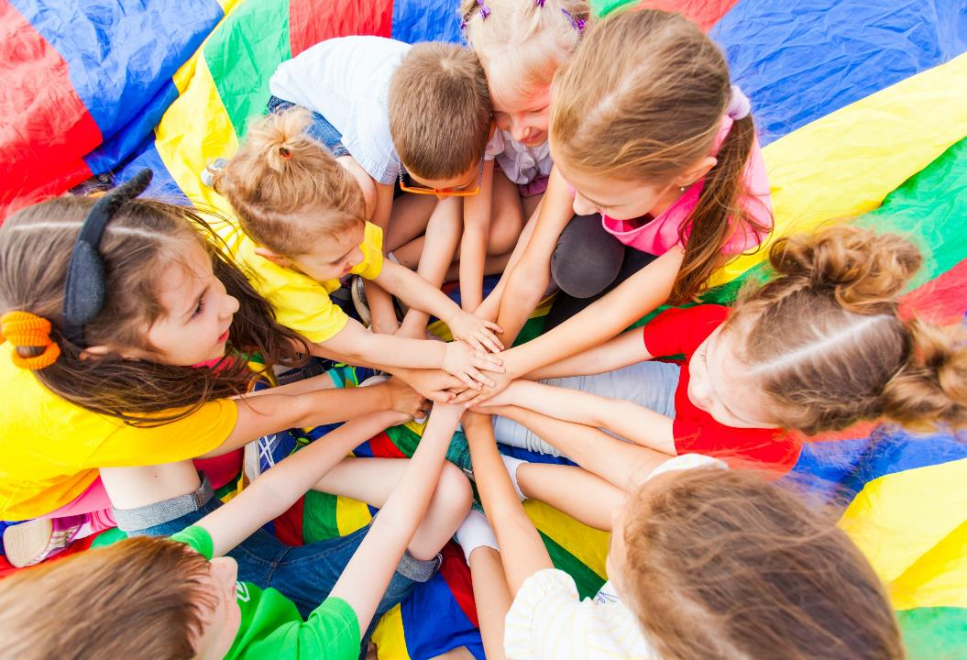
WARM UP

Slide 3
It’s time to learn …

Slide 4
Thursday, November 28th 2024
UNIT 3. SCHOOL
ART ( PART E,F,G)

Slide 5
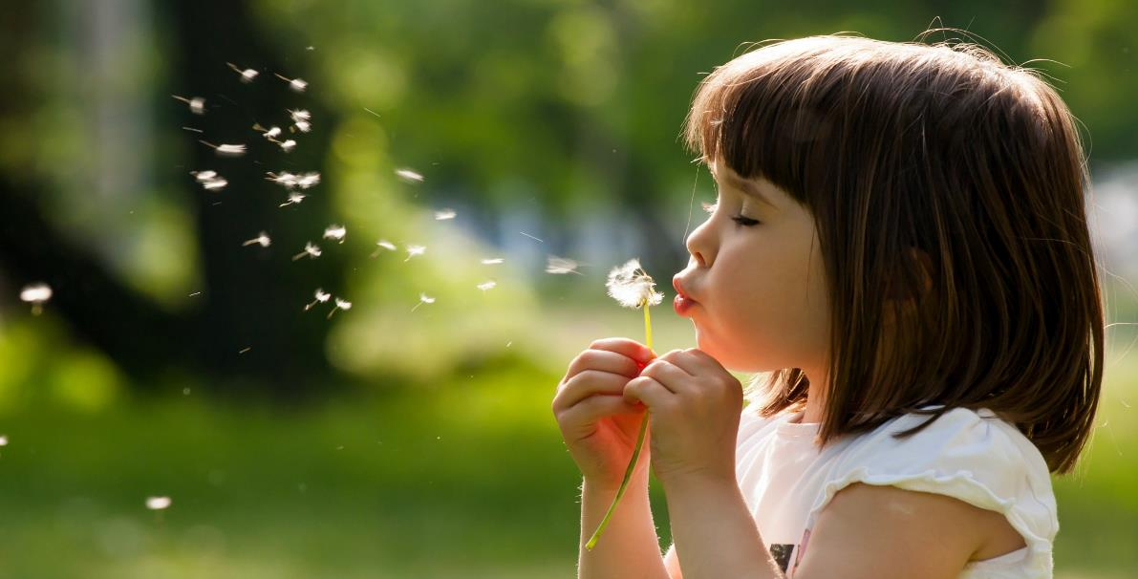
Let’s play!

Slide 6
1
4
6
1
SPIN
2
5
2
5
4
3
3
6
Next Part

Slide 7
Go back

Slide 8
Go back

Slide 9
Go back

Slide 10
Go back

Slide 11
Go back

Slide 12
Go back

Slide 13
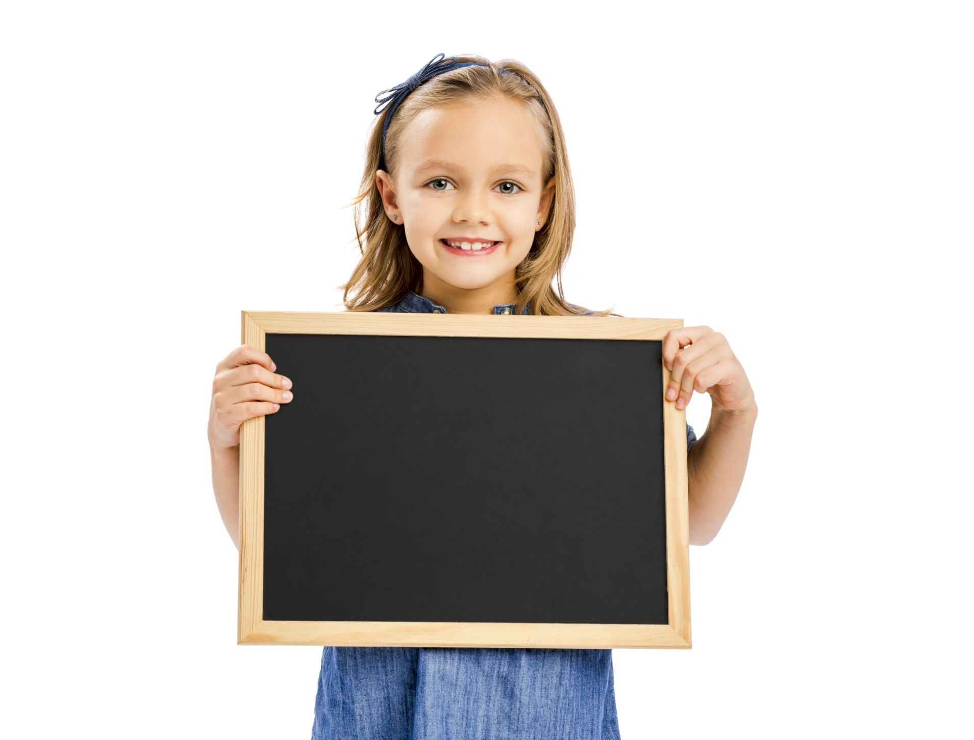
Reading

Slide 14
1 Minh has a blue notebook. True / False

Slide 15
2 Minh can paint a fish. True / False

Slide 16
3 Minh can make yellow with orange and red. True / False

Slide 17
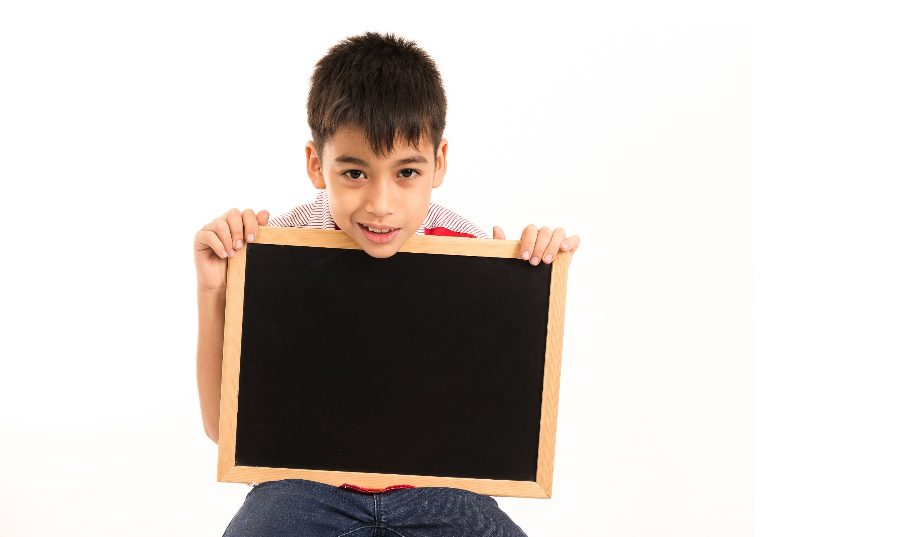
Writing

Slide 18
Example:
is red
a red pencil and a red cat
my red pencil
a pencil case with red and yellow
pink
red and white

Slide 19
CONSOLIDATION

Slide 20
Lesson 3
Homework
Learn by hearts vocabularies and make sentences using them.
Do the exercises on page 30 WB

Slide 21
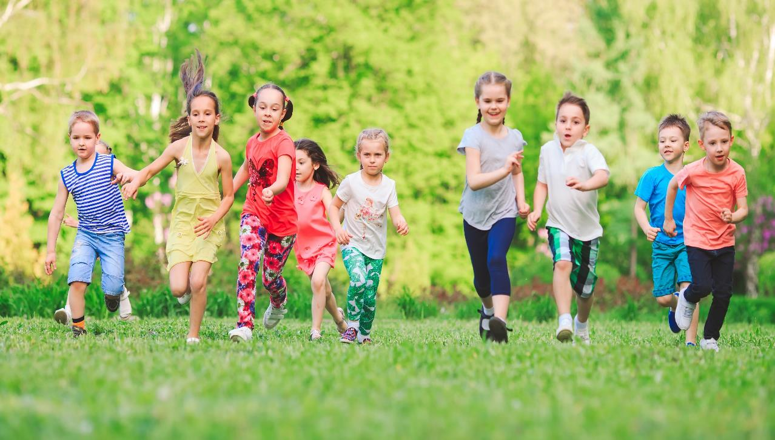
Have a nice day!

