Slide 1
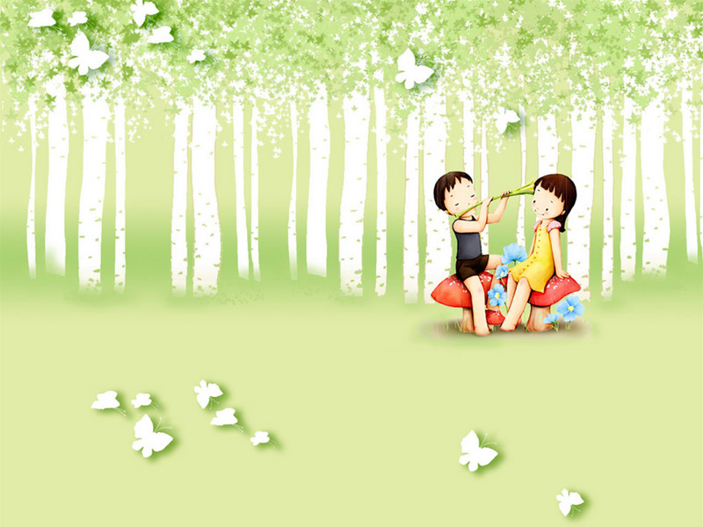
SAI SON A Primary School
Welcome To Our Class 3
Teacher: Trinh thi Nhung

Slide 2
Unit 3: School
Lesson 3.1
Page 44

Slide 3
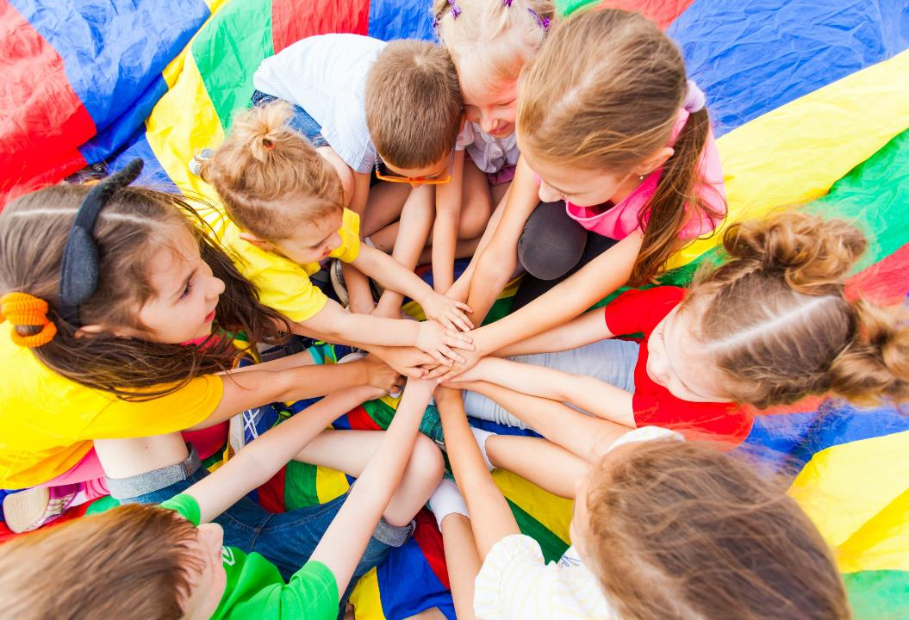
WARM UP

Slide 4
LET’S PLAY!
What’s missing?
Notes:
Put three or four FLASHCARDS (school subjects) on the board and tell your child to look at them. Ask them to close their eyes and take one card away. When your child opens their eyes, ask them to guess what is missing.

Slide 5
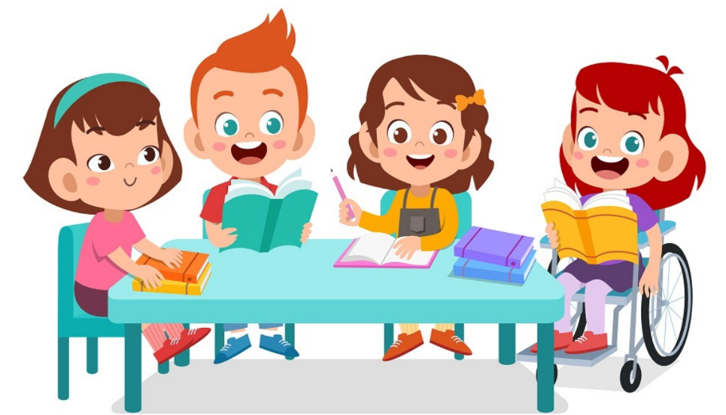
It’s time to learn …

Slide 6
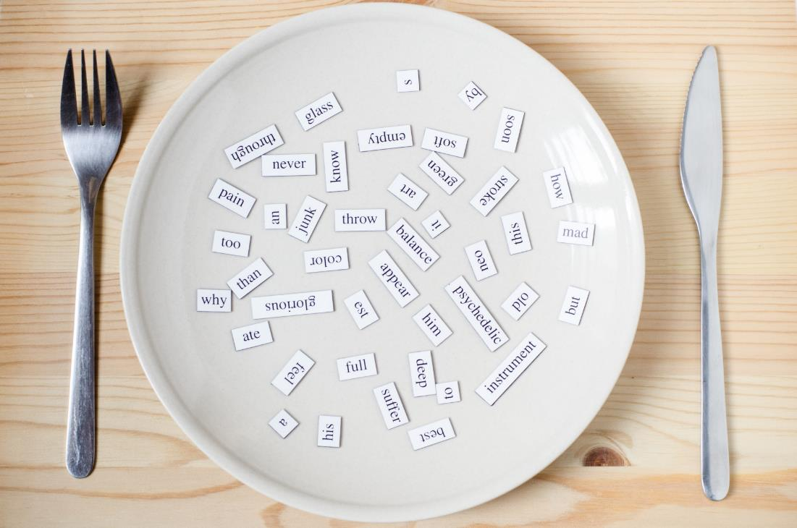
New words
Monday,
Tuesday, Wednesday, Thursday,
Friday,
Saturday,
Sunday

Slide 7
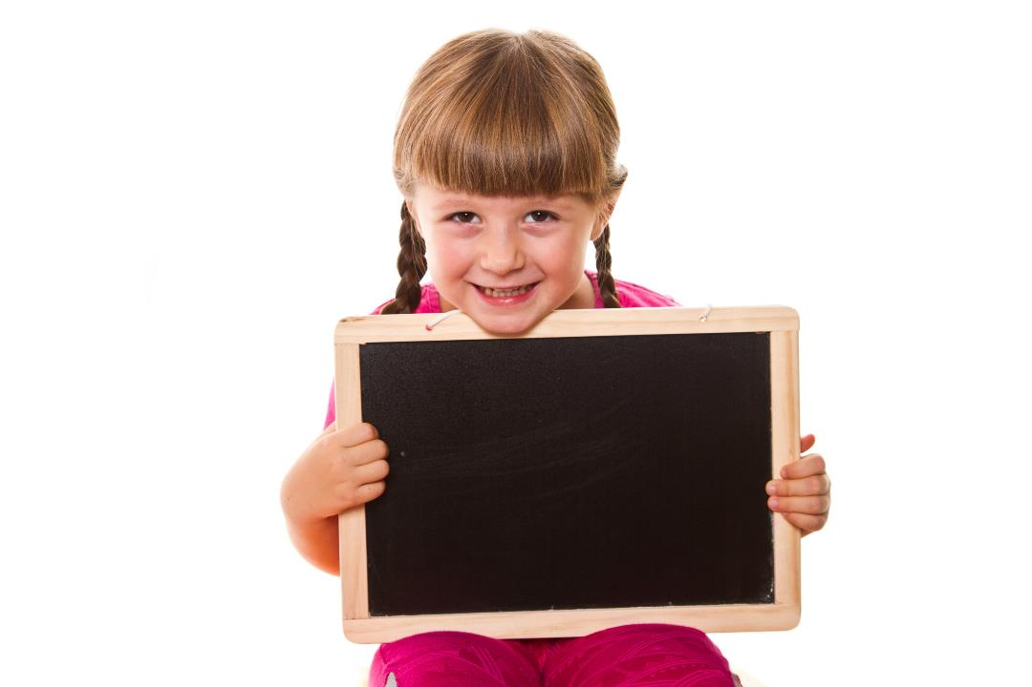
Presentation

Slide 8
Listen and point.
Click the icon to hear the sound.

Slide 9
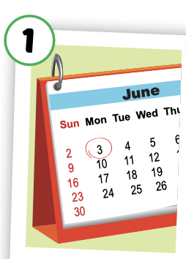
Listen and repeat.
Click each picture to hear the sound.
Monday
/ˈmʌndeɪ/
Thứ Hai

Slide 10
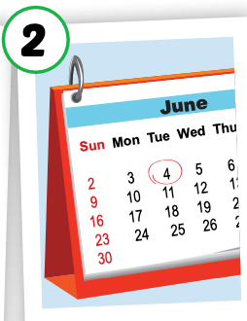
Listen and repeat.
Click each picture to hear the sound.
Tuesday
/ˈtuːzdeɪ/
Thứ Ba

Slide 11
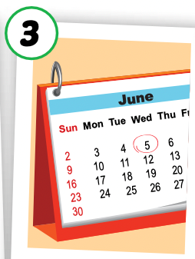
Listen and repeat.
Click each picture to hear the sound.
Wednesday
/ˈwenzdeɪ/
Thứ Tư

Slide 12
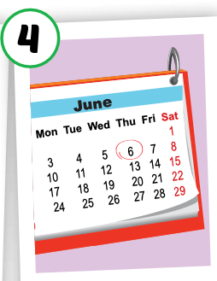
Listen and repeat.
Click each picture to hear the sound.
Thursday
/ˈθɜːrzdeɪ/
Thứ Năm

Slide 13
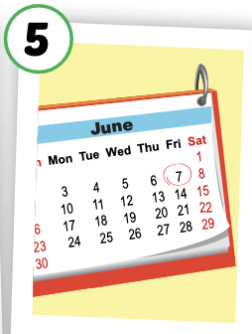
Listen and repeat.
Click each picture to hear the sound.
Friday
/ˈfraɪdeɪ/
Thứ Sáu

Slide 14
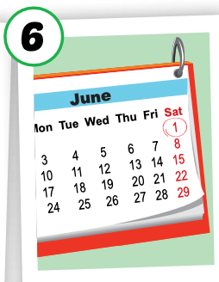
Listen and repeat.
Click each picture to hear the sound.
Saturday
/ˈsætərdeɪ/
Thứ Bảy

Slide 15
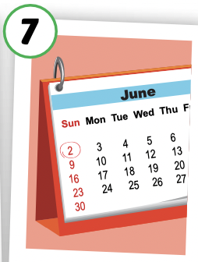
Listen and repeat.
Click each picture to hear the sound.
Sunday
/ˈsʌndeɪ/
Chủ Nhật

Slide 16
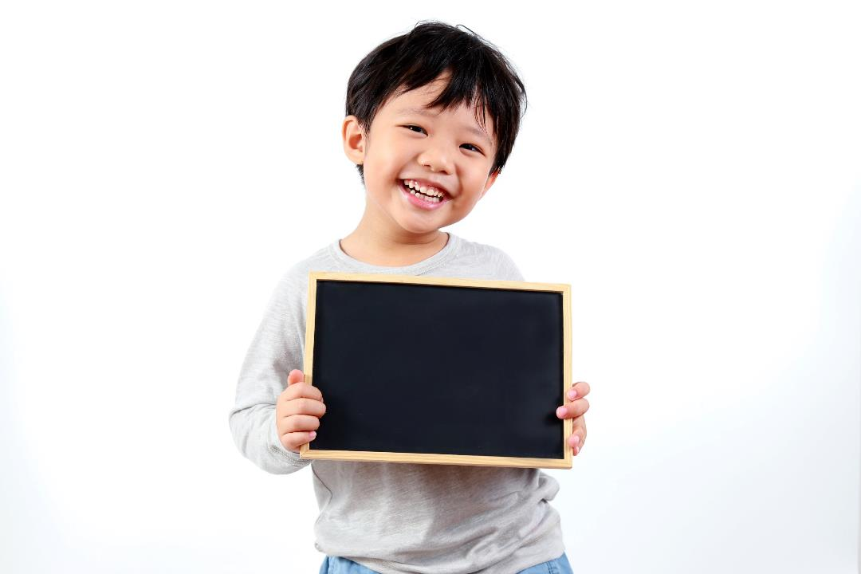
Practice

Slide 17
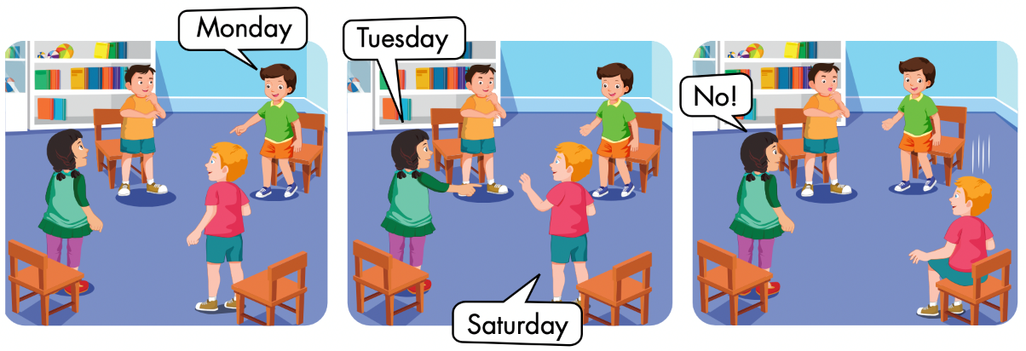

Slide 18
Let’s play!

Slide 19
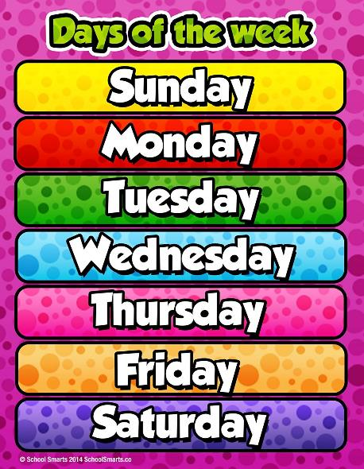
Days of the Week Game
Guess the day of the week

Slide 20
Say
the day
Click on
the number
Say
the number

Slide 21
1
2

Slide 22
2
1
3

Slide 23
3
4
1
2

Slide 24
2
1
3

Slide 25
1
2
3

Slide 26
3
1
2
5
4

Slide 27
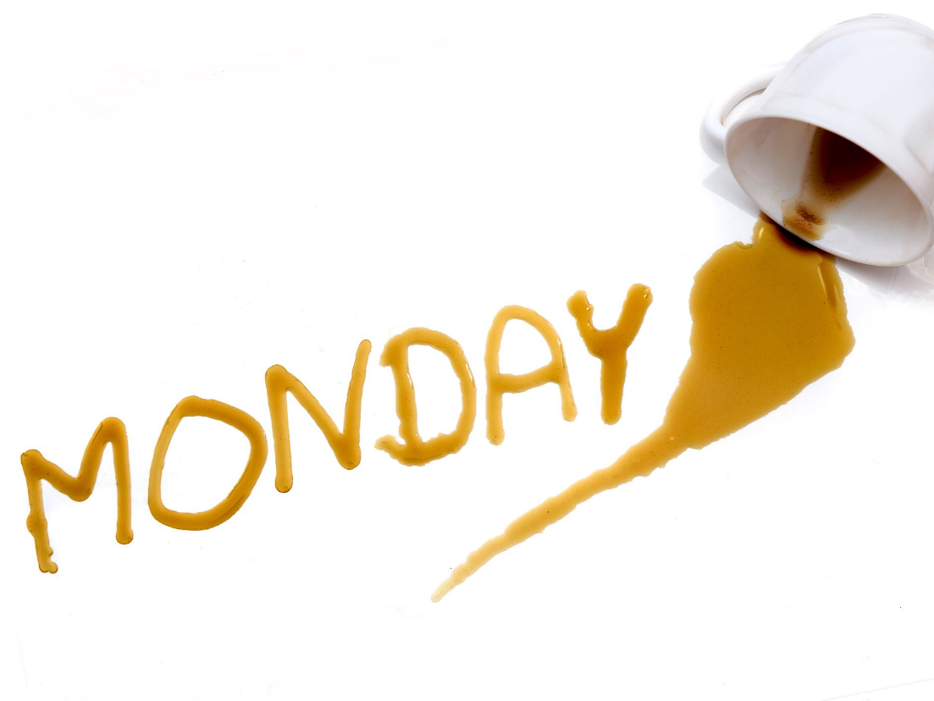
1
4
3
2

Slide 28
2
3
1

Slide 29
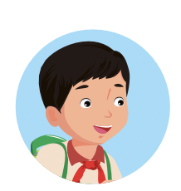
Good job!

Slide 30
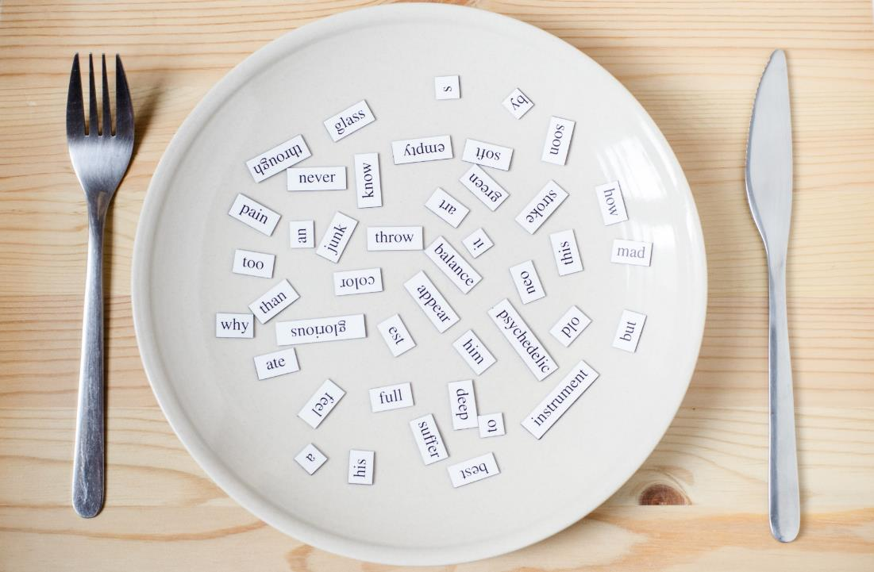
Structures
When do you have English?
- I have English on Wednesdays and Fridays.

Slide 31
Click the icon to hear the sound.

Slide 32
Practice

Slide 33
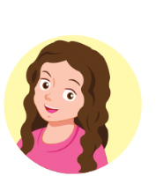
LET’S PRACTICE!
I have English on Monday.
I have ……….. on ……….
English/ Monday
music/ Thursday
P.E./ Wednesday
math/ Tuesday

Slide 34
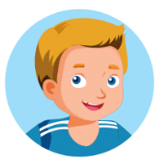
LET’S PRACTICE!
P.E./ Wednesday
English/ Monday
math/ Tuesday
music/ Thursday
When do you have English?
When do you have………….?
I have ……….. on ……….
I have English on Mondays.

Slide 35
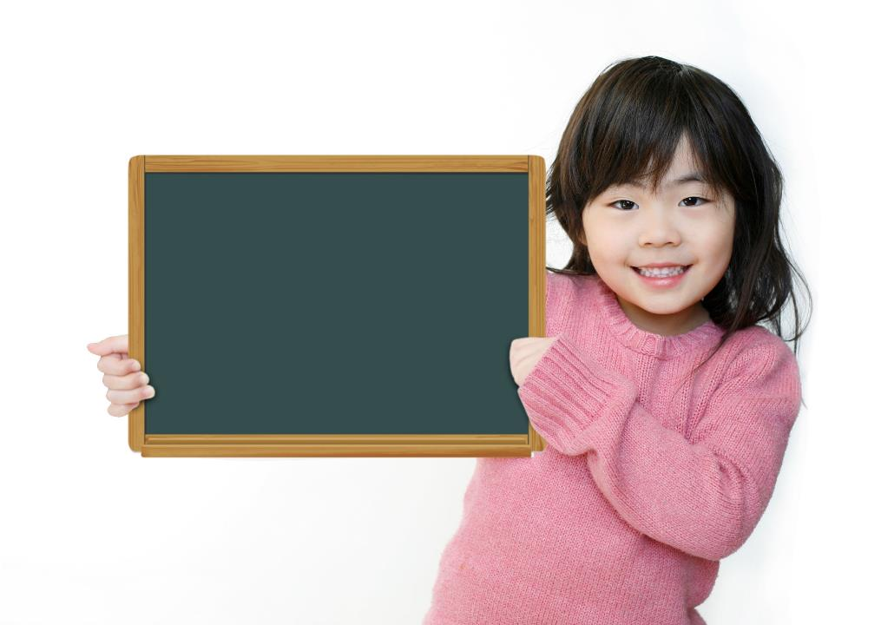
Production

Slide 37
Monday

Slide 38
music
Wednesday

Slide 39
CONSOLIDATION

Slide 40
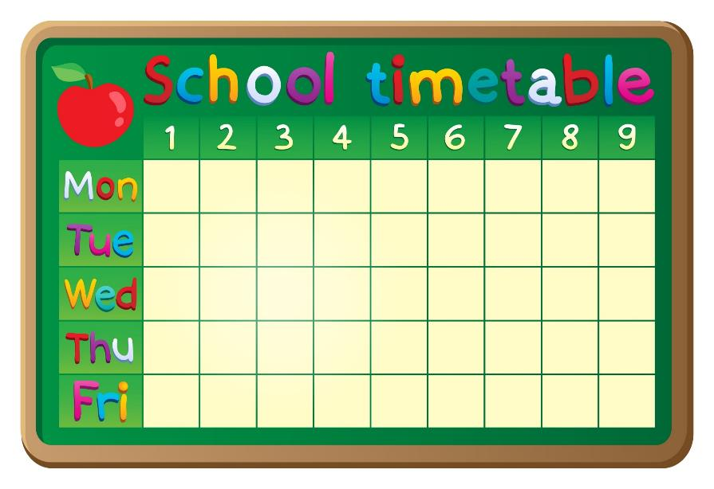
Let’s draw!

Slide 41
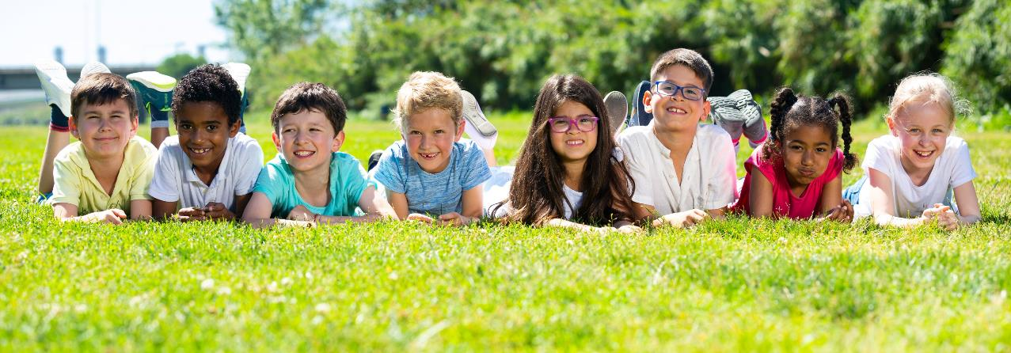
Have a nice day!

