Slide 1
Unit 2
WHAT I CAN DO
REVIEW 2- PAGE 33

Slide 2
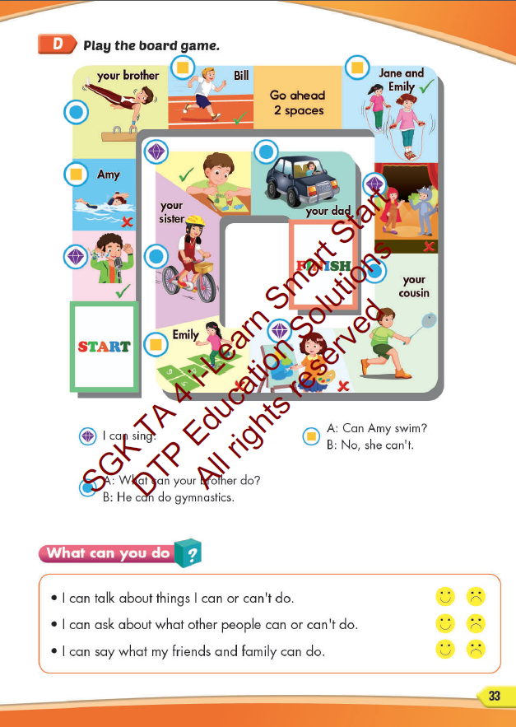
Lesson Outline
Warm-up
Speaking
Consolidation
Wrap-up

Slide 3
Objectives
By the end of this lesson, students will be able to review unit 2.
Vocabulary: play badminton, play the guitar, swim, play the piano, do gymnastics
Structure:
What can you do?
I can swim.
Can you play the piano?
Yes, I can. / No, I can’t.

Slide 4
WARM UP

Slide 5
LISTEN AND CHOOSE

Slide 6
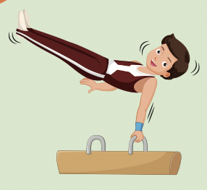
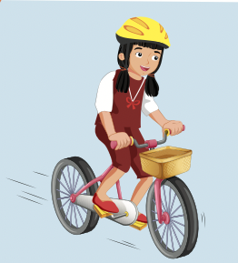
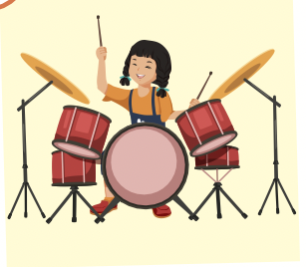

Slide 8
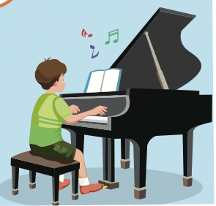
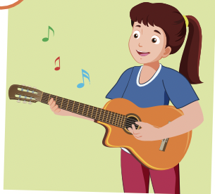
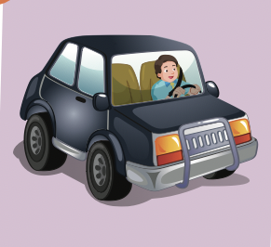

Slide 10
It’s time to learn …

Slide 11
Speaking

Slide 13
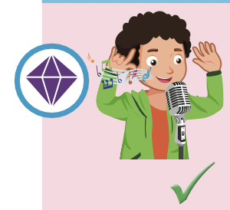

Slide 14
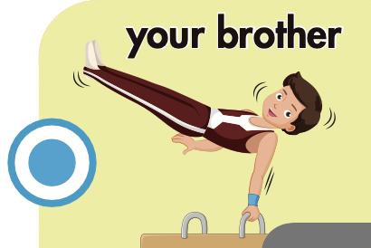

Slide 15
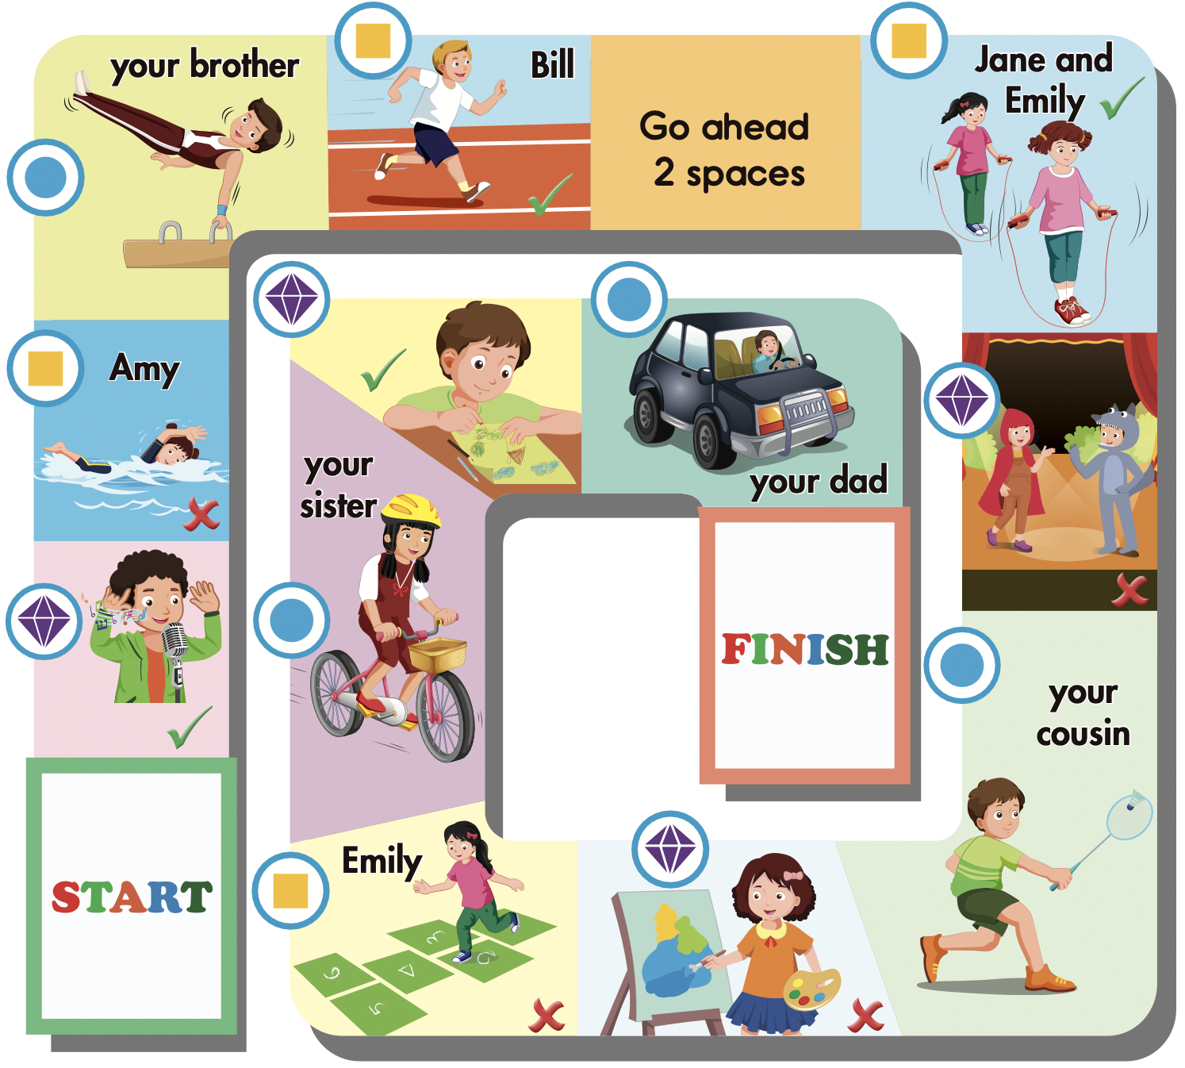

Slide 17
Listening

Slide 18
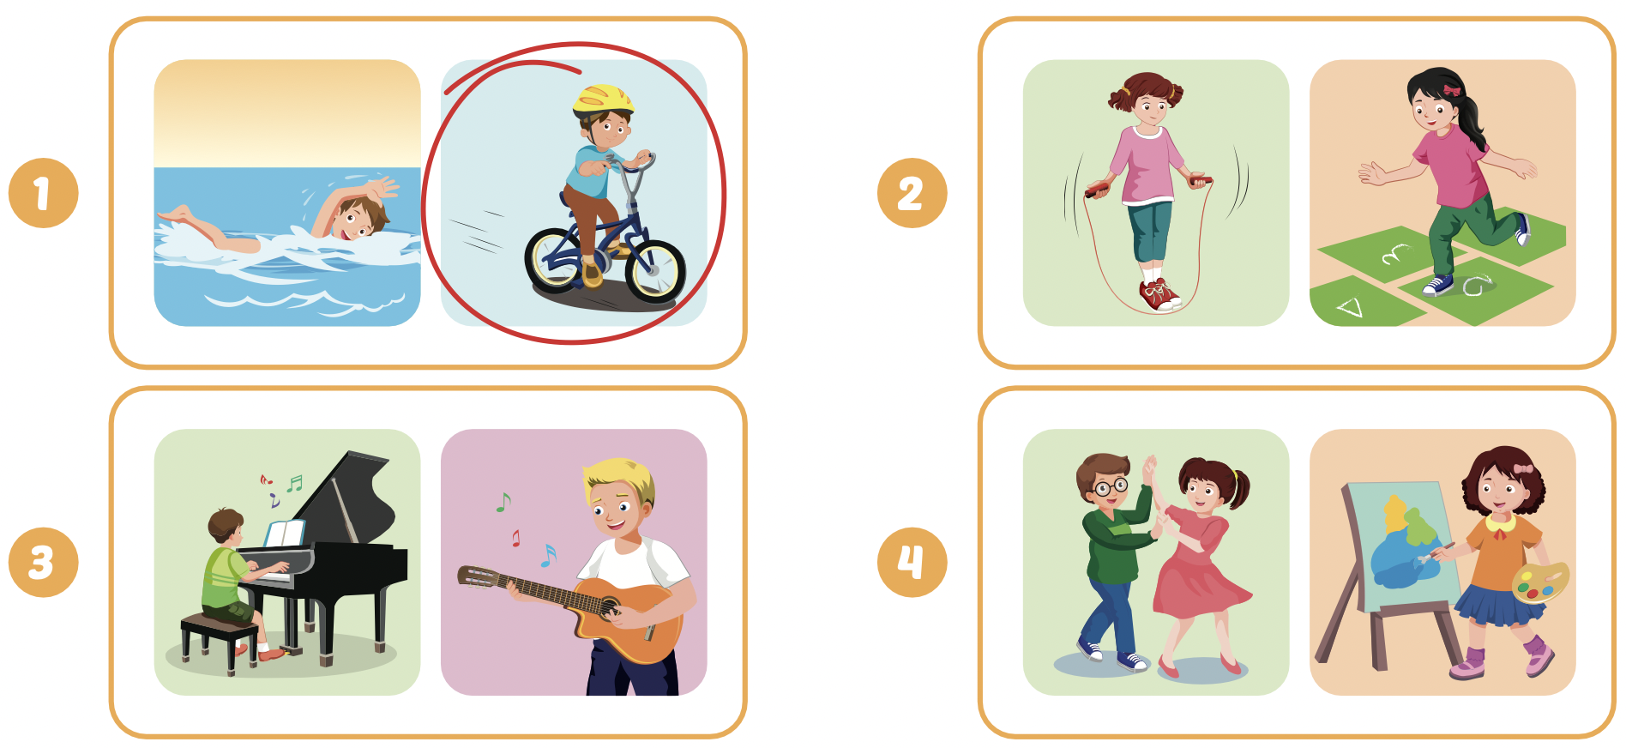
Extra Practice
WB, page 20

Slide 19
UNSCRAMBLE THE SENTENCES

Slide 20
can’t / the / They / keyboard/ play/.
They can’t play the keyboard.

Slide 21
she / can/ What / do /?
What can she do?

Slide 22
you/ Can / the / play / guitar/?
Can you play the guitar?

Slide 23
mom / What / your / do / can / ? /
What can your mom do?

Slide 24
climb / he / tree/ Can / tree / a / ?
Can he climb a tree?

Slide 25
Writing

Slide 26
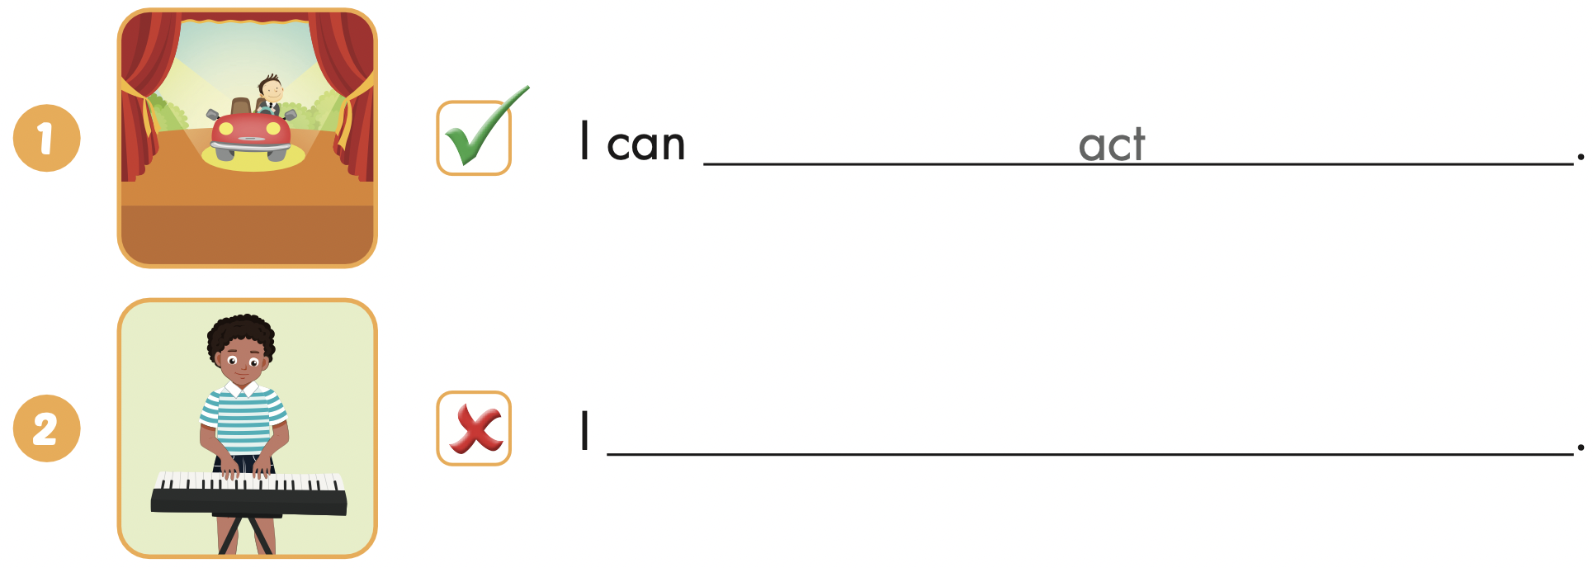
Extra Practice
WB, page 21
can’t play the keyboard

Slide 27
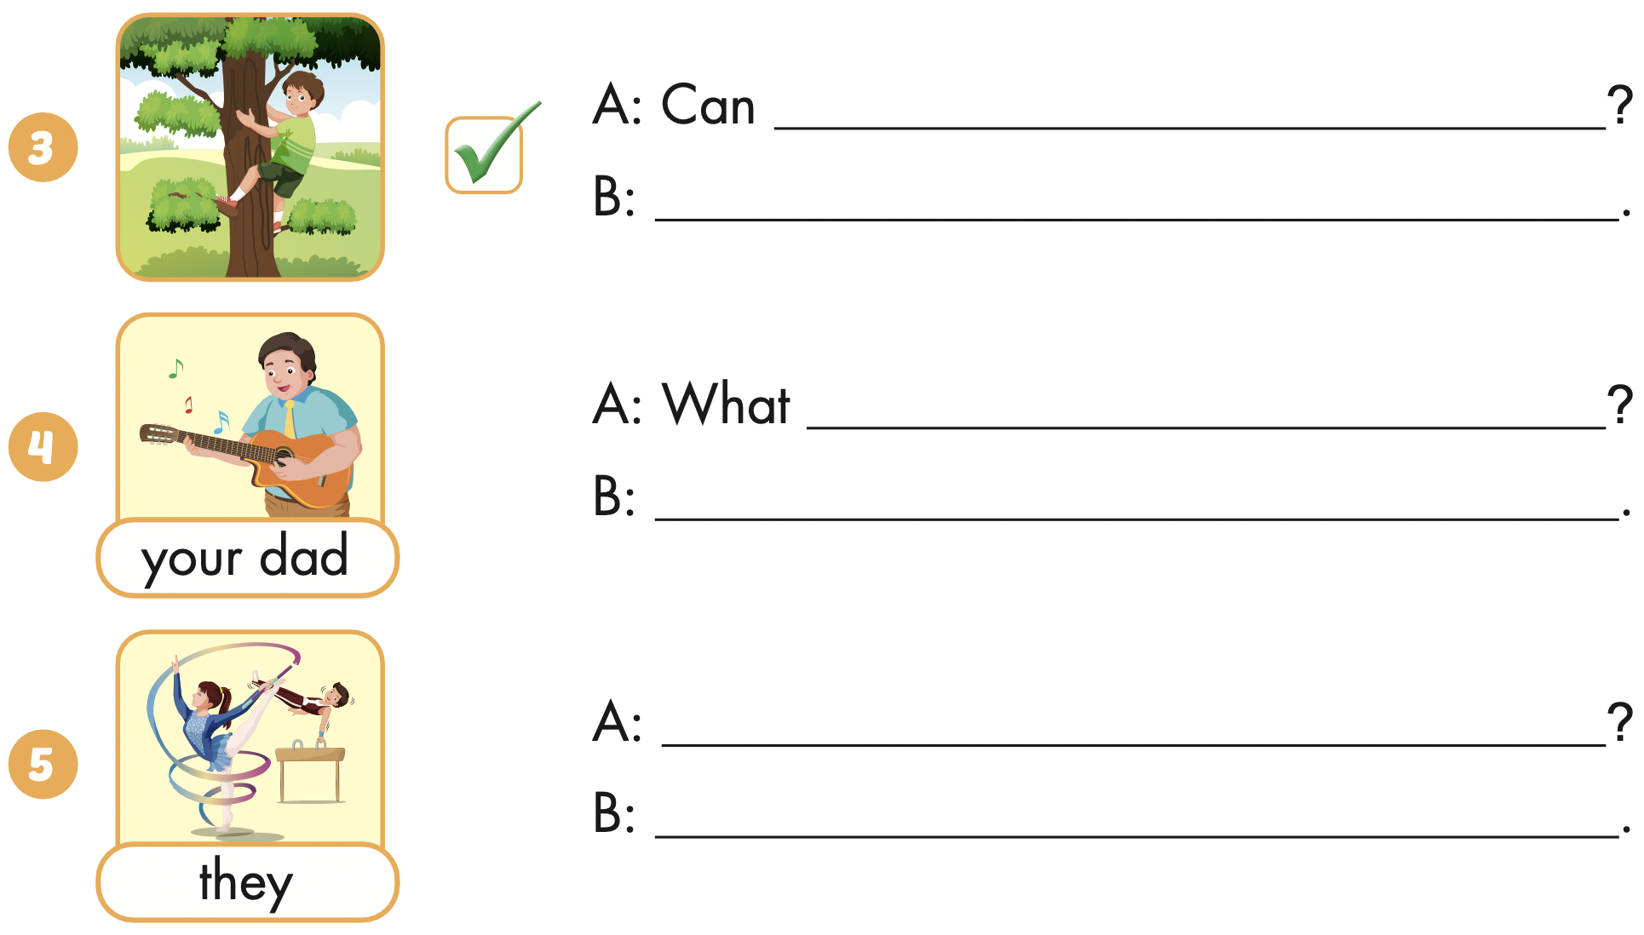
Extra Practice
WB, page 21
you climb a tree
Yes, I can
can your dad do
He can play the guitar
What can they do
They can do gymnastics

Slide 28
CONSOLIDATION

Slide 29
WRAP-UP

Slide 30
Today’s lesson
Vocabularies
play badminton,
play the guitar,
swim,
play the piano,
do gymnastics
Structures/ Sentence patterns
What can you do?
I can swim.
Can you play the piano?
Yes, I can. / No, I can’t.

Slide 31
Homework
Practice the vocabularies and structure; and make sentences using them.
Do the exercises in Tiếng Anh 4 i-Learn Smart Start Notebook (page 16)
Prepare the next lesson (page 34 SB)
Play the consolidation games in Tiếng Anh 4 i-Learn Smart Start DHA App on www.eduhome.com.vn

Slide 32
Enjoy your day!

