Slide 1
Unit 2
WHAT I CAN DO
LESSON 3.3 - PAGE 28

Slide 2
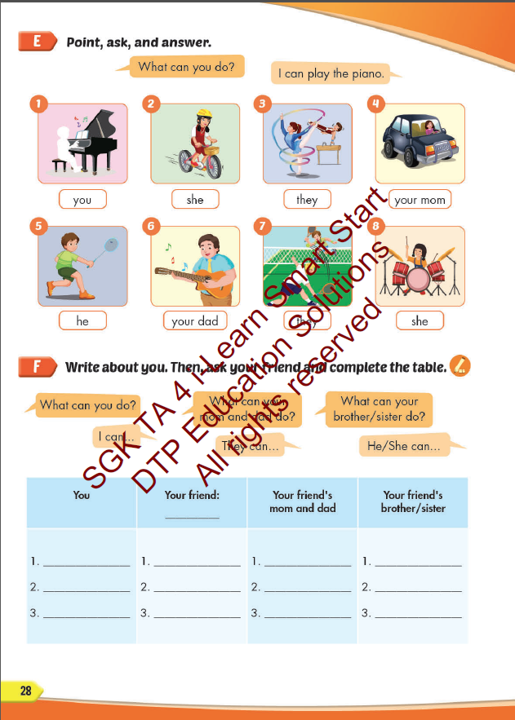
Lesson Outline
Warm-up
Practice
Speaking
Consolidation
Wrap-up

Slide 3
Objectives
By the end of this lesson, students will be able to ask and answer about what their friends and family can do.
Vocabulary: play the guitar, play the piano, drive a car, ride a bike, do gymnastics, play the drums.
Structure:
What can you do? - I can play the piano.
What can your mom do? - She can drive a car.
What can your friends do? - They can ride bikes

Slide 4
WARM UP

Slide 7
It’s time to learn …

Slide 8
WORD
Click on the right word

Slide 9
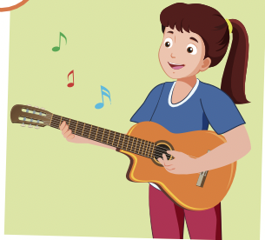
Click on the right word
play the piano
drive a car
play the guitar

Slide 10
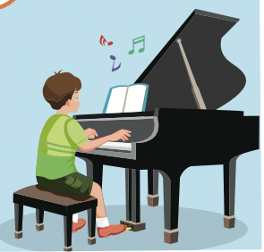
Click on the right word
play the piano
drive a car
ride a bike

Slide 11
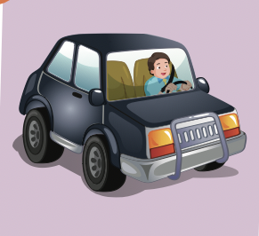
Click on the right word
do gymnastics
drive a car
ride a bike

Slide 12
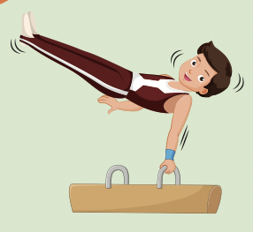
Click on the right word
do gymnastics
play the drums
ride a bike

Slide 13
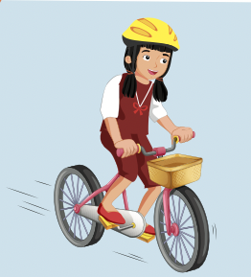
Click on the right word
draw
play the drums
ride a bike

Slide 14
Practice

Slide 15
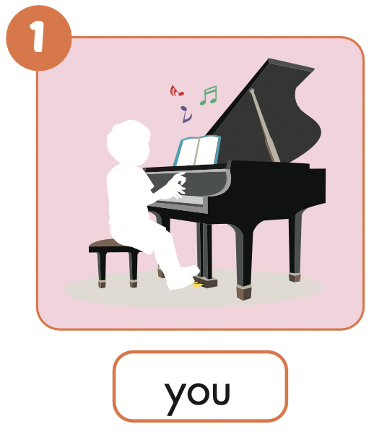

Slide 16
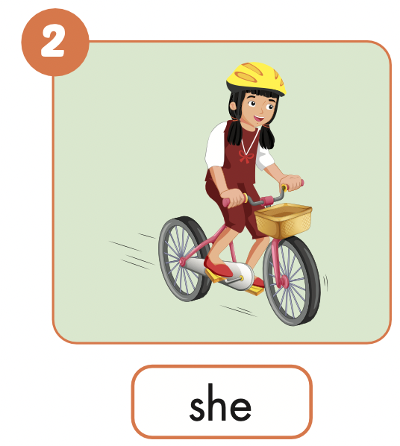
What can she do?
She can ride a bike.

Slide 17
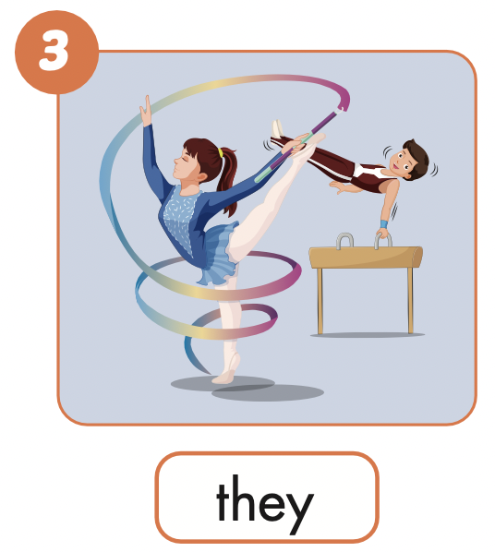
What can they do?
They can do gymnastics.

Slide 18
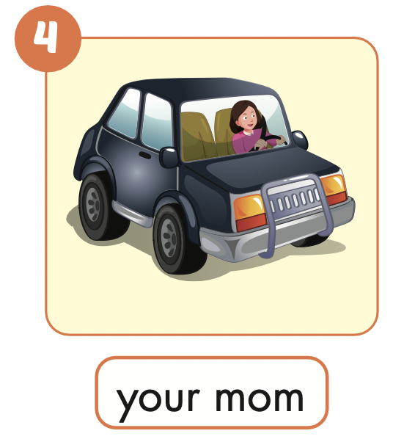
What can your mom do?
She can drive a car.

Slide 19
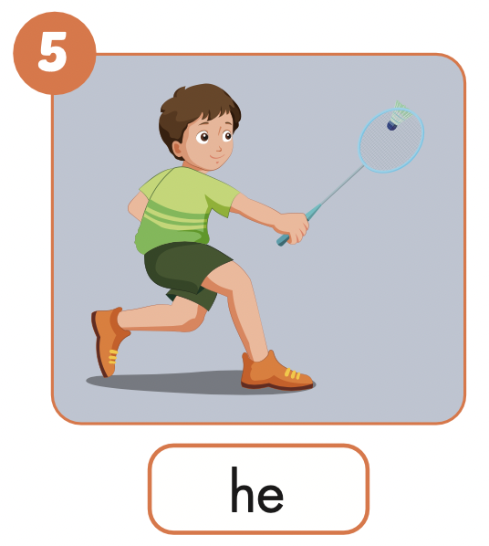
What can he do?
He can play badminton.

Slide 20
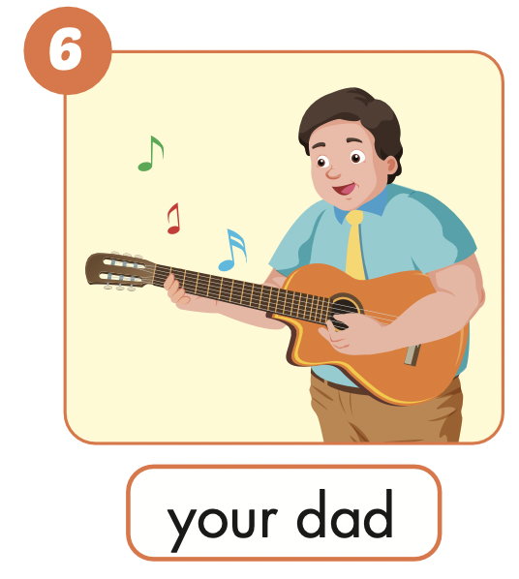
What can your dad do?
He can play the guitar.

Slide 21
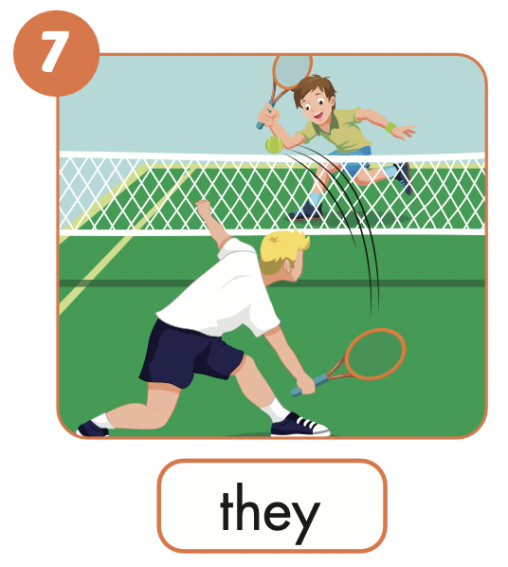
What can they do?
They can play tennis.

Slide 22
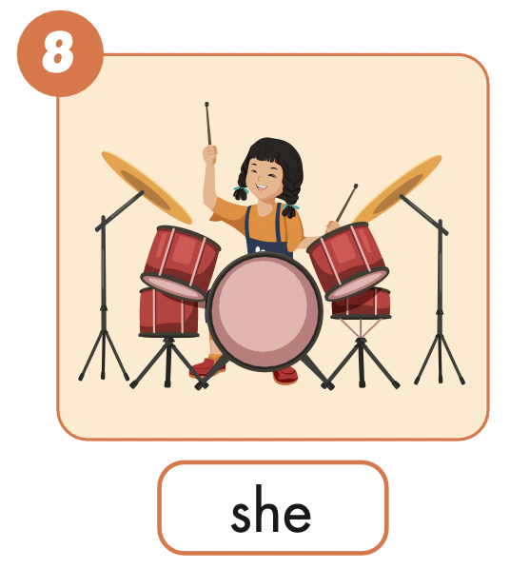
What can she do?
She can play the drums.

Slide 23
Production

Slide 24
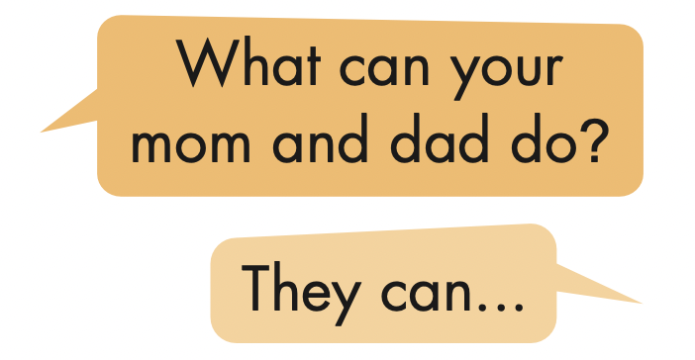
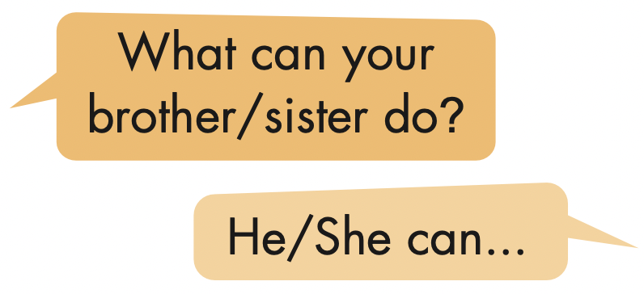
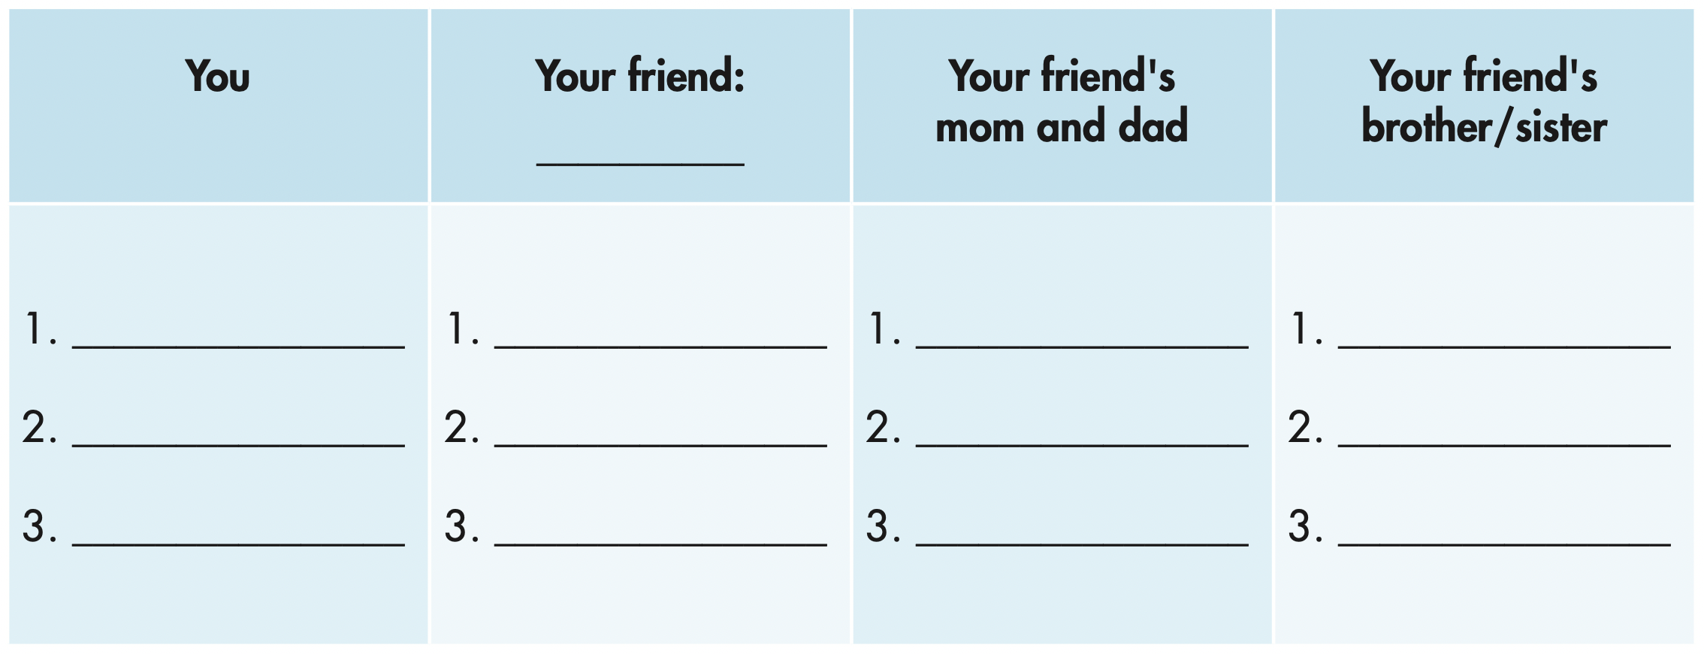

Slide 25
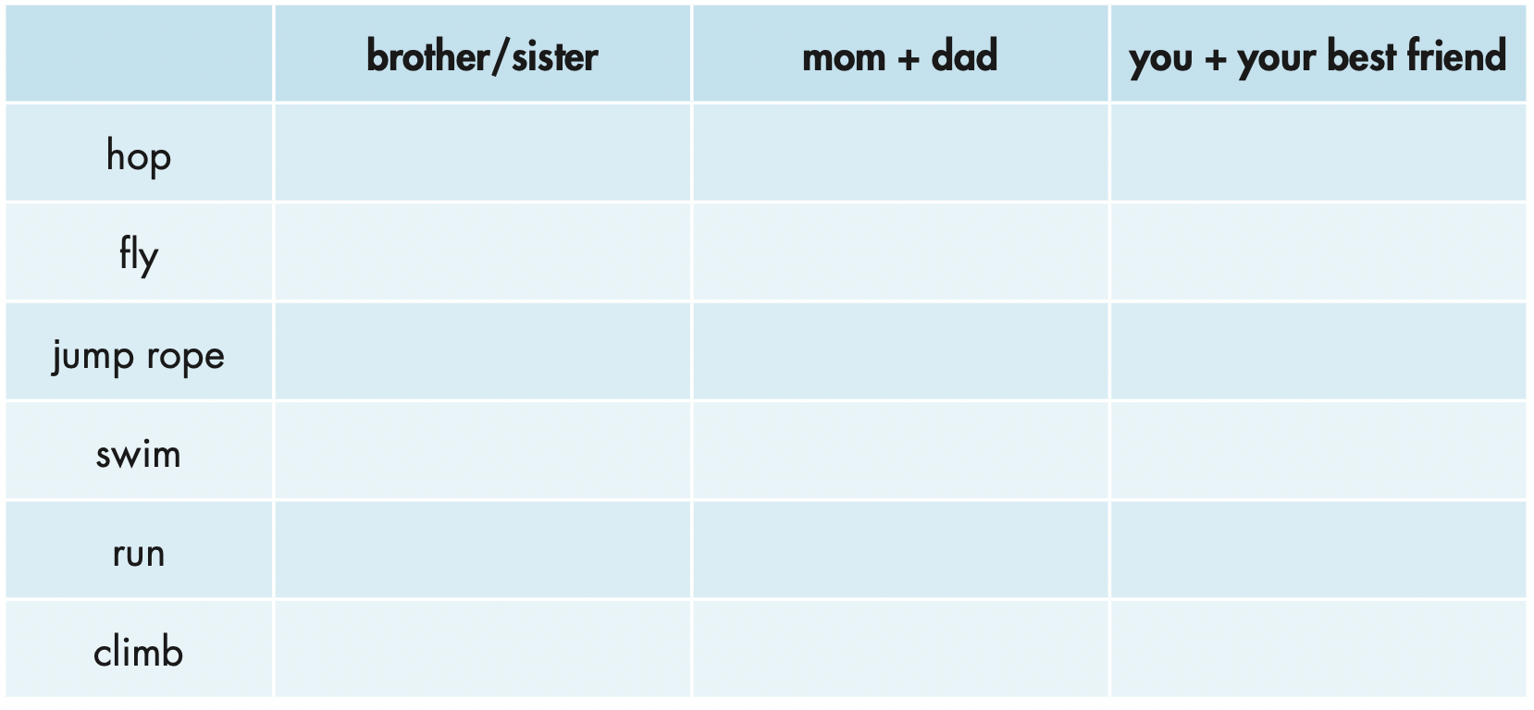
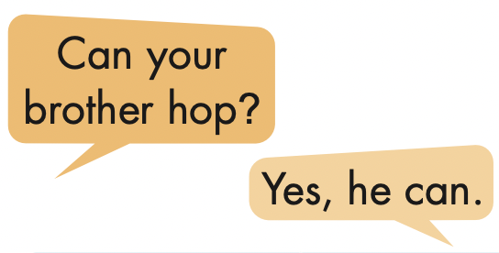
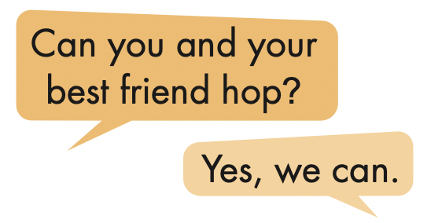
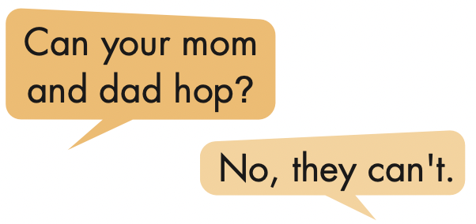

Slide 26
CONSOLIDATION

Slide 27
Writing

Slide 28
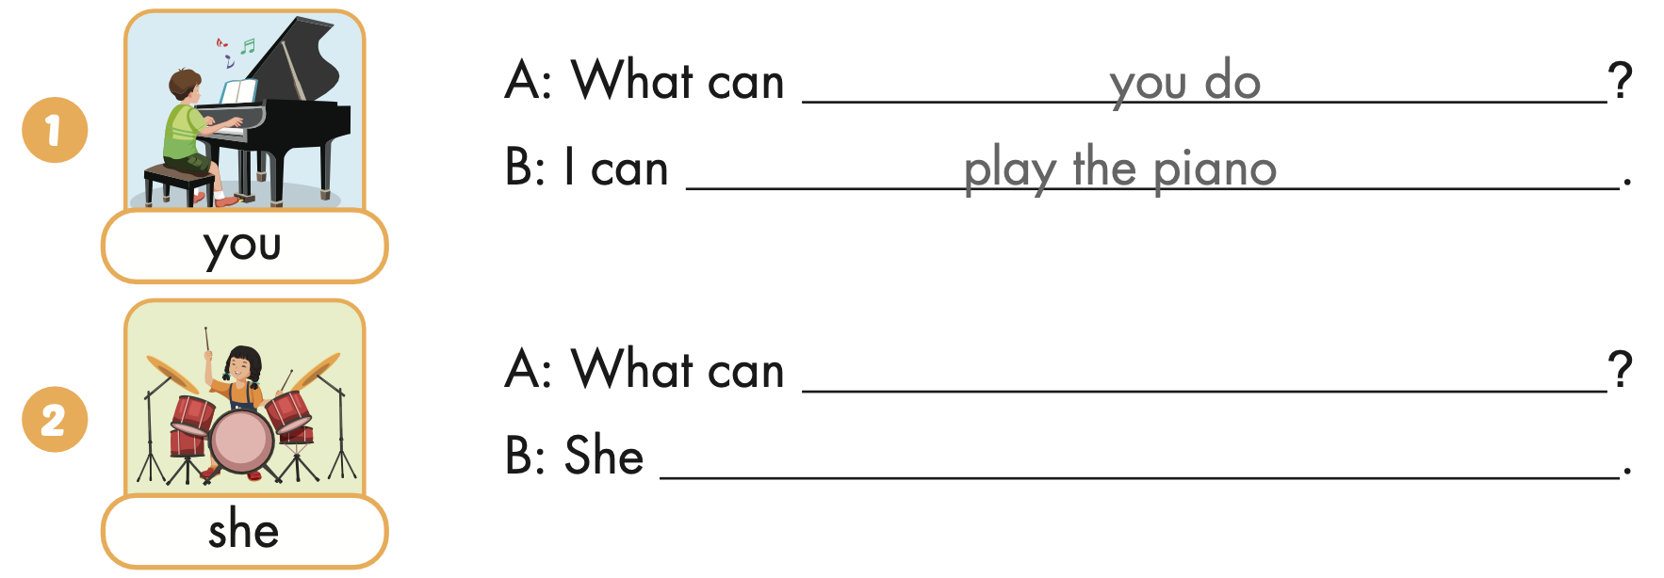
Extra Practice
WB, page 17
she do
can play the drums

Slide 29
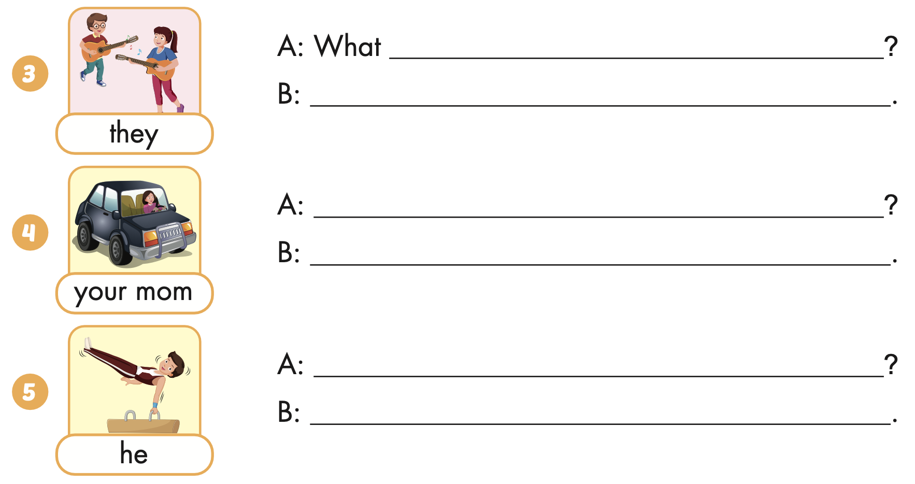
Extra Practice
WB, page 17
can they do
They can play the guitar
What can your mom do
She can drive a car.
What can he do
He can do gymnasyics

Slide 30
WRAP-UP

Slide 31
Today’s lesson
Structures/ Sentence patterns
What can you do?
I can play the piano.
What can your mom do?
She can drive a car.
What can your friends do? They can ride bikes.
Vocabularies
play the guitar,
play the piano,
drive a car,
ride a bike,
do gymnastics,
play the drums.

Slide 32
Homework
Practice the vocabularies and structure; and make sentences using them.
Do the exercises in Tiếng Anh 4 i-Learn Smart Start WB (page 17)
Do the exercises in Tiếng Anh 4 i-Learn Smart Start Notebook (page 12)
Prepare the next lesson (page 29 SB)
Play the consolidation games in Tiếng Anh 4 i-Learn Smart Start DHA App on www.eduhome.com.vn

Slide 33
Enjoy your day!

