Slide 1
Unit 2
WHAT I CAN DO
LESSON 3.2 - PAGE 27

Slide 2
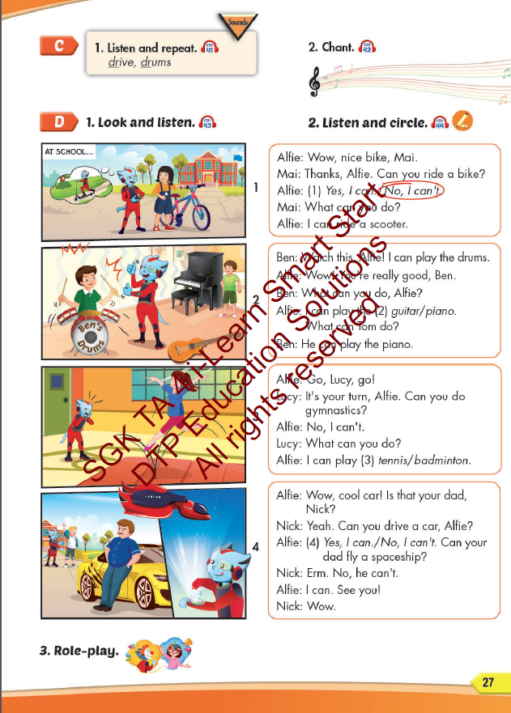
Lesson Outline
Warm-up
Listening
Consolidation
Wrap-up

Slide 3
Objectives
By the end of this lesson, students will be able to identify the /dr/ sound and practice the conversations.
Vocabulary: drive, drums
Structure: What can you do? - I can play the drums.
What can your mom do? - She can drive a car.
Phonics: /dr/

Slide 4
WARM UP

Slide 5
LISTEN AND CHOOSE

Slide 6
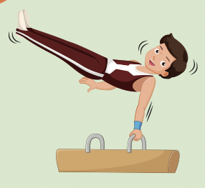
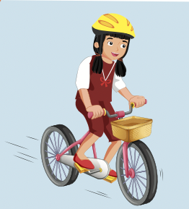
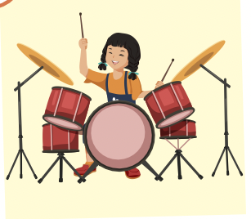

Slide 8
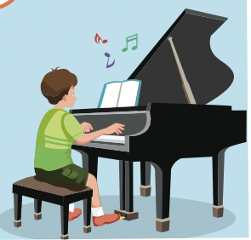
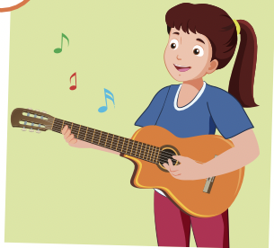
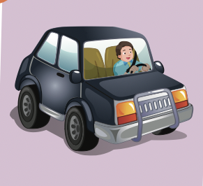

Slide 10
It’s time to learn …

Slide 11
Phonics /dr/

Slide 12
Presentation

Slide 13
Click the icon to hear the sound.
drum
drive
/drʌm/
/draɪv/

Slide 14
Practice

Slide 17
Structures
What can you do?
- I can play the drums.
What can your mom do?
- She can drive a car.

Slide 18
Speaking

Slide 19
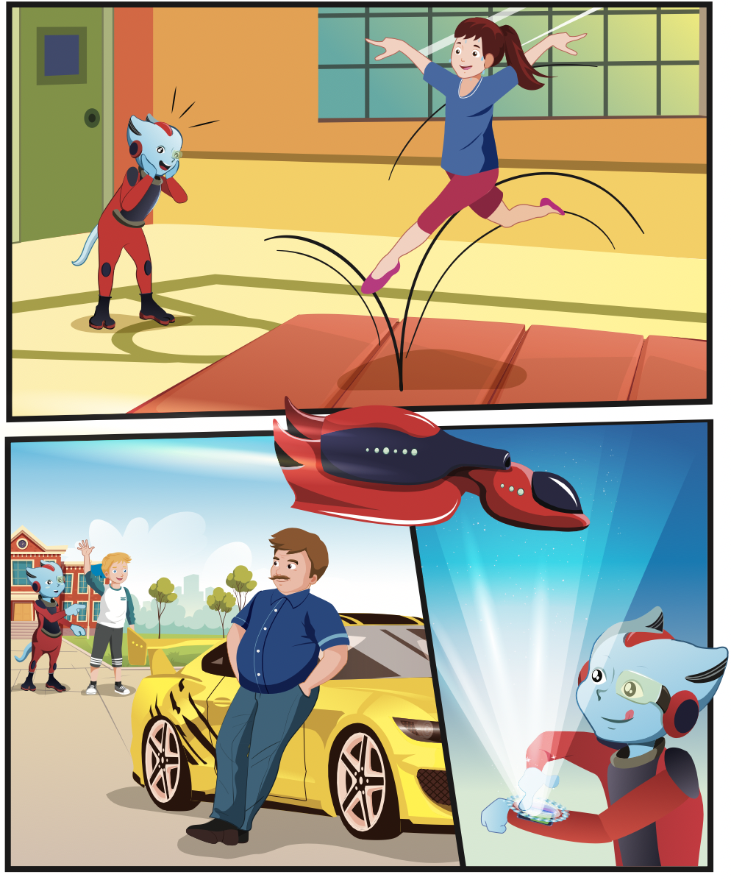
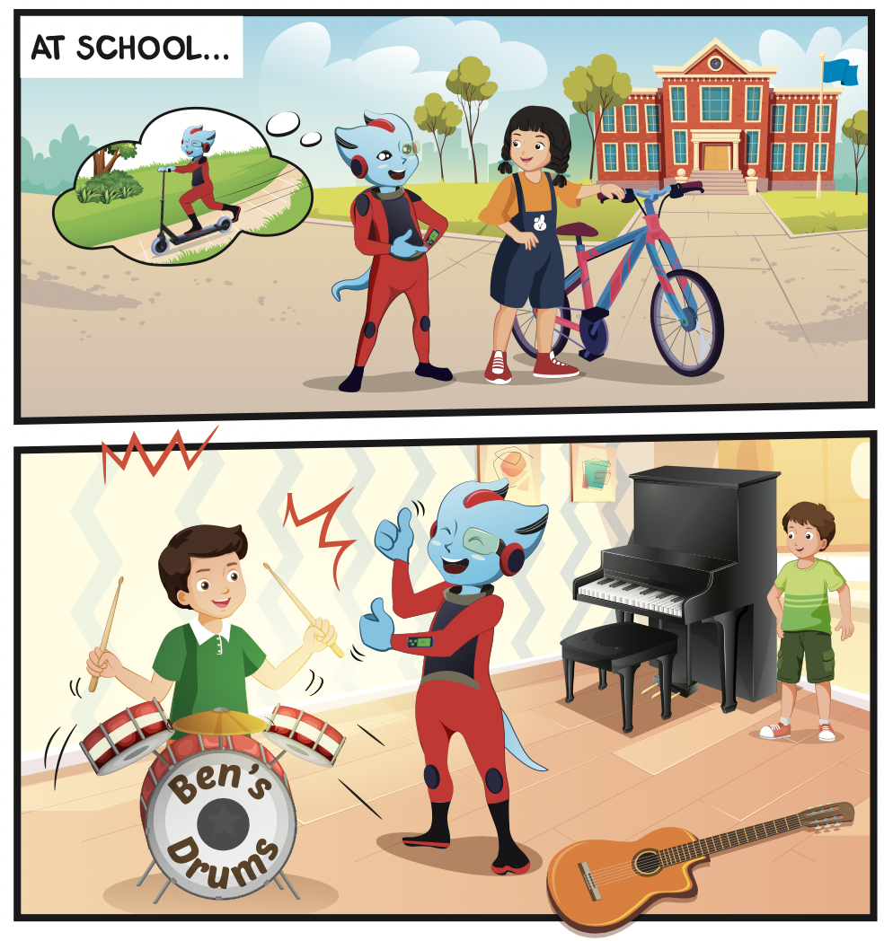
Which classes do they have?
Who can you see?
What can you see in the music class?

Slide 20
Listening

Slide 22
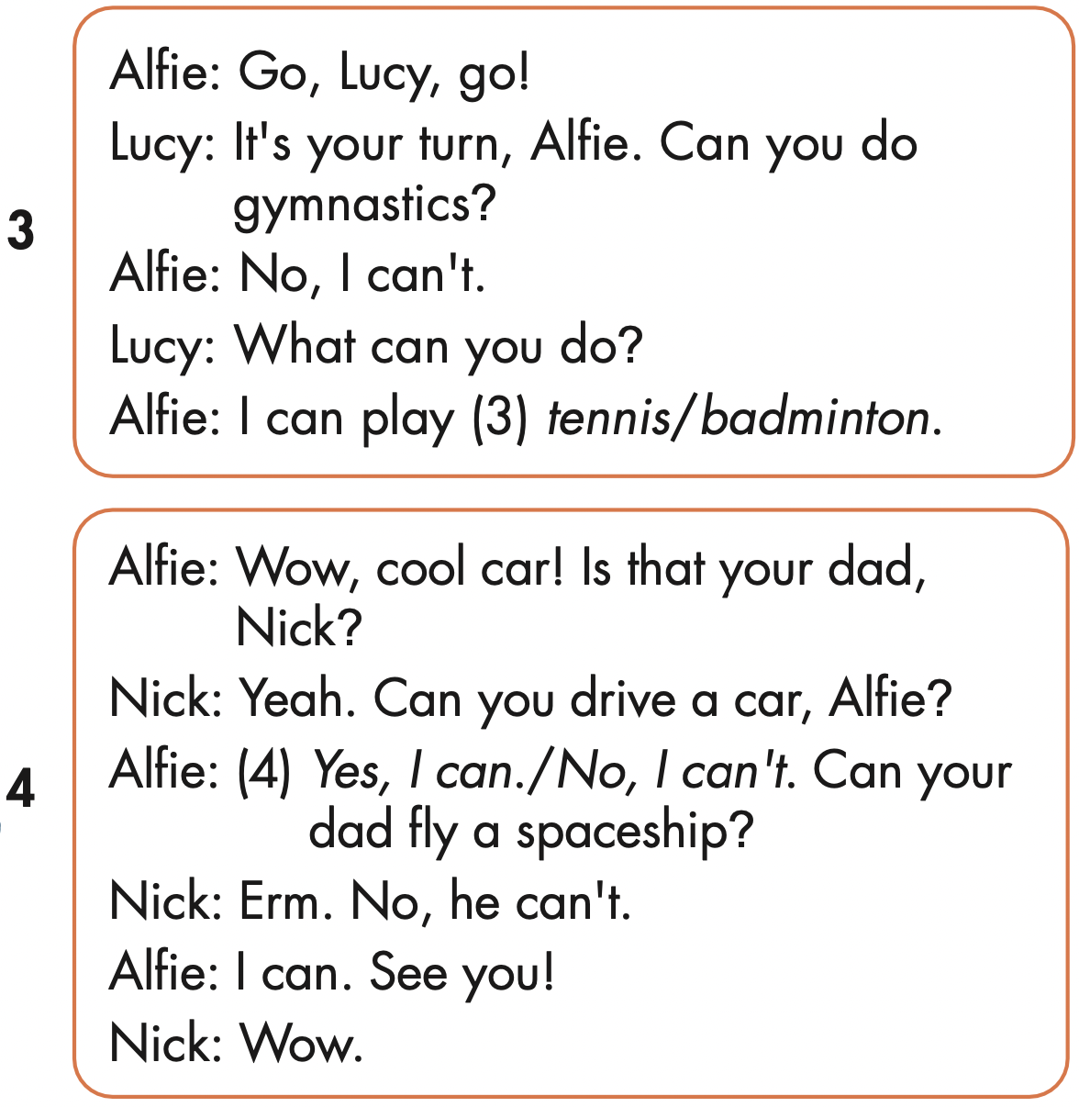
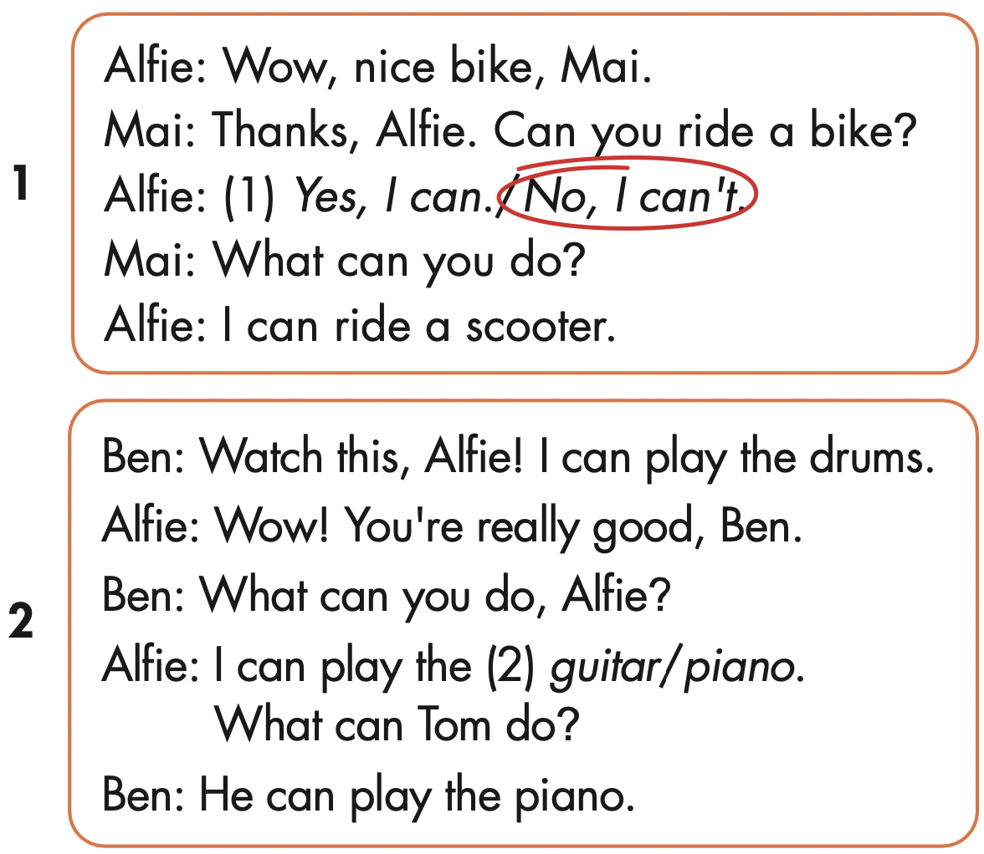

Slide 23
Production

Slide 25
Writing

Slide 26
Make your own stories.

Slide 27
CONSOLIDATION

Slide 28
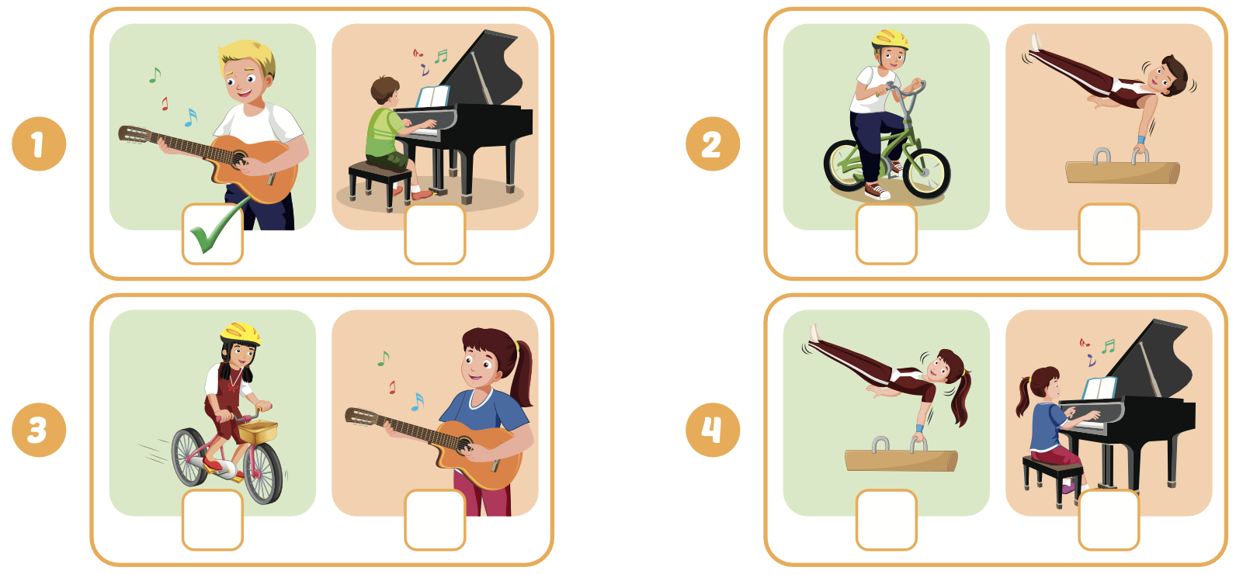
Extra Practice
WB, page 17

Slide 29
WRAP-UP

Slide 30
Today’s lesson
Phonics
/dr/
Structures/ Sentence patterns
What can you do?
- I can play the drums.
What can your mom do?
- She can drive a car.

Slide 31
Homework
Practice the vocabularies and structure; and make sentences using them.
Do the exercises in Tiếng Anh 4 i-Learn Smart Start WB (page 17)
Do the exercises in Tiếng Anh 4 i-Learn Smart Start Notebook (page 12)
Prepare the next lesson (page 28 SB)
Play the consolidation games in Tiếng Anh 4 i-Learn Smart Start DHA App on www.eduhome.com.vn

Slide 32
Enjoy your day!

