Slide 1
Unit 2
WHAT I CAN DO
LESSON 1.2 - PAGE 21

Slide 2
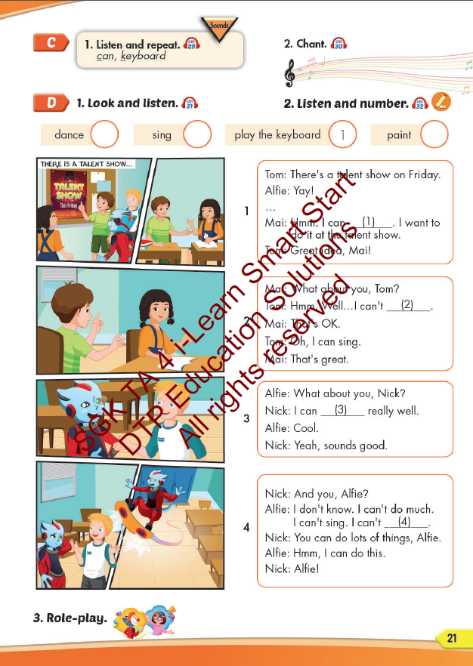
Lesson Outline
Warm-up
Listening
Consolidation
Wrap-up

Slide 3
Objectives
By the end of this lesson, students will be able toto identify the /k/ sound and practice the conversations
Vocabulary: can, keyboard.
Structure: I can dance. / I can't sing.
Phonics: /k/

Slide 4
WARM UP

Slide 5
LISTEN AND CHOOSE

Slide 6
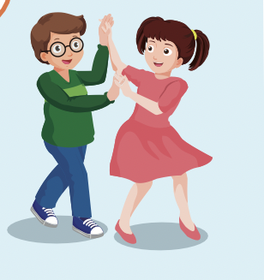
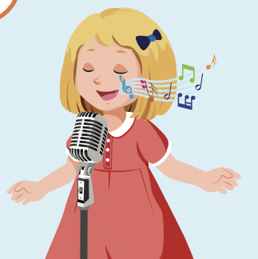

Slide 8
act
paint
dance
Play the keyboard
sing

Slide 11
dance
draw
act
paint
sing

Slide 12
It’s time to learn …

Slide 13
Phonics
/k/
can, keyboard.

Slide 14
Presentation

Slide 15
Click each English word to hear the sound.
can
keyboard
/kæn/
/ˈkiːbɔːrd/

Slide 16
Practice

Slide 19
Structures
I can dance.
I can't sing.

Slide 20
WORD QUIZ
Click on the right word

Slide 21
Click on the right word
sing
dance
play the keyboard

Slide 22
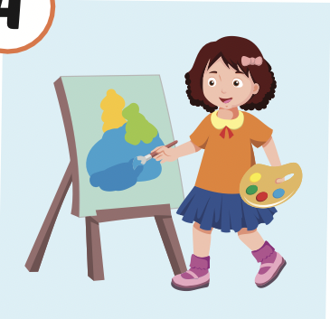
Click on the right word
paint
dance
sing

Slide 23
Click on the right word
sing
dance
draw

Slide 24
Click on the right word
draw
swim
sing

Slide 25
Speaking

Slide 26
Where are they?
Who is talking?

Slide 27
Listening

Slide 29
2
3
4

Slide 30
Speaking

Slide 32
Production

Slide 33
Writing

Slide 34
MAKE YOUR OWN STORY

Slide 35
CONSOLIDATION

Slide 36
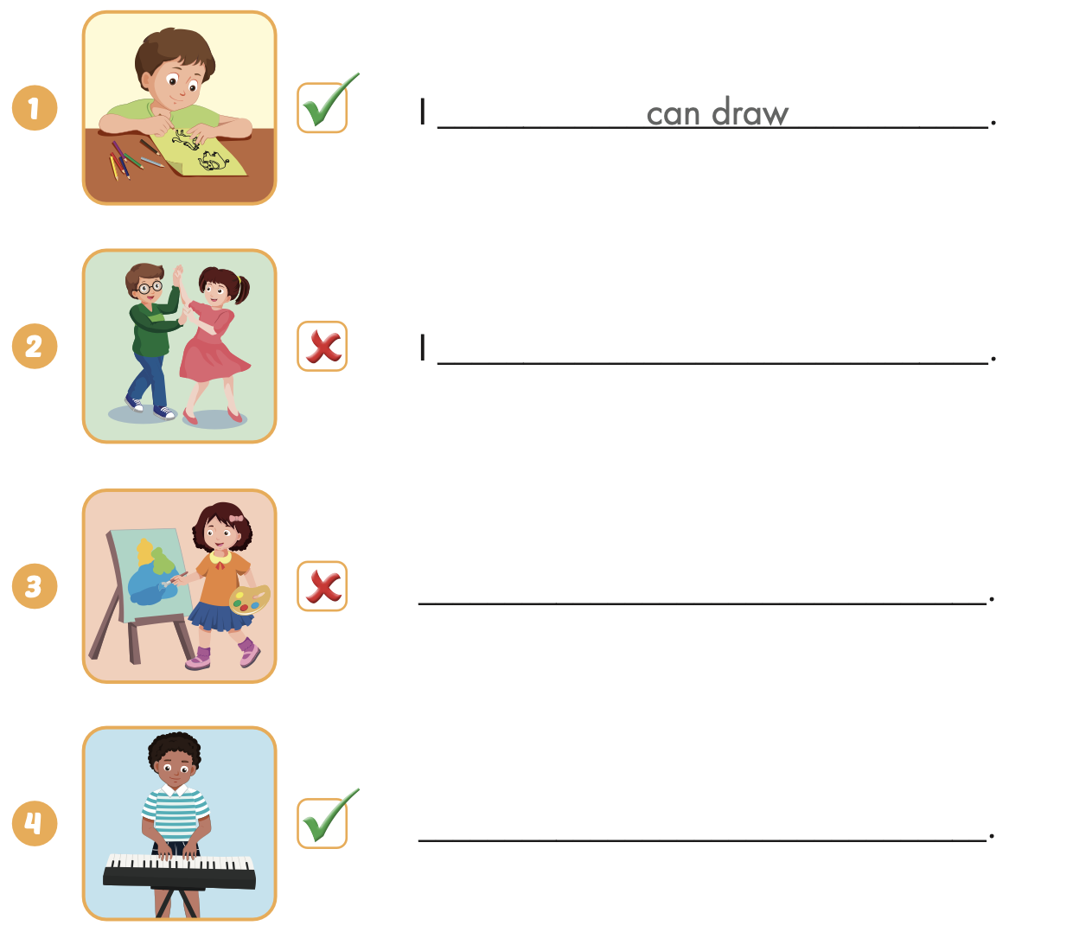
Extra Practice
WB, page 13
can’t dance
I can’t paint
I can play the keyboard

Slide 37
WRAP-UP

Slide 38
Today’s lesson
Phonics
/k/
Structures/ Sentence patterns
I can dance.
I can’t sing.

Slide 39
Homework
Practice the vocabularies and structure; and make sentences using them.
Do the exercises in Tiếng Anh 4 i-Learn Smart Start WB (page 13)
Do the exercises in Tiếng Anh 4 i-Learn Smart Start Notebook (page 10)
Prepare the next lesson (page 22 SB)
Play the consolidation games in Tiếng Anh 4 i-Learn Smart Start DHA App on www.eduhome.com.vn

Slide 40
Enjoy your day!

