Slide 1
Unit 1: Animals
Review and Practice 1
Page 18

Slide 2
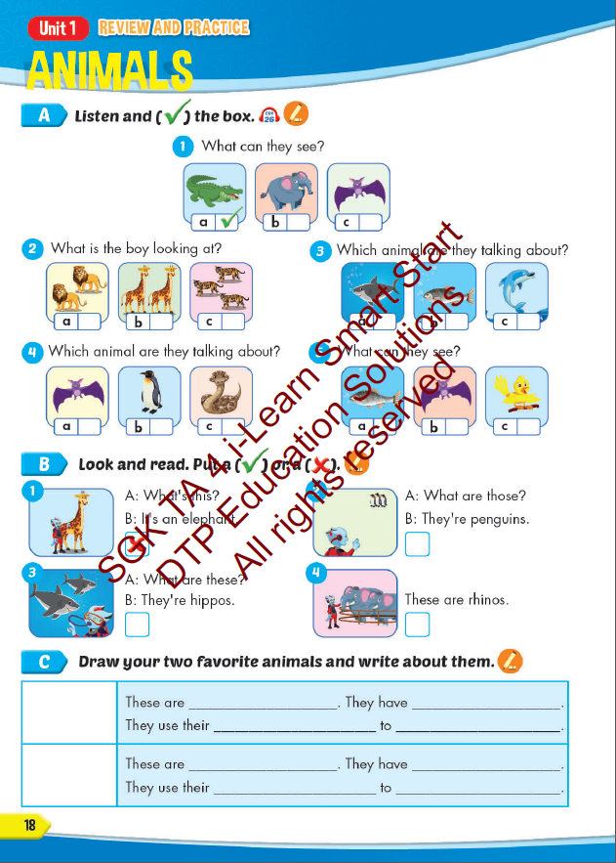
Lesson Outline
Warm-up
Reading
Listening
Consolidation
Wrap-up

Slide 3
Objectives
By the end of this lesson, students will be able to…
Vocabulary: Review: " snake, monkey, horse, camel, hippo, rhino, panda, giraffe, lion, dolphin, tiger, zebra, crocodile, bat, shark, penguin, kangaroo, elephant."
Structure: Review: "This is a monkey. - These are monkeys. That's a snake. - Those are snakes, What's this? It's a panda. What's that? It's a dolphin, What are these? They're penguins. What are those? They're bats."

Slide 4
WARM UP

Slide 5
VOCAB QUIZ

Slide 6
monkey
A
B

Slide 7
rhino
A
B

Slide 8
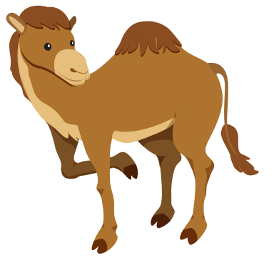
hippo
A
B

Slide 9
camel
B
A

Slide 10
horse
A
B

Slide 11
snake
A
B

Slide 12
It’s time to learn …

Slide 13
Listening

Slide 14
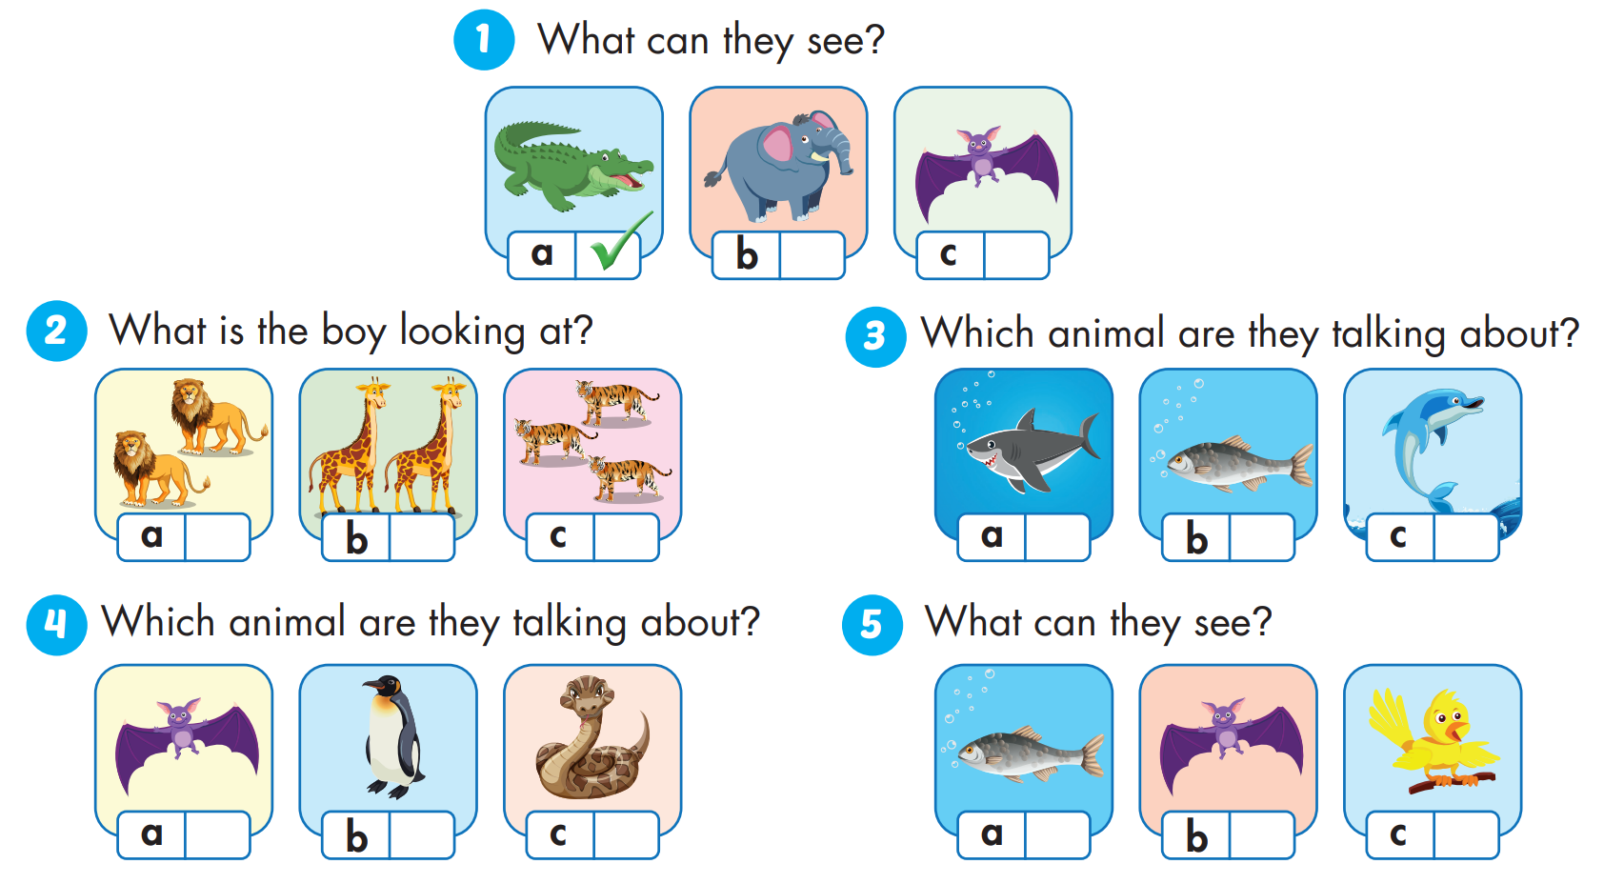

Slide 15
Reading

Slide 18
Practice

Slide 19
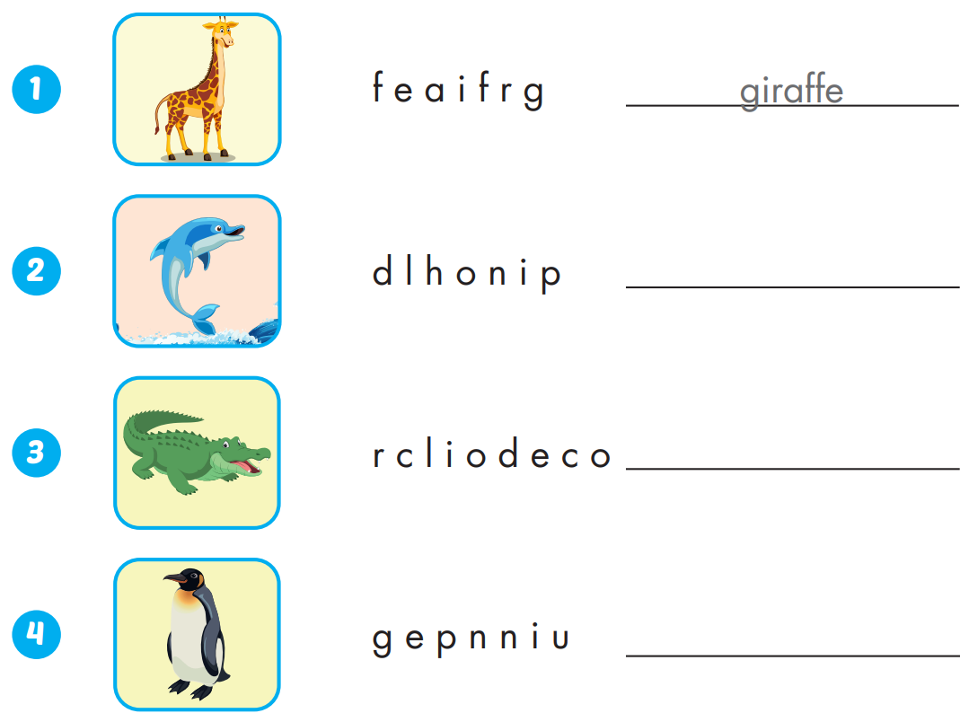
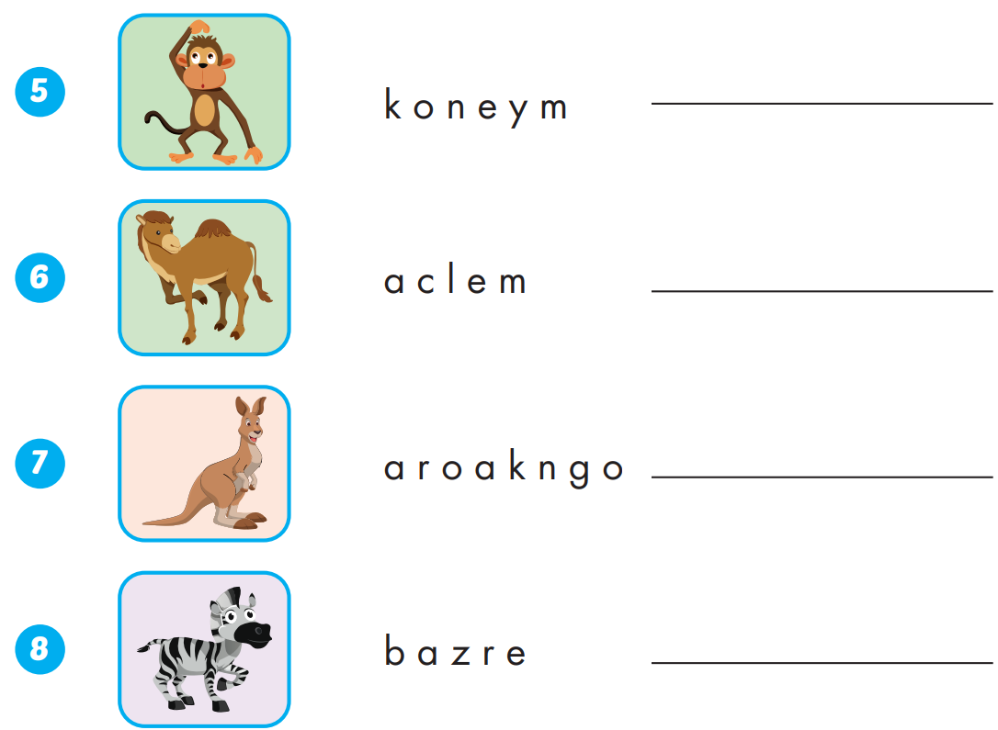
Extra Practice
WB, page 10
monkey
dolphin
camel
crocodile
kangaroo
zebra
penguin

Slide 20
WRAP-UP

Slide 21
Today’s lesson
Vocabularies
Vocabulary: Review: " snake, monkey, horse, camel, hippo, rhino, panda, giraffe, lion, dolphin, tiger, zebra, crocodile, bat, shark, penguin, kangaroo, elephant."
Structures/ Sentence patterns
Review: "This is a monkey.
- These are monkeys.
That's a snake.
- Those are snakes,
What's this? It's a panda.
What's that? It's a dolphin,
What are these? They're penguins.
What are those? They're bats."

Slide 22
Homework
Practice the vocabularies and structure; and make sentences using them.
Do the exercises in Tiếng Anh 4 i-Learn Smart Start WB (page 10)
Do the exercises in Tiếng Anh 4 i-Learn Smart Start Notebook (page 8)
Prepare the next lesson (page 19 SB)
Play the consolidation games in Tiếng Anh 4 i-Learn Smart Start DHA App on www.eduhome.com.vn

Slide 23
Enjoy your day!

