Slide 1
Unit 1: Animals
Lesson 4.2 Science
Page 16

Slide 2
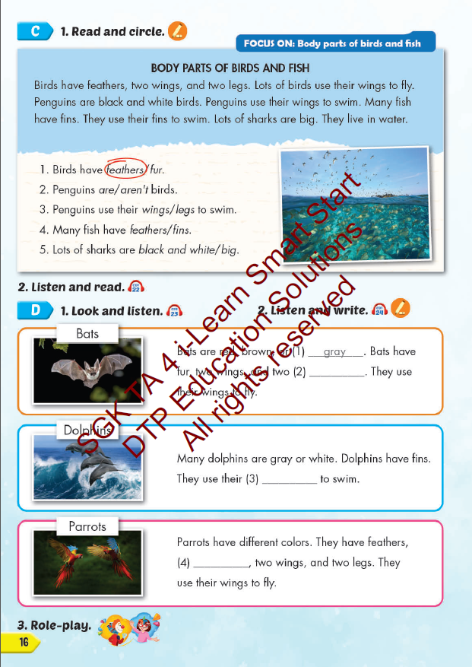
Lesson Outline
Warm-up
Reading
Listening
Consolidation
Wrap-up

Slide 3
Objectives
By the end of this lesson, students will be able to…
Vocabulary: Pronounce and use the words related to the topic properly: wing, feather, tail, fin, fur, claw.
Structure: Birds have feathers, two wings, and two legs.

Slide 4
WARM UP

Slide 5
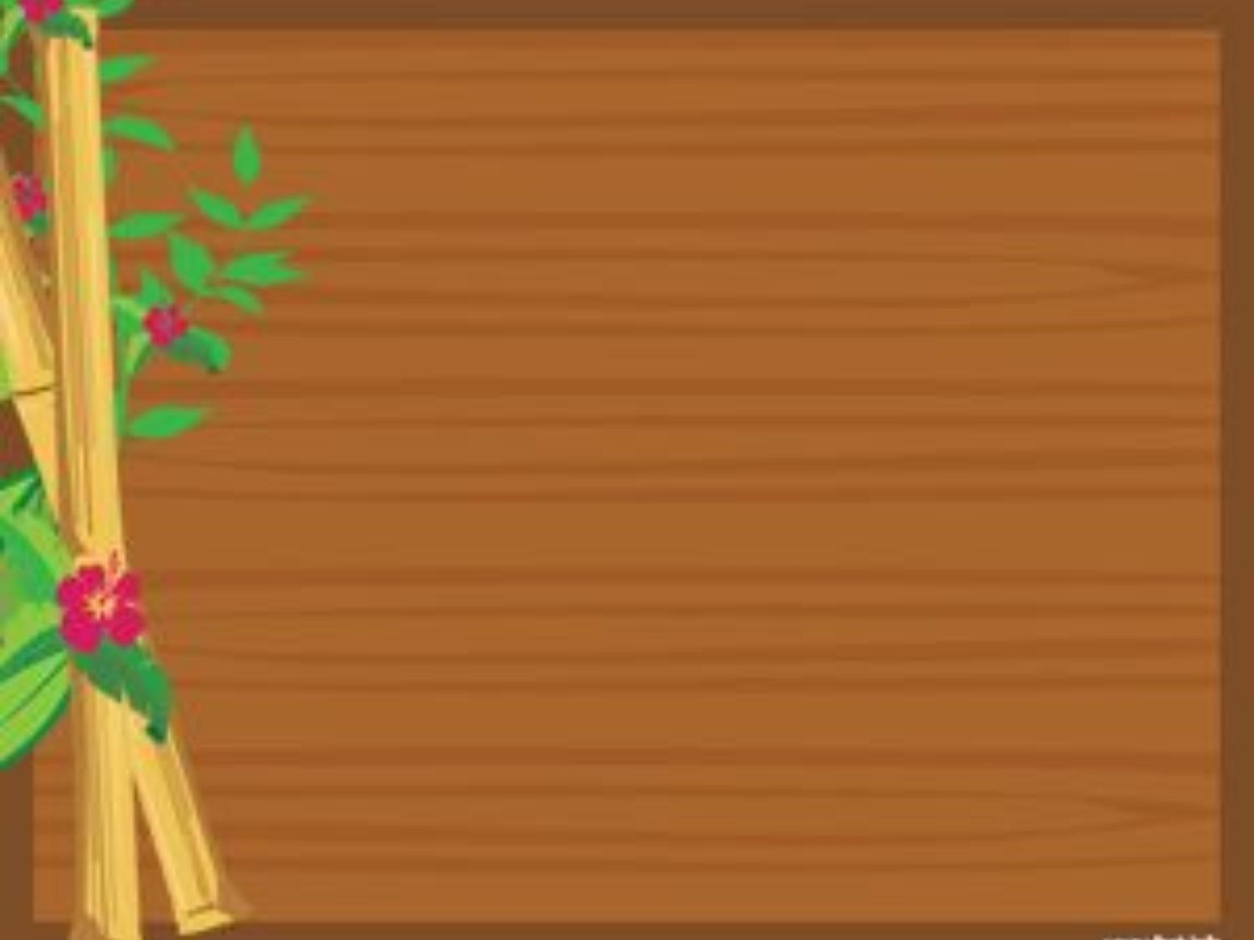
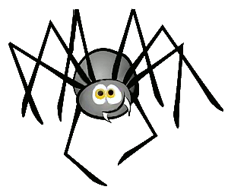

Slide 6
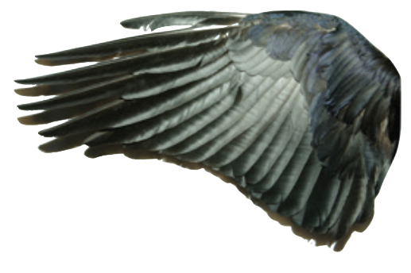
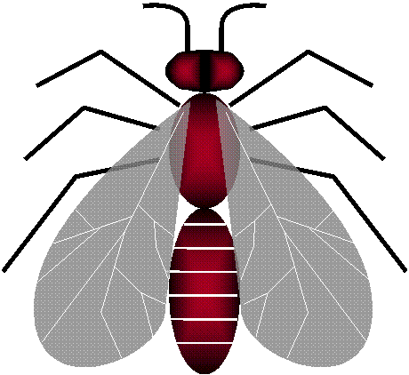
Click on the correct fly
feather
wing
NEXT

Slide 7
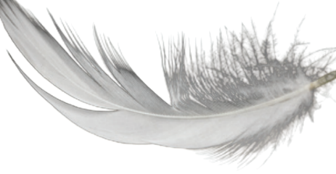
feather
fur
NEXT

Slide 8
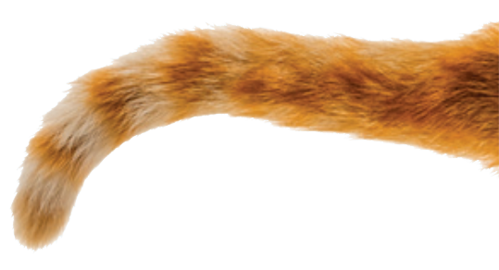
tail
wing
NEXT

Slide 9
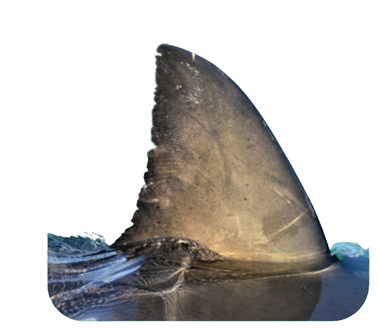
tail
fin
NEXT

Slide 10
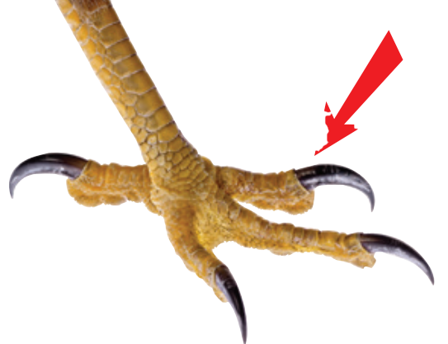
fin
claw
NEXT
Notes:
BÀI GIẢNG PPT SMART START 3 NEW 2022
Author: Thao Nguyen
Điện thoại: 0905917335
Zalo: 0905917335
Fb: https://www.facebook.com/dn.thaonguyen/
Group chia sẻ tài liệu: https://www.facebook.com/groups/220848385841356
******Liên hệ chính chủ để được hỗ trợ nếu bài bị lỗi.

Slide 12
It’s time to learn …

Slide 13
Reading

Slide 15
Listening

Slide 16
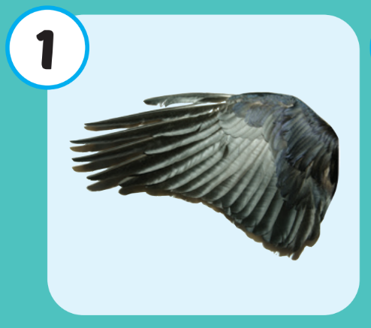

Slide 18
legs
fins
claws

Slide 19
Practice

Slide 20
Extra Practice
WB, page 9
4
3
5
6
2

Slide 21
WRAP-UP

Slide 22
Today’s lesson
Vocabularies
wing, feather, tail, fin, fur, claw.
Structures/ Sentence patterns
Birds have feathers, two wings, and two legs.

Slide 23
Homework
Practice the vocabularies and structure; and make sentences using them.
Do the exercises in Tiếng Anh 4 i-Learn Smart Start WB (page 9)
Do the exercises in Tiếng Anh 4 i-Learn Smart Start Notebook (page 7)
Prepare the next lesson (page 17 SB)
Play the consolidation games in Tiếng Anh 4 i-Learn Smart Start DHA App on www.eduhome.com.vn

Slide 24
Enjoy your day!

