Slide 1
Unit 1: Animals
Lesson 3.2
Page 13

Slide 2
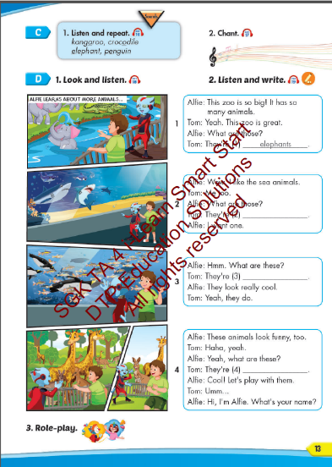
Lesson Outline
Warm-up
Listening
Consolidation
Wrap-up

Slide 3
Objectives
By the end of this lesson, students will be able to…
Vocabulary: Pronounce and use the words related to the topic properly: crocodile, bat, shark, penguin, kangaroo, elephant.
Structure: What are these? - They're penguins.
What are those? - They're bats.
Phonics: Identify the /ə/ and /e/ sound. and practice the conversations.

Slide 4
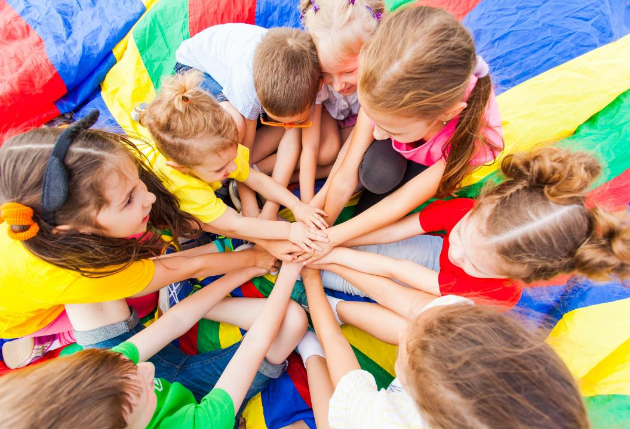
WARM UP

Slide 5
Check your memory

Slide 6
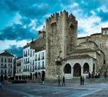
Unit 1: Animals
PUZZLE

Slide 7
Unit 1: Animals
Turn around as many colored boxes as you can within the time limit (5 seconds) and say what it is in the picture.

Slide 8
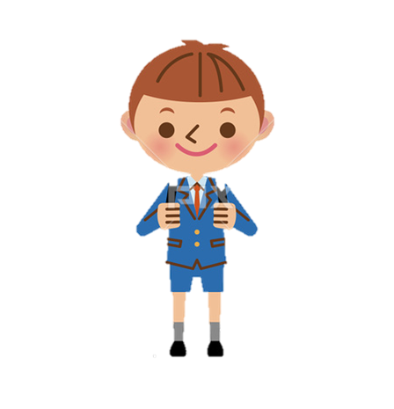
It's a crocodile.
What is in the picture?
T
I
M
E
I
S
U
P
CHECK
NEXT
Click on the colored boxes to turn them around

Slide 9
It's a bat.
What is in the picture?
T
I
M
E
I
S
U
P
CHECK
NEXT
Click on the colored boxes to turn them around

Slide 10
It's a shark.
What is in the picture?
T
I
M
E
I
S
U
P
CHECK
NEXT
Click on the colored boxes to turn them around

Slide 11
It's a penguin.
What is in the picture?
T
I
M
E
I
S
U
P
CHECK
NEXT
Click on the colored boxes to turn them around

Slide 12
It's an elephant.
What is in the picture?
T
I
M
E
I
S
U
P
CHECK
NEXT
Click on the colored boxes to turn them around

Slide 13
It's a kangaroo.
What is in the picture?
T
I
M
E
I
S
U
P
CHECK
NEXT
Click on the colored boxes to turn them around

Slide 14
It’s time to learn …

Slide 15
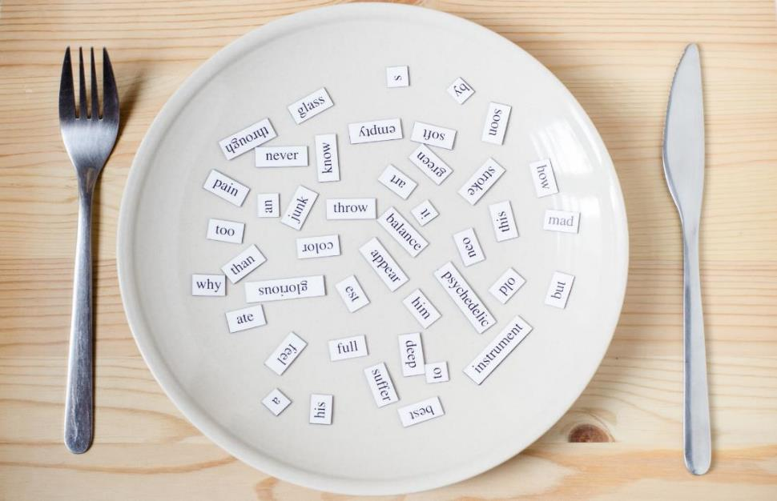
Phonics
/ə/ and /e/

Slide 16
Click CD1 track 16 to hear the sound.
a a kangaroo
o o crocodile
e e elephant
e e penguin

Slide 17
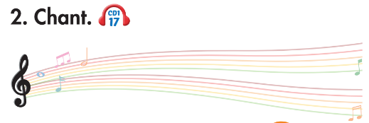
Track 17
What are these?
What are these?
What are these?
What are these?
They're kangaroos.
They're elephants.
They're kangaroos.
They're elephants.
What are those?
What are those?
What are those?
What are those?
They're crocodiles.
They're penguins.
They're crocodiles.
They're penguins.
Click on the music note to hear the sound.
Notes:
Bấm vào ngôi sao là ra script, bấm vào hình CD3-49 sẽ ra audio

Slide 18
about
bed
List the words with the same sound /ə/ and /e/. Practice saying them with a partner.
ago
head
sofa
end
sugar
friend

Slide 19
Listening

Slide 20
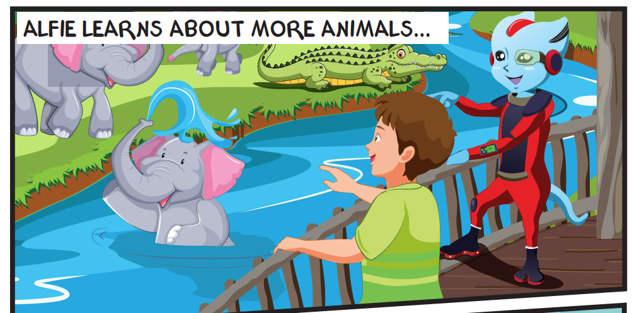
Look at the picture and answer.
Pre Listening
Who can you see?
Alfie and Tom.

Slide 21
Look at the picture and answer.
Pre Listening
Where are Alfie and Tom?
They're at the zoo.

Slide 22
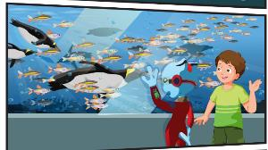
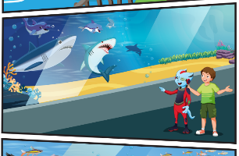
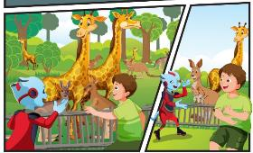
Look at the picture and answer.
Pre Listening
What can you see?
I can see sharks, dolphins, elephants, crocodiles,
penguins, fish, kangaroos, giraffes.

Slide 23
Look at the picture and answer.
Pre Listening
What animal is Alfie talking to?
They're talking about a kangaroo.

Slide 24
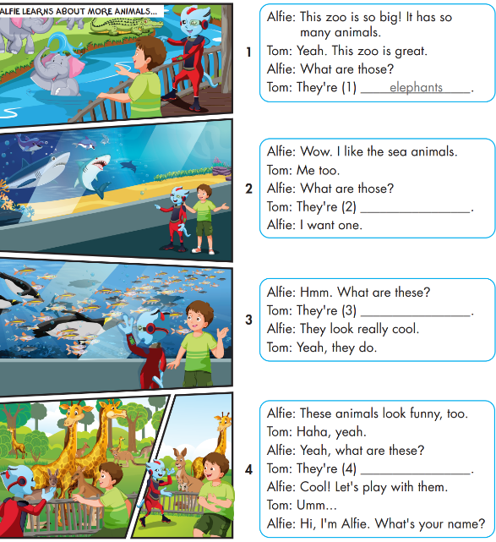
While Listening
Notes:
Bấm vô chữ listen audio sẽ bật, muốn tắt bấm vô audio lần nữa

Slide 25
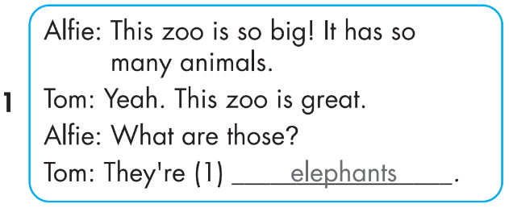
While Listening

Slide 26
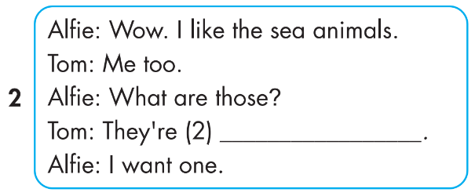
While Listening
Notes:
Bấm vô chữ listen audio sẽ bật, muốn tắt bấm vô audio lần nữa

Slide 27
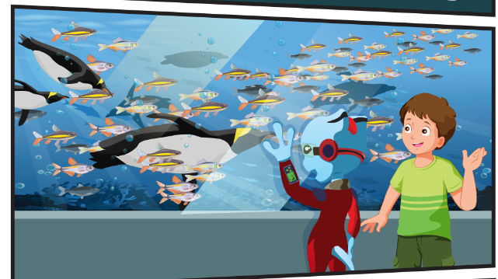
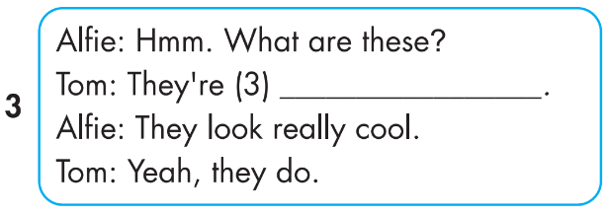
While Listening

Slide 28
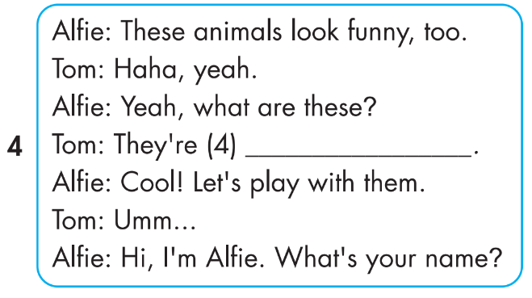
While Listening
Notes:
Bấm vô chữ listen audio sẽ bật, muốn tắt bấm vô audio lần nữa

Slide 29
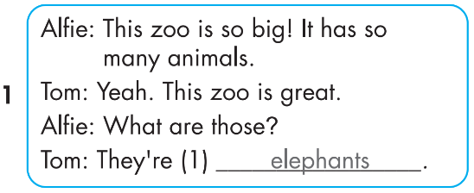
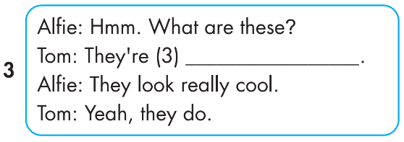
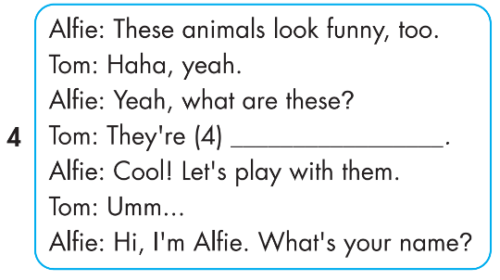
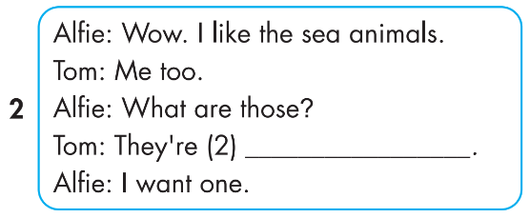
Click on 4 numbers to hear each sentence.
While Listening
3
penguins
1
4
kangaroos
2
sharks

Slide 30
Production

Slide 31
Post Listening

Slide 32
3
penguins
1
4
kangaroos
2
sharks
Notes:
Bấm vô chữ listen audio sẽ bật, muốn tắt bấm vô audio lần nữa

Slide 33
Extra Practice
WB, P. 6
Notes:
Nếu muốn chạy full audio thì click vô chữ listen, nếu muốn chạy từng hình thì click vô từng hình, muốn xem đáp án thì click vô ô vuông nhỏ

Slide 34
WRAP-UP

Slide 35
Today’s lesson
Vocabularies
crocodile, bat, shark, penguin, kangaroo, elephant.
Structures/ Sentence patterns
What are these? - They're penguins.
What are those? - They're bats.
Phonics
Phonics: Identify the /ə/ and /e/ sound. and practice the conversations.

Slide 36
Homework
Practice the vocabularies and structure; and make sentences using them.
Do the exercises in Tiếng Anh 4 i-Learn Smart Start WB (page 6)
Do the exercises in Tiếng Anh 4 i-Learn Smart Start Notebook (page 6)
Prepare the next lesson (page 14 SB)
Play the consolidation games in Tiếng Anh 4 i-Learn Smart Start DHA App on www.eduhome.com.vn

Slide 37
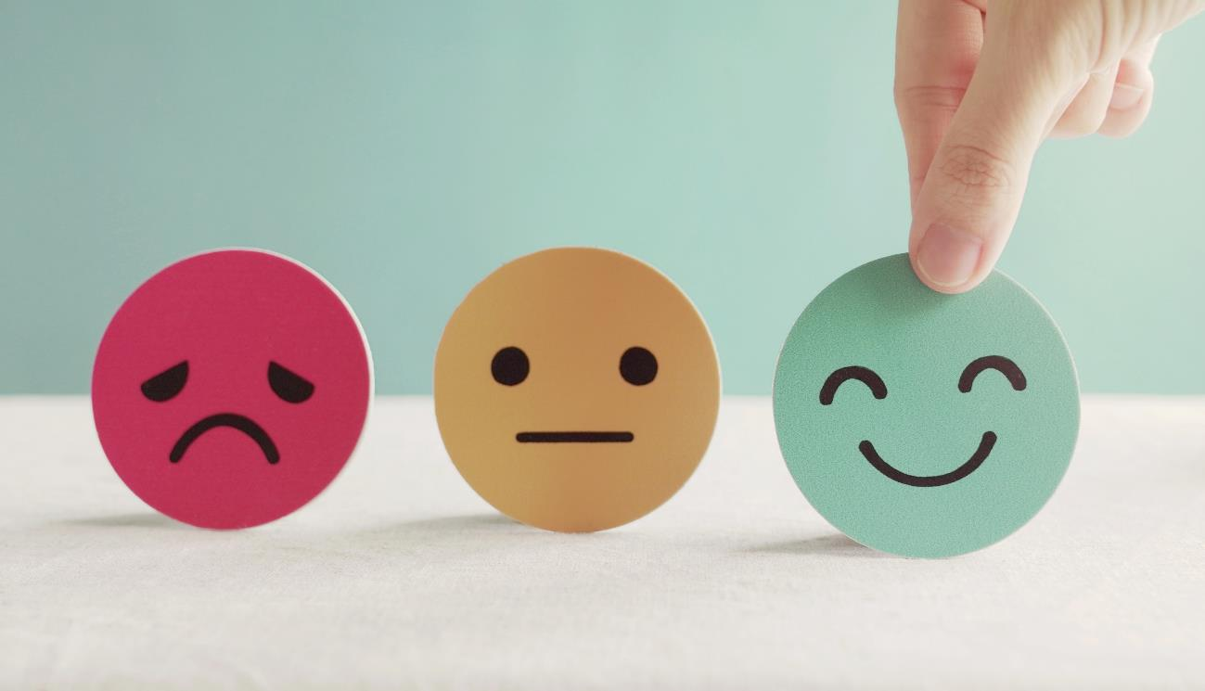
Lesson 3
Stay positive and have a nice day!

