Slide 1
Unit 1: Animals
Lesson 3.1
Page 12

Slide 2
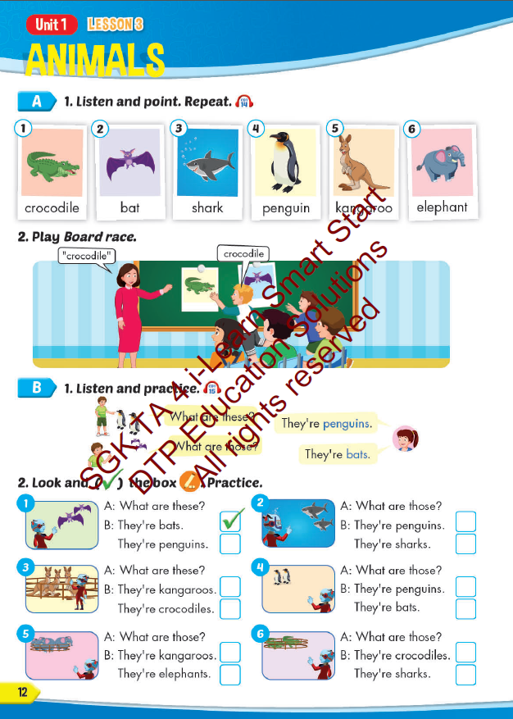
Lesson Outline
Warm-up
Vocabulary
Structure
Consolidation
Wrap-up

Slide 3
Objectives
By the end of this lesson, students will be able to…
Vocabulary: Pronounce and use the words related to the topic properly: crocodile, bat, shark, penguin, kangaroo, elephant.
Structure: What are these? - They're penguins.
What are those? - They're bats.

Slide 4
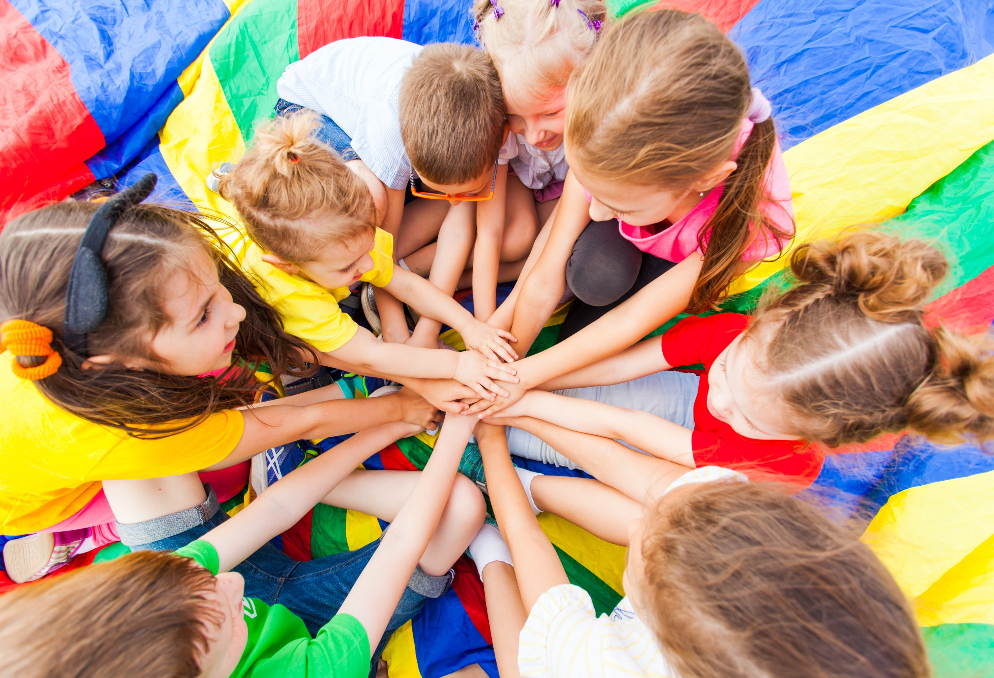
WARM UP

Slide 5
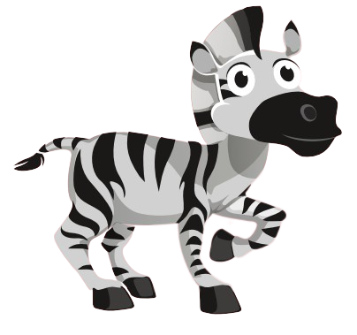
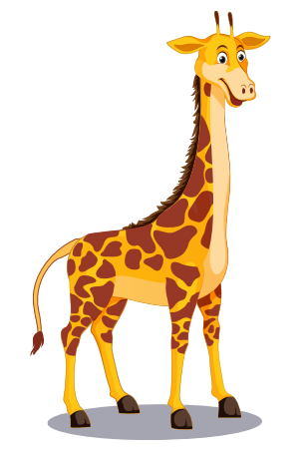
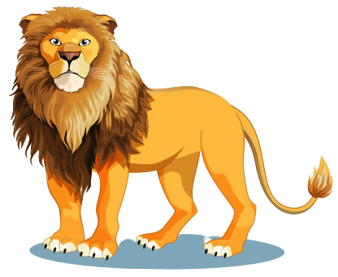
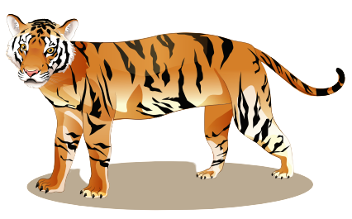
Look at the picture and say aloud the word.

Slide 6
It’s time to learn …

Slide 7
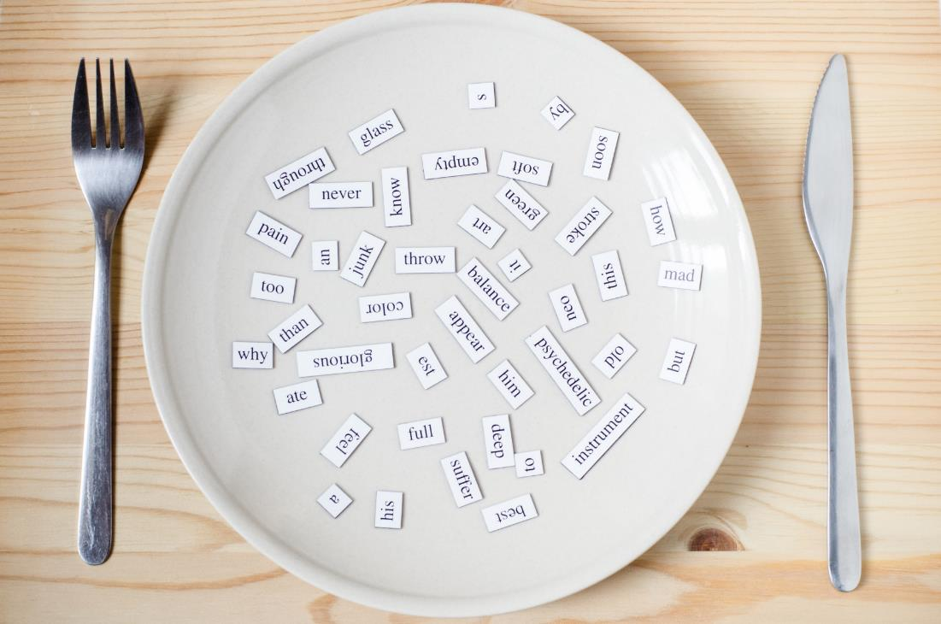
New words
crocodile, bat, shark,
penguin, kangaroo, elephant.

Slide 8
Presentation

Slide 9
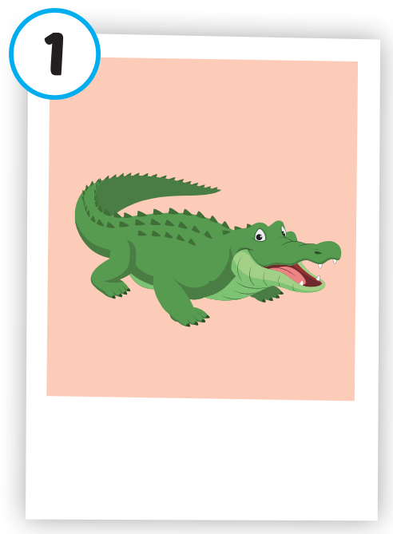
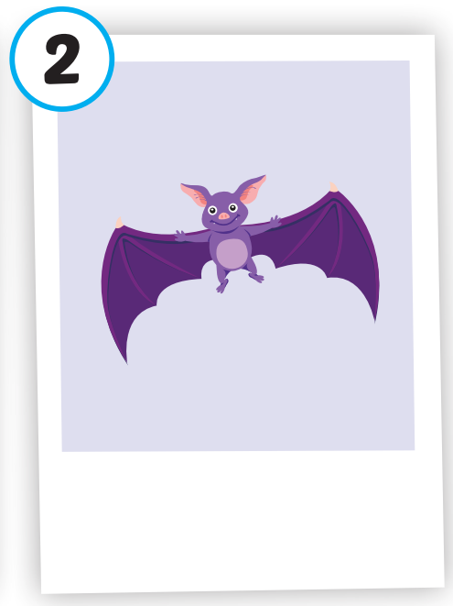
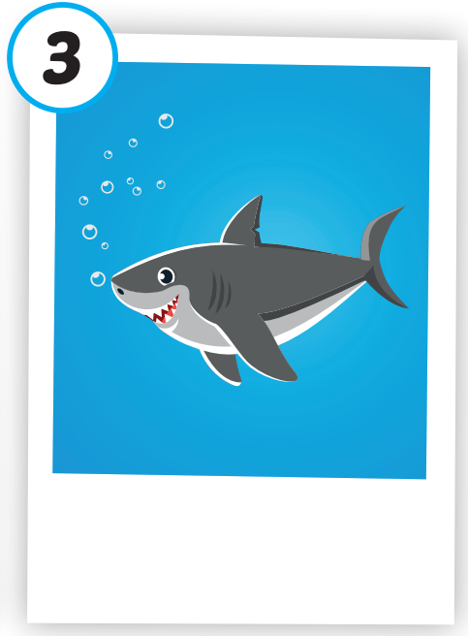
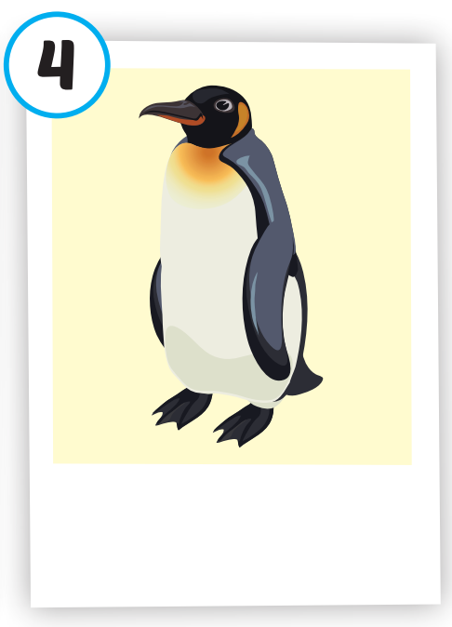
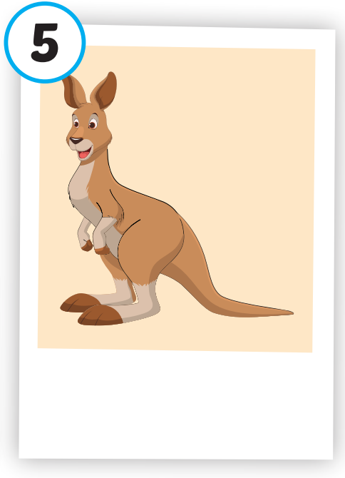
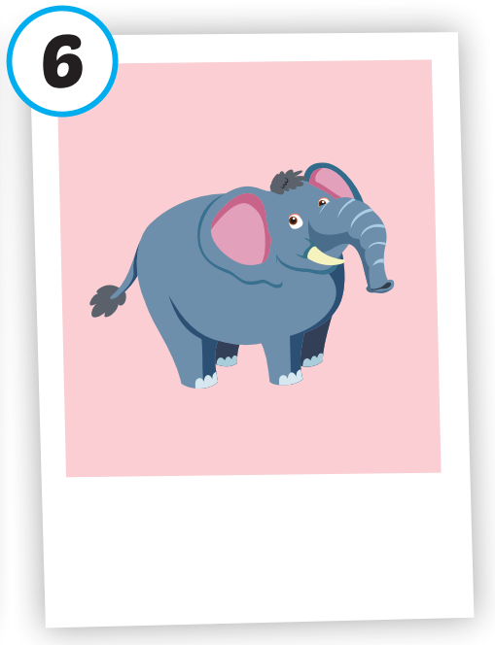
Click on each picture to hear the sound.
/ˈkrɑːkədaɪl/cá sấu
/bæt/
con dơi
/ʃɑːrk/
cá mập
/ˈpeŋɡwɪn/
chim cánh cụt
/ˌkæŋɡəˈruː/
con chuột túi
/ˈeləfənt/
con voi

Slide 10
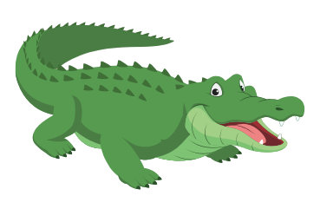
Click on each picture to hear the sound.
/ˈkrɑːkədaɪl/cá sấu
Notes:
Click vào hình A. 1. Listen and point. Repeat để cho cả audio full chạy

Slide 11
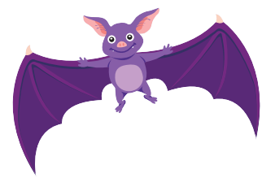
Click on each picture to hear the sound.
/bæt/
con dơi

Slide 12
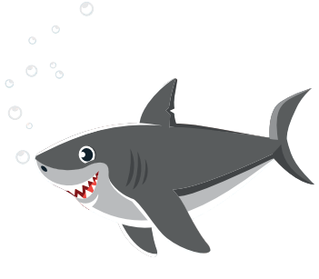
Click on each picture to hear the sound.
/ʃɑːrk/
cá mập
Notes:
Click vào hình A. 1. Listen and point. Repeat để cho cả audio full chạy

Slide 13
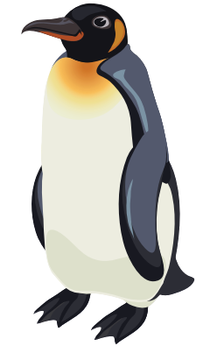
Click on each picture to hear the sound.
/ˈpeŋɡwɪn/
chim cánh cụt

Slide 14
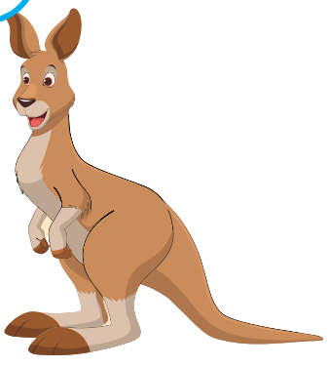
Click on each picture to hear the sound.
/ˌkæŋɡəˈruː/
con chuột túi

Slide 15
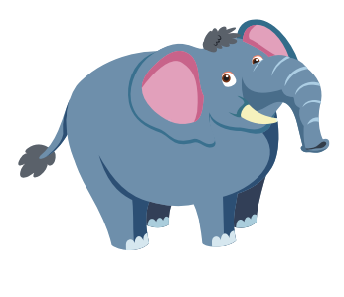
Click on each picture to hear the sound.
/ˈeləfənt/
con voi
Notes:
Click vào hình A. 1. Listen and point. Repeat để cho cả audio full chạy

Slide 16
Check your memory

Slide 17
What animal is missing?

Slide 18
?
elephant

Slide 19
?
penguin

Slide 20
?
kangaroo

Slide 21
?
crocodile

Slide 22
?
bat

Slide 23
?
shark

Slide 24
Practice

Slide 26
Structure
What are these? - They're penguins.
What are those? - They're bats.

Slide 27
Presentation

Slide 28
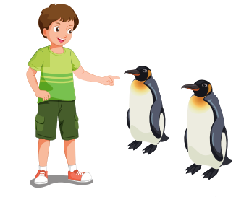
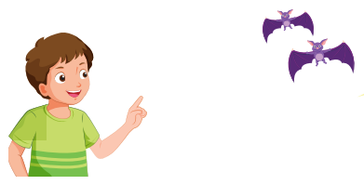
Structure

Slide 29
Practice

Slide 32
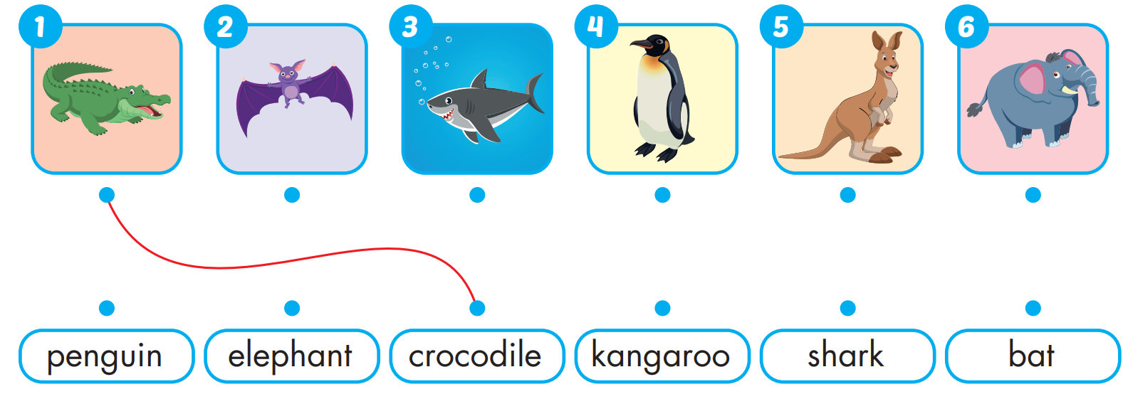
Extra Practice
WB, page 6

Slide 33
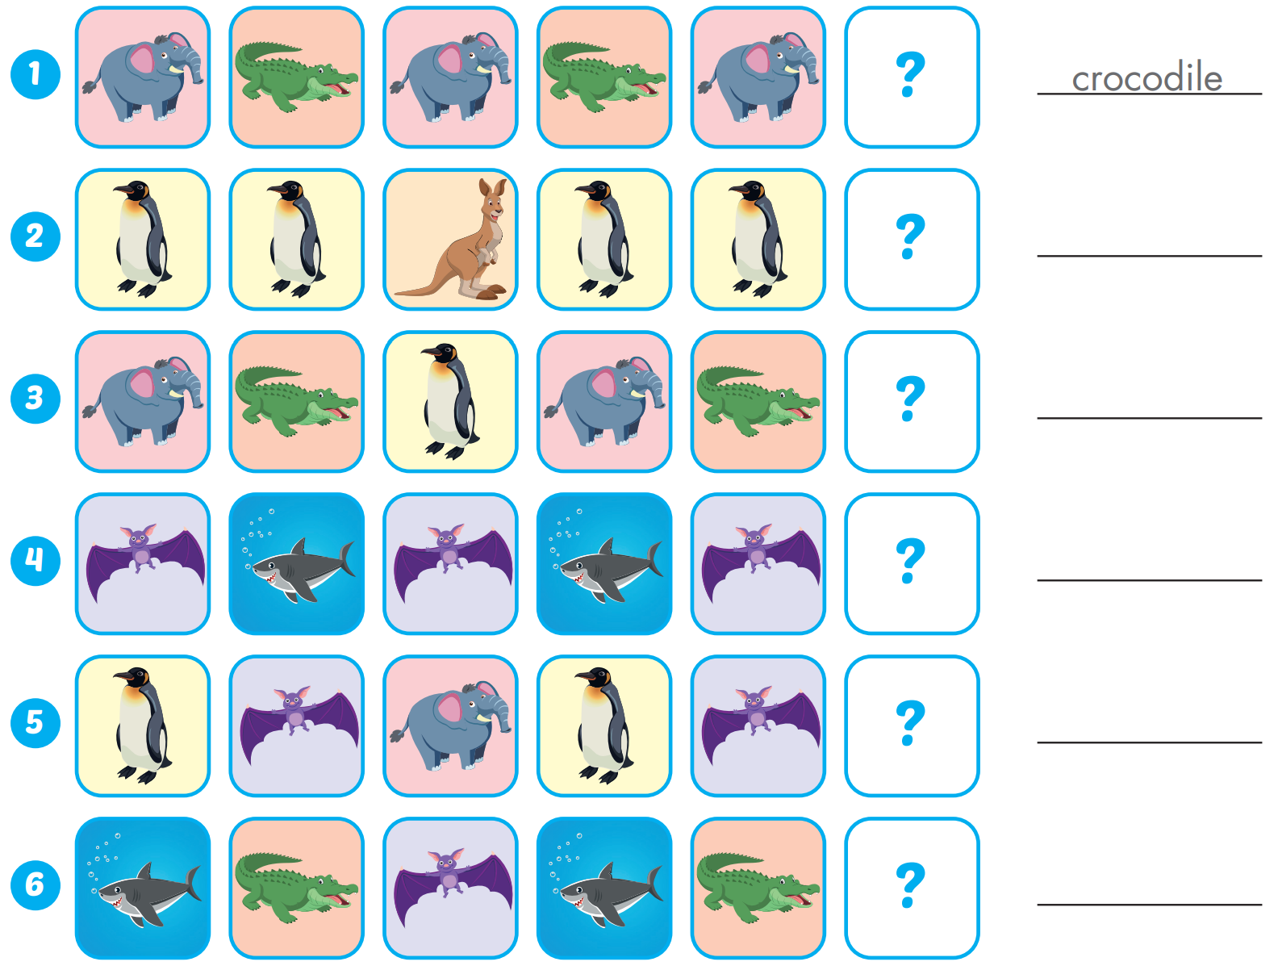
Extra Practice
WB, page 6
kangaroo
penguin
shark
penguin
bat

Slide 34
WRAP-UP

Slide 35
Today’s lesson
Vocabularies
crocodile, bat, shark, penguin, kangaroo, elephant.
Structures/ Sentence patterns
What are these? - They're penguins.
What are those? - They're bats.

Slide 36
Homework
Practice the vocabularies and structure; and make sentences using them.
Do the exercises in Tiếng Anh 4 i-Learn Smart Start WB (page 6)
Do the exercises in Tiếng Anh 4 i-Learn Smart Start Notebook (page 6)
Prepare the next lesson (page 13 SB)
Play the consolidation games in Tiếng Anh 4 i-Learn Smart Start DHA App on www.eduhome.com.vn

Slide 37
Lesson 3
Stay positive and have a nice day!

