Slide 1
Unit 1: Animals
Lesson 1.2
Page 7

Slide 2
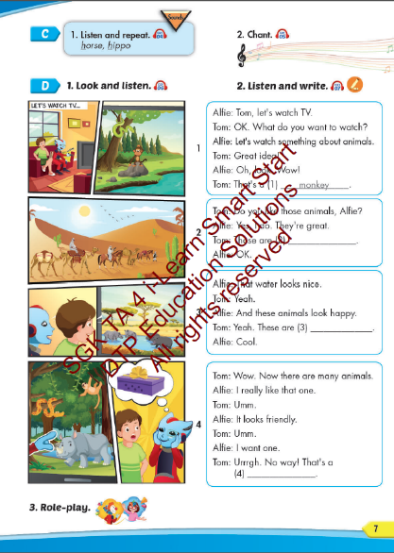
Lesson Outline
Warm-up
Listening
Consolidation
Wrap-up

Slide 3
Objectives
By the end of this lesson, students will be able to…
Vocabulary: Pronounce and use the words related to the topic properly: snake, monkey, horse, camel, hippo, rhino.
Structure: This is a monkey. - These are monkeys.
That's a snake. - Those are snakes
Phonics: Identify the /h/ sound and practice the conversations.

Slide 4
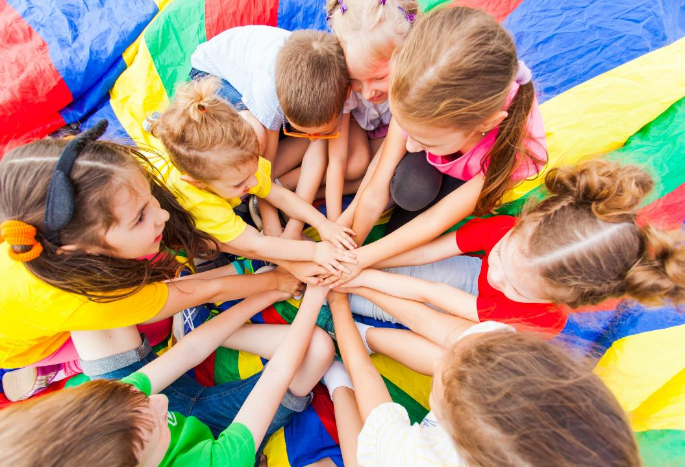
WARM UP

Slide 5
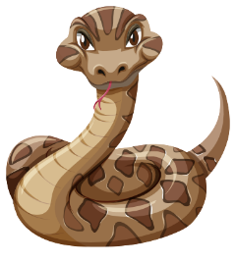
It’s a …..
It’s a snake.
Ms Huyền Phạm
0936.082.789

Slide 6
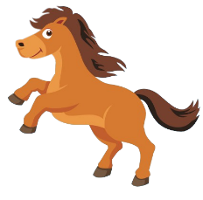
It’s a …..
It’s a horse.
Ms Huyền Phạm
0936.082.789

Slide 7
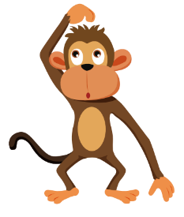
It’s a …..
It’s a monkey.
Ms Huyền Phạm
0936.082.789

Slide 8
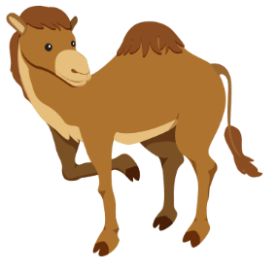
It’s a …..
It’s a camel.
Ms Huyền Phạm
0936.082.789

Slide 9
They’re …..
They’re hippos.
Ms Huyền Phạm
0936.082.789

Slide 10
They’re …..
They’re rhinos.
Ms Huyền Phạm
0936.082.789

Slide 11
It’s time to learn …

Slide 12
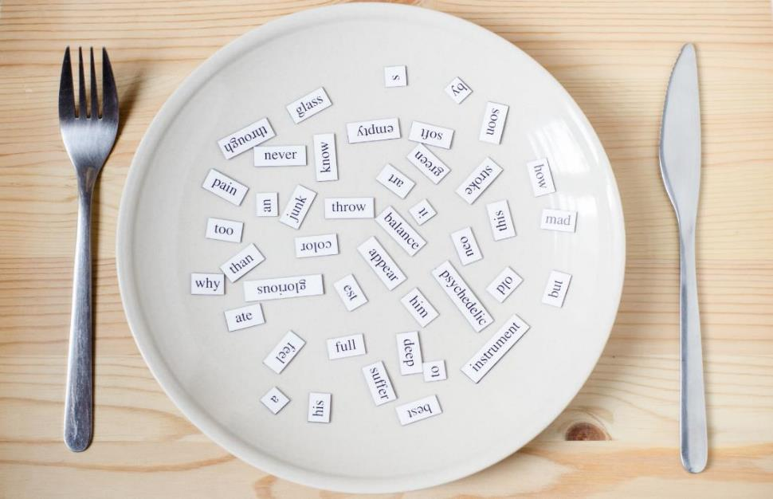
Phonics
/h/

Slide 13
Click CD1 track 04 to hear the sound.
h h horse
h h hippo

Slide 14
Track 05
This is a horse.
This is a horse.
These are hippos.
These are hippos.
That's a hippo.
That's a hippo.
Those are horses.
Those are horses.
Hippos, horses, hippos, horses
Hippos, horses, hippos, horses
Click on the music note to hear the sound.
Notes:
Bấm vào ngôi sao là ra script, bấm vào hình CD3-49 sẽ ra audio

Slide 15
hat
how
List the words with the same sound /h/. Practice saying them with a partner.
hello
help
house
hope
happy
high

Slide 16
Listening

Slide 17
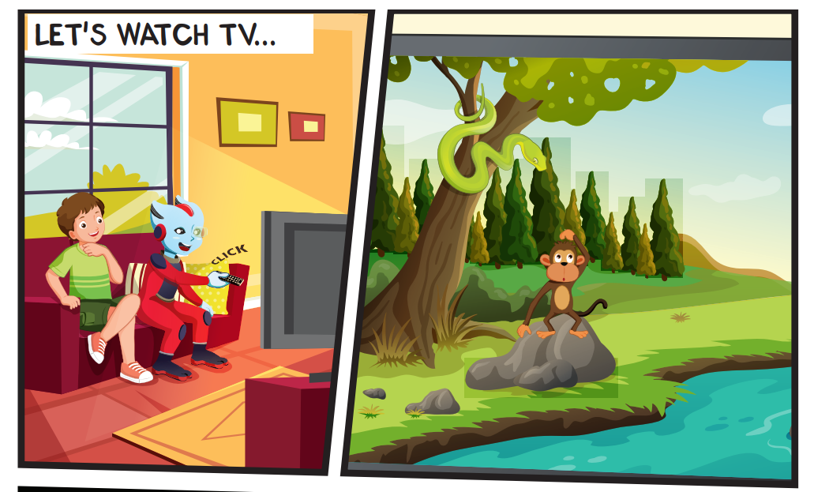
Look at the picture and answer.
Pre-Listening
Who can you see?
Alfie and Tom.

Slide 18
Look at the picture and answer.
Pre-Listening
What are they doing?
They are watching TV.

Slide 19
Look at the picture and answer.
Pre-Listening
How many monkeys can you see?
one monkey.

Slide 20
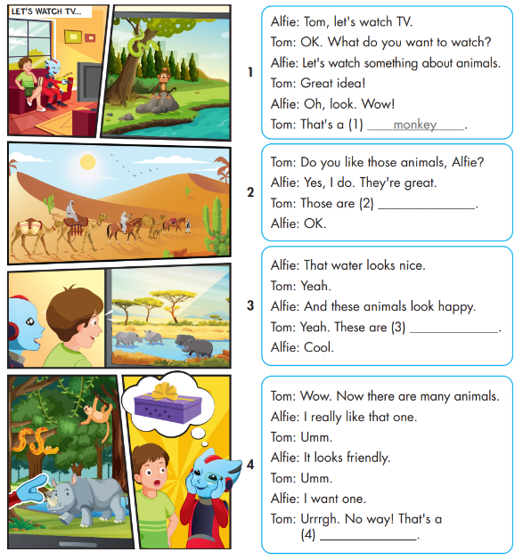
While-Listening

Slide 21
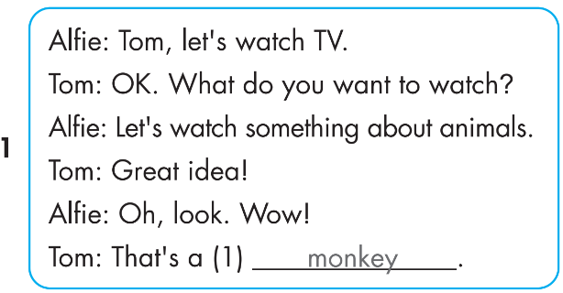
While-Listening

Slide 22
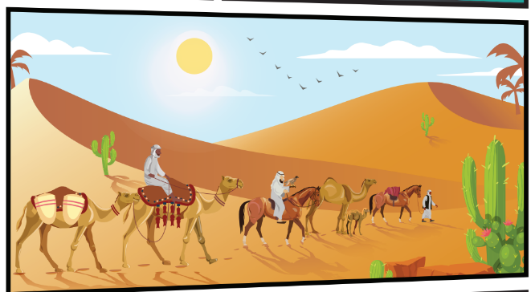
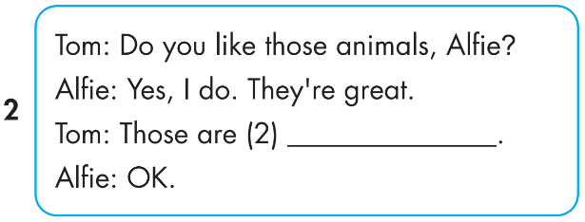
While-Listening
Notes:
Bấm vô chữ listen audio sẽ bật, muốn tắt bấm vô audio lần nữa

Slide 23
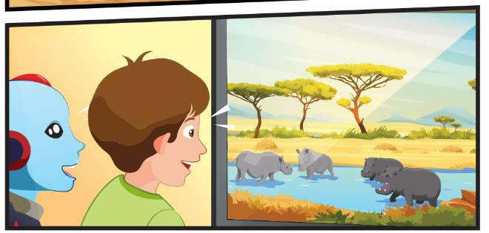
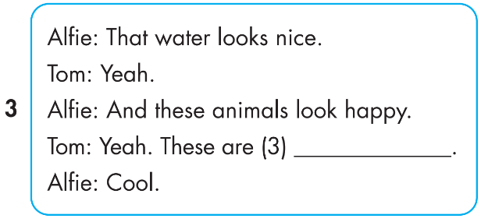
While-Listening

Slide 24
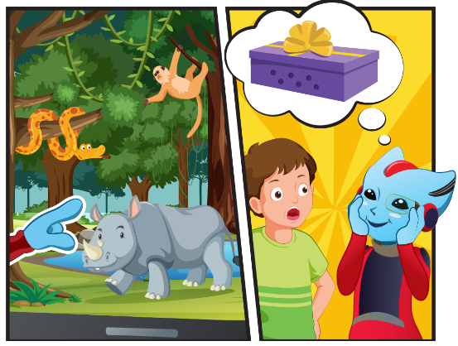
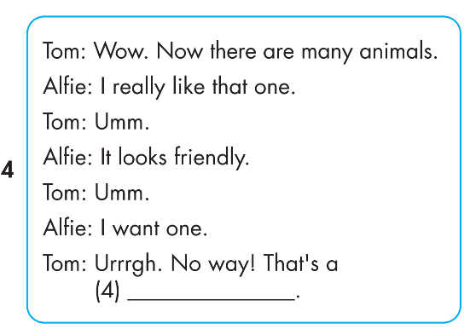
While-Listening

Slide 25
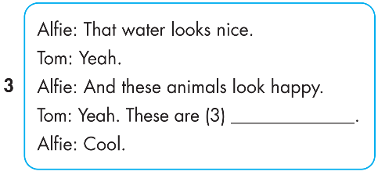
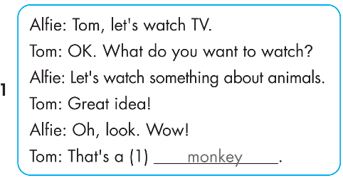
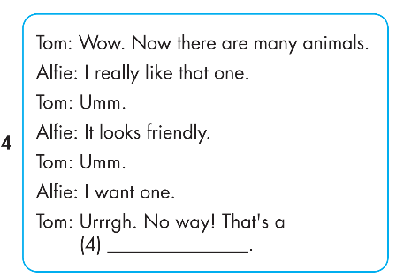
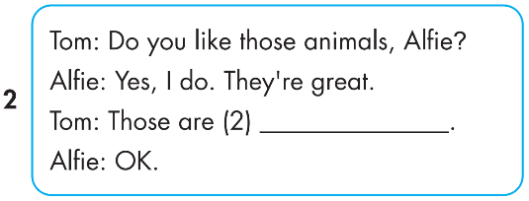
Click on 4 numbers to hear each sentence.
While-Listening
3
1
rhinos
4
2
horses
snake
Notes:
Bấm vô chữ listen audio sẽ bật, muốn tắt bấm vô audio lần nữa

Slide 26
Post-Listening

Slide 27
3
1
rhinos
4
2
horses
snake
Notes:
Bấm vô chữ listen audio sẽ bật, muốn tắt bấm vô audio lần nữa

Slide 28
Practice

Slide 29
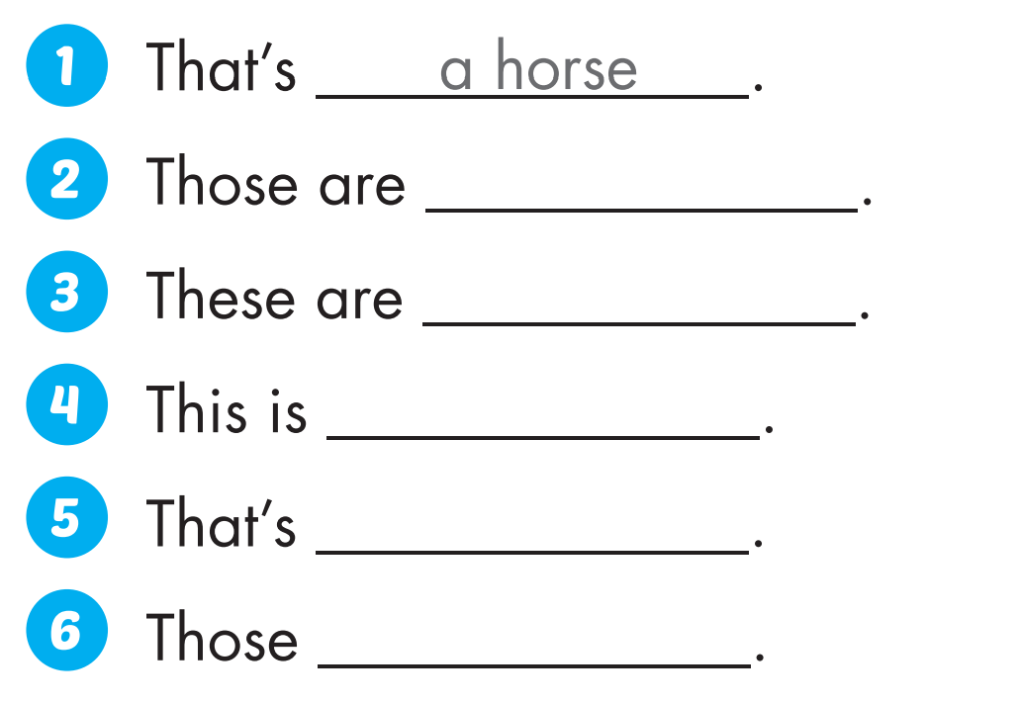
Extra Practice
WB, P. 3
monkeys
snakes
a camel
a rhino
are hippos

Slide 30
Production

Slide 31
CONSOLIDATION

Slide 32
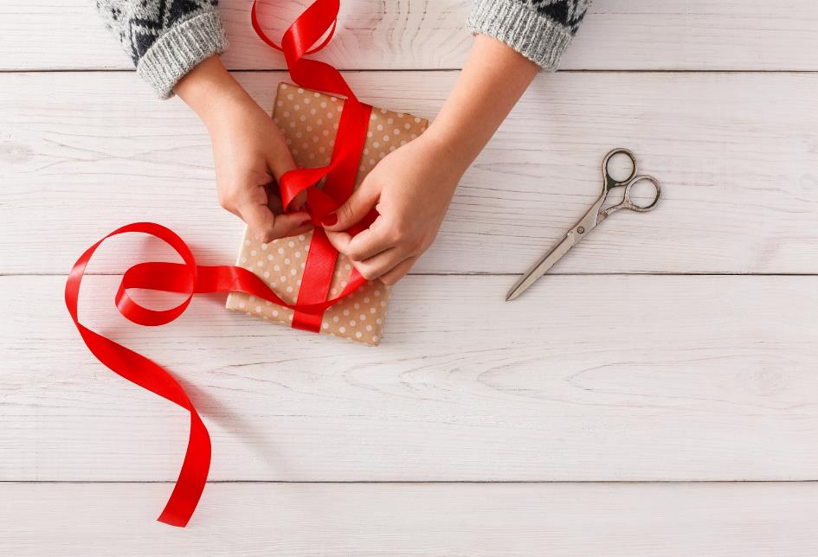
WRAP-UP

Slide 33
Today’s lesson
Structures/ Sentence patterns
This is a monkey.
These are monkeys.
That's a snake.
Those are snakes
Vocabularies
snake, monkey, horse, camel, hippo, rhino.
Phonics
Identify the /h/ sound and practice the conversations.

Slide 34
Homework
Practice the vocabularies and structure; and make sentences using them.
Do the exercises in Tiếng Anh 4 i-Learn Smart Start WB (page 3)
Do the exercises in Tiếng Anh 4 i-Learn Smart Start Notebook (page 6)
Prepare the next lesson (page 8 SB)
Play the consolidation games in Tiếng Anh 4 i-Learn Smart Start DHA App on www.eduhome.com.vn

Slide 35
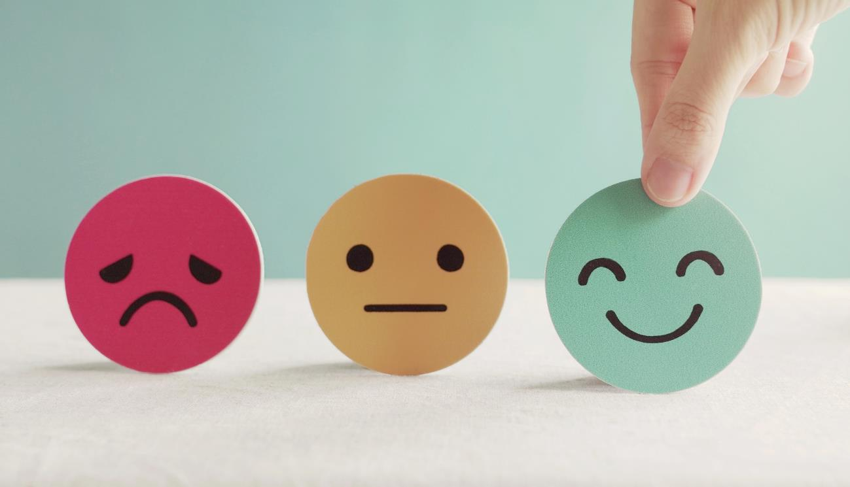
Lesson 3
Stay positive and have a nice day!

