Slide 1
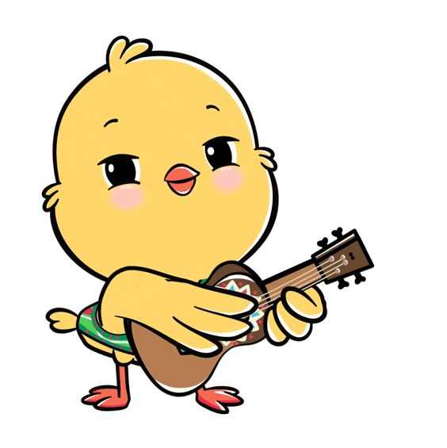
Welcome to our class!

Slide 2

Warm-up

Slide 3
Let’s play!

Slide 4

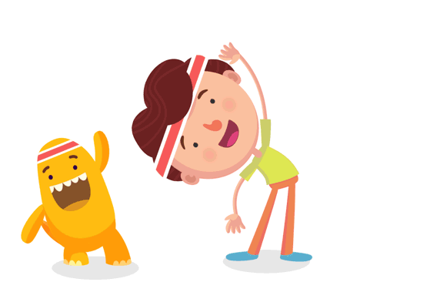
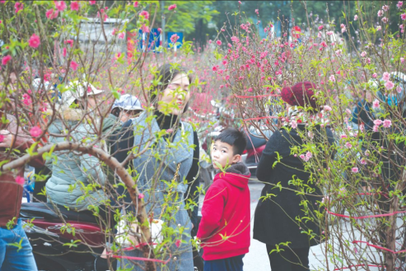
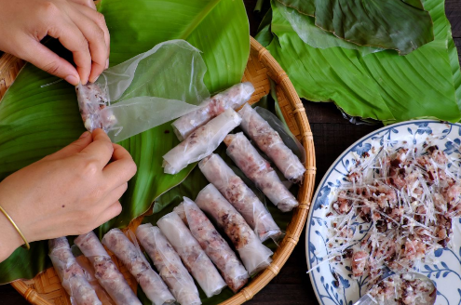
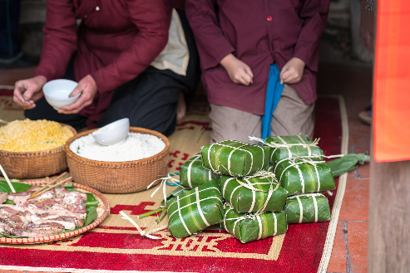


1/8
A: Will you make spring rolls for Tet?
B: No, I won’t. I’ll make banh chung.
A B C

Slide 5
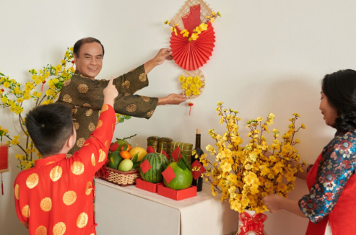
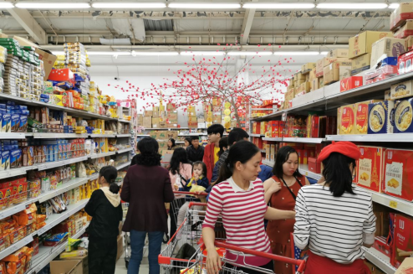
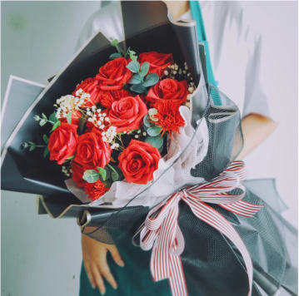
2/8
A: Will you decorate the house for Tet?
B: Yes, I will.
A B C

Slide 6
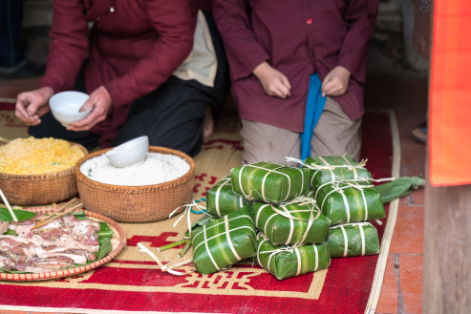
3/8
A: Will you buy roses for Tet?
B: No, I won’t. I’ll buy a branch of peach blossoms.
A B C

Slide 7


4/8
A: Will you do you shopping for Tet?
B: Yes, I will.
A B C

Slide 8

5/8
Listen and choose.
A B C

Slide 9
6/8
Listen and choose.
A B C

Slide 10

7/8
Listen and choose.
A B C

Slide 11

8/8
Listen and choose.
A B C

Slide 12
Well done!

Slide 13
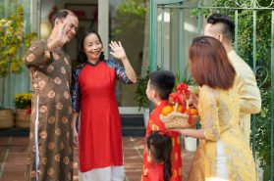
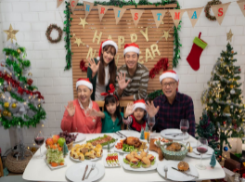
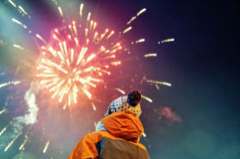
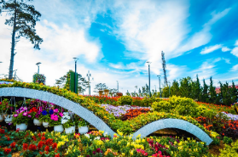
Unit 12
Our Tet holiday
Lesson 2

Slide 14
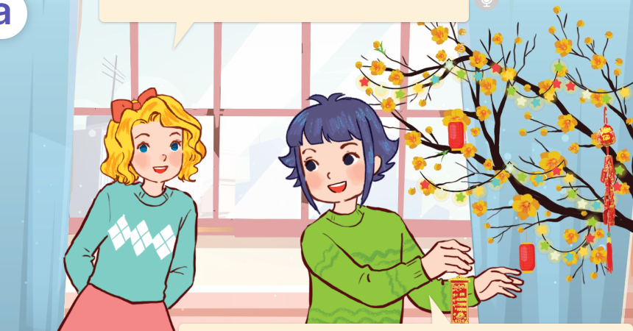
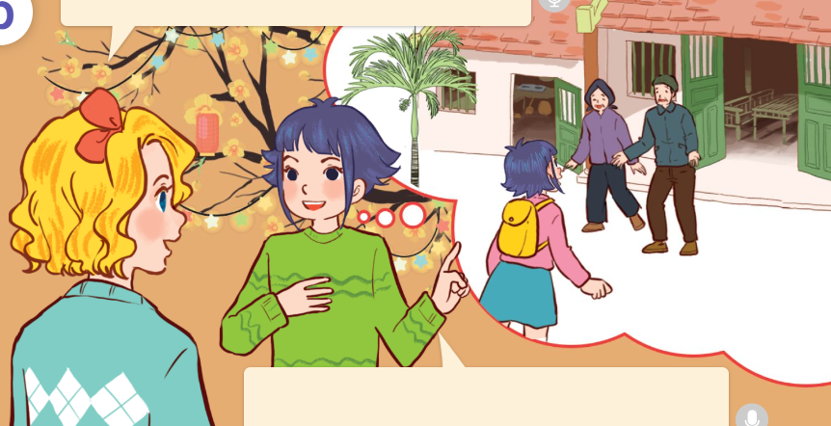
1. Look, listen and repeat.
What are you doing, Linh?
Where will you go at Tet?
a
b
I’m decorating my house for Tet.
I’ll go to my grandparents’ house in the countryside.
Click on the speaker / sentences to listen.

Slide 15
Vocabulary

Slide 16

Vocabulary
fireworks show
sự trình diễn pháo hoa
Click on the English words to listen.

Slide 17

flower festival
Lễ hội hoa

Slide 18

New Year party
tiệc năm mới

Slide 19

grandparents’ house
nhà ông bà

Slide 20



Review
New Year party
flower festival
fireworks show
grandparents’ house
Click on the English word to listen again.

Slide 21




Vocabulary
1. fireworks show
: sự trình diễn pháo hoa
2. flower festival
: lễ hôi hoa
3. New Year party
: tiệc đầu năm
4. grandparents’ house
: nhà ông bà
Click on the English word to listen again.

Slide 22

Checking vocabulary!

Slide 23





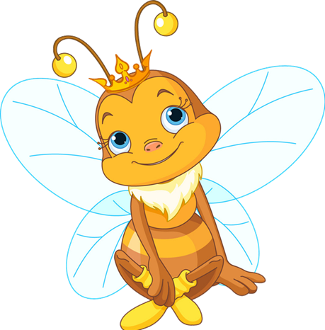
fireworks show
fireworks show
A
B
C
NEXT

Slide 24



flower festival
flower festival
A
B
C
NEXT

Slide 25



New Year party
New Year party
A
B
C
NEXT

Slide 26



grandparents’ house
grandparents’ house
A
B
C
NEXT

Slide 27
Well done!

Slide 28
Structures

Slide 29




Cách hỏi ai đó dự định đi đâu vào dịp Tết:
Where will you go at Tet?
I’ll go to _______.
Example:
Where will you go at Tet?
I’ll go to a fireworks show.

Slide 30






Unit 12 lesson 2
Where will you go at Tet?
I’ll go to ________.
my grandparents’ house
a New Year party
a fireworks show
a flower festival

Slide 31




2. Listen, point and say.
a
b
Where will you go at Tet?
my grandparents’ house
a fireworks show
I’ll go to ______.
c
d
a New Year party
a flower festival
Click on the words / phrases to listen again.

Slide 32



2. Listen, point and say.
a
my grandparents’ house
Where will you go at Tet?
I’ll go to my grandparents’ house.
Click on the sentences to listen.

Slide 33

2. Listen, point and say.
b
a fireworks show
Where will you go at Tet?
I’ll go to a fireworks show.

Slide 34

2. Listen, point and say.
c
a New Year party
Where will you go at Tet?
I’ll go to a New Year party.

Slide 35

2. Listen, point and say.
d
a flower festival
Where will you go at Tet?
I’ll go to a flower festival.

Slide 36
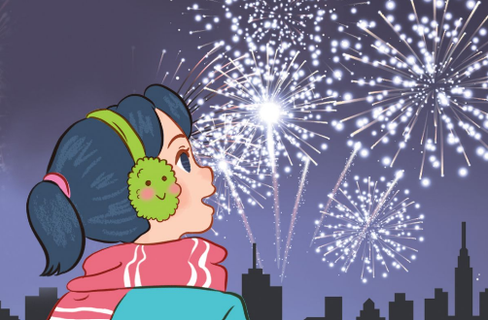
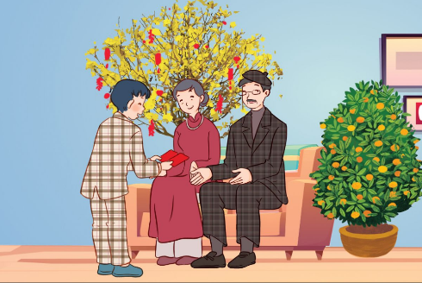
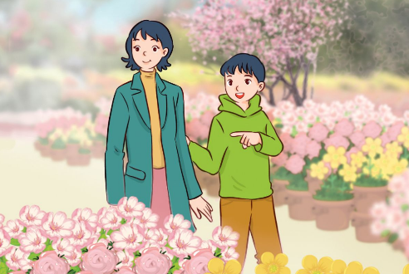
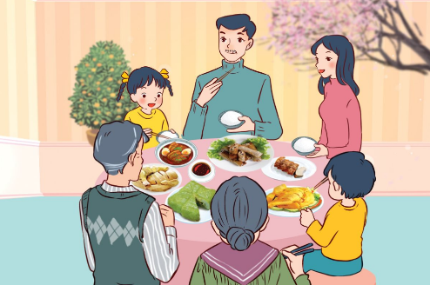
3. Let’s talk.
Will you ___________ for Tet?
_______________________.
Where will you go at Tet?
_____________________.

Slide 37

3. Let’s talk.
Will you __________________ for Tet?
decorate the house
Yes, I will
____________.
Where will you go at Tet?
_______________________.
I’ll go to a fireworks show

Slide 38
3. Let’s talk.
make banh chung
Will you ____________________ for Tet?
No, I won’t. I’ll make spring rolls
____________________________.
Where will you go at Tet?
I’ll go to my grandparents’ house
______________________________.

Slide 39
3. Let’s talk.
buy a branch of peach blossoms
Will you _____________________________ for Tet?
Yes, I will
____________.
Where will you go at Tet?
I’ll go to a flower festival
_____________________.

Slide 40
3. Let’s talk.
Will you _______________ for Tet?
do the shopping
Yes, I will
__________.
Where will you go at Tet?
I’ll go to a New Year party
_______________________.

Slide 41
Let’s play!

Slide 42








Sun flower

Slide 43



1/8
A: Where will you go at Tet?
B: I’ll go to ________.
Click on the flowers to choose.
A
B
C
D
a New Year party
a flower festival
a fireworks show
my grandparents’ house

Slide 44
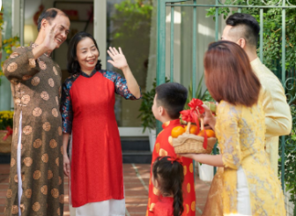
2/8
A: Where will you go at Tet?
B: I’ll go to ________.
Click on the flowers to choose.
A
B
C
D
a flower festival
a New Year party
my grandparents’ house
a fireworks show

Slide 45

3/8
A: Where will you go at Tet?
B: I’ll go to ________.
Click on the flowers to choose.
A
B
C
D
my grandparents’ house
a New Year party
a fireworks show
a flower festival

Slide 46

4/8
A: Where will you go at Tet?
B: I’ll go to ________.
A
B
C
D
a flower festival
my grandparents’ house
a fireworks show
a New Year party

Slide 47



5/8
A: Where will you go at Tet?
B: I’ll go to my grandparents’ house.
A
B
C
D

Slide 48




6/8
A: Where will you go at Tet?
B: I’ll go to a New Year party.
A
B
C
D

Slide 49



7/8
A: Where will you go at Tet?
B: I’ll go to a fireworks show.
A
B
C
D
Sai
Sai

Slide 50




8/8
A: Where will you go at Tet?
B: I’ll go to a flower festival.
A
B
C
D

Slide 51


Slide 52









WELL DONE!

Slide 53
Homework
Learn by heart all the new words and the model sentences.
Read again the dialogue in part 1.

Slide 54

Goodbye!

