Slide 1
Welcome to our class!

Slide 2
Warm-up

Slide 3
Slow Reveal!

Slide 4
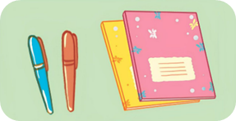
1/8
Where are the pencils?
They’re beside the book.
_______________________

Slide 5
2/8
Where are the pictures?
They’re above the window.
______________________

Slide 6
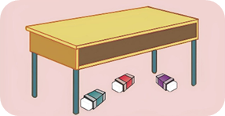
3/8
Where are the erasers?
They’re under
the desk.
______________________

Slide 7
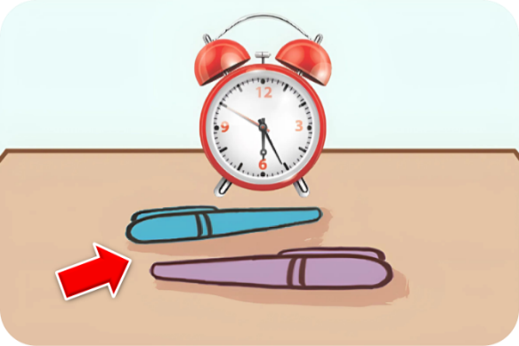
4/8
Where are the pens?
___________________
They’re in front of
the clock.

Slide 8
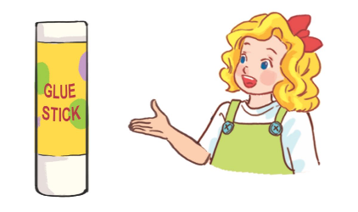
5/8
Whose glue stick is this?
__________________
It’s Mary’s.

Slide 9
6/8
_________________________________
Whose set square is this?
It’s Linh’s.

Slide 10
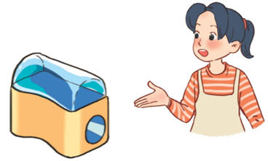
7/8
Whose pencil sharpener is this?
____________________________
It’s Mai’s.

Slide 11
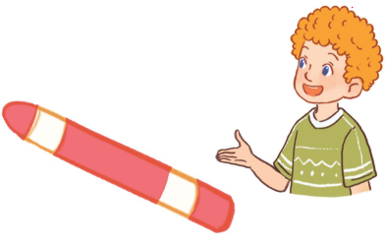
_________________________
8/8
Whose crayon is this?
It’s Bill’s.

Slide 12
Let's have a great class!

Slide 14
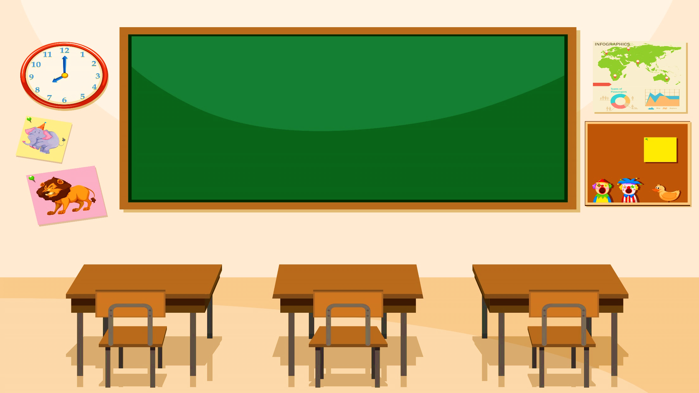
Monday, August 18th 2024
Unit 8
In our classroom
Lesson 3

Slide 15
Contents
Read and answer.
Look and write.
Project

Slide 16
Let’s play!

Slide 18
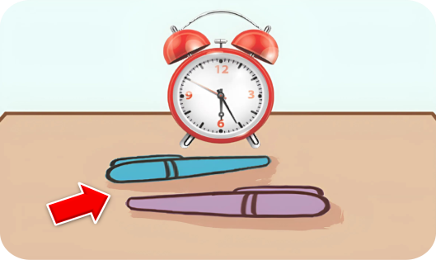
1/10
Fcebook: Bùi Liễu Powerpoint 0968142780
Where are the pens?
A. They’re under the clock.
B. They’re in front of the clock.
-1
-1
+5
-1
C. They’re beside the book.
D. They’re under the book.

Slide 19
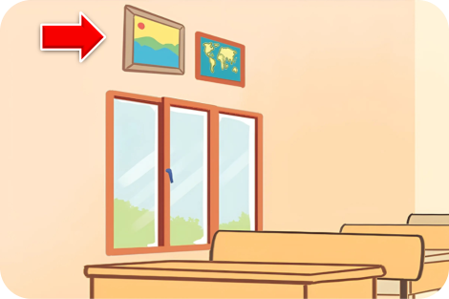
2/10
A: Where are the pictures?
B: They’re _____ .
A. above the window
B. beside the window
-1
-1
-1
+5
C. above the clock
D. under the desk

Slide 20
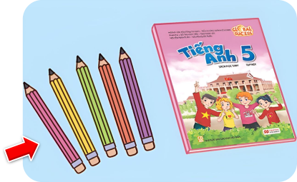
A: Where are the pencils?
B: They’re ___________.
3/10
A. in front of the clock
B. beside the clock
-1
-1
-1
+5
C. above the window
D. beside the book

Slide 21
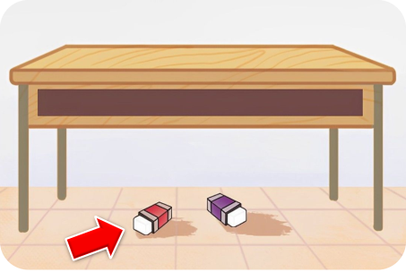
A: ____ are the erasers?
B: They’re under the desk.
4/10
A. When
B. What
+5
-1
-1
-1
C. Where
D. Who

Slide 22
5/10
A: Whose ____ is this?
B: It’s Mary’s.
A. glue stick
B. crayon
-1
-1
-1
+5
C. pencil sharpener
D. set square

Slide 23
A: ____ pencil sharpener is this?
B: It’s Mai’s.
6/10
A. Where
B. Whose
-1
-1
-1
+5
C. Who
D. What

Slide 24
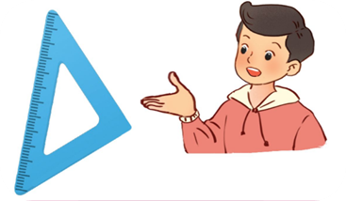
7/10
A: Whose ___ is this?
B: It’s Nam’s.
A. set square
B. glue stick
-1
-1
-1
+5
C. pencil sharpener
D. crayon

Slide 25
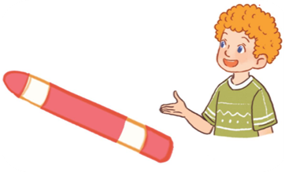
A: ______________
B: It’s Bill’s.
8/10
A. Whose pensil sharpener is this?
B. Whose crayon is this?
-1
-1
-1
+5
C. Whose set square is this?
D. Whose glue stick is this?

Slide 26
A: Where are the erasers?
B: __________________
9/10
A. Because she think it’s fun.
B. They’re under the desk.
-1
-1
-1
+5
C. Go along the corridor and turn left
D. It’s beside the picture.

Slide 27
A: _________________
B: It’s Mary’s.
10/10
A. Is this your glue stick?
B. Why does she like playing games?
+5
-1
-1
-1
C. Whose glue stick is this?
D. Where is the glue stick?

Slide 28
Great job!
Exit

Slide 29
4. Read and answer.
1
Trang, Hung and Lan are in Class 5A. They’re very tidy! Trang’s set square is on her desk, beside her pencil case. Hung’s pencils are on his desk, in front of his pencil sharpener. Lan’s school bag is under her desk.
Trang has a new storybook. It’s in her school bag. Hung’s storybook is beside his notebook. Lan’s storybook is in the desk. They want to read together after the lesson. They love stories, especially fairy tales for children.
2
1. Whose set square is on her desk?
Trang’s (set square is on her desk).
2. Where are Hung’s pencils?
They’re on his desk, in front of his pencil sharpener.

Slide 30
4. Read and answer.
1
Trang, Hung and Lan are in Class 5A. They’re very tidy! Trang’s set square is on her desk, beside her pencil case. Hung’s pencils are on his desk, in front of his pencil sharpener. Lan’s school bag is under her desk.
Trang has a new storybook. It’s in her school bag. Hung’s storybook is beside his notebook. Lan’s storybook is in the desk. They want to read together after the lesson. They love stories, especially fairy tales for children.
2
3
4
3. Whose storybook is in her school bag?
Trang’s (storybook is in her school bag).
4. Where is Lan’s storybook?
It’s in the desk.

Slide 31
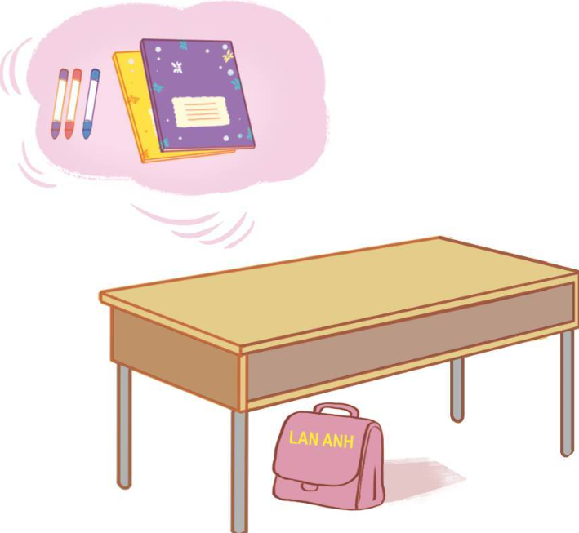
5. Look and write.
1. I have some new ___________.
crayons
2. The crayons are ______ the notebook.
beside
3. Lan Anh has a new ___________.
school bag
4. Lan Anh’s _________ is ____________.
school bag
under the desk

Slide 32
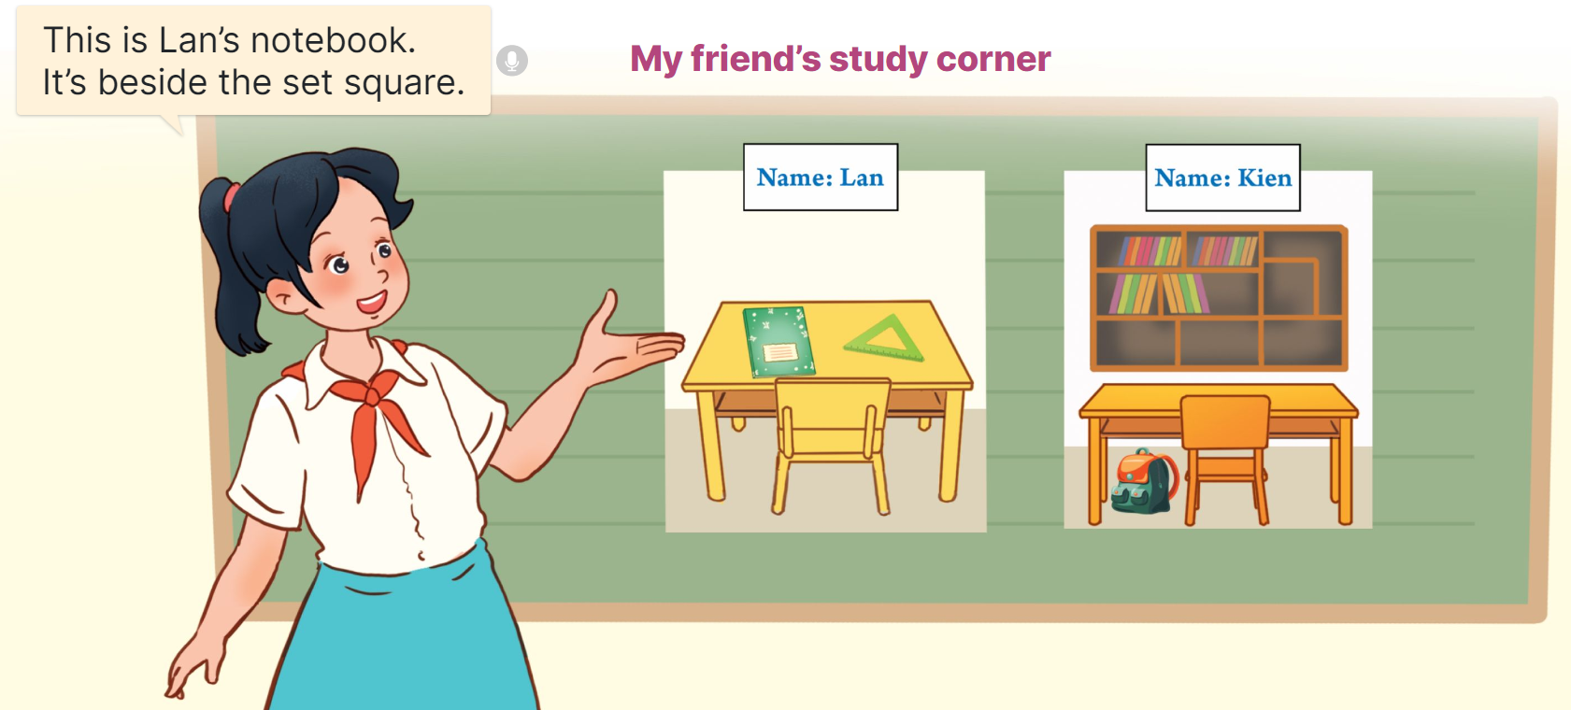
6. Project.
My friend’s study corner
This is Lan’s notebook. It’s beside the set square.

Slide 33
Fun corner
& wrap - up

Slide 34
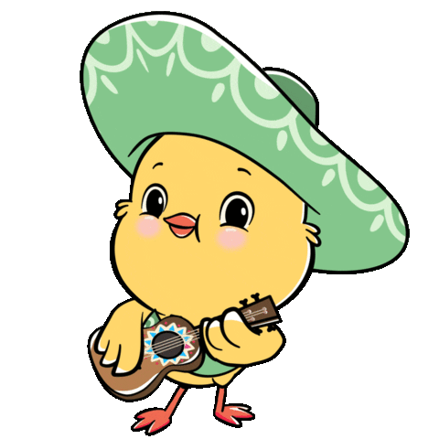
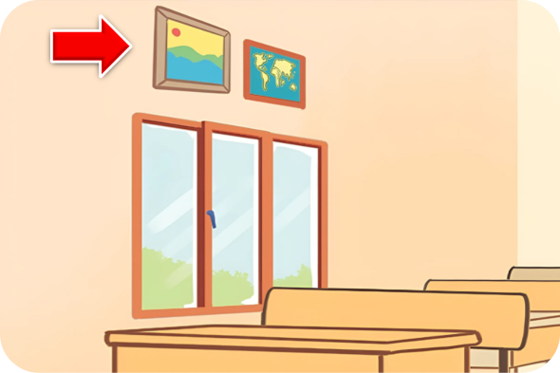
Listen and choose.
1/8
A
B
C

Slide 35
Listen and choose.
2/8
A
B
C

Slide 36
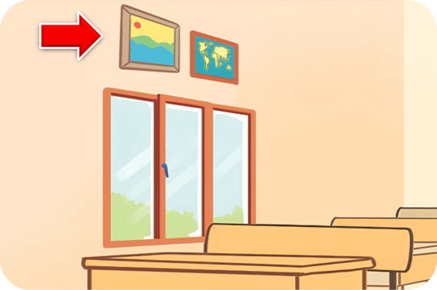
Listen and choose.
3/8
A
B
C

Slide 37
Listen and choose.
4/8
A
B
C

Slide 38
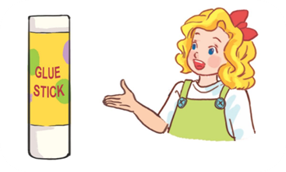
Listen and choose.
5/8
A
B
C

Slide 39
Listen and choose.
6/8
A
B
C

Slide 40
Listen and choose.
7/8
A
B
C

Slide 41
Listen and choose.
8/8
A
B
C

Slide 42
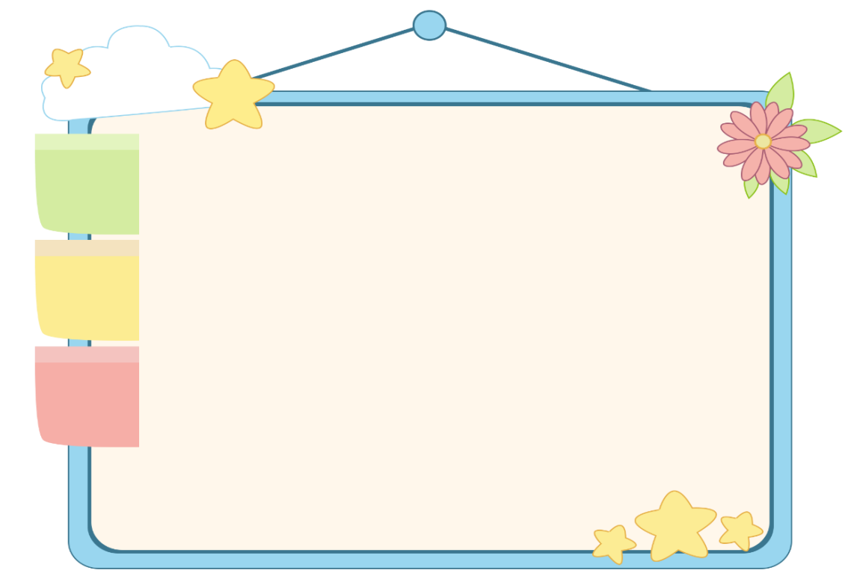
WELL DONE!

Slide 43
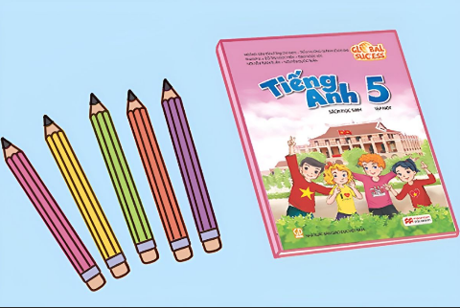
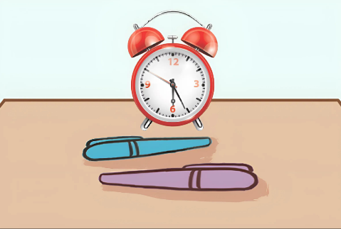
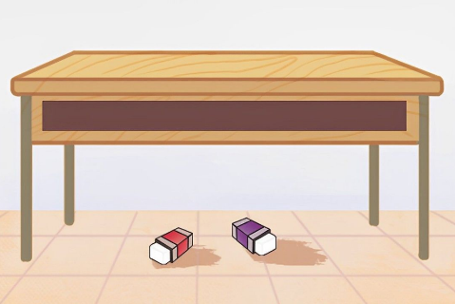
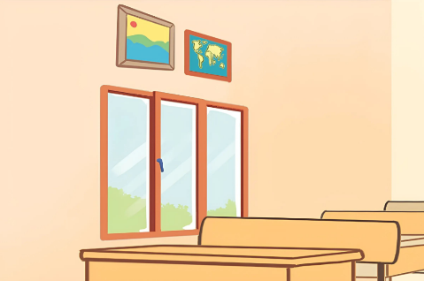
Unit 8 lesson 1
Where are the _____ ?
They’re _____.
they’re = they are
pencils / beside / book
pens / in front of / clock
erasers / under / desk
pictures / above / window

Slide 44
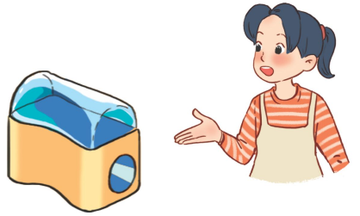
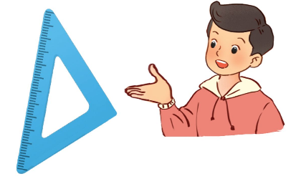
Unit 8 lesson 2
Whose _____ is this?
It’s _______.
it’s = it is
crayon / Bill’s
pencil sharpener / Mai’s
glue stick / Mary’s
set square / Nam’s

Slide 45
Homework
Review the lesson today. Prepare for unit 9 lesson 1.

Slide 46
Goodbye!

