Slide 2
6
Our school
LESSON 2 - PERIOD 4

Slide 3
Contents
Warm-up and review
Activity 4
01
02
Activity 5
Activity 6
03
04
You can describe the topic of the section here
Listen and tick.
Read and match.
Let’s play.
Fun corner
05
Game

Slide 4
WARM-UP AND REVIEW

Slide 5
Slap the board game
Notes:
Chia lớp thành 2 - 3 đội.
Gv dán thẻ từ hoặc viết từ lên bảng.
Gv đọc 1 từ, hs của đội nào đập tay vào đúng tranh/ từ nhanh hơn đội đó được 1 điểm

Slide 6
LISTEN AND NUMBER.

Slide 7
Look and answer the question.

Slide 8
Look and answer the question.

Slide 9
Look and answer the question.

Slide 10
Look and answer the question.

Slide 11
Listen and number.
4
2
1
3

Slide 12
READ AND MATCH.

Slide 13
Look and read aloud.

Slide 15
LET’S PLAY.

Slide 17
FUN CORNER

Slide 18
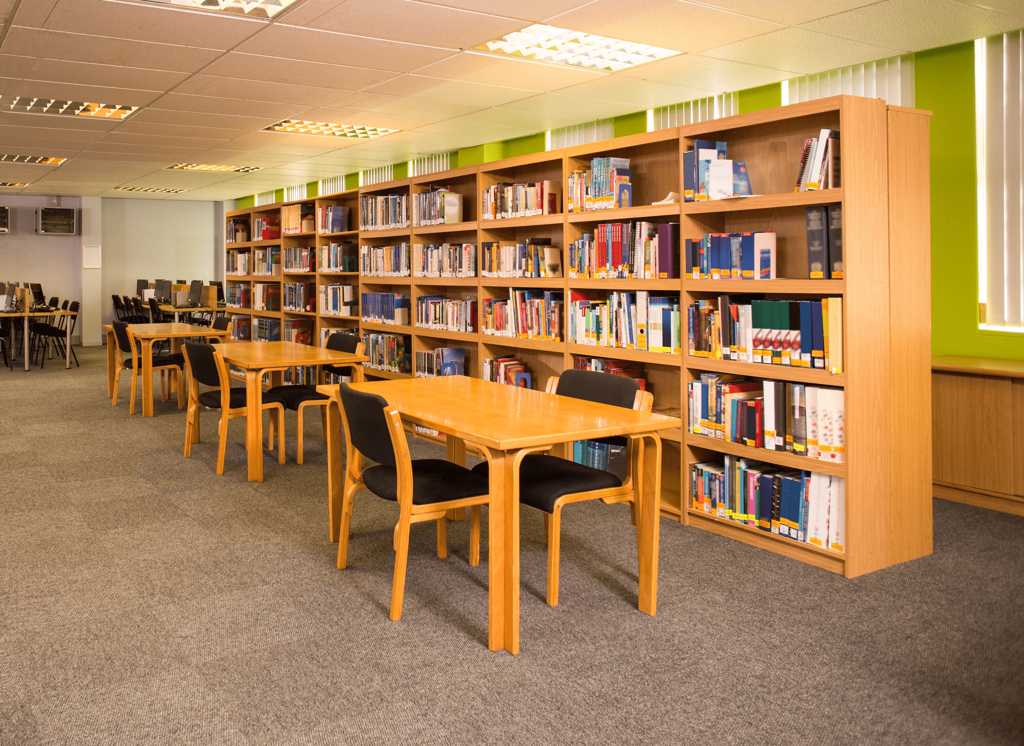
Read and say the correct answer.
We like reading.
Let’s go to the library.

Slide 19
1 point
5 points
SPIN
3 points
2 points
10 points
tekhnologic
Notes:
5 Segments

Slide 20
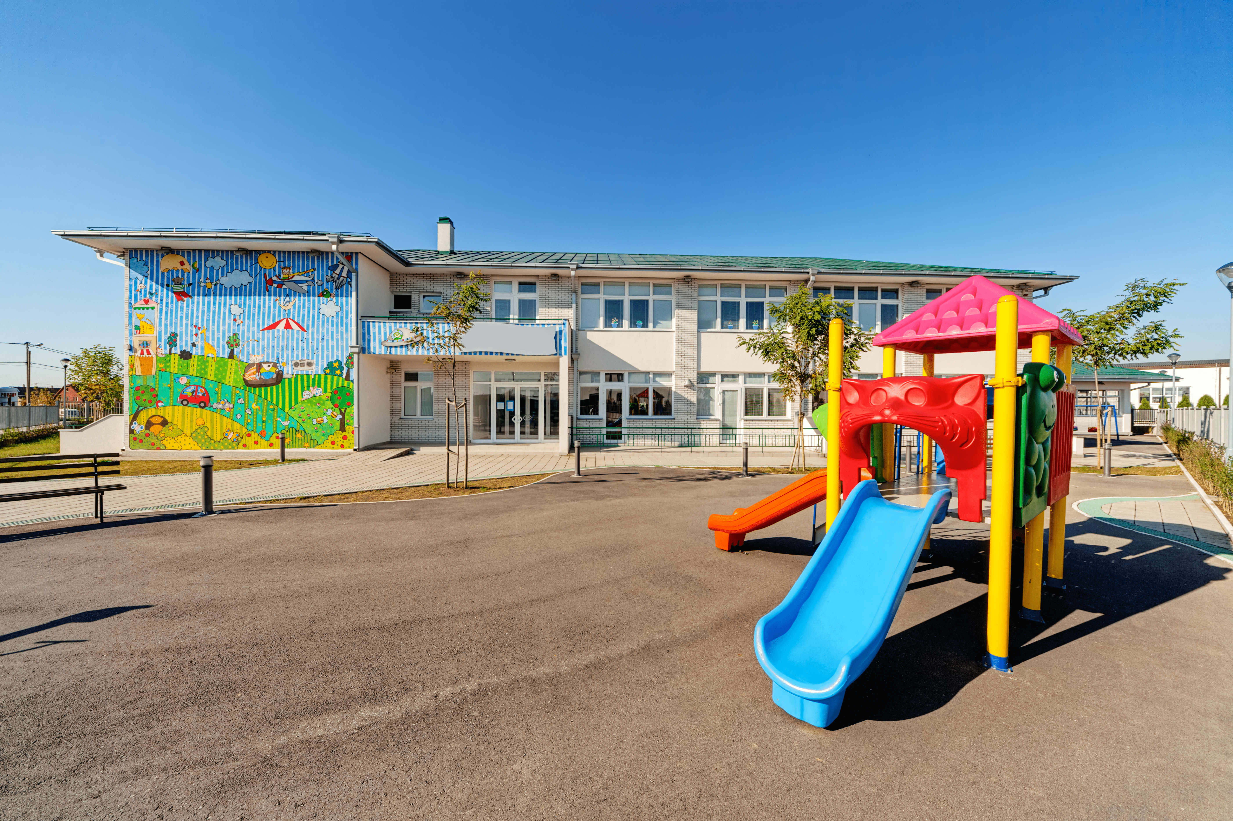
Read and say the correct answer.
I like running and playing.
Let’s go to the playground.

Slide 21
1 point
5 points
SPIN
3 points
2 points
10 points
tekhnologic
Notes:
5 Segments

Slide 22
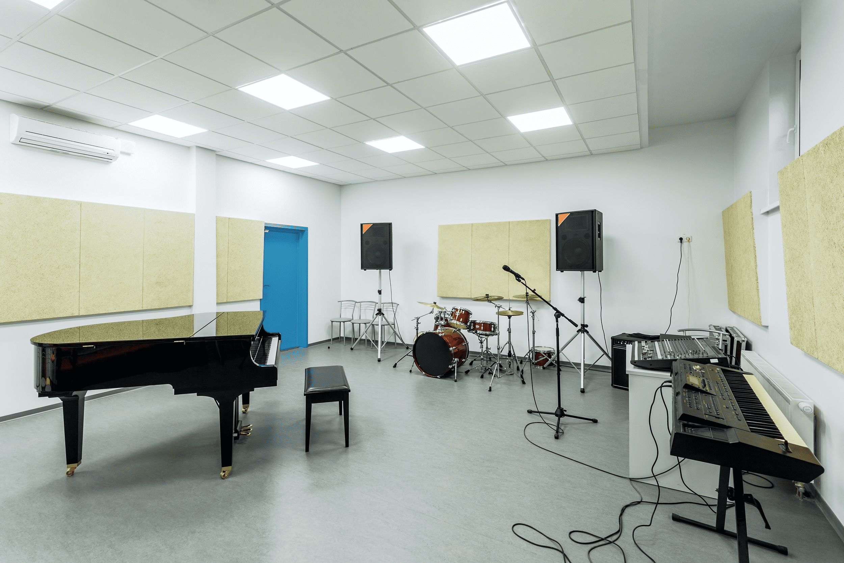
Read and say the correct answer.
We like singing songs.
Let’s go to the music room.

Slide 23
1 point
5 points
SPIN
3 points
2 points
10 points
tekhnologic
Notes:
5 Segments

Slide 24
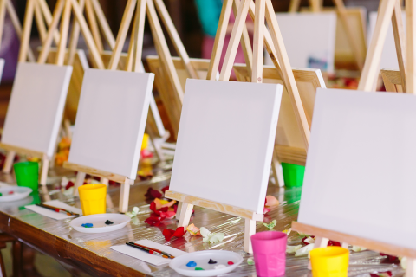
Read and say the correct answer.
I like drawing.
Let’s go to the art room.

Slide 25
1 point
5 points
SPIN
- 3 points
2 points
10 points
tekhnologic
Notes:
5 Segments

Slide 26
Read and say the correct answer.
We like playing sports.
Let’s go to the gym.

Slide 27
- 1 point
- 5 points
SPIN
3 points
2 points
-10 points
tekhnologic
Notes:
5 Segments

Slide 28
Read and say the correct answer.
I like playing computer games.
Let’s go to the computer room.

Slide 29
10 point
5 points
SPIN
3 points
2 points
10 points
tekhnologic
Notes:
5 Segments

Slide 30
Website: hoclieu.vn
Fanpage: facebook.com/www.tienganhglobalsuccess.vn

