Slide 1
Warmly welcome to
our lesson!

Slide 2
Warm-up

Slide 3
Let’s sing.
Where are you from?
Hello. I’m Minh.
I’m from Viet Nam.
Hello, Lucy. Where are you from?
I’m from Britain.
Hello, Mary. Where are you from?
I’m from America.
Hello, Ben. Where are you from?
I’m from Australia.
Click on karaoke symbol to listen.

Slide 4
My friends
Unit
1
Lesson 2(1,2,3)

Slide 5
Contents
Look, listen and repeat.
Listen, point and say.
Let’s talk.

Slide 6
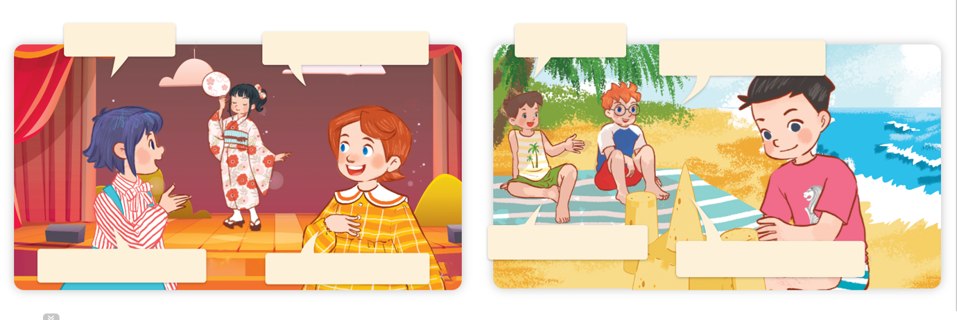
1. Look, listen and repeat.
Who’s that?
It’s my new friend.
Who’s that?
It’s my new friend.
a
b
Where’s
he from?
Where’s she from?
She’s from Japan.
He’s from Singapore.
Click on the sentences to listen again.

Slide 7
Vocabulary

Slide 8
Thailand
nước Thái Lan

Slide 9
Malaysia
nước Ma-lai-xi-a

Slide 10
Singapore
nước Xin-ga-po

Slide 11
Japan
nước Nhật

Slide 12
Review
Singapore
Malaysia
Thailand
Japan

Slide 13
Checking vocabulary
Look and match.
1
2
3
4
a. Singapore
b. Malaysia
c. Japan
d. Thailand

Slide 14
Vocabulary
1. Singapore
: nước Xing-ga-po
2. Malaysia
: nước Ma-lai-xi-a
3. Thailand
: nước Thái Lan
4. Japan
: nước Nhật

Slide 15
Structures

Slide 16
Where’s he / she from?
He’s / She’s from _____.
Where’s he from?
Ex:
He’s from Singapore.

Slide 17
Unit 1 lesson 2
Where’ s he / she from?
He’s / She’s from _____.
Singapore
Japan
Malaysia
Thailand

Slide 18
2. Listen, point and say.
a
b
Where’s he / she from?
Singapore
Malaysia
He’s / She’s from ____.
c
d
Thailand
Japan

Slide 19
2. Listen, point and say.
a
Where’s he / she from?
He’s / She’s from ____.
Singapore
Where’s he from?
He’s from Singapore.
Click on the sentences to listen again.

Slide 20
2. Listen, point and say.
b
Where’s he / she from?
He’s / She’s from ____.
Malaysia
Where’s he from?
He’s from Malaysia.

Slide 21
2. Listen, point and say.
c
Where’s he / she from?
He’s / She’s from ____.
Thailand
Where’s she from?
She’s from Thailand.

Slide 22
2. Listen, point and say.
d
Where’s he / she from?
He’s / She’s from ____.
Japan
Where’s she from?
She’s from Japan.

Slide 23
3. Let’s talk.
Where’s he / she from?
____.

Slide 24
3. Let’s talk.
________________.
He’s from Malaysia
Where’s ____ from?
he

Slide 25
3. Let’s talk.
________________.
He’s from Singapore
Where’s ____ from?
he

Slide 26
3. Let’s talk.
________________.
She’s from Thailand
Where’s ____ from?
she

Slide 27
3. Let’s talk.
______________.
She’s from Japan
Where’s ____ from?
she

Slide 28
Let’s play!

Slide 29
FEEDING GOLDFISH
Mỗi câu trả lời đúng là
CÂU THẦN CHÚ giúp cá Vàng
ngoi lên mặt nước nhận thức ăn.
Nào chúng mình cùng giúp
bạn nhỏ cho cá Vàng ăn nhé!
START

Slide 30
Next
A. Japan
B. Thailand
C. Singapore

Slide 31
Next
A. Thailand
B. Japan
C. Malaysia

Slide 32
Next
A. Thailand
B. Singapore
C. Japan

Slide 33
Next
A. Japan
B. Thailand
C. Singapore

Slide 34
Next
A: Where’s he from?
B: He’s from ____.
A. Singapore
B. Malaysia
C. Thailand

Slide 35
Next
A: Where’s he from?
B: He’s from ____.
A. Japan
B. Malaysia
C. Singapore

Slide 36
A: Where’s she from?
B: ____ from Thailand.
Next
A. She’s
B. He’s
C. He is

Slide 37
Next
A: Where’s ____ from?
B: She’s from Japan.
A. she
B. he
C. you

Slide 38
Next
A: Where is he from?
B: He is from Malaysia.
A. .
B.

Slide 39
Next
where’s = where ___
A. are
B. am
C. is

Slide 40
THANK YOU!
Next

Slide 41
Great!

Slide 42
Wrap up

Slide 43
Unit 1 lesson 2
Where’ s he / she from?
He’s / She’s from _____.
Singapore
Japan
Malaysia
Thailand

Slide 44
Homework
Learn by heart all the new words and the model sentences.
Read again the dialogue in part 1.

Slide 45
Thank you!

