Slide 1
Unit
7
Our timetables
Lesson 1

Slide 2
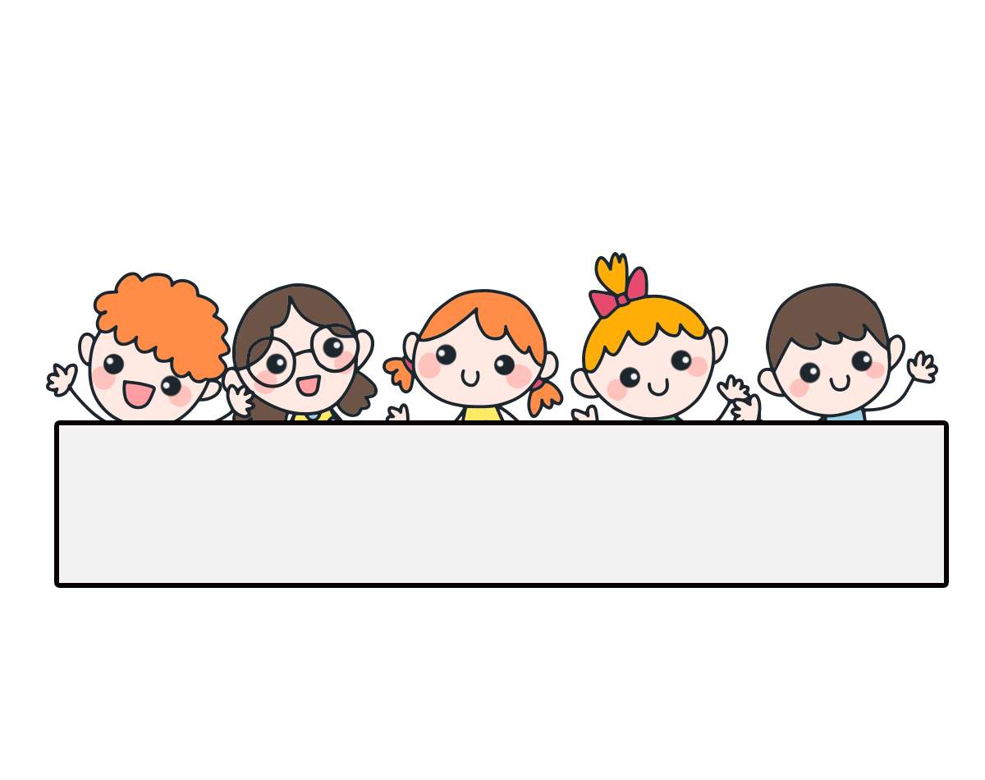
Warm-up

Slide 3
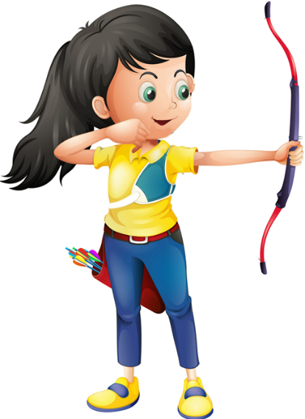
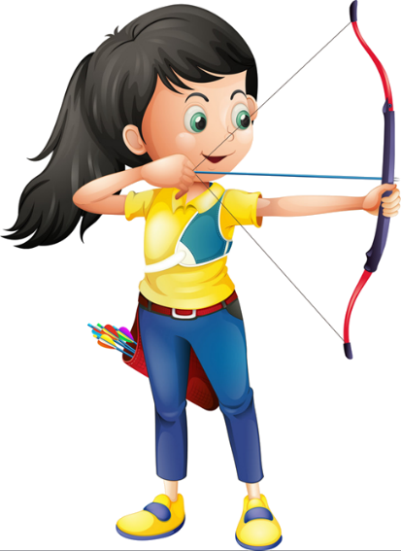
Ms Huyền Phạm
0936.082.789

Slide 4
Where _____ your school?
It is in the town.
A. are
B. is
Ms Huyền Phạm
0936.082.789

Slide 5
How many _____ are there at your school?
A. playgrounds
B. gardens
Ms Huyền Phạm
0936.082.789

Slide 6
Where’s your school?
_____________.
A. It’s in the mountains.
B. There is one.
Ms Huyền Phạm
0936.082.789

Slide 7
______ your school?
It is in the village.
A. Where is
B. When is
Ms Huyền Phạm
0936.082.789

Slide 8
Our school is near two ____.
A. village
B. villages
Ms Huyền Phạm
0936.082.789

Slide 9
Where ___ your school?
It ___ in the village.
A. is - is
B. are - is
Ms Huyền Phạm
0936.082.789

Slide 10
____ many gardens are there at your school?
A. How
B. What
Ms Huyền Phạm
0936.082.789

Slide 11
How many computer rooms ____ there at your school?
A. is
B. are
Ms Huyền Phạm
0936.082.789

Slide 12
A. How many buildings
are there at your school?
B. How many computer rooms are there at your school?
Ms Huyền Phạm
0936.082.789

Slide 13
There are two ____ not far from my ____.
A. town - house
B. towns - school
Ms Huyền Phạm
0936.082.789

Slide 14
Good job!
Ms Huyền Phạm
0936.082.789

Slide 15
Contents
Look, listen and repeat.
Listen, point and say.
Let’s talk.
Listen and tick or cross.
Look, complete and read.
Let’s play.

Slide 16
1. Look, listen and repeat.
What time do you have class today, Minh?
What subjects do you have today?
a
b
At eight, Mum.
I have English and maths.

Slide 17
Vocabulary

Slide 18
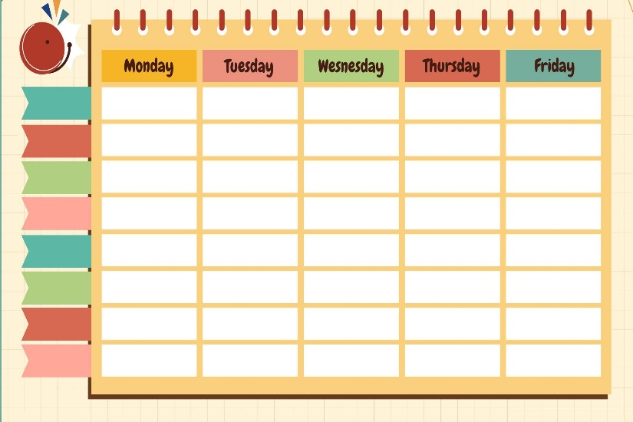
timetable
thời khóa biểu

Slide 19
subject
môn học

Slide 20
Vietnamese
môn Tiếng Việt

Slide 21
maths
môn Toán, toán học

Slide 22
Vocabulary
science
môn Khoa học

Slide 23
Vocabulary
English
môn Tiếng Anh

Slide 24
Review
timetable
subject
Vietnamese
English
maths
science

Slide 25
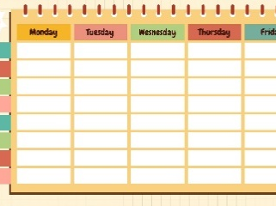
Match
1
2
3
4
5
6
a
b
c
d
e
f
science
English
maths
Vietnamese
subject
timetable

Slide 26
Vocabulary
1. timetable
: thời khóa biểu
2. subject
: môn học
3. Vietnamese
: môn Tiếng Việt
4. English
: môn Tiếng Anh
5. maths
: môn Toán
6. science
: môn Khoa học

Slide 27
Structures

Slide 28
Structures
What subjects do you have today?
I have _______.

Slide 29
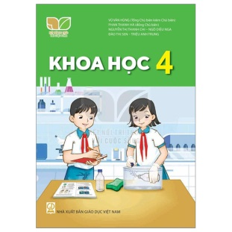
Unit 7.1
What subjects do you have today?
I have______.
i
Vietnamese
maths
English
science

Slide 30
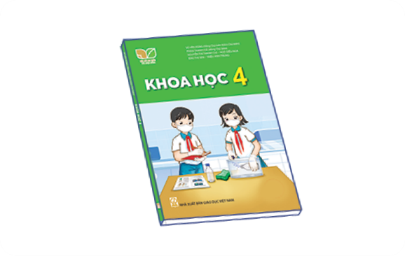
2. Listen, point and say.
a
b
What subjects do you have today?
Vietnamese
English
I have______.
c
d
maths
science

Slide 31
2. Listen, point and say.
Vietnamese
What subjects do you have today?
I have Vietnamese.
Click on the sentences to listen again.

Slide 32
2. Listen, point and say.
English
What subjects do you have today?
I have English.

Slide 33
2. Listen, point and say.
maths
What subjects do you have today?
I have maths.

Slide 34
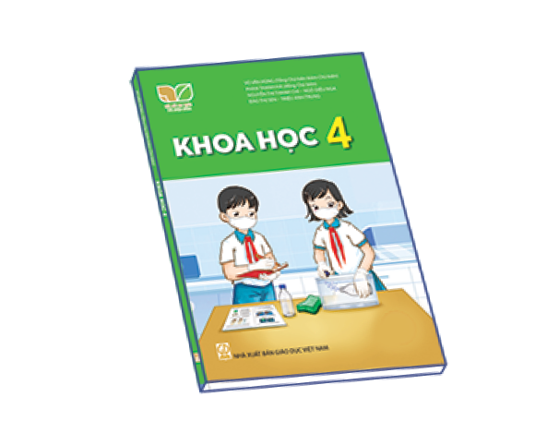
2. Listen, point and say.
science
What subjects do you have today?
I have science.

Slide 35
3. Let’s talk.

Slide 36
Let’s play!

Slide 37
Find Pikachu

Slide 38
A. English
B. Vietnamese
C. science

Slide 39
A. science
B. maths
C. Vietnamese

Slide 40
A. maths
B. science
C. English

Slide 41
A.timetable
B. subject
C. science

Slide 42
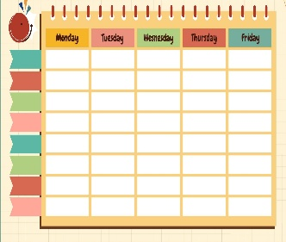
a
b
c

Slide 43
a
b
c

Slide 44
a
b
c

Slide 45
a
b
c

Slide 46
A. subject
What ____ do you have today?
I have science.
B. fruits
C. subjects

Slide 47
A. I have maths and English.
What subjects do you have today?
B. I have science and maths.
C. I have science and English.

Slide 48
Excellent!

Slide 49
Wrap up

