Slide 1
UNIT 14 - LESSON 1
What happened
in the story?

Slide 2
Vocabulary

Slide 3
Vocabulary
hear
: nghe
heard
: đã nghe
let
: để cho, cho phép
let
: đã để cho, đã cho phép
order
: ra lệnh
ordered
: đã ra lệnh
happen
: xảy ra
happened
: đã xảy ra
call
: gọi
called
: đã gọi
: đã tìm thấy
find
: tìm thấy
found
exchange A for B
exchanged A for B
: đổi A lấy B
: đã đổi A lấy B
grow
: trồng
grew
: đã trồng

Slide 4
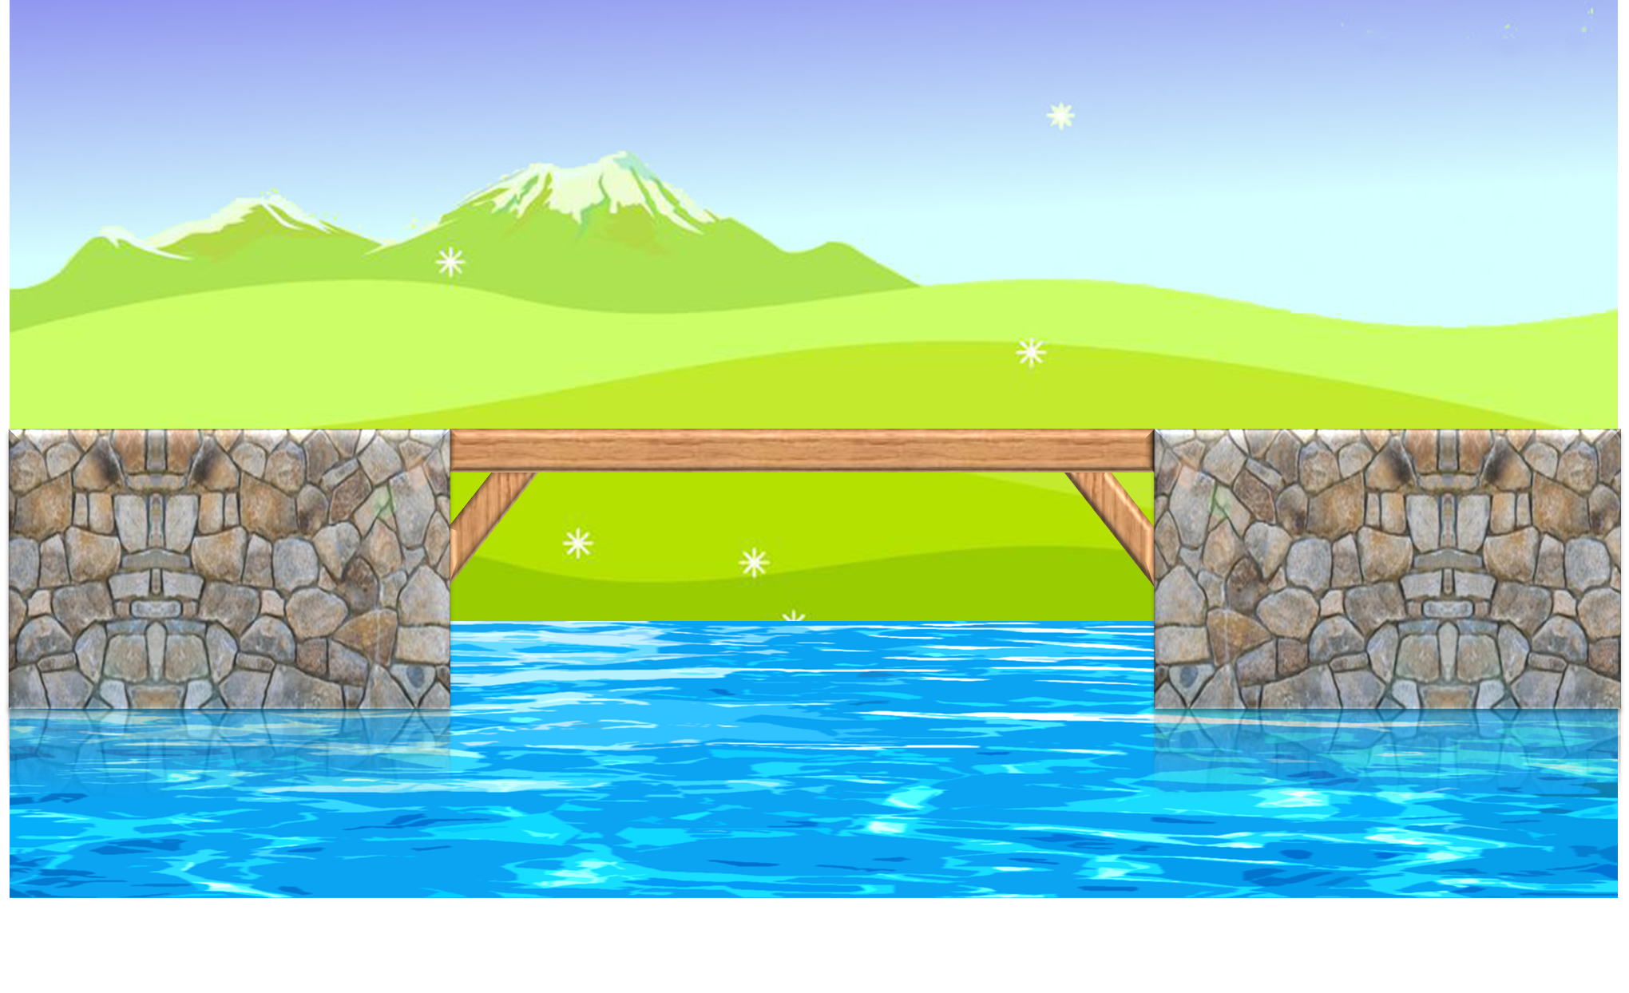
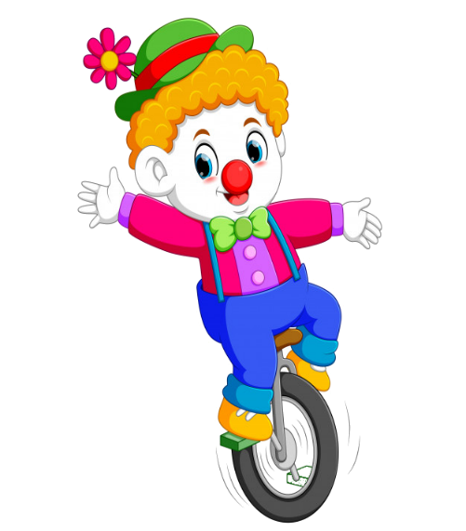



PLAY

Slide 5




: tìm
order
Nghe
Đã nghe
Ra lệnh
Đã ra lệnh

Slide 6
hear
nghe
gọi
ra lệnh
tìm

Slide 7
let
gọi
Đã đi
Đã gọi
để cho

Slide 8
happened
: trồng
Đã để cho
Đã xảy ra
để cho
xảy ra

Slide 9
call
gọi
Đã gọi
đổi A lấy B
Đã đổi A lấy B

Slide 10
exchange A for B
Ra lệnh
Đã ra lệnh
đổi A lấy B
Đã đổi A lấy B

Slide 11
grow
đổi
trồng
Đã đổi
Đã trồng

Slide 12
Found
Đã ra lệnh
Đã xảy ra
Đã đổi
Đã tìm thấy

Slide 13
find
Đã xảy ra
Đã tìm thấy
xảy ra
Tìm thấy

Slide 14
Grew
Đã trồng
Đã cho
trồng
Đã gọi

Slide 15


EXIT

Slide 16
Grammar

Slide 17
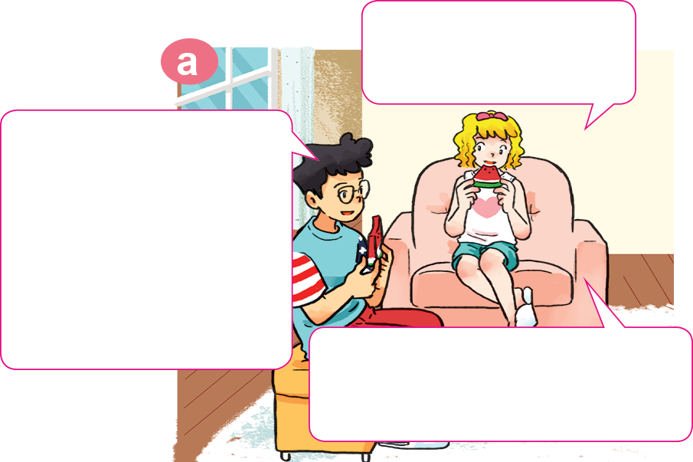
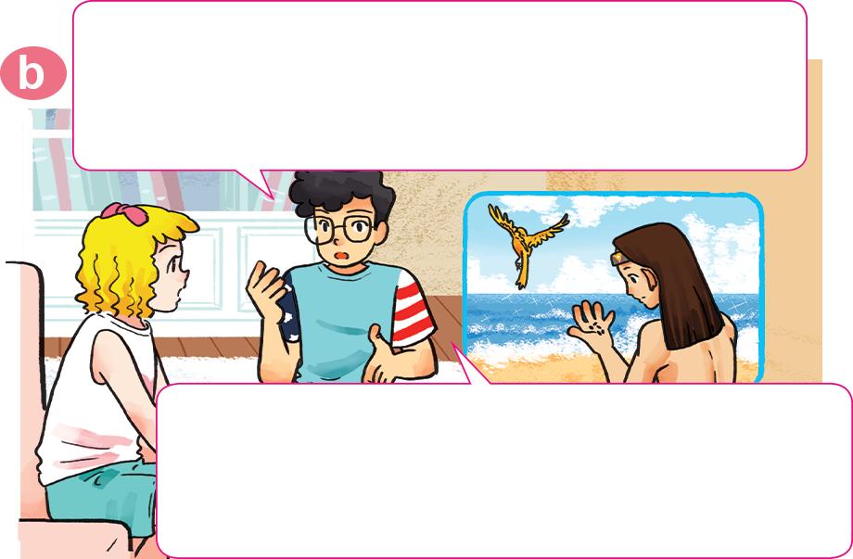

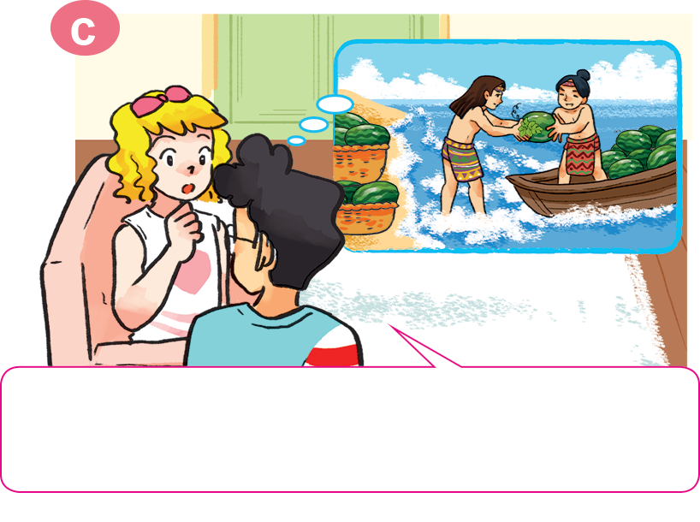
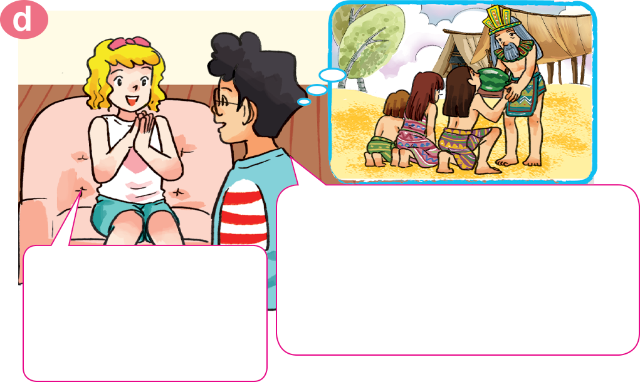
1. Look, listen and repeat.
Watermelons
are so delicious!
First, King Hung ordered Mai An Tiem and his family to live on an island. The island was very far away.
We have a Vietnamese story about watermelons called The Story of Mai An Tiem.
Oh, really? What happened in the story?
Then one day, An Tiem found some black seeds and he grew them. The seeds gave watermelons.
In the end, King Hung heard about the story and he let An Tiem and his family go back home.
Oh, they werelucky in the end, right?
Next, An Tiem's family exchanged the watermelons for food and drink.
Click text to hear.

Slide 18
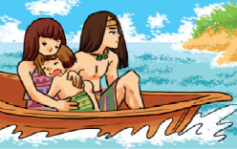
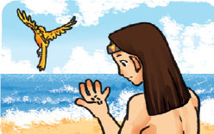
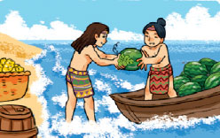
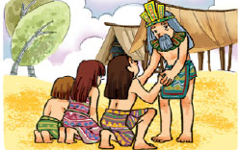
2. Point and say
What happened in the story?
Then
King Hung ordered Mai An Tiem and his family to live on an island. The island was very far away.
one day, An Tiem found some black seeds and he grew them. The seeds gave watermelons.
First,
King Hung heard about the story and he let An Tiem and his family go back home.
In the end,
Next,
An Tiem's family exchanged the watermelons for food and drink.

Slide 19


3. Let’s talk
Ask and answer questions about The Story of Mai An Tiem.
What happened in the story?
First, _______________.
Then _______________.
Next, _______________ .
In the end, _______________

Slide 20



LET’S PLAY
A GAME

Slide 21





What happened in the story?
_______, King Hung ordered Mai An Tiem and his family to live on an island.
First
Then
Next

Slide 22
What happened in the story?
The island was very _______.
near
here
far away

Slide 23
What happened in the story?
______ one day, An Tiem found some black seeds and he grew them. The seeds gave watermelons.
First
Then
In the end

Slide 24
What happened in the story?
The seeds gave ________.
lemon
water
watermelons

Slide 25
What happened in the story?
____, An Tiem's family exchanged the watermelons for food and drink.
Then
Next
In the end

Slide 26
What happened in the story?
Next, An Tiem's family __________ the watermelons for food and drink.
exchanged
changed
gave

Slide 27
What happened in the story?
Next, An Tiem's family exchanged the watermelons for ____________.
food and
drink
fruit
vegetable

Slide 28
What happened in the story?
________ King Hung heard about the story and he let An Tiem and his family go back home.
First
Then
In the end

Slide 29
What happened in the story?
In the end, King Hung ______ about the story and he let An Tiem and his family go back home.
heared
heard
hear

Slide 30
What happened in the story?
In the end, King Hung heard about the story and he let An Tiem and his family ________.
go back home
go the island
go far away

Slide 31
Good job!

Slide 32
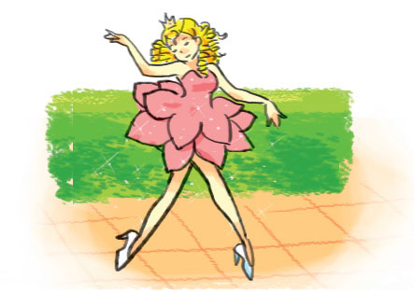
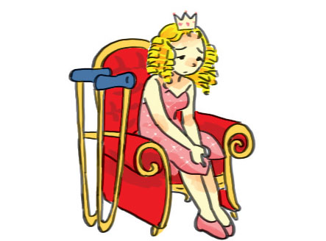
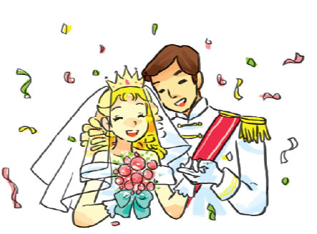
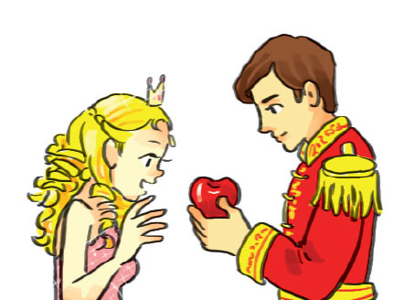
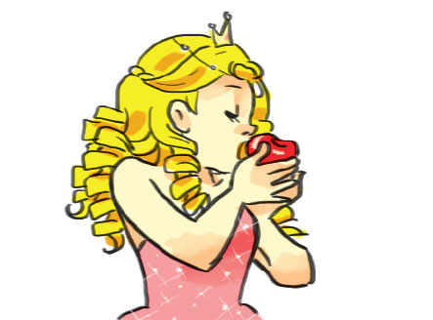
4. Listen and number.
1
2
1
2
4
1
3
4
3
4
5
5
5
2
3

Slide 33
5. Read and complete
apple
In the end
princess
legs
got up
Many years ago, there was a very beautiful (1) _________ who lived in a castle. The princess had a problem with her (2) _________ and couldn't walk. One day, a prince visited the castle and met the beautiful princess. He gave her an (3) _________ and said, “This magic apple can make you walk!” The princess was very happy. She ate the apple. Then the next morning, she (4) _________ and was so surprised because she could walk and run and dance. (5) _________, the prince and the princess got married and lived happily ever after.
princess
legs
apple
got up
In the end

Slide 34

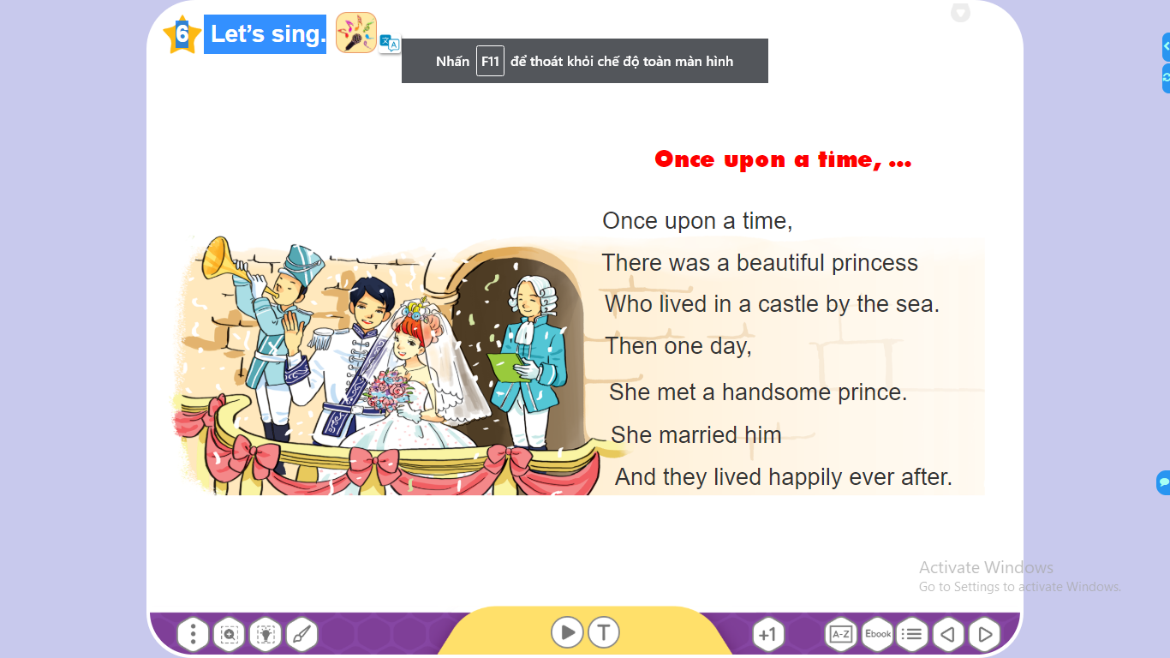
6. Let’s sing.

