Slide 1


Slide 2



Unit
12
JOBS
Lesson 1

Slide 3

Warm-up

Slide 4

Facebook : Bùi Liễu
0968142780
Let’s play!

Slide 5









Sun Flower

Slide 6



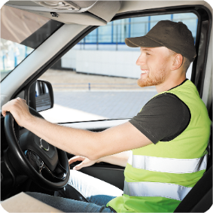


What’s his job?
He’s a worker.
Click the clock to start the timer.
A
B
C
D

Slide 7

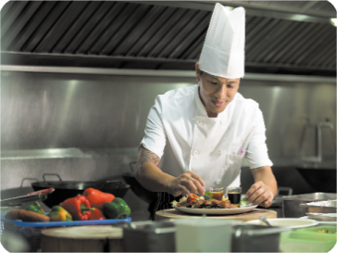

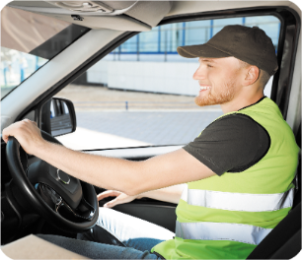
What’s her job?
She’s a teacher.
Click the clock to start the timer.
A
B
C
D
Sai
Sai
Đúng
Sai

Slide 8


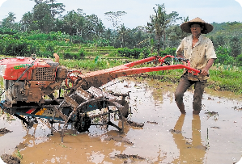

What’s her job?
She’s a singer.
Click the clock to start the timer.
A
B
C
D
Sai
Đúng
Sai
Sai

Slide 9

What’s his job?
He’s a farmer.
Click the clock to start the timer.
A
B
C
D
Sai
Sai
Sai
Đúng

Slide 10
What’s ______ job?
He’s a doctor.
Click the clock to start the timer.
A
B
C
D
his
her
my
our

Slide 11
What’s ______ job?
She’s a teacher.
Click the clock to start the timer.
A
B
C
D
her
his
my
our

Slide 12
What’s his job?
_______ a farmer.
Click the clock to start the timer.
A
B
C
D
She’s
He is
I am
She is

Slide 13
What’s her job?
_______ a cook.
Click the clock to start the timer.
A
B
C
D
I am
She is
He is
He

Slide 14
What is _____?
She is a singer.
Click the clock to start the timer.
A
B
C
D
hobby
her hobby
her name
her job

Slide 15
_______________?
She’s a nurse.
Click the clock to start the timer.
A
B
C
D
What’s your name?
What’s her hobby?
What’s her job?
What’s his job?

Slide 16


Slide 17






Contents
Look, listen and repeat.
Listen, point and say.
Let’s talk.
Listen and tick or cross.
Look, complete and read.
Let’s sing.

Slide 18

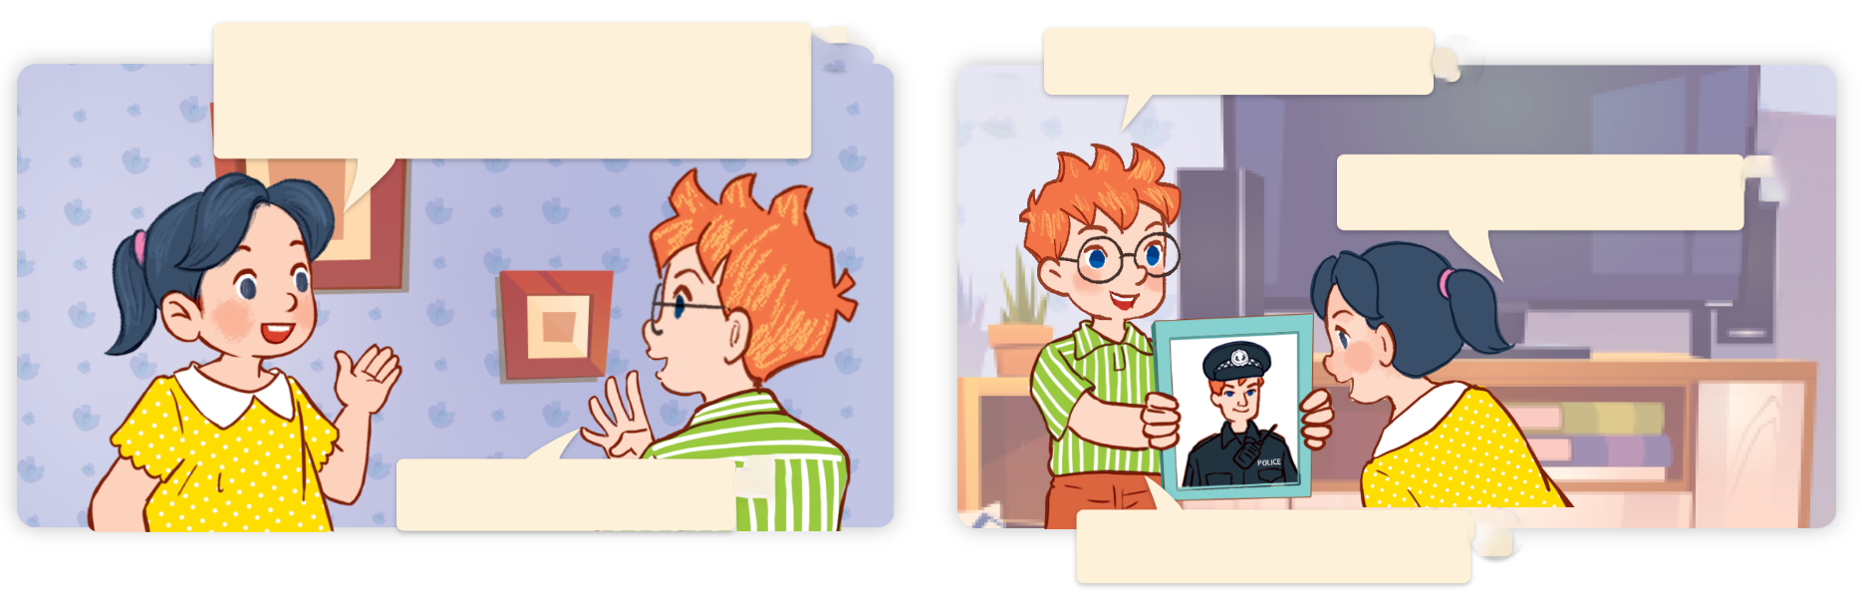
1. Look, listen and repeat.
How many people are there in your family?
This is my father.
a
b
What does he do?
There are four.
He’s a policeman.

Slide 19
Vocabulary

Slide 20
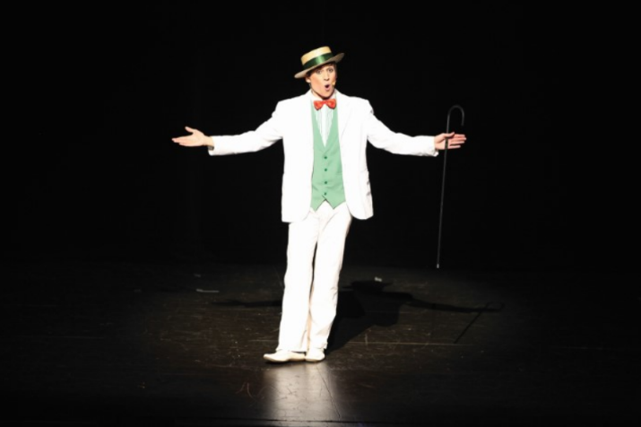
Vocabulary
actor
diễn viên (nam)

Slide 21
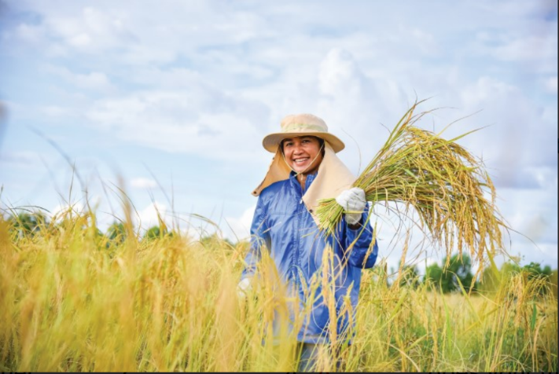
Vocabulary
farmer
nông dân

Slide 22

Vocabulary
office worker
nhân viên văn phòng

Slide 23
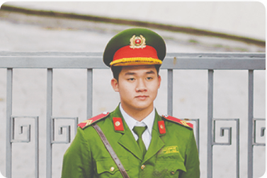
Vocabulary
policeman
cảnh sát

Slide 24
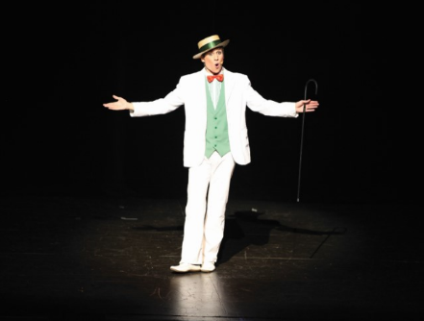
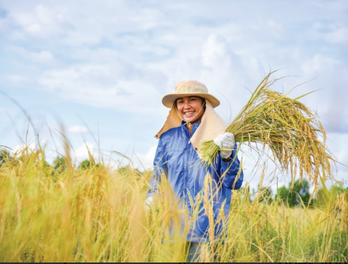

Review
actor
farmer
office worker
policeman

Slide 25
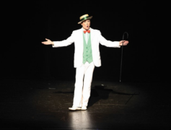



Vocabulary
1. actor
: diễn viên (nam)
2. farmer
: nông dân
3. office worker
: nhân viên văn phòng
4. policeman
: cảnh sát (nam)

Slide 26

Let’s play!

Slide 27




What is missing?
Học sinh có 5 giây để nhớ vị trí của ảnh, ở các slide sau, hs cần nói ra dc từ vựng bị thiếu ở thứ tự ảnh đó là gì.
Notes:
What is missing?

Slide 28
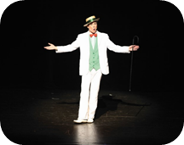

What is missing?
1/4
Notes:
What is missing?

Slide 29

What is missing?
2/4

Slide 30
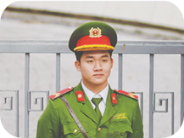
What is missing?
3/4
Notes:
What is missing?

Slide 31

What is missing?
4/4
Notes:
What is missing?

Slide 32
Well done!

Slide 33


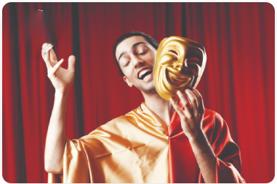
2. Listen, point and say.
a
b
What does he / she do?
a farmer
a policeman
He’s / She’s ______.
c
d
he’s = he is
she’s = she is
an office worker
an actor

Slide 34


2. Listen, point and say.
What does he / she do?
He’s / She’s ______.
a farmer
What does she do?
She’s a farmer.

Slide 35
2. Listen, point and say.
What does he / she do?
He’s / She’s ______.
a policeman
What does he do?
He’s a policeman.

Slide 36
2. Listen, point and say.
What does he / she do?
He’s / She’s ______.
an office worker
What does she do?
She’s an office worker.

Slide 37
2. Listen, point and say.
What does he / she do?
He’s / She’s ______.
an actor
What does he do?
He’s an actor.

Slide 38
Structures

Slide 39
Structures
What does he / she do?
He’s / She’s _________.
he’s = he is
she’s = she is

Slide 40



Unit 12.1
What does he / she do?
He’s / She’s ________.
actor
policeman
farmer
office worker

Slide 41
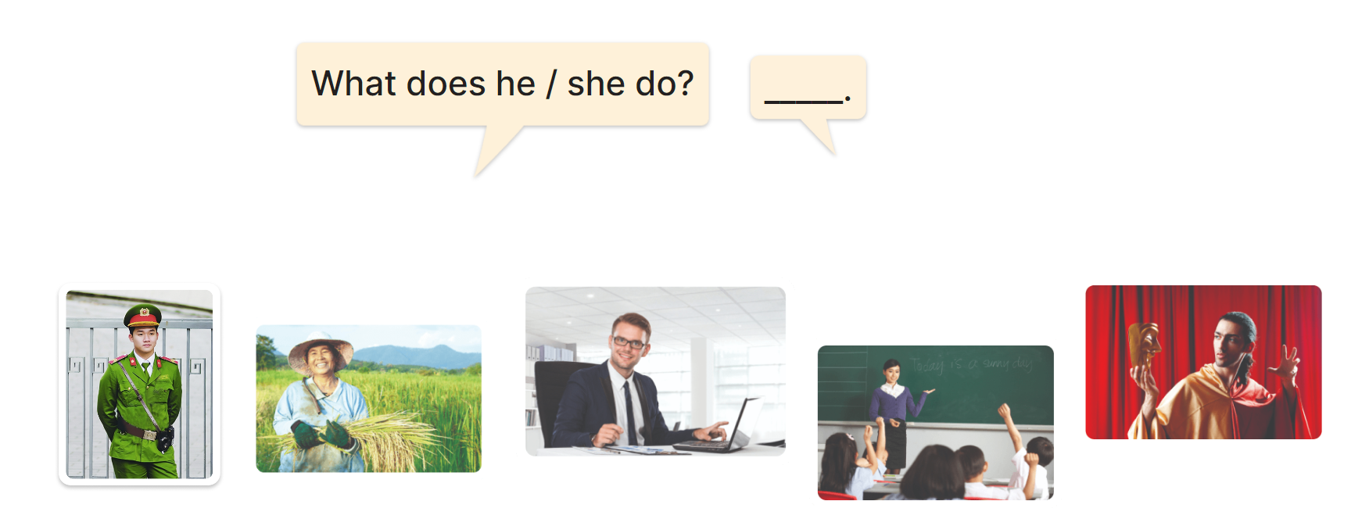
3. Let’s talk.

Slide 42

Facebook : Bùi Liễu
0968142780
Let’s play!

Slide 43








Ms Huyền Phạm
0936.082.789

Slide 44

A. actor
B. policeman
Ms Huyền Phạm
0936.082.789

Slide 45
A. office worker
B. policeman
Ms Huyền Phạm
0936.082.789

Slide 46
A. office worker
B. farmer
Ms Huyền Phạm
0936.082.789

Slide 47
She’s __ farmer.
A. a
B. an
Ms Huyền Phạm
0936.082.789

Slide 48
He’s __ actor.
A. an
B. a
Ms Huyền Phạm
0936.082.789

Slide 49
po____man
A. lice
B. live
Ms Huyền Phạm
0936.082.789

Slide 50
A. actor
B. farmer
Ms Huyền Phạm
0936.082.789

Slide 51

What does _____ do?
A. he
B. she
Ms Huyền Phạm
0936.082.789

Slide 52
He’s a policeman.
A. False
B. True
Ms Huyền Phạm
0936.082.789

Slide 53
Facebook : Bùi Liễu
0968142780
She’s an actor.
A. True
B. False
Ms Huyền Phạm
0936.082.789

Slide 54

Good job!
Ms Huyền Phạm
0936.082.789

Slide 55
Homework
Learn by heart all the new words.
Read again the dialogue in part 1.

Slide 56

Thank you!

