Slide 1

Welcome to our class!
Class: 4E
Subject: English
Teacher: Le Thi Minh Hien

Slide 2



Saturday, November 8th 2025
Unit
6
Our school facilities
Lesson 1: Part 1,2,3

Slide 3
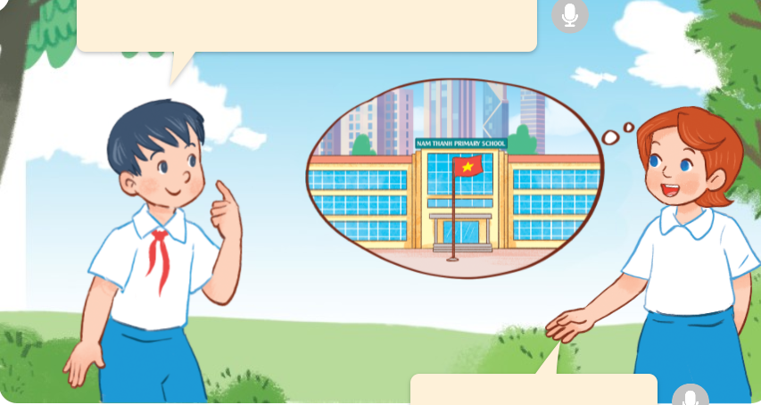
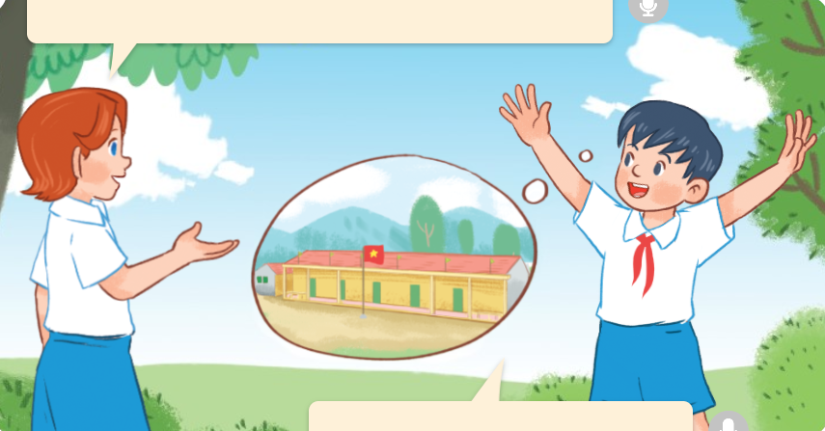
1. Look, listen and repeat.
a
b

Slide 4
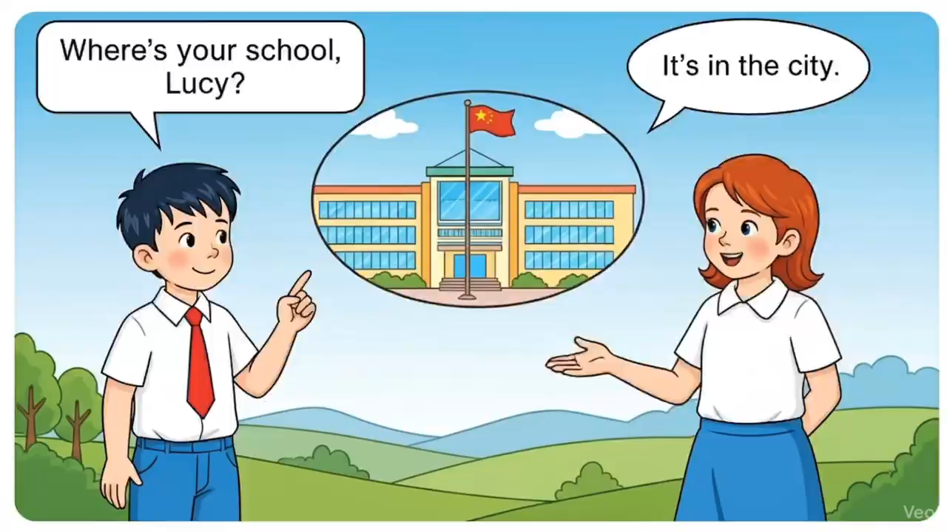

Slide 5

1. Look, listen and repeat.
Where’s your school, Lucy?
And where’s your school, Hung?
a
b
It’s in the city.
It’s in the mountains.

Slide 6
Vocabulary

Slide 7

Vocabulary
mountains
những dãy núi

Slide 8
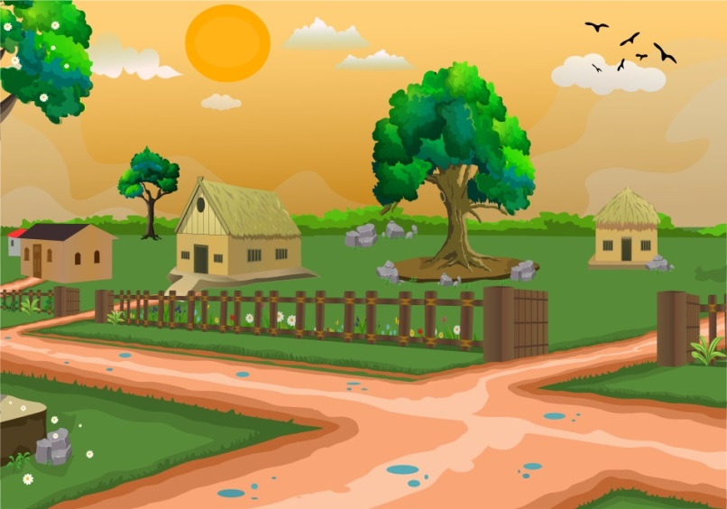
village
ngôi làng

Slide 9

city
thành phố

Slide 10
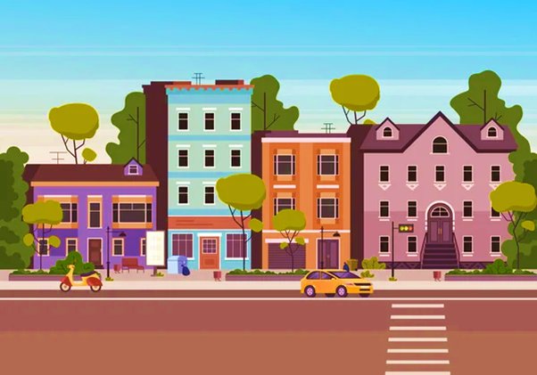
town
thị trấn

Slide 11

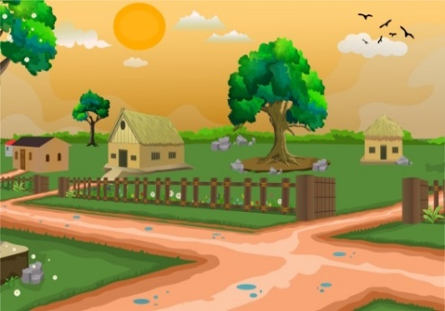

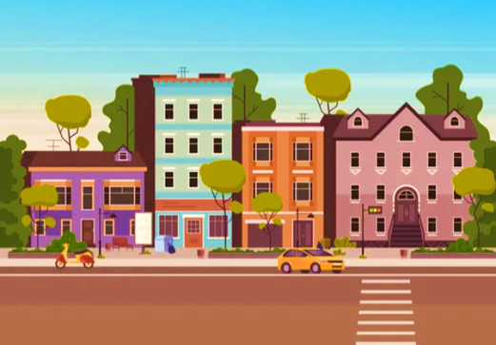
Review
mountains
village
city
town

Slide 12
Guessing game

Slide 13
mountains

Slide 14
village

Slide 15
city

Slide 16
town

Slide 17
Structures

Slide 18
Where’s your school?
It’s in the city.
village.

Slide 19


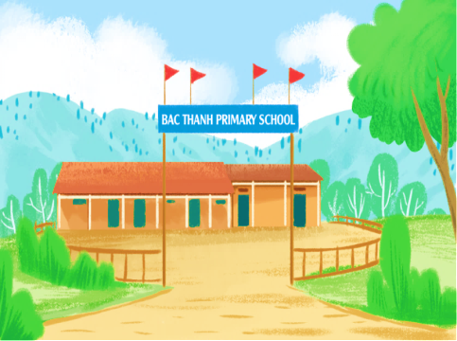
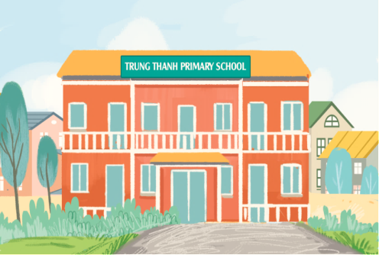
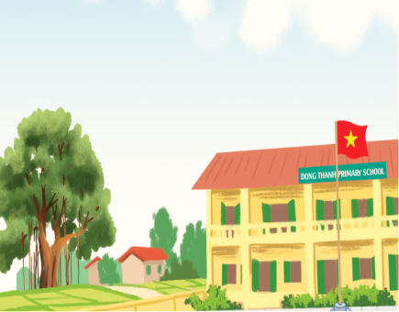
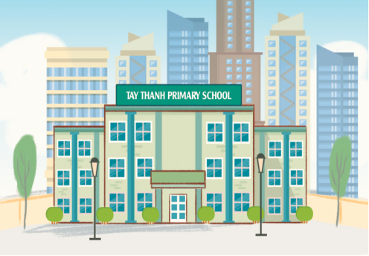
Unit 6 lesson 1
Where’s your school?
It’s in the ______.
mountains
town
village
city

Slide 20
2. Listen, point and say.
Where’s your school?
village
mountains
It’s in the _____.
town
city

Slide 21
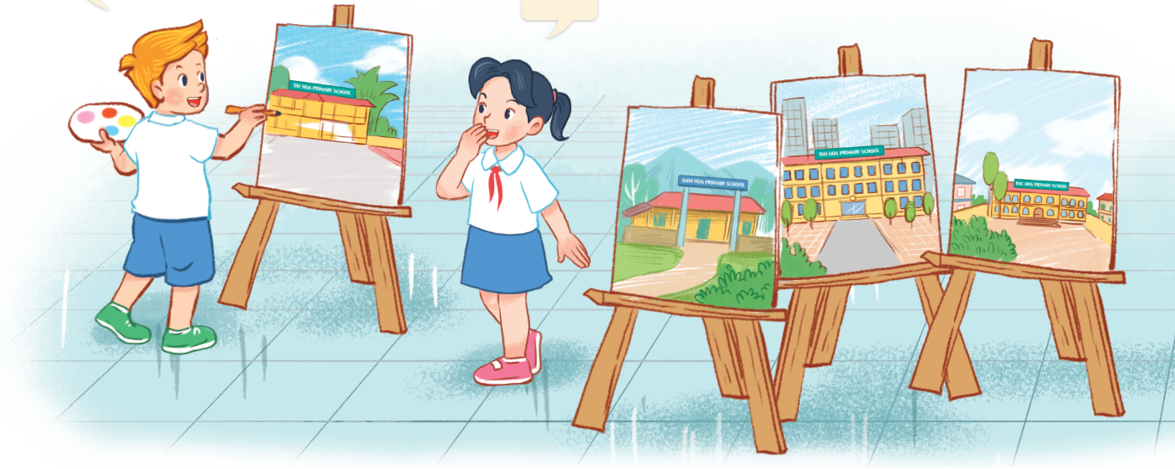
3. Let’s talk.
Where’s your school?
_________.

Slide 22


Let’s play!

Slide 23




Where’s your school?
A. It’s in the city.
B. It’s in the village.

Slide 24

Where’s your school?
A. It’s in the village.
B. It’s in the mountains.

Slide 25

Where’s your school?
A. It’s in the city.
B. It’s in the village.

Slide 26
Where’s your school?
A. It’s in the town.
B. It’s in the village.

Slide 27
Where ___ your school?
It’s in the city.
A. is
B. are

Slide 28
Where’s your school?
It’s ___ the village.
A. on
B. in

Slide 29
____ is your school?
It’s in the town.
A. Where
B. What

Slide 30

Where’s your school?
____ in the mountains.
A. They are
B. It is

Slide 31
Well done!

Slide 32

Thank you

