Slide 1


Welcome to our class!

Slide 2
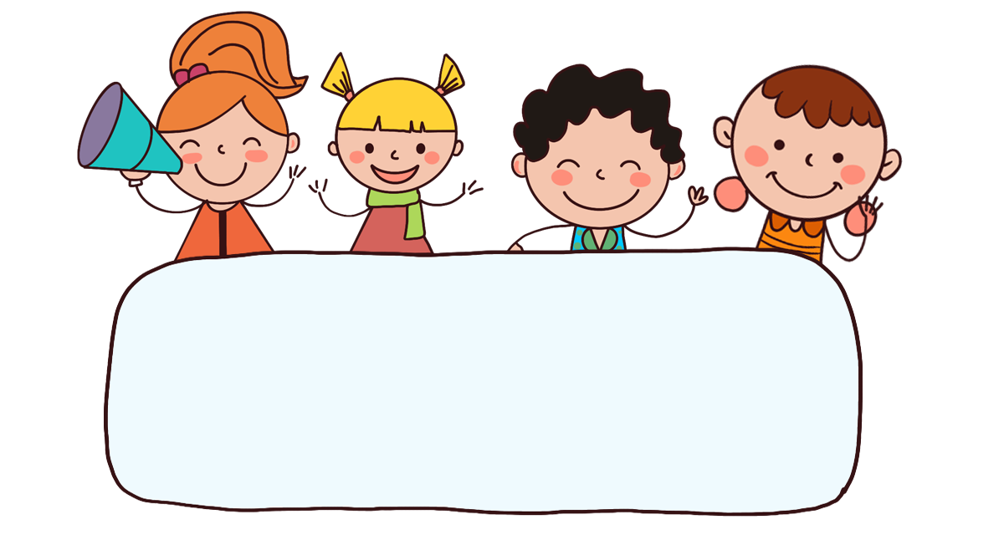
Warm-up

Slide 3
Let’s sing

Slide 4

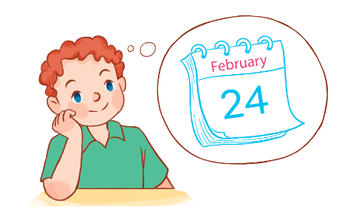
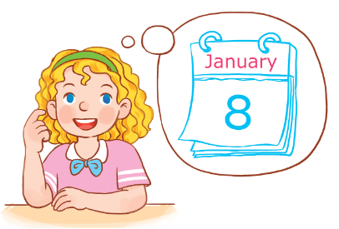
Let’s sing.
When’s your birthday?
When’s your birthday?
When’s your birthday?
It’s in January.
My birthday’s in January.
When’s your birthday?
When’s your birthday?
It’s in February.
My birthday’s in February.

Slide 5
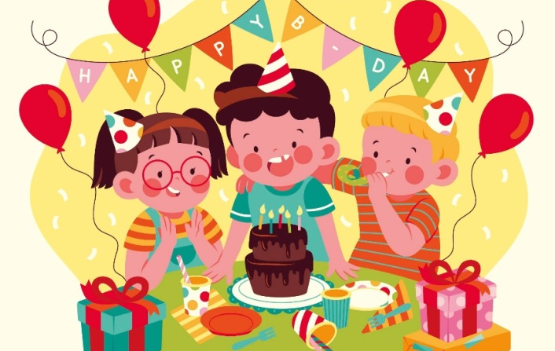
My birthday party
Unit
4
Lesson 2

Slide 6



Contents
Look, listen and repeat.
Listen, point and say.
Let’s talk.

Slide 7

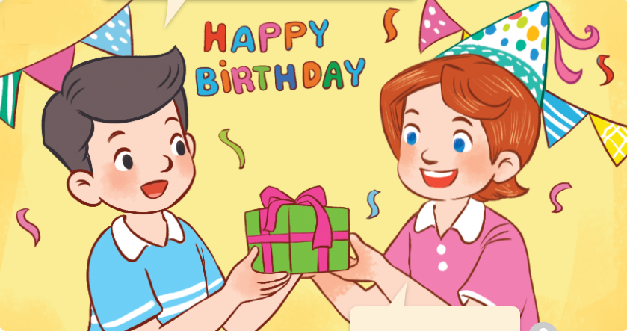
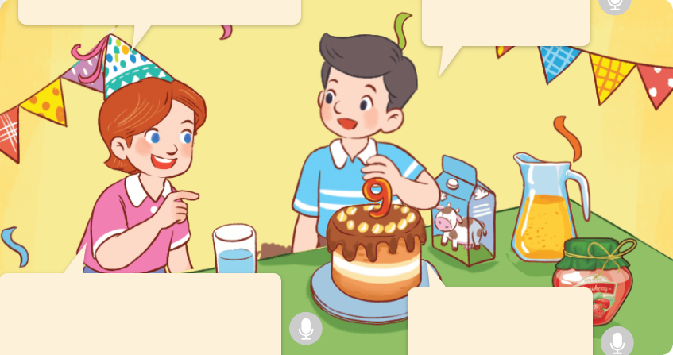
1. Look, listen and repeat.
Happy birthday, Lucy!
What do you want to eat, Nam?
I want some jam.
a
b
What do you want to drink?
I want some juice.
Thank you.

Slide 8
Vocabulary

Slide 9

Vocabulary
juice
/dʒuːs/
nước ép

Slide 10

lemonade
/ˌleməˈneɪd/
nước chanh

Slide 11
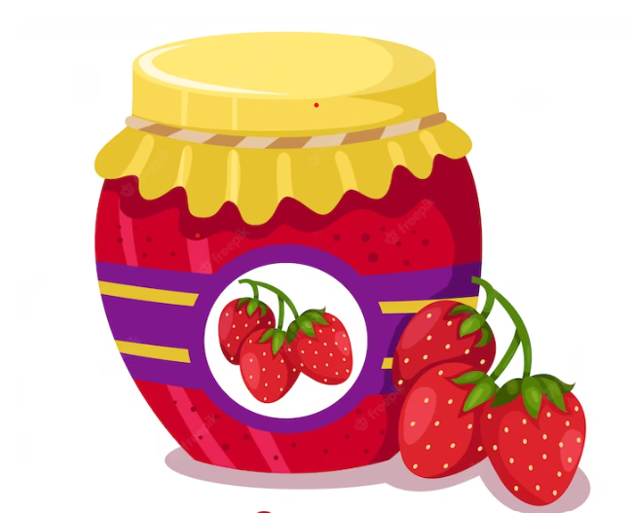
jam
/dʒæm/
mứt

Slide 12
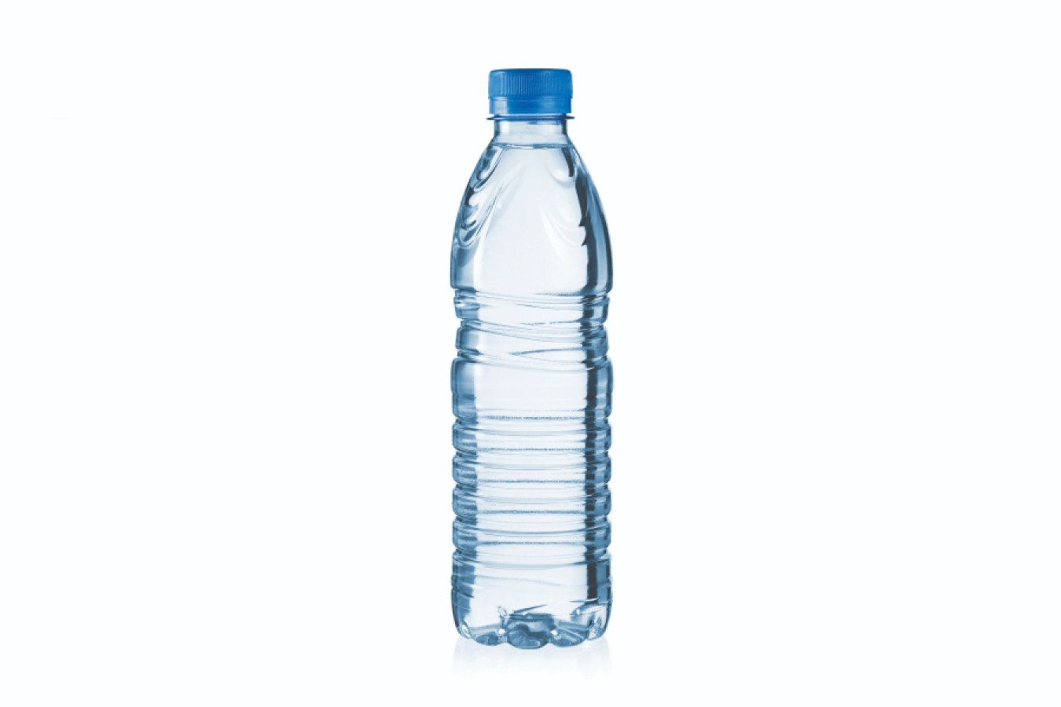
water
/ˈwɔːtər/
nước lọc

Slide 13
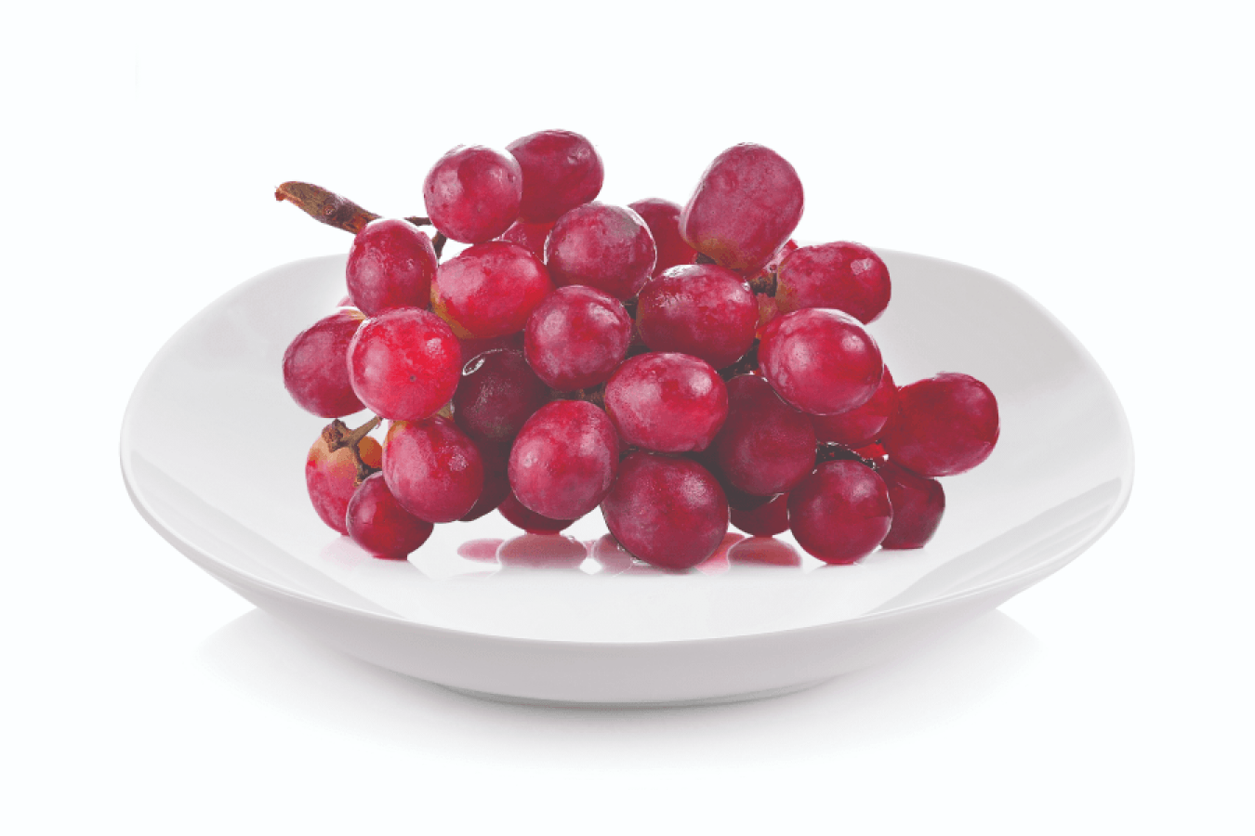
grapes
/ɡreɪps/
quả nho

Slide 14
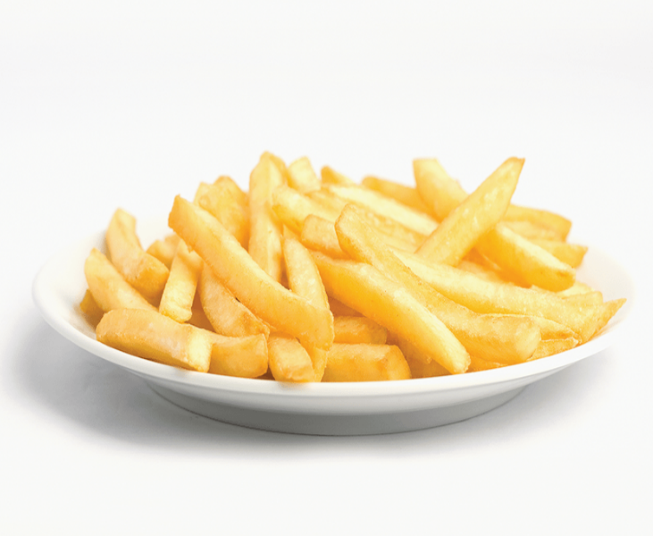
chips
/tʃɪps/
khoai tây chiên

Slide 15


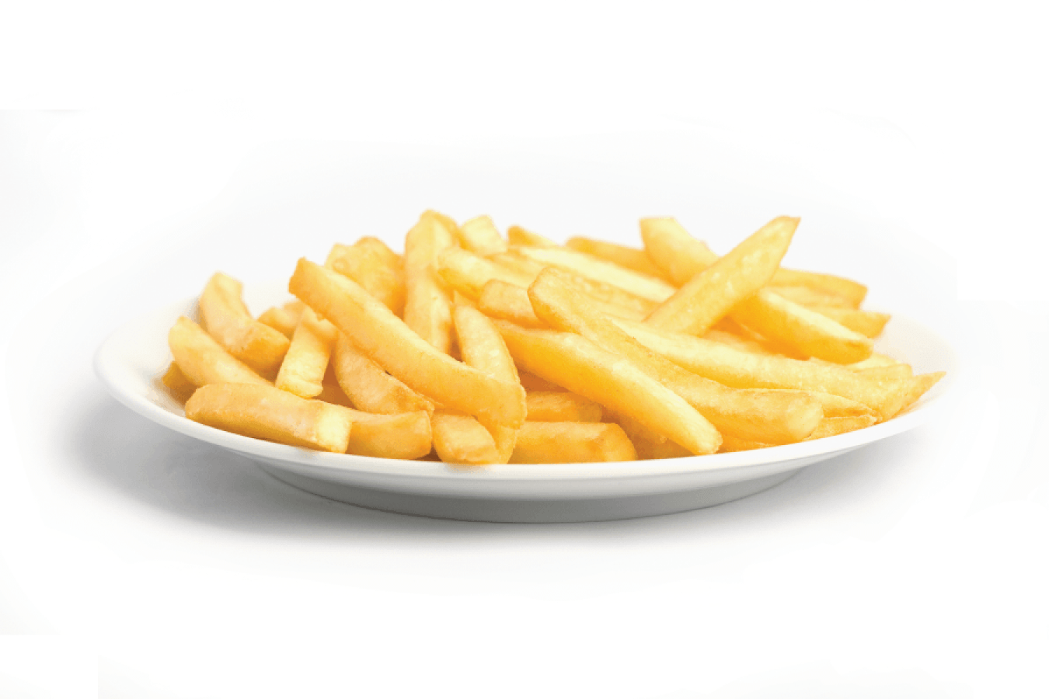
Review
juice
lemonade
jam
water
grapes
chips

Slide 16


Vocabulary
juice
: nước ép
lemonade
: nước chanh
jam
: mứt
water
: nước lọc
grapes
: quả nho
chips
: khoai tây chiên

Slide 17


Checking vocabulary
Choose the right answers
Bùi Liễu Powerpoint
1
2
3
4
5
6
juice
water
chips
grapes
jam
_____
_____
_____
_____
lemonade
_____
_______
a
chips
c
water
e
grapes
b
jam
d
lemonade
f
juice

Slide 18
Structures

Slide 19




Cách hỏi bạn muốn ăn hoặc uống gì.
What do you want to eat / drink?
I want _____.
Ex:
What do you want to eat?
I want some chips.

Slide 20


Unit 4 lesson 2
What do you want to eat / drink?
I want ________.
some chips
some
juice
some grapes
some
jam
some lemonade
some water

Slide 21


2. Listen, point and say.
a
b
What do you want to eat / drink ?
some chips
some grapes
c
d
I want _______.
some lemonade
some water

Slide 22


2. Listen, point and say.
a
What do you want to eat / drink ?
I want _____.
some chips
What do you want to eat?
I want some chips.

Slide 23

2. Listen, point and say.
b
What do you want to eat / drink ?
I want _____.
some grapes
What do you want to eat?
I want some grapes.

Slide 24
2. Listen, point and say.
c
What do you want to eat / drink ?
I want _____.
some lemonade
What do you want to drink?
I want some lemonade.

Slide 25


2. Listen, point and say.
d
What do you want to eat / drink ?
I want _____.
some water
What do you want to drink?
I want some water.

Slide 26
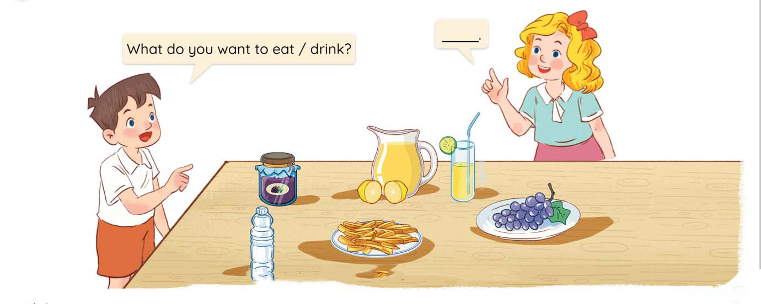
3. Let’s talk.
What do you want to eat / drink?
________________.

Slide 27

3. Let’s talk.
What do you want to ____?
eat
______________.
I want some jam

Slide 28
3. Let’s talk.
What do you want to _____?
drink
__________________.
I want some lemonade

Slide 29
3. Let’s talk.
What do you want to ____?
eat
________________.
I want some grapes

Slide 30
3. Let’s talk.
What do you want to ____?
eat
_______________.
I want some chips

Slide 31
3. Let’s talk.
What do you want to _____?
drink
_______________.
I want some water

Slide 32

Thank you!

