Slide 1

Welcome to our class!

Slide 2

Warm-up
Trong game “Bombstar" sử dụng "hyperlink" để liên kết các slide trong game. Nếu thầy cô thêm slide hoặc xóa bớt slide trước game đó thì thầy cô cần chỉnh lại "hyperlink". Nếu thầy cô ko tự chỉnh được "hyperlink" thì liên hệ e, e hướng dẫn nhé.

Slide 3



Honey bee
Start

Slide 4




1/6
A: ______ do you live?
B: I live in Hoa Binh Road.
A. Where
B. When
C. Who

Slide 5

2/6
A: Where do you live?
B: I live ___ 9 Quang Trung Road.
A. in
B. on
C. at

Slide 6
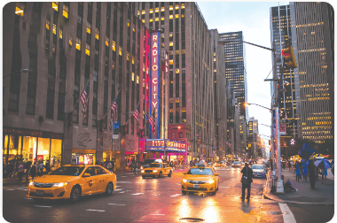

3/6
A: What’s the city like?
B: It’s a ____ city.
A. quiet
B. big
C. noisy

Slide 7
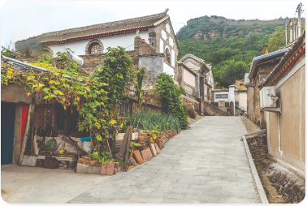
4/6
A: What’s the village like?
B: It’s a ____village.
A. busy
B. quiet
C. noisy

Slide 8
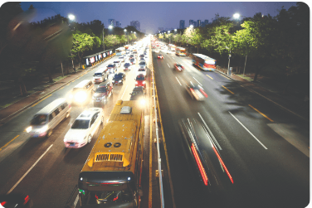

5/6
A: What’s the road like?
B: It’s a ____ road.
A. busy
B. quiet
C. noisy

Slide 9


6/6
A: ________________
B: It’s a busy street.
A. What’s the street like?
B. What’s the road like?
C. What’s the city like?

Slide 10

Thank you!
End

Slide 11

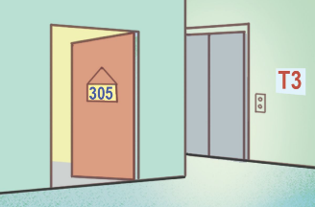


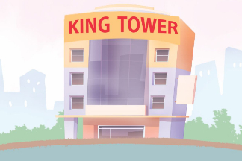
Unit 2
Our homes
Lesson 1

Slide 12



Contents
Look, listen and repeat.
Listen, point and say.
Let’s talk.

Slide 13

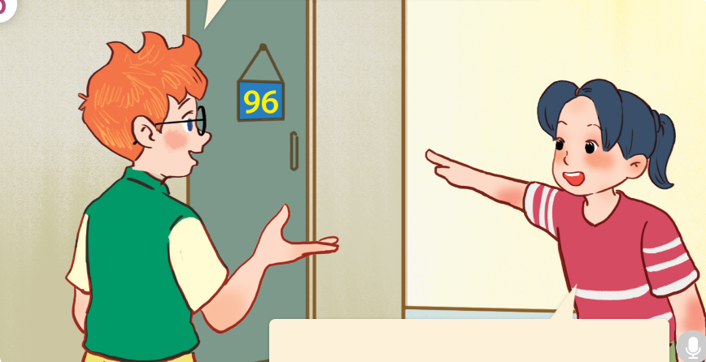
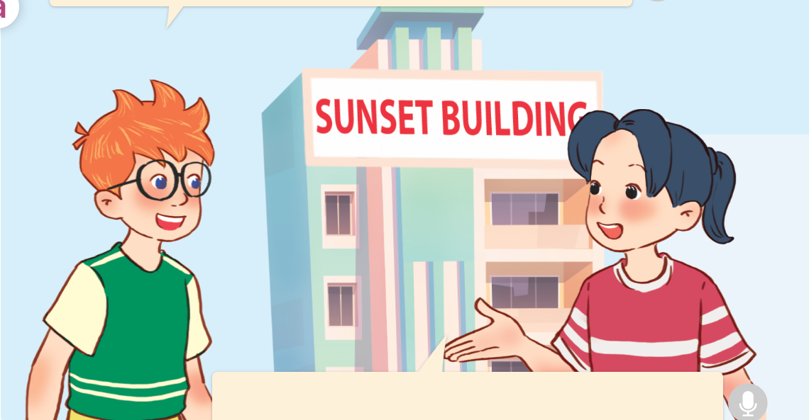
1. Look, listen and repeat.
Do you live in this building?
Hello, Mai.
Nice to see you again.
a
b
Yes, I do.
I live in that flat.
Hi, Ben.
Nice to see you, too.
Click on the speaker / sentences to listen.

Slide 14
Vocabulary

Slide 15

Vocabulary
building
/ˈbɪl.dɪŋ/
tòa nhà
Click on the English words to listen.

Slide 16

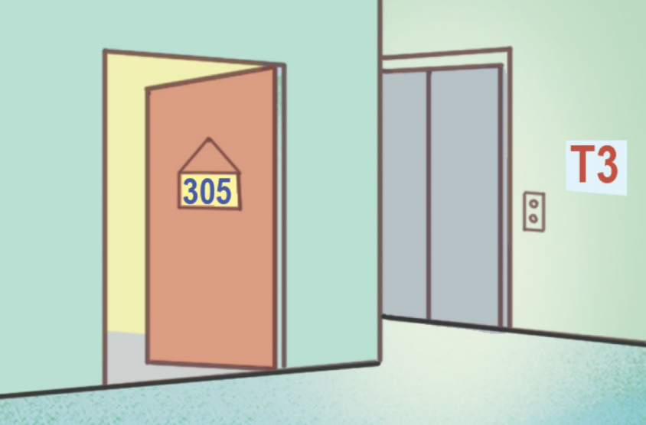
flat
/flæt/
căn hộ

Slide 17

house
/haʊs/
căn nhà

Slide 18

tower
/taʊər/
tòa tháp

Slide 19




Review
building
flat
house
tower
Click on the English word to listen again.

Slide 20



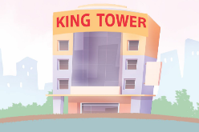
Vocabulary
1. building
: tòa nhà
2. flat
: căn hộ
3. house
: căn nhà
4. tower
: tòa tháp
Click on the English word to listen again.

Slide 21

Checking vocabulary!

Slide 22

LOOK AND CHOOSE!

Slide 23






Look and choose.
a
b
flat

Slide 24

Look and choose.
a
b
house

Slide 25


Look and choose.
a
b
tower

Slide 26


Look and choose.
a
b
building

Slide 27
Well done!

Slide 28
Structures

Slide 29






Do you live in this / that _____?
Yes, I do.
No, I don’t.
Example:
Do you live in this house?
Yes, I do.

Slide 30


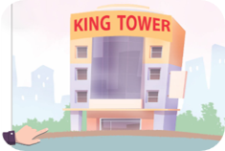
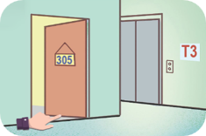

Unit 2 lesson 1
Do you live in this / that _____?
Yes, I do.
No, I don’t.
house / yes
tower / no
flat / no
building / yes

Slide 31

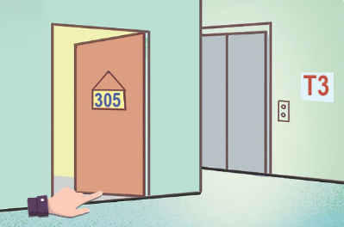


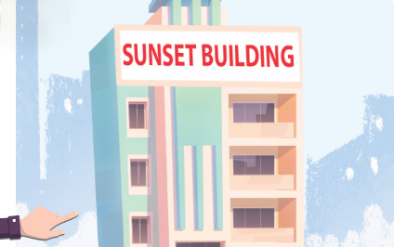
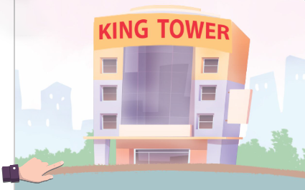
2. Listen, point and say.
a
b
Do you live in this / that ___?
house / yes
flat / no
Yes, I do.
c
d
No, I don’t.
Click on the words/phrases
to listen again.
building / yes
tower / no

Slide 32


2. Listen, point and say.
a
house / yes
Do you live in this house?
Yes, I do.
Click on the sentences to listen.

Slide 33

2. Listen, point and say.
b
flat / no
Do you live in this flat?
No, I don’t.

Slide 34

2. Listen, point and say.
c
building / yes
Do you live in that building?
Yes, I do.

Slide 35
2. Listen, point and say.
d
tower / no
Do you live in that tower?
No, I don’t.

Slide 36
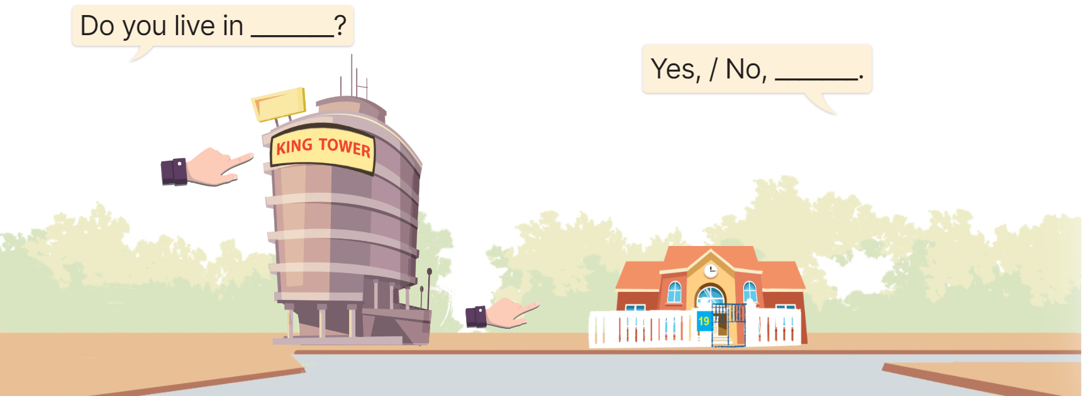
3. Let’s talk.
Do you live in ________?
Yes, / No, ____.

Slide 37
3. Let’s talk.
this tower
Do you live in _________?
No, I don’t. I live in a house in the countryside.

Slide 38
3. Let’s talk.
that house
Do you live in _________?
___________________
Yes, I do. It’s my house.

Slide 39
Fun corner
& wrap-up

Slide 40





BOMBSTAR
PLAY

Slide 41













Team 1
Team 2
Team 3
-1
-1
Chia lớp thành 3 đội, cho sẵn mỗi đội 2 điểm. Mỗi câu trả lời đúng tặng 1 điểm, câu có bom thì trừ 1 điểm.

Slide 42
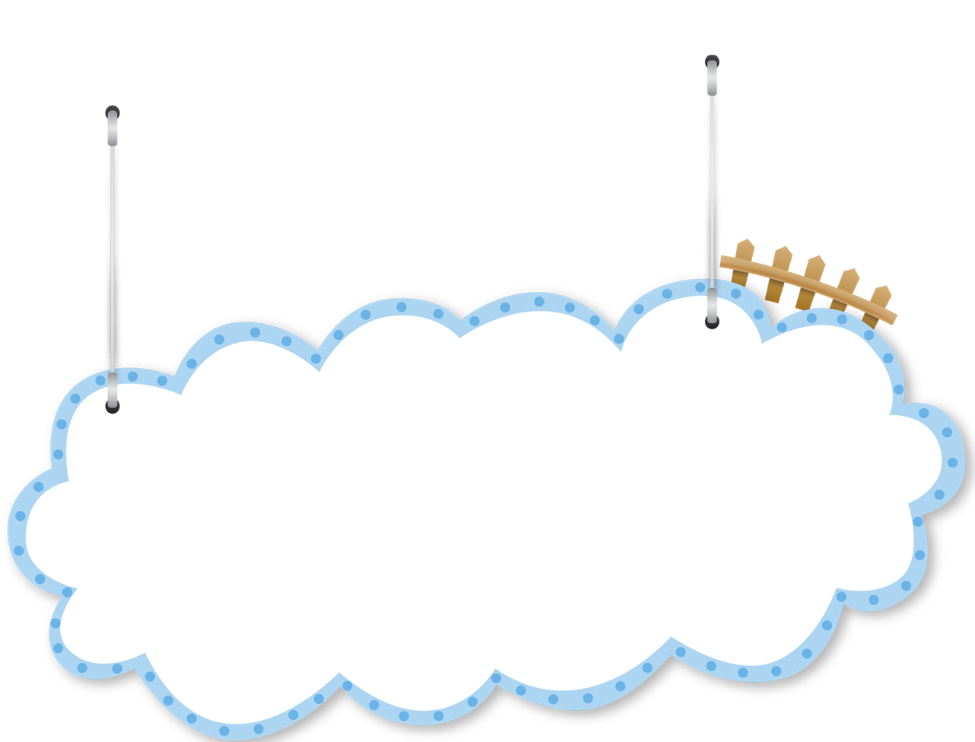




I _______ play badminton in my free time.
A. always
B. never
C. somtimes

Slide 43

He _____ cleans the house.
A. sometimes
B.usually
C. always

Slide 44
A: Do you live in this ____?
B: No, I don’t.
A. tower
B. house
C. flat

Slide 45
A: Do you live in that ____?
B: No, I don’t.
A. building
B. tower
C. flat

Slide 46
A: _______ in this house?
B: Yes, I do.
A. Does he live
B. Do you live
C. Does she live

Slide 47
A: Do you live in that tower?
B: ___________
A. Yes, I can.
B. No, I don’t.
C. Yes, I do.

Slide 48
A: Do you live in
____ flat?
B: No, I don’t.
A. that
B. this

Slide 49
A: Do you live ____ this house?
B: Yes, I do.
A. on
B. in
C. at

Slide 50
A: Do you live in this flat?
B: __________
A. No, I can’t.
B. Yes, I can.
C. No, I don’t.

Slide 51
A: Do you live in ____?
B: No, I don’t.
A. this building
B. that building
C. that
tower

Slide 52

Well done!

Slide 53

Goodbye!

