Slide 1
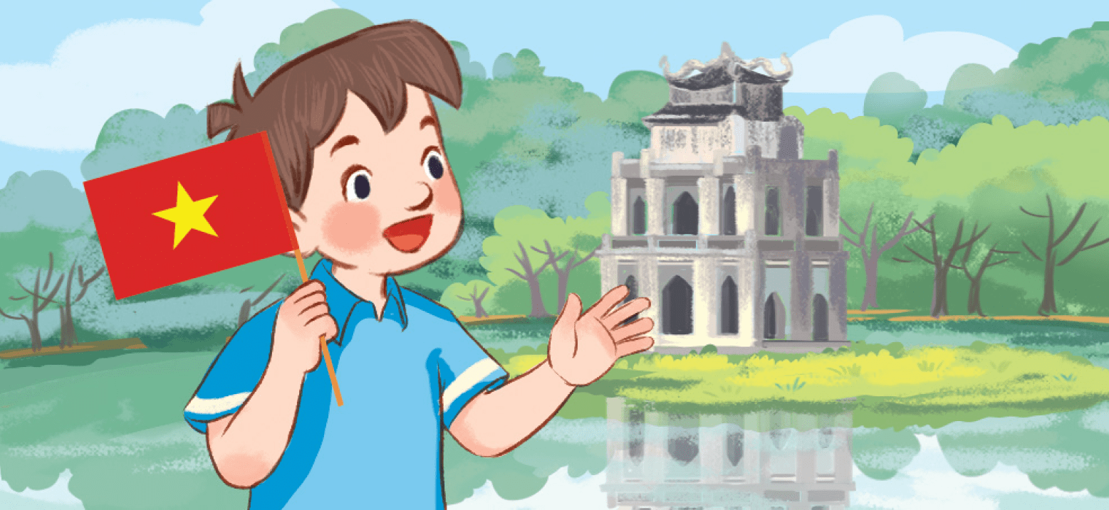
Monday, May 10th 2023
My friends
Unit
1
Lesson 3 (4+5+6)

Slide 2
Facebook : Bùi Liễu
0968142780
Warm up

Slide 3
Facebook: Bùi Liễu
0968142780
Let’s play!

Slide 4
Honey bee
Start

Slide 5
1/8
Where are you from?
I’m from _____.
A. America
B. Thailand
C. Malaysia

Slide 6
2/8
Where are you from?
I’m from _____.
A. Viet Nam
B. Singapore
C. Britain

Slide 7
3/8
Where are you from?
_____ from Viet Nam.
A. I’m
B. He
C. She

Slide 8
4/8
Where ___ you from?
I’m from Australia.
A. is
B. am
C. are

Slide 9
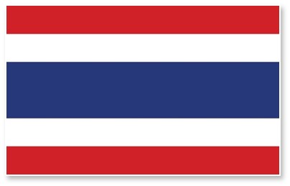
5/8
_____ is she from?
She is from Thailand.
A. How
B. What
C. Where

Slide 10
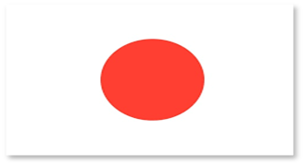
6/8
Where are ____ from?
I’m from Japan.
A. you
B. he
C. they

Slide 11
7/8
Where’s he from?
He’s from _____.
A. Singapore
B. Malaysia
C. Australia

Slide 12
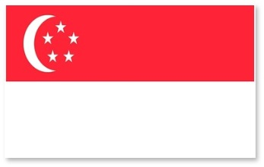
8/8
Where ___ he from?
He ___ from Singapore.
A. am - am
B. are - are
C. is – is

Slide 13
Thank you!
End

Slide 14
Contents
Read and tick True or False.
Let’s write.
Project.

Slide 15
4. Read and tick True or False.
Hello. I am Minh. I am nine years old. I am from Viet Nam. I have two friends, Tony and Laura. Tony is from America. Laura is from Australia. They are friendly.
True | False
1.
Minh is nine years old.
2.
Minh is from Viet Nam.
3.
Tony is from Australia.
4.
Laura is from America.

Slide 16
5. Let’s write.
Hi. My name is _________. I am ___________ years old. I am from Viet Nam.
This is my friend, She is from ________. And this is _________ He is from ____________.
Hang
ten
Japan
Bill
Singapore

Slide 17
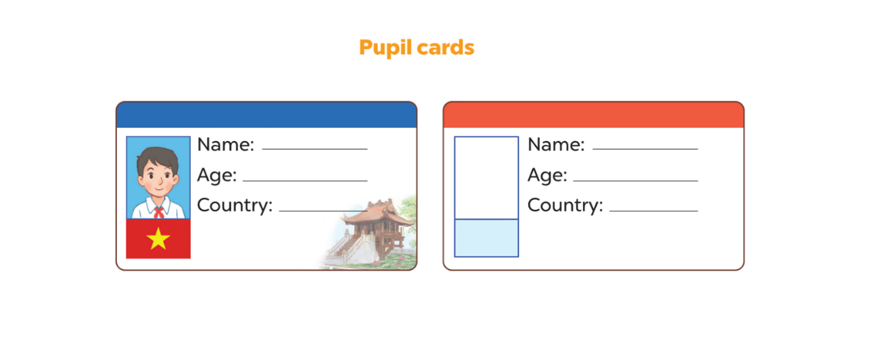
6. Project
Nam
10
Viet Nam

Slide 18
Wrap up

Slide 19
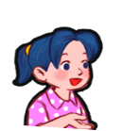
Unit 1 lesson 1
Where are you from?
I’m from _____.
I am = I’m
Viet Nam
Australia
Britain
America

Slide 20
Unit 1 lesson 2
where’s = where is
he’s = he is
she’s = she is
Where’ s he / she from?
He’s / She’s from _____.
Singapore
Japan
Malaysia
Thailand

Slide 21
Homework
…………………………………….
…………………………………….

Slide 22
Thank you!

