Slide 1
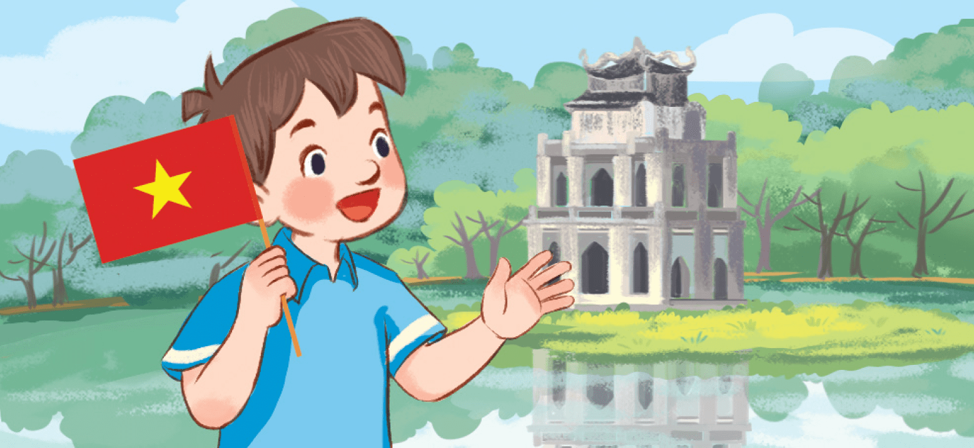
Friday , September 15th 2023
My friends
Unit
1
Lesson 2 (4+5+6)

Slide 2
Warm-up

Slide 3
Let’s play!

Slide 4
Thailand
Answer

Slide 5
Singapore
Answer

Slide 6
Malaysia
Answer

Slide 7
Japan
Answer

Slide 8
Where’s he from?
- He’s from _____.
Malaysia
Answer

Slide 9
Where’s she from?
- She’s from _____.
Thailand
Answer

Slide 10
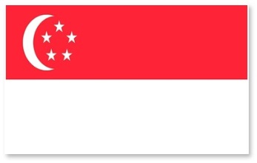
Where’s he from?
- He’s from _____.
Singapore
Answer

Slide 11
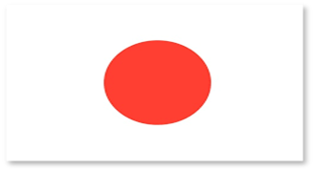
Where’s she from?
- She’s from _____.
Japan
Answer

Slide 12
Where’s he/she from?
- He’s/She’s from Thailand.
he/He’s
Answer

Slide 13
Where’s he/she from?
- He’s/She’s from Malaysia.
he/He’s
Answer

Slide 14
_____ she from?
- She’s from Japan.
Where’s
Answer

Slide 15
Great!

Slide 16
Contents
Listen and tick.
Look, complete and read.
Let’s play.

Slide 17
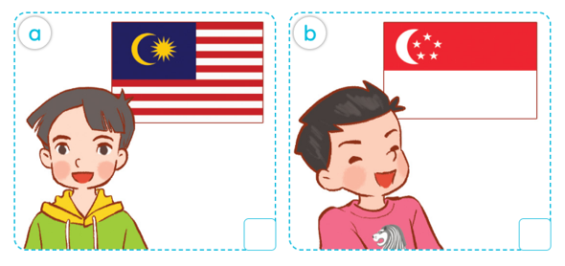
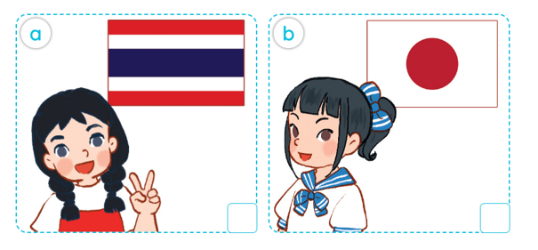
4. Listen and tick.
1.
2.

Slide 18
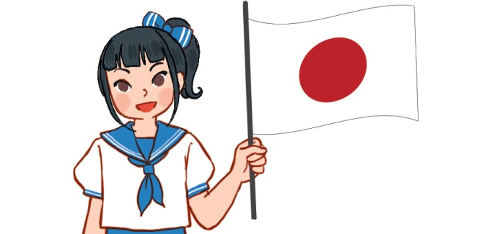
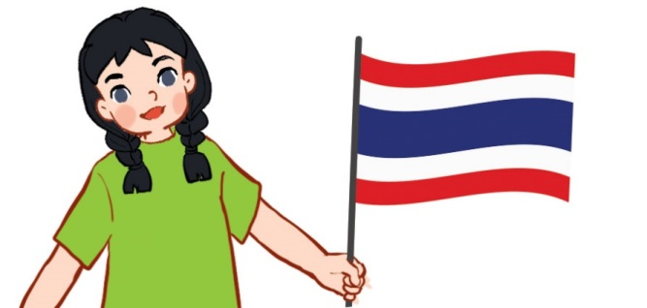
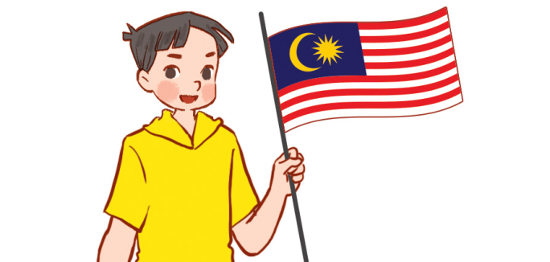
5. Look, complete and read.
1.
2.
A: Where’s she from?
B: She’s from __________.
A: Where’s he from?
B: He’s _______________.
Japan
from Singapore
3.
4.
he from
A: ________ she from?
B: She’s ___________.
A: Where’s ___________?
B: ________ Malaysia.
Where’s
from Thailand
He’s from

Slide 19
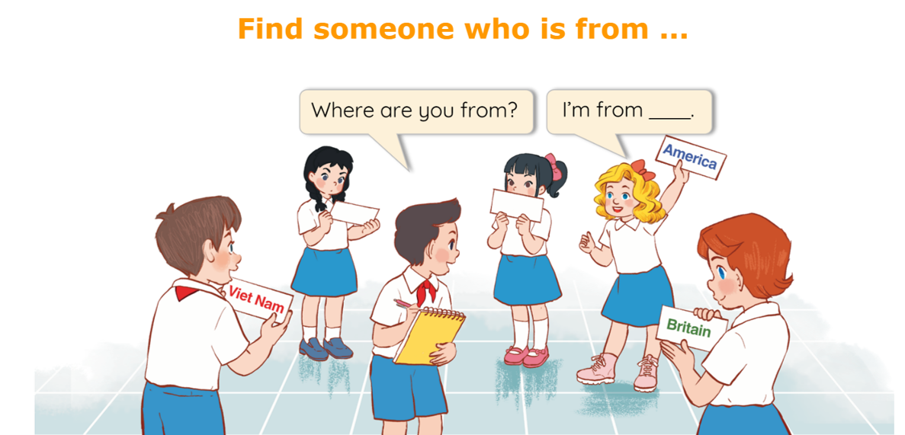
6. Let’s play.

Slide 20
Wrap up

Slide 21
Unit 1 lesson 2
where’s = where is
he’s = he is
she’s = she is
Where’ s he / she from?
He’s / She’s from _____.
Singapore
Japan
Malaysia
Thailand

Slide 22
Homework
……………………………………..
……………………………………..

Slide 23
Thank you!

