Slide 1
Tuesday, September 12th 2023
My friends
Unit
1
Lesson 1 (1+2+3)

Slide 2
Warm-up

Slide 3
Let’s sing!

Slide 5
Contents
Look, listen and repeat.
Listen, point and say.
Let’s talk.

Slide 6
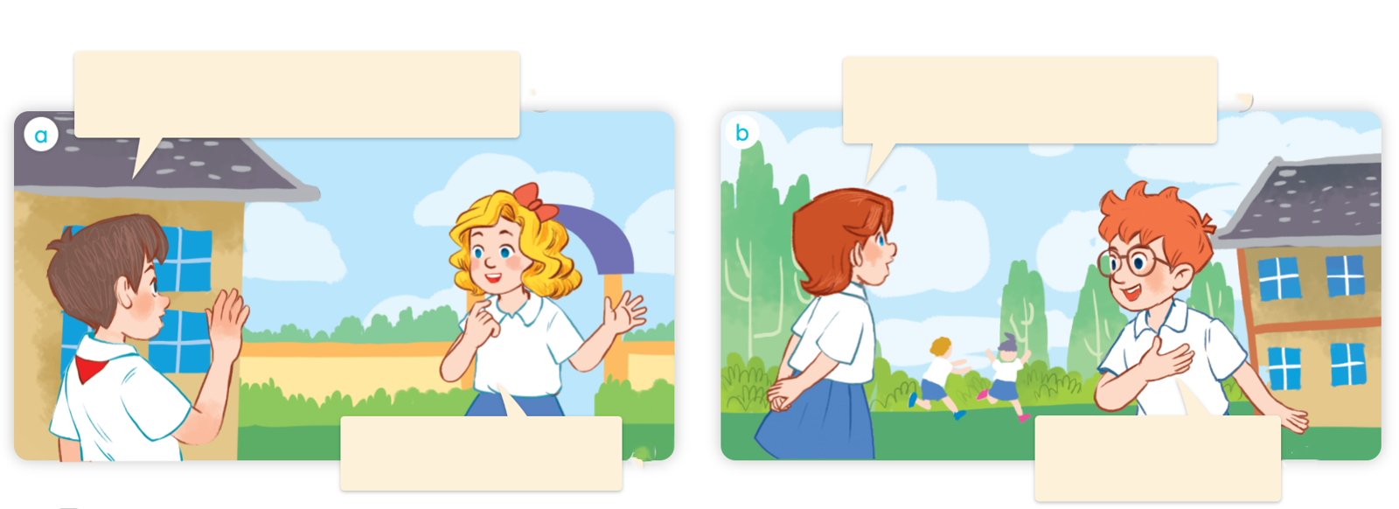
1. Look, listen and repeat.
Hello. I’m Minh. I’m from Viet Nam. Where are you from?
Hi. I’m Lucy. I’m from Britain. Where are you from?
Hello, Minh. I’m Mary. I’m from America.
Hi, Lucy. I’m Ben. I’m from Australia.
Where are they?
Who are they?
What are they doing?
Click on the sentences to hear the sound.

Slide 7
Vocabulary

Slide 8
Viet Nam
/ˌviːetˈnɑːm/
nước Việt Nam

Slide 9
Britain
/ˈbrɪtn/
nước Anh

Slide 10
America
/əˈmerɪkə/
nước Hoa Kỳ

Slide 11
Australia
/ɒˈstreɪliə/
nước Ô-xtrây-li-a (Úc)

Slide 12
Review
Viet Nam
Britain
America
Australia

Slide 13
Look and match.
1
2
3
4
Britain
Viet Nam
America
Australia

Slide 14
Write down your notebooks.
Viet Nam
nước Việt Nam
Britain
nước Anh
America
nước Hoa Kỳ
Australia
nước Ô-xtrây-li-a (Úc)

Slide 15
Structures

Slide 16
Cách hỏi bạn đến từ đâu.
Where are you from?
(Bạn đến từ đâu?)
I’m = I am
I’m from _____.
(Tớ đến từ ____.)
Ex:
Where are you from?
I’m from Viet Nam.

Slide 17
Where are you from?
I’m from _____.
I am = I’m
Viet Nam
Australia
Britain
America

Slide 18
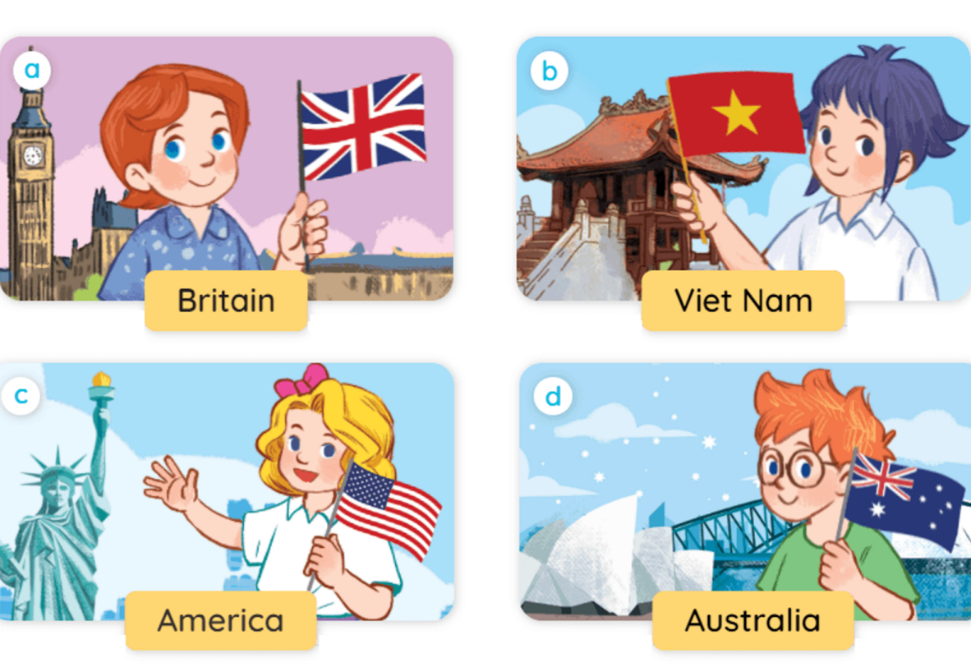
2. Listen, point and say.
Where are you from?
I’m from _____.

Slide 19
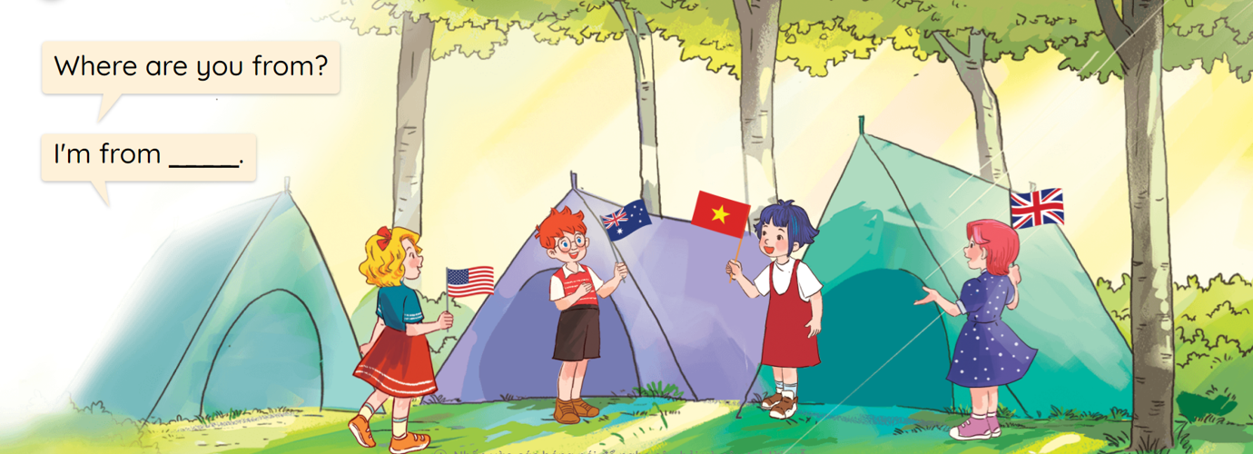
3. Let’s talk.

Slide 20
Let’s play!

Slide 21
NEXT
A. America
B. Britain

Slide 22
A. Australia
B. Viet Nam
NEXT

Slide 23
A. Australia
B. Britain
NEXT

Slide 24
A. Viet Nam
B. America
NEXT

Slide 25
Where are you from? – I’m from _____.
A. America
B. Australia
NEXT

Slide 26
Where are you from? – I’m from _____.
A. Viet Nam
B. Australia
NEXT

Slide 27
Where are you from? – I’m from _____.
A. Britain
B. America
NEXT

Slide 28
Where are you from? – I’m from _____.
A. Viet Nam
B. Britain
NEXT

Slide 29
Where ___ you from? – I’m from Viet Nam.
A. are
B. is
NEXT

Slide 30
_____ are you from? – I’m from America.
A. Where
B. What
END

Slide 31
Well done!

Slide 32
Wrap up

Slide 33
Unit 1 lesson 1
Where are you from?
I’m from _____.
I am = I’m
Viet Nam
Australia
Britain
America

Slide 34
Homework
Learn by heart all the new words.
Read again the dialogue in part 1.

Slide 35
Thank you!

