Slide 1
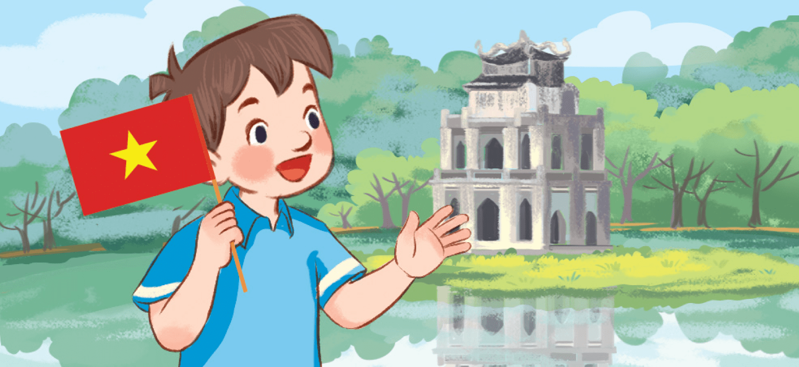
Monday, September 16th 2024
My friends
Unit
1
Lesson 1 (4+5+6)

Slide 2
Warm-up

Slide 3
Let’s play!

Slide 4
3
4
2
6
5
1
End

Slide 5
Where are you from? - I’m from America.
A
B
C
back
Click on the letter A, B or C to choose the answer.

Slide 6
Where are you from? - I’m from Britain.
A
B
C
back

Slide 7
Where are you from? - I’m from Australia.
A
B
C
back

Slide 8
Where are you from? - I’m from Viet Nam.
A
B
C
back

Slide 9
Where ___ you from? - I’m from Viet Nam.
A
B
C
back

Slide 10
______ are you from? - I’m from Viet Nam.
A
B
C
back

Slide 11
Well done!

Slide 12
Contents
Listen and number.
Look, complete and read.
Let’s sing.

Slide 13
4. Listen and number.
4
1
3
2

Slide 14
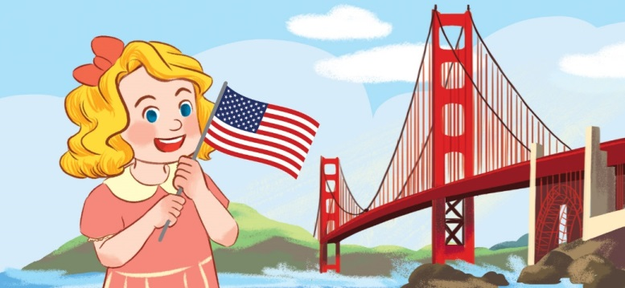
5. Look, complete and read.
1.
I’m Minh. I’m from _________.
2.
I’m Mary. I’m ______________.
Viet Nam
from America
3.
4.
A: Where are you ________?
B: I’m _____________.
Where
from
A: ________ are you from?
B: I’m from __________.
Britain
from Australia

Slide 15
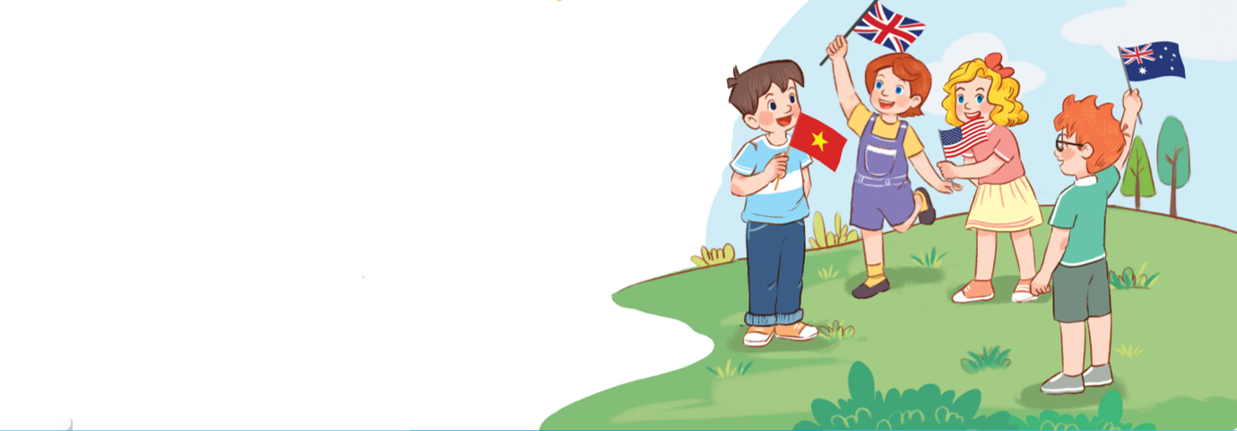
6. Let’s sing.
Where are you from?
Hello. I’m Minh.
I’m from Viet Nam.
Hello, Lucy. Where are you from?
I’m from Britain.
Hello, Mary. Where are you from?
I’m from America.
Hello, Ben. Where are you from?
I’m from Australia.
Click on the speaker or the leaves to hear.

Slide 16
6. Let’s sing.
Where are you from?
Hello. I’m Minh.
I’m from Viet Nam.
Hello, Lucy. Where are you from?
I’m from Britain.
Hello, Mary. Where are you from?
I’m from America.
Hello, Ben. Where are you from?
I’m from Australia.

Slide 17
6. Let’s sing.

Slide 18
Wrap up

Slide 19
Unit 1 lesson 1
Where are you from?
I’m from _____.
I am = I’m
Viet Nam
Australia
Britain
America

Slide 20
Homework
………………………………..
………………………………...

Slide 21
Thank you!

