Slide 1
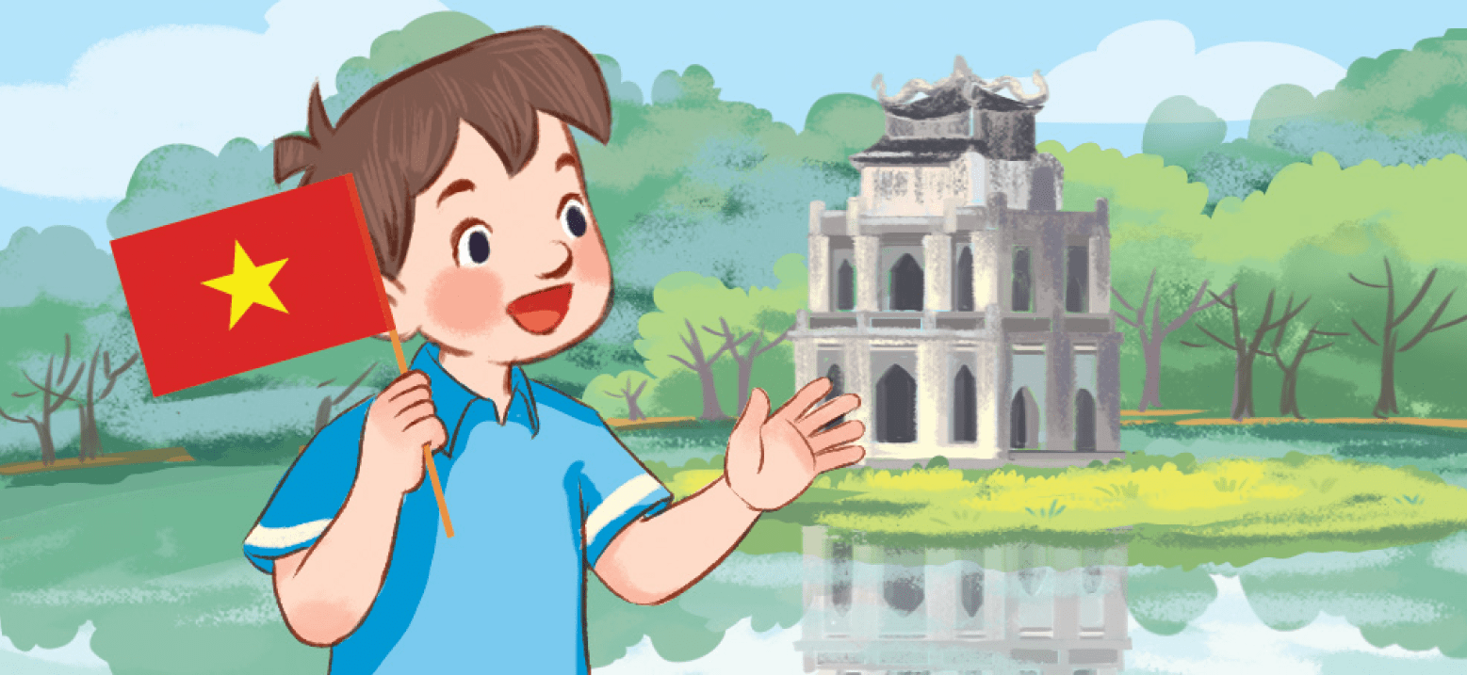
Fridday, September 14th 2023
My friends
Unit
1
Lesson 2 (1+2+3)

Slide 2

Warm-up

Slide 3
Let’sing!

Slide 4


Let’s sing.
Where are you from?
Hello. I’m Minh.
I’m from Viet Nam.
Hello, Lucy. Where are you from?
I’m from Britain.
Hello, Mary. Where are you from?
I’m from America.
Hello, Ben. Where are you from?
I’m from Australia.

Slide 5



Contents
Look, listen and repeat.
Listen, point and say.
Let’s talk.

Slide 6

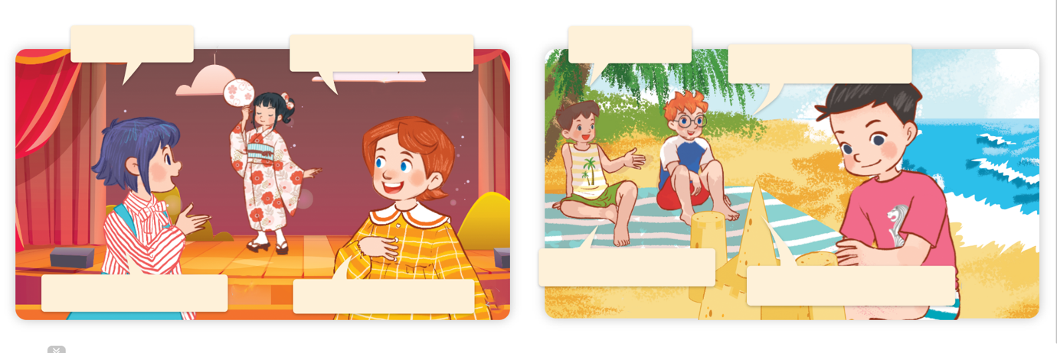
1. Look, listen and repeat.
Who’s that?
Who’s that?
It’s my new friend.
It’s my new friend.
Where’s he from?
Where’s she from?
She’s from Japan.
He’s from Singapore.
Where are they?
Who are they?
What are they doing?
Click on the sentences to hear the sound.

Slide 7
Vocabulary

Slide 8

Singapore
/ˌsɪŋəˈpɔː(r)/
nước Xin-ga-po

Slide 9

Malaysia
/məˈleɪʒə/
nước Ma-lai-xi-a

Slide 10

Thailand
/ˈtaɪlænd/
nước Thái Lan

Slide 11

Japan
/dʒəˈpæn/
nước Nhật

Slide 12


Review
Singapore
Malaysia
Thailand
Japan

Slide 13
Checking vocabulary
Look and match.
1
2
3
4
Singapore
Malaysia
Japan
Thailand

Slide 14
Write down your notebooks.
Singapore
nước Xing-ga-po
Malaysia
nước Ma-lai-xi-a
Thailand
nước Thái Lan
Japan
nước Nhật

Slide 15
Structures

Slide 16





Cách hỏi cậu ấy / cô ấy đến từ đâu.
Where’s he / she from?
where’s = where is
he’s = he is
she’s = she is
(Cậu ấy / cô ấy đến từ đâu?)
He’s / She’s from _____.
(Cậu ấy / cô ấy đến từ ____.)
Ex:
Where’s he from?
He’s from Singapore.

Slide 17


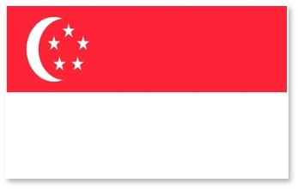







Unit 1 lesson 2
where’s = where is
he’s = he is
she’s = she is
Where’ s he / she from?
He’s / She’s from _____.
Singapore
Japan
Malaysia
Thailand

Slide 18
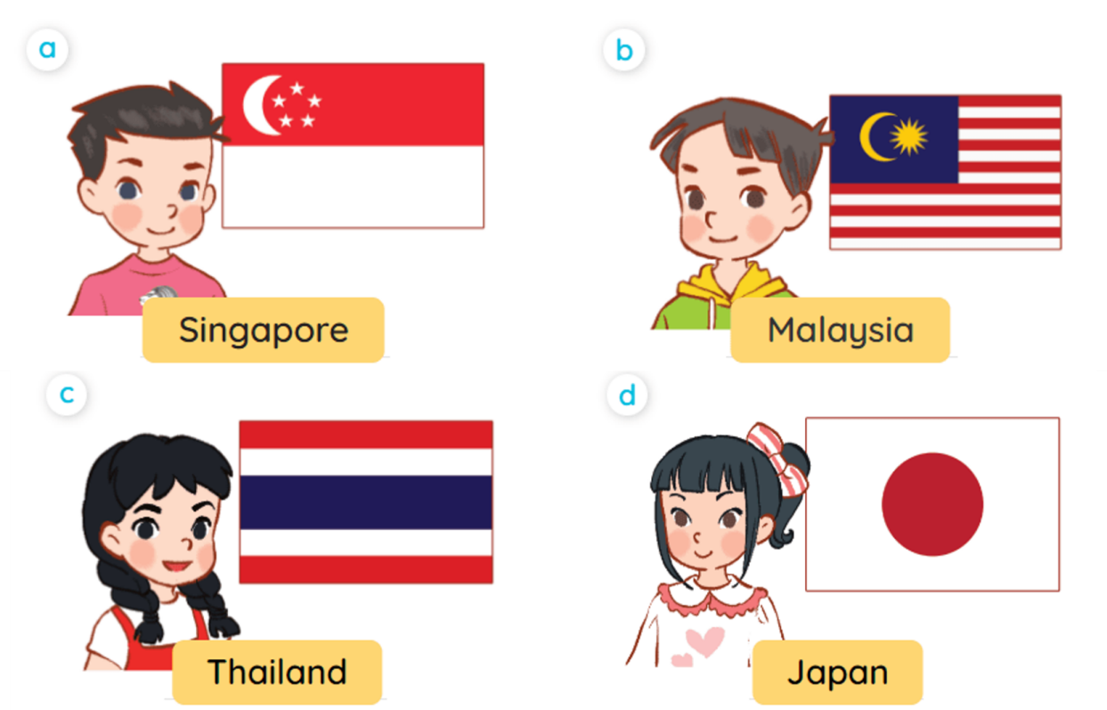
2. Listen, point and say.
Where’s he/she from?
He’s / She’s from _____.

Slide 19
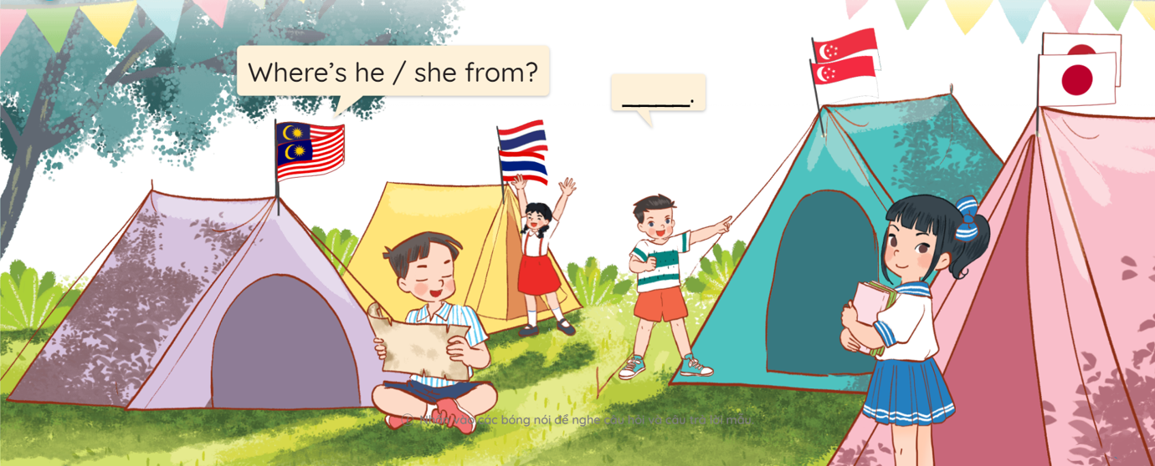
3. Let’s talk.

Slide 20








FEEDING GOLDFISH
Mỗi câu trả lời đúng là
CÂU THẦN CHÚ giúp cá Vàng
ngoi lên mặt nước nhận thức ăn.
Nào chúng mình cùng giúp
bạn nhỏ cho cá Vàng ăn nhé!
START

Slide 21


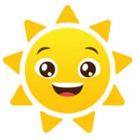

Facebook: Bùi Liễu
Mobile phone: 0968142780
Next
A. Japan
B. Thailand
C. Singapore

Slide 22

Next
A. Thailand
B. Japan
C. Malaysia

Slide 23

Next
A. Thailand
B. Singapore
C. Japan

Slide 24

Next
A. Japan
B. Thailand
C. Singapore

Slide 25

Next
Where’s he from?
- He’s from ____.
A. Singapore
B. Malaysia
C. Thailand

Slide 26

Next
Where’s he from?
- He’s from ____.
A. Japan
B. Malaysia
C. Singapore

Slide 27

Where’s she from?
- ____ from Thailand.
Next
A. She’s
B. He is
C. He is

Slide 28

Next
Where’s ____ from?
- She’s from Japan.
A. she
B. he
C. you

Slide 29


Next
Where is he from?
- He’s from Malaysia.
A. .
B.

Slide 30
Next
where’s = where ___
A. are
B. am
C. is

Slide 31
THANK YOU!
Next

Slide 32
Wrap up

Slide 33
Unit 1 lesson 2
where’s = where is
he’s = he is
she’s = she is
Where’ s he / she from?
He’s / She’s from _____.
Bùi Liễu
0968142780
Singapore
Japan
Malaysia
Thailand

Slide 34
Homework
Learn by heart all the new words.
Read again the dialogue in part 1.

Slide 35

Thank you!
Facebook: Bùi Liễu
0968142780

