Slide 1


Yen Son Secondary School
Welcome to our class
Teacher: Chu Thị Sơn

Slide 2


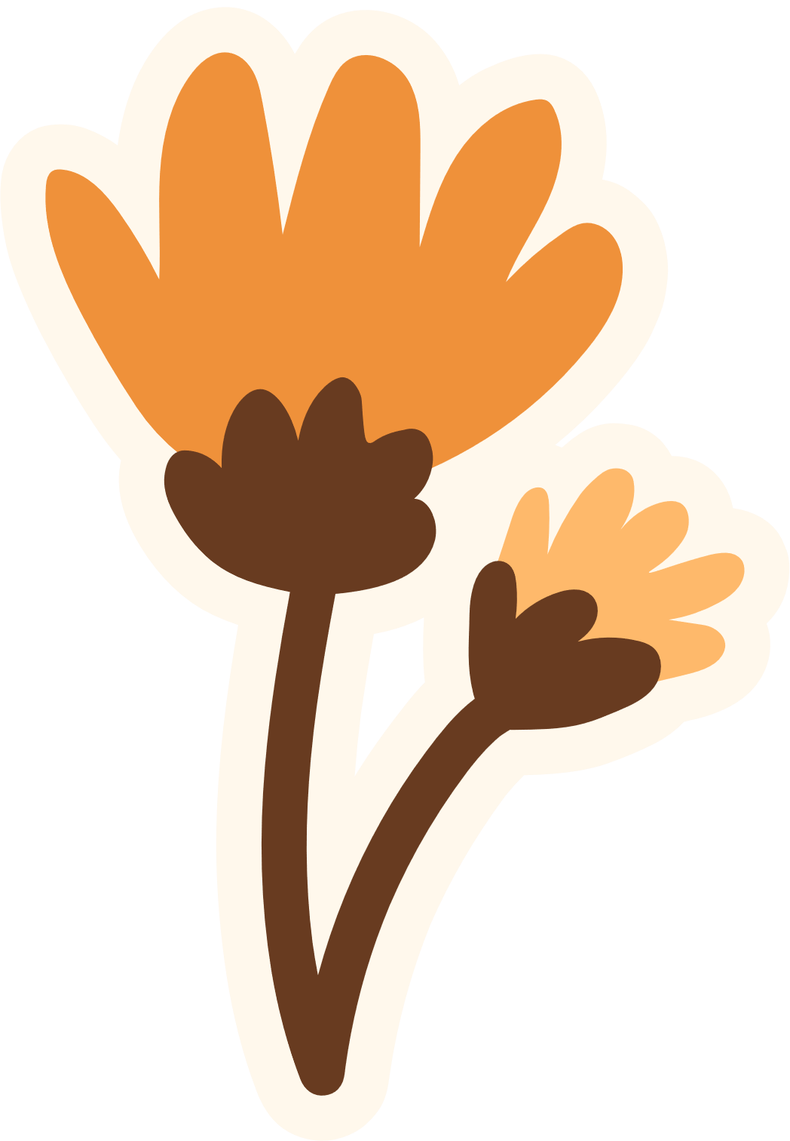
LET’S
WATCH A VIDEO

Slide 3
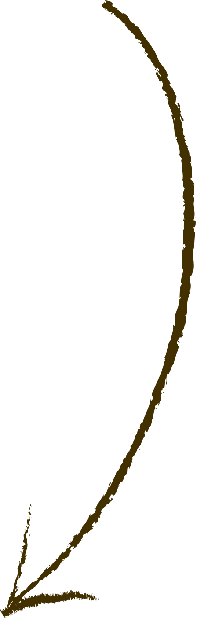

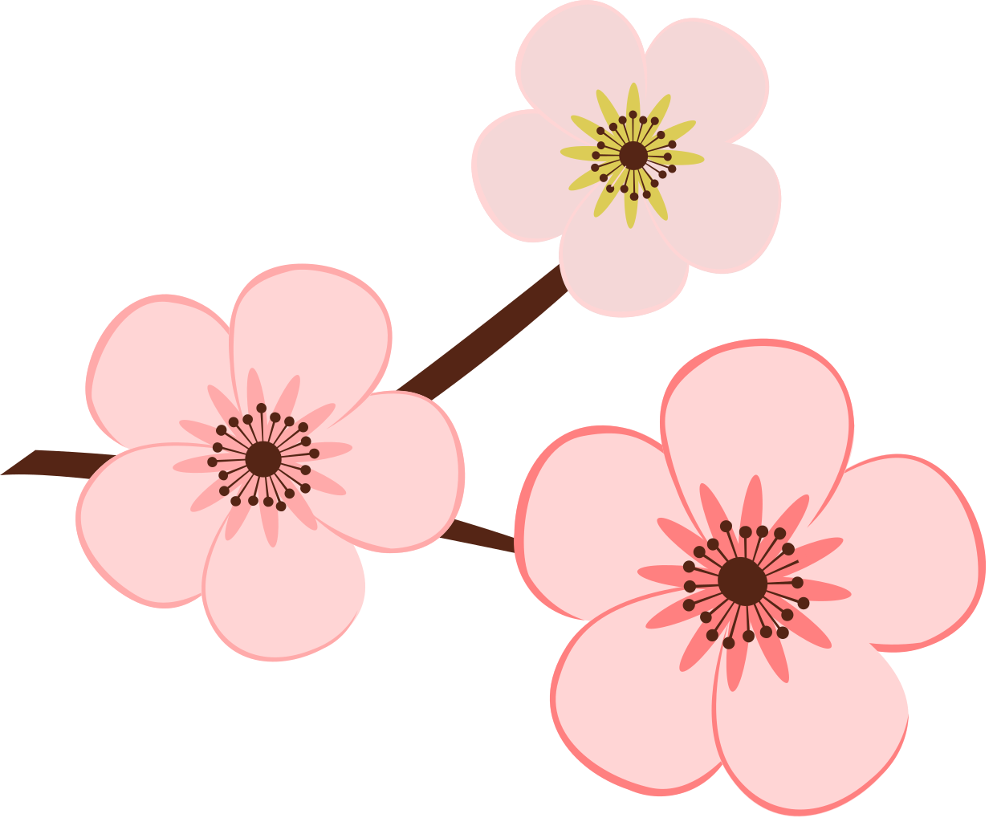
WHAT IS THE FESTIVAL ON THIS VIDEO?
WHAT DO PEOPLE USUALLY DO ON THIS FESTIVAL?

Slide 4
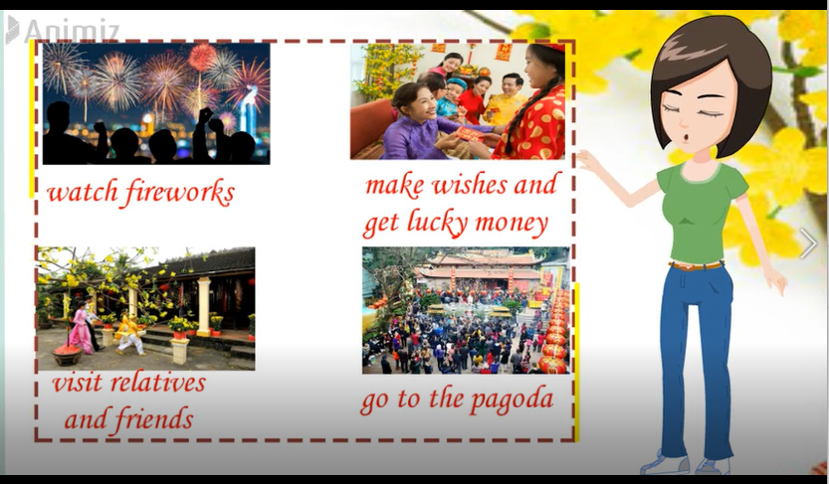
Check your answers

Slide 5
Unit 5
OUR CUSTOMS
AND TRADITIONS
Lesson 1: Getting Started

Slide 6



Vocabulary

Slide 7
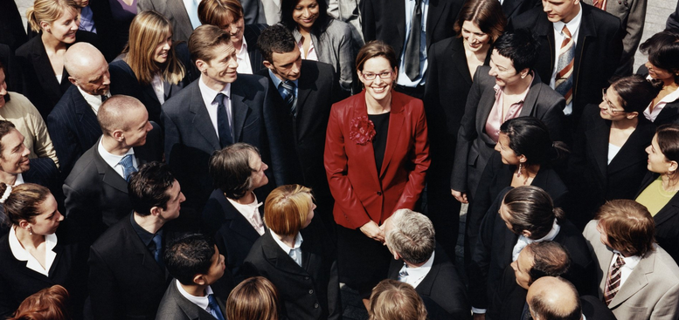

Vocabulary
admire (v)
/ədˈmaɪr/
khâm phục

Slide 8
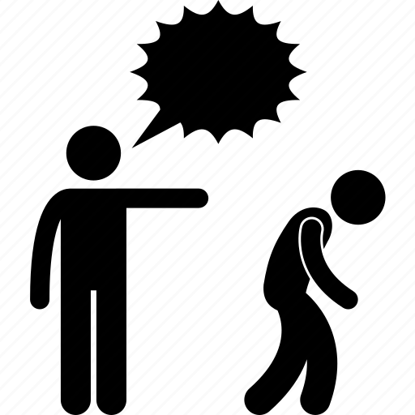
Vocabulary
chase away
/tʃeɪs əˈweɪ/
xua đuổi

Slide 9
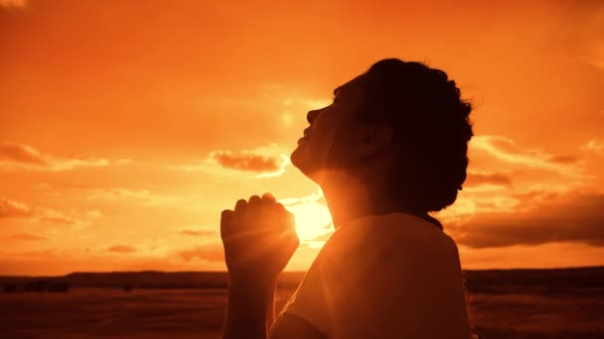
Vocabulary
pray (v)
/preɪ/
cầu nguyện

Slide 10
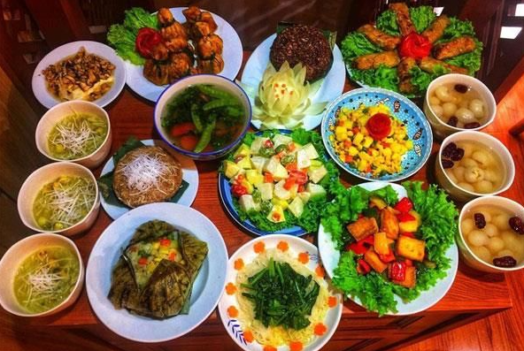
Vocabulary
offering (n)
/ˈɒfərɪŋ/
đồ thờ cúng

Slide 11
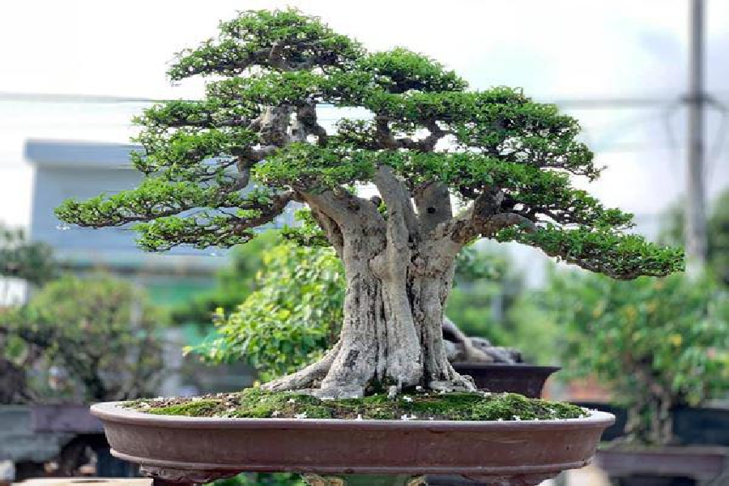
Vocabulary
ornamental tree
/ɔːnəˈmentl triː/
cây cảnh

Slide 12
Vocabulary
to admire | /ədˈmaɪr/ | khâm phục
to chase away | /tʃeɪs/ | xua đuổi
to pray | /preɪ/ | cầu nguyện
offering (n) | /ˈɒfərɪŋ/ | đồ thờ cúng
ornamental tree(n) | /ɔːnəˈmentl triː/ | cây cảnh

Slide 13


Listening
Reading

Slide 14
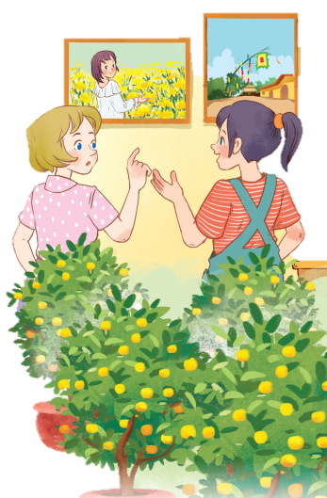


1. Listen and read
- Who are they?
- What can you see in each picture?
- Listen and tick the word you hear.
=> Elena and Trang
communal house
a bamboo pole
lucky money
ornamental trees
apricot blossom
sticky rice
lanterns
chung cake
the blooming flowers
small bells
peach blossoms
kumquat trees

Slide 15
1. Listen and read
Elena: Wow, this girl looks so cute.
Trang: Yeah ... She’s my cousin. She’s at Sa Dec flower Village. Tet is coming soon, so many people visit flower villages to take pictures with the blooming flowers.
Elena: Oh, I’m fond of admiring the flowers. Does your family visit places like this too?
Trang: Yes, we do. We usually visit Nhat Tan Village to buy kumquat trees and peach blossoms.
Elena: I see flowers and ornamental trees everywhere these days. What are they for?
Trang: We, Vietnamese, use plants and flowers for decorations and for offerings. They are an important part of our Tet tradition.
Elena: And what’s that tall tree in the photo?
Trang: Well, it’s actually a bamboo pole. People place it in the yard of the communal house. They hang decorative items like small bells and lanterns on it. They want to chase away bad luck and pray for a lucky new year.
Elena: Interesting! I didn’t know that.

Slide 16

2. Read the conversation again and tick T (True) or F (False).
Sentences | T | F
1. Elena and Trang are at Sa Dec Flower Village.
2. Many people visit flower villages to take photos.
3. Trang’s family usually buys kumquat trees and peach blossoms at Nhat Tan Village.
4. Flowers are not part of any Vietnamese traditions.
5. People decorate bamboo poles with small bells and lanterns for New Years.

Slide 17

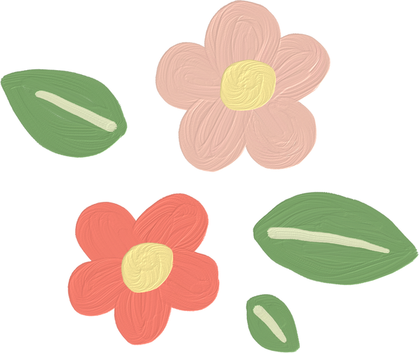
Check your answers
1. Elena and Trang are at Sa Dec Flower Village.
F
Trang’s cousin is
Elena: Wow, this girl looks so cute.
Trang: Yeah ... She’s my cousin. She’s at Sa Dec flower Village.

Slide 18
Check your answers
T
2. Many people visit flower villages to take photos.
Trang: Yeah ... She’s my cousin. She’s at Sa Dec flower Village. Tet is coming soon, so many people visit flower villages to take pictures with the blooming flowers.

Slide 19
Check your answers
3. Trang’s family usually buys kumquat trees and peach blossoms at Nhat Tan Village.
T
Elena: Oh, I’m fond of admiring the flowers. Does your family visit places like this too?
Trang: Yes, we do. We usually visit Nhat Tan Village to buy kumquat trees and peach blossoms.

Slide 20
Check your answers
F
4. Flowers are not part of any Vietnamese traditions.
an important part of our Tet tradition.
Elena: I see flowers and ornamental trees everywhere these days. What are they for?
Trang: We, Vietnamese, use plants and flowers for decorations and for offerings. They are an important part of our Tet tradition.

Slide 21
Check your answers
5. People decorate bamboo poles with small bells and lanterns for New Years.
T
Elena: And what’s that tall tree in the photo?
Trang: Well, it’s actually a bamboo pole. People place it in the yard of the communal house. They hang decorative items like small bells and lanterns on it.

Slide 22
Look at the answers again.
Sentences | T | F
1. Elena and Trang are at Sa Dec Flower Village.
2. Many people visit flower villages to take photos.
3. Trang’s family usually buys kumquat trees and peach blossoms at Nhat Tan Village.
4. Flowers are not part of any Vietnamese traditions.
5. People decorate bamboo poles with small bells and lanterns for New Years.
Trang’s cousin is
Plants and flowers are an important part of Tet.

Slide 23
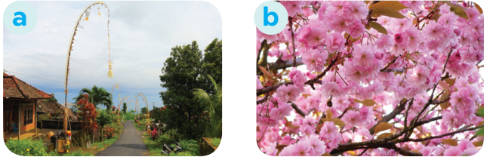
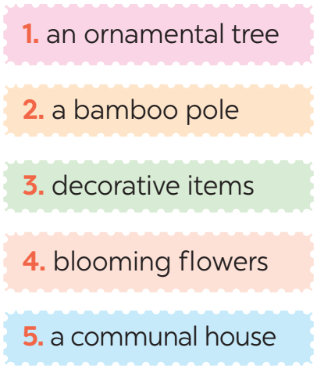
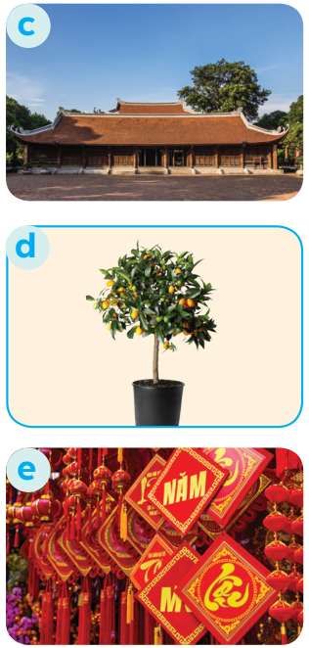
3. Match the phrase with the correct pictures.

Slide 24
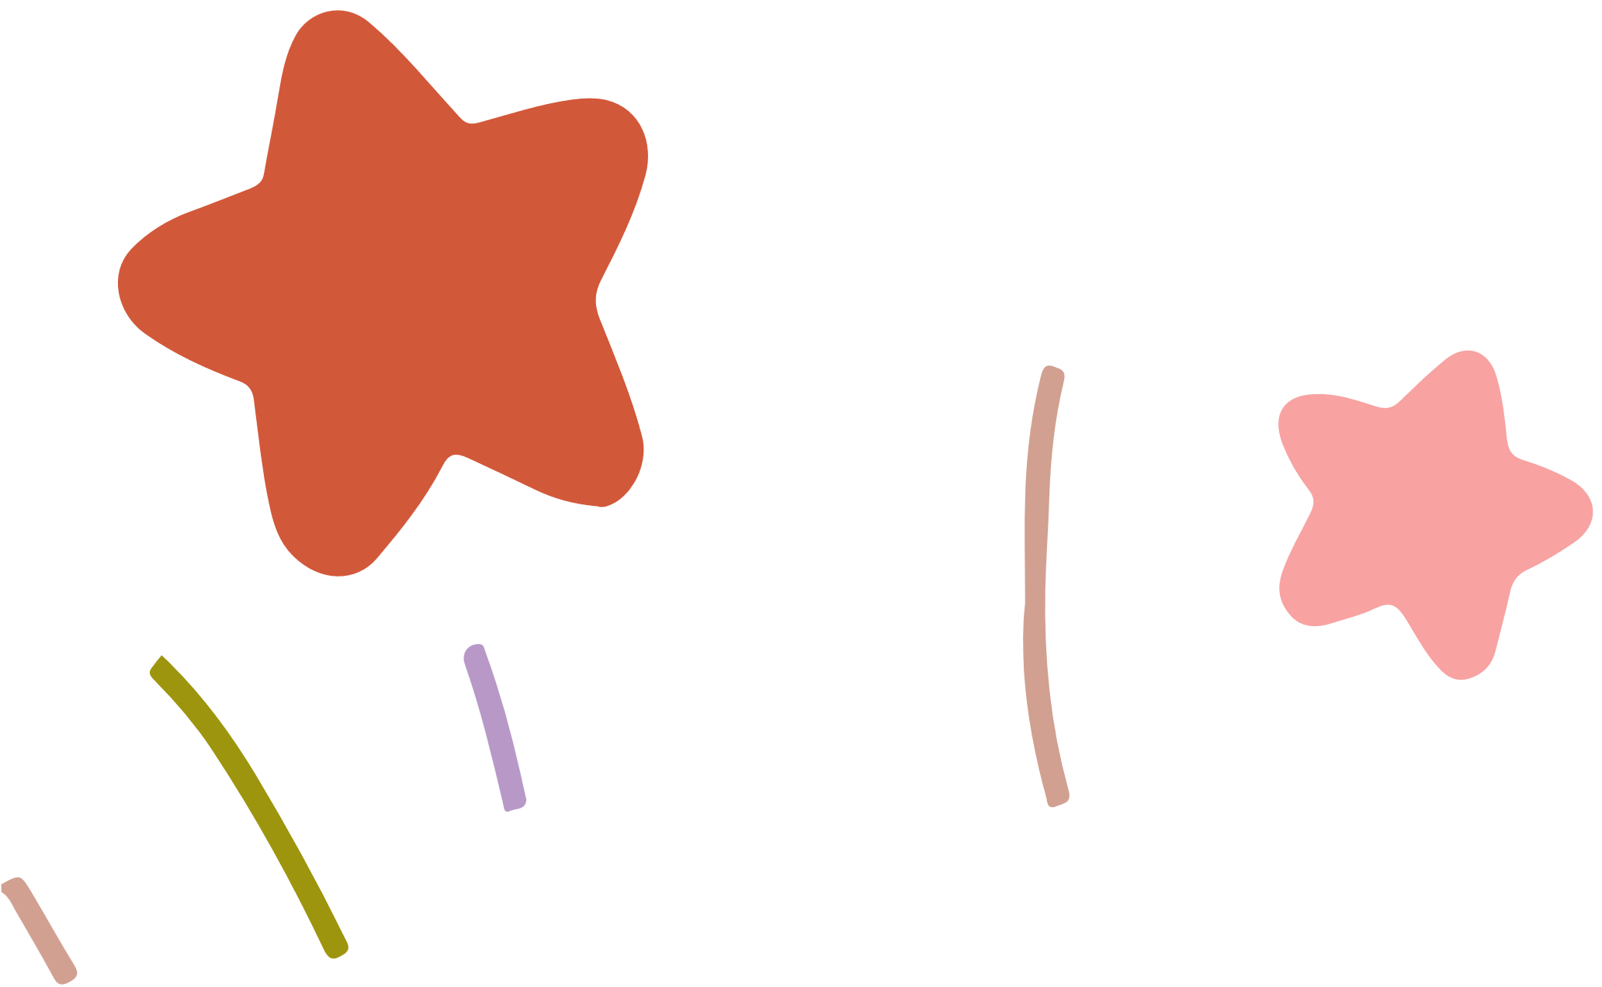


4. Complete the sentences with the verbs from the box.
admire chase pray place
1. The British decorate their Christmas trees and ______ presents under them.
2. Tom likes to ______ the view from the hill.
3. In many cultures, knocking on wood is a way to ______ away bad spirits.
4. Many Asians go to Buddhist temples to ______ for good luck.
place
admire
chase
pray

Slide 25


NEW YEARS
AROUND THE WORLD
People around the world celebrate New Years differently. Choose the tradition below.

Slide 26
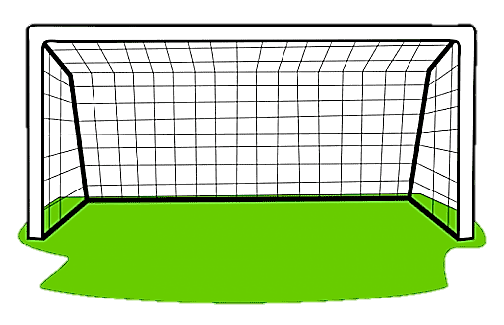
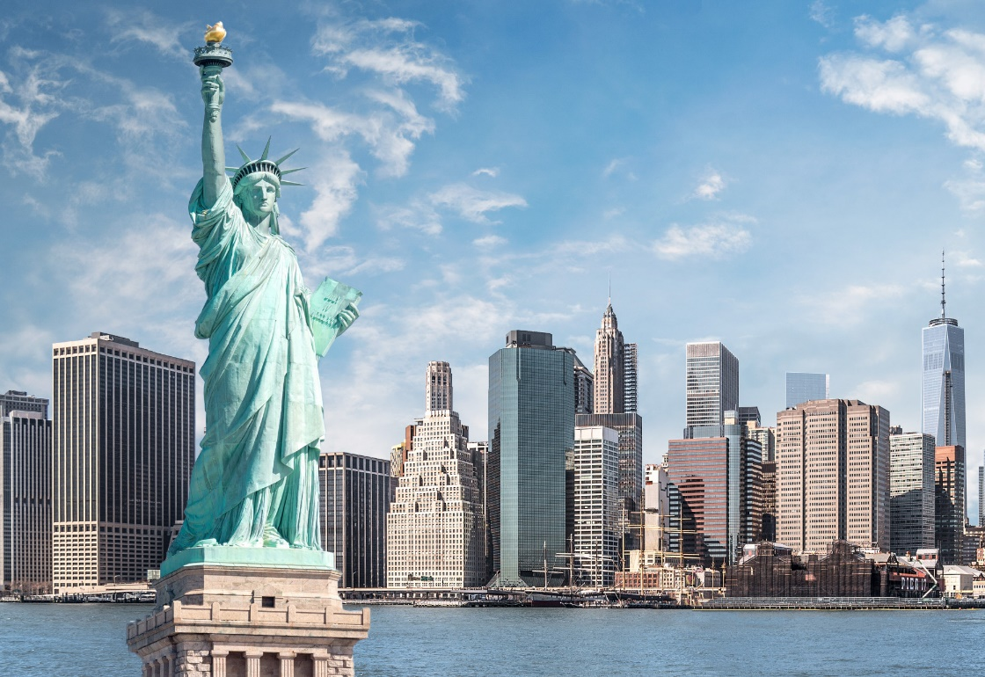
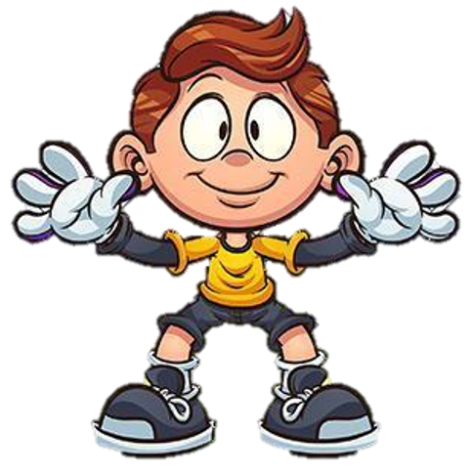
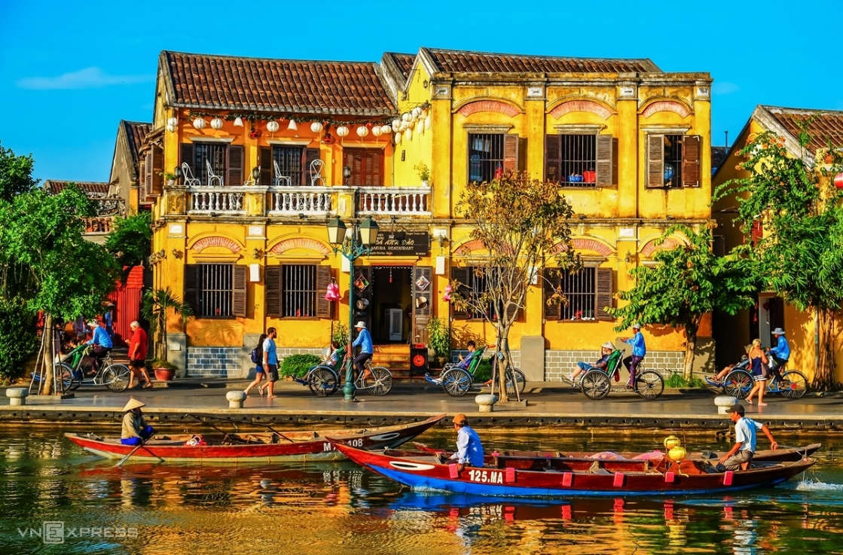

1. Visiting pagodas.
A. The US
B. Viet Nam

Slide 27
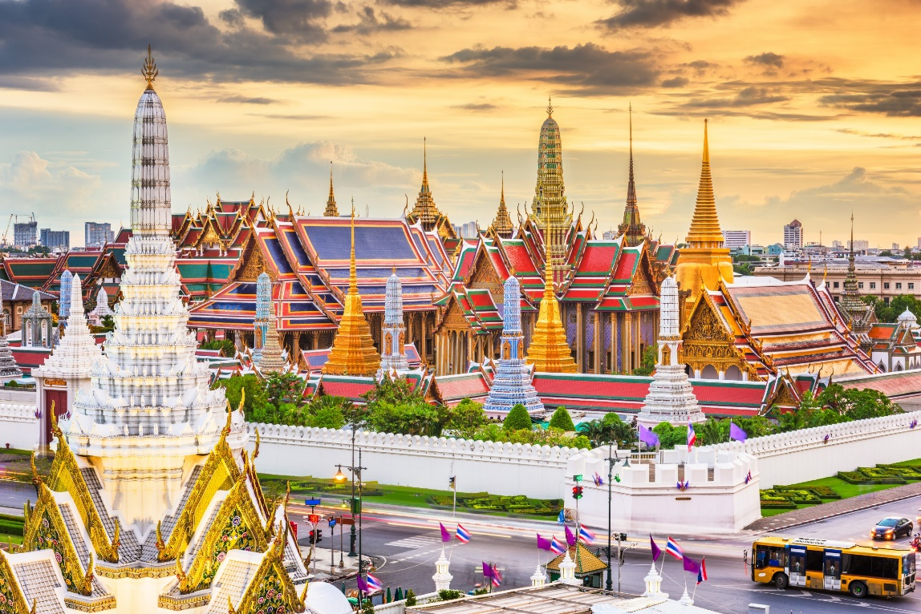
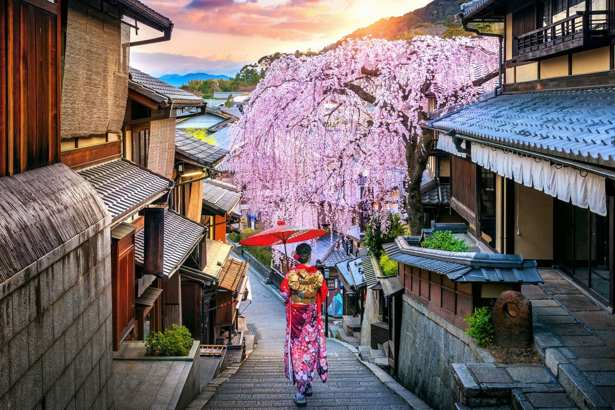
2. Throwing water at each other.
A. Thailand
B. Japan

Slide 28
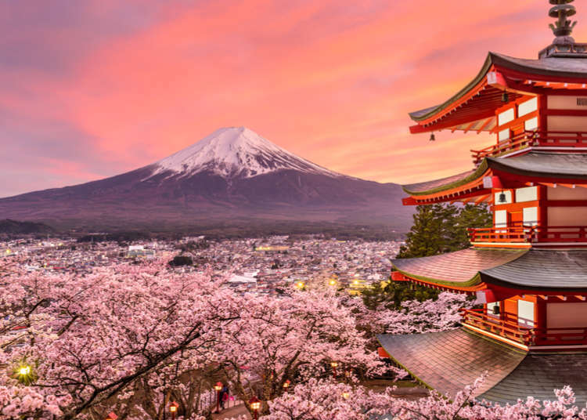
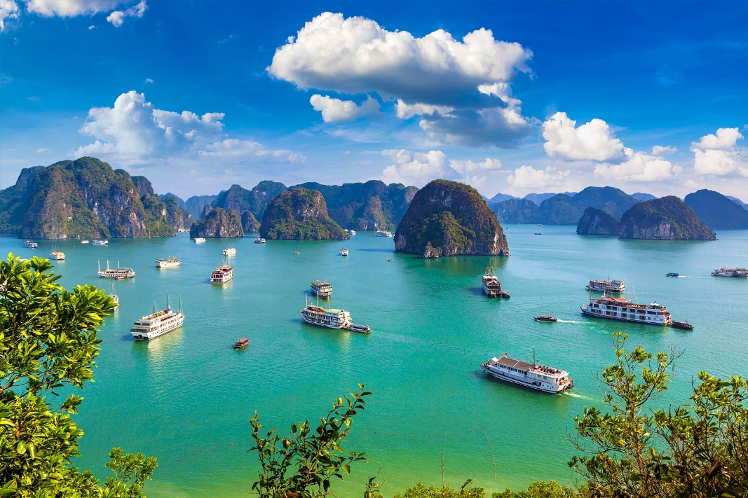
3. Ringing a bell 108 times.
A. Japan
B. Viet Nam

Slide 29
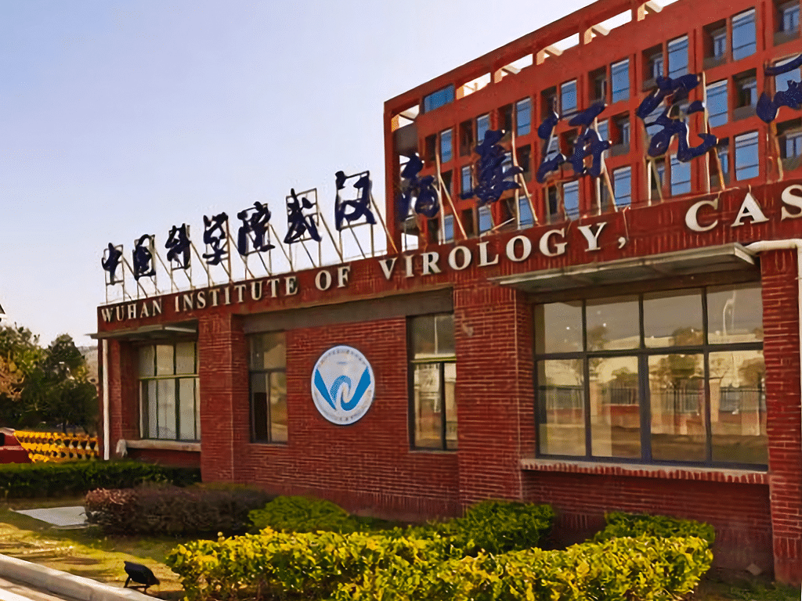
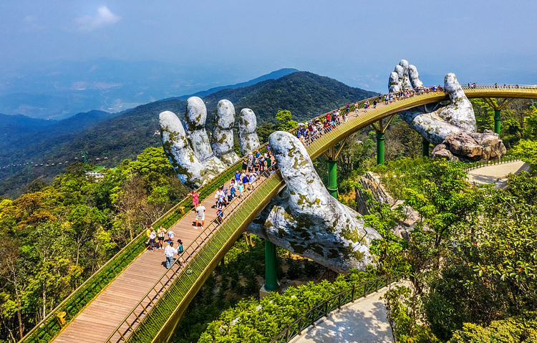
4. Giving and receiving lucky money.
A. The US
B. Viet Nam

Slide 30
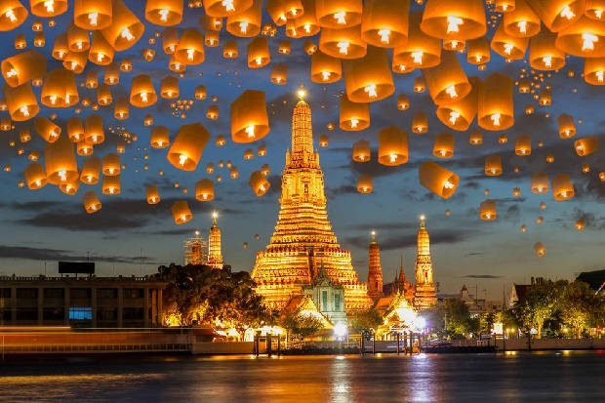
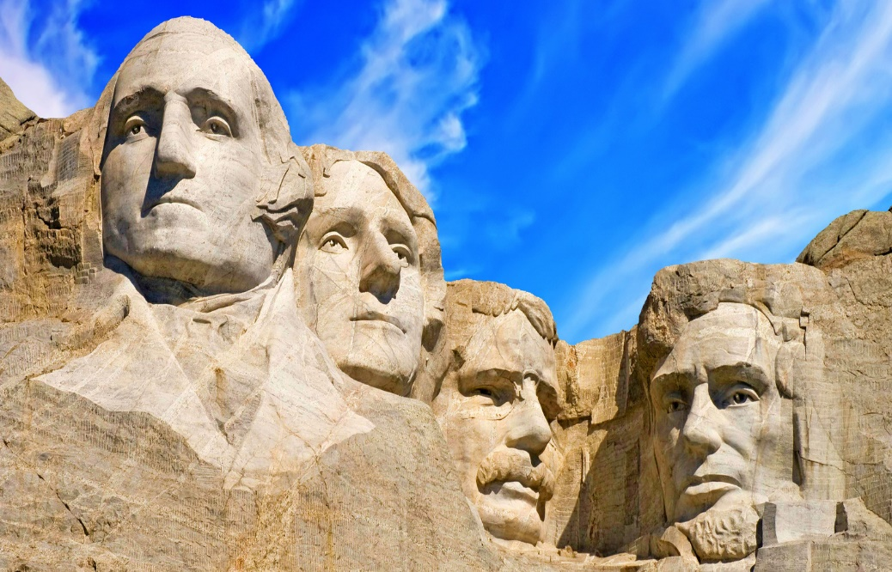
5. Watching a ball drop at midnight in Times Square.
A. Thailand
B. The US

Slide 31
Wrap - up
What have we learnt in this lesson?
identify the topic of the unit
use lexical items related to Tet holiday.
identify the language features that are covered in the lesson.

Slide 32

Homework
- Learn the new words by heart.
- Practice talking about Tet Holiday.

